Slide 1
12th Meeting of the Meso-American and Caribbean Sea Hydrographic Commission
IHB Report

Slide 2
Ratification of Protocol of Amendments on IHO Convention
Principal effects of the Amendments are:
Remove requirement for States applying for membership of the IHO to await the approval of two thirds of the existing Member States
Change 5-year programme cycle to three years between Conferences (to be known as Assemblies)
Establish a Council. Council will meet annually
Change elected position of President of the Directing Committee to Secretary-General - elected Directors will be subordinate to the Secretary-General
New arrangements similar to most other inter-governmental organisations

Slide 3
Ratification of Protocol of Amendments on IHO Convention
44 of 48 approvals received
( + Belgium? Ukraine?)

Slide 4
Ratification of Protocol of Amendments on IHO Convention
IHO/MACHC Member State | Malta (53 needed)
Brazil | ☑
Colombia
Cuba | ☑
France | ☑
Guatemala
Jamaica
Mexico | ☑
Netherlands | ☑
Suriname
Trinidad and Tobago
United Kingdom | ☑
United States of America | ☑
Venezuela
Colombia
Guatemala
Jamaica
Trinidad and Tobago
Venezuela
…. yet to respond

Slide 5
Applications to join the IHO
Malta
Congo
Solomon Is
Vanuatu

Slide 6
Applications to join the IHO – Status of voting
IHO/MACHC Member State | Malta | Congo | Solomon Is | Vanuatu
Brazil
Colombia
Cuba | ☑ | ☑ | ☑ | ☑
France
Guatemala
Jamaica
Mexico
Netherlands
Suriname | ☑ |  |  | ☑
Trinidad and Tobago
United Kingdom |  | ☑ | ☑
United States of America | ☑ | ☑ |  | ☑
Venezuela

Slide 7
Responses to Voting by correspondence
IHO/MACHC Member State | voting record
Brazil | 6/6
Colombia | 2/6
Cuba | 5/6
France | 6/6
Guatemala | 0/6
Jamaica | 0/6
Mexico | 1/6
Netherlands | 6/6
Suriname | 3/6
Trinidad and Tobago
United Kingdom | 6/6
United States of America | 6/6
Venezuela

Slide 8
MACHC States not yet Members of the IHO :
Antigua and Barbuda | Bahamas
Barbados | Belize
Costa Rica | Dominica
El Salvador | Grenada
Guyana | Honduras
Nicaragua | Panama
Saint Kitts and Nevis | Saint Lucia
Saint Vincent and the Grenadines

Slide 9
IHO GIS and data base developments
see Agenda item 7.5

Slide 10
International Chart Coordination
see also Agenda item 7.1
USA – INT chart coordinator
4 new INT charts (Cuba)
0 new editions
48 of 82 (~59%) published

Slide 11
Capacity Building
see also Agenda item 10.1
Reduced funding for 2016
MACHC CB - 2015:
Ph 1 skills course in Spanish, Mexico, Nov 2015
Maritime Boundaries, Suriname, august 2015
Seminar – Saint John’s – this week!
Technical visit to Haiti – postponed

Slide 12
Capacity Building
see also Agenda item 10.1
Reduced funding for 2016
MACHC CB - 2015:
Ph 1 skills course in Spanish, Mexico, Nov 2015
Maritime Boundaries, Suriname, august 2015
Seminar – Saint John’s – this week!
Technical visit to Haiti – postponed

Slide 13
Capacity Building
CAT A Hydrography – USM 2016-17
calls for nominations for 2016 /17 course (CL72/2015 – nominations by Mar 16)
NF CHART program – Cat B in nautical cartography
calls for nominations in 2016
NF Ocean Mapping Program – CAT A Hydrography, UNH, 2017
calls for nominations in early 2016

Slide 14
Publicity and Outreach
States encouraged to link hydrography to UN Post 2015 development agenda
particularly:
sustainable development goals
SDG 14 – use of the oceans
disaster risk reduction

Slide 15
Publicity and Outreach
World Hydrography Day 2016
Theme :
Hydrography - the key to well-managed seas and waterways

Slide 16
SDG 14: Conserve and sustainably use the oceans, seas and marine resources for sustainable development
Targets:
reduce pollution
strengthen the resilience of marine ecosystems
minimize ocean acidification
regulate fishing and prevent over-fishing
increase marine protected areas
improve the blue economy for SIDS
increase scientific knowledge
support small-scale artisanal fishers
fully implement UNCLOS

Slide 17
SDG 14: Conserve and sustainably use the oceans, seas and marine resources for sustainable development
Targets:
reduce pollution
strengthen the resilience of marine ecosystems
minimize ocean acidification
regulate fishing and prevent over-fishing
increase marine protected areas
improve the blue economy for SIDS
increase scientific knowledge
support small-scale artisanal fishers
fully implement UNCLOS

Slide 18
SDG 14: Conserve and sustainably use the oceans, seas and marine resources for sustainable development
Targets:
reduce pollution
strengthen the resilience of marine ecosystems
minimize ocean acidification
regulate fishing and prevent over-fishing
increase marine protected areas
improve the blue economy for SIDS
increase scientific knowledge
support small-scale artisanal fishers
fully implement UNCLOS

Slide 19
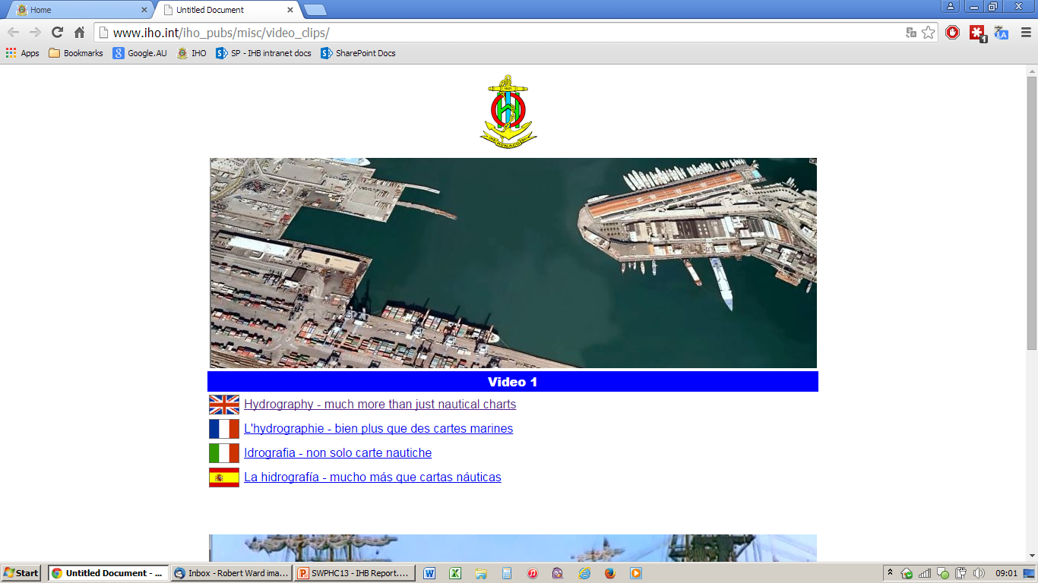
Publicity and Outreach
video clips : “what is hydrography ?” “Hydrography for kids”
available from You Tube via IHO website
in English, French, Italian, Japanese, Korean, Spanish, Portuguese

Slide 20
Publicity and Outreach
next video : “want some excitement? … become a hydrographer”
See CL79 - IHO Video on Recruitment of Hydrographers - Request for video footage and images

Slide 21
Publicity and Outreach
MoU with OECS
– recognised as IHO Observer Organization - June 2015
THSoA
– recognised as IHO Observer Organization – September 2015

Slide 22
Actions Requested :
1. MACHC to note this report
2. Colombia, Guatemala, Jamaica, Trinidad and Tobago , and Venezuela to progress the ratification of the Protocol of Amendments to the IHO Convention and report any difficulties being encountered or assistance required to the IHB
3. The Relevant States’ Representatives to expedite the approval process for the applications of The Republic of the Congo, Malta, The Solomon Islands and Vanuatu to join IHO

Slide 23
Actions Requested :
4. All chart producing States to provide continuous updates to S-11 Part B, through USA as coordinator for INT Region B
5. All States to review entries in IHO Publications C-55 and P-5 (Year Book) at least annually.
6. Take any other actions as considered appropriate.

Slide 25
IHO GIS and data base developments
Country Information Data base
“C-55” data base
see also Agenda item 7.5
INToGIS data base
provides support for ICCWGs and S52 Part B
ENC coverage GIS analysis tools
overlap checker
sort and search by producer
(strictly for IHO use only)

Slide 26
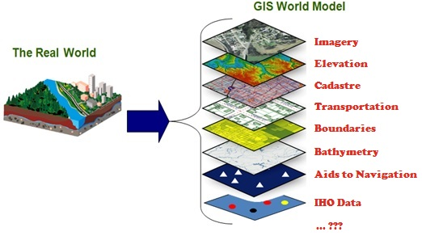
IHO GIS and Databases
IHB transition to Esri-based GIS solution underway
avoid duplication of data and inputs
enable data visualization
enable data fusion and analysis
provide GIS data layers for RHCs and Member States

