Slide 1
7th MEETING OF THE IHO HYDROGRAPHIC SERVICES AND STANDARDS COMMITTEE (HSSC)
Busan, Republic of Korea, 10-13 November

Slide 2
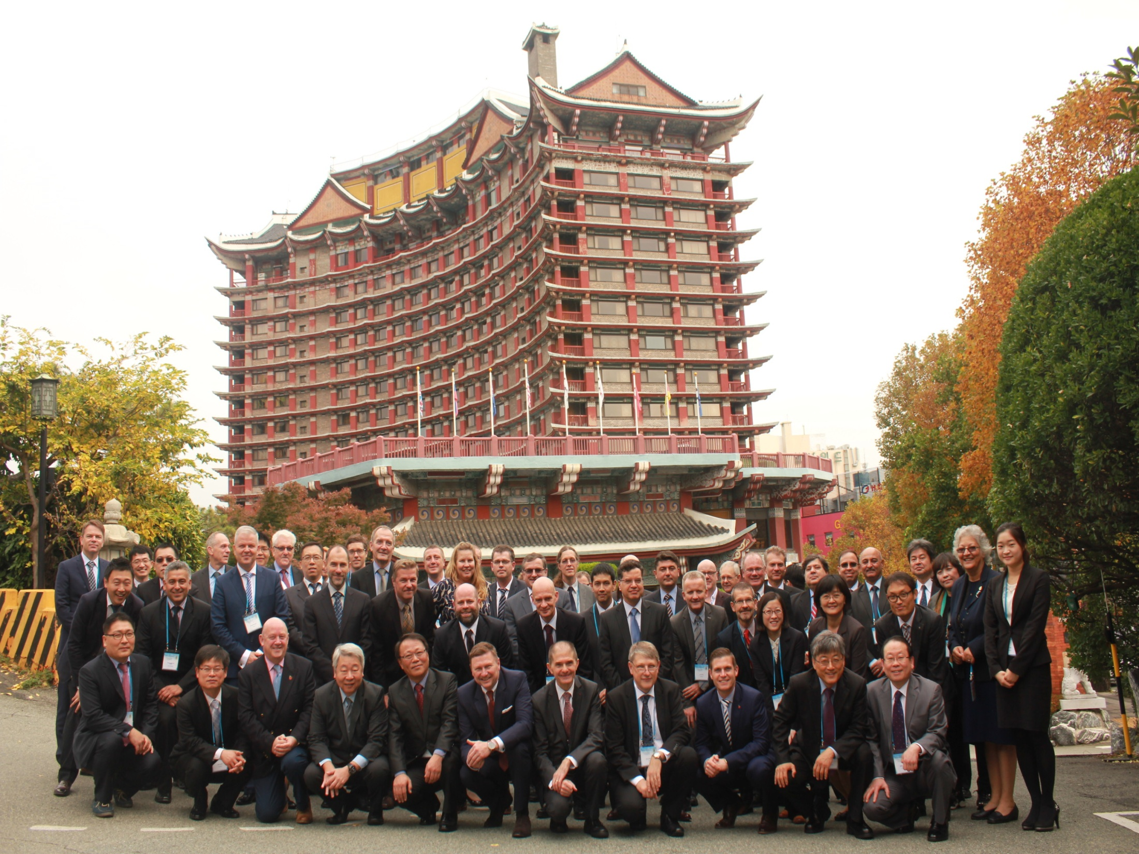

Slide 3
The meeting was attended by 48 representatives from 20 Member States, the IHB, and six international organizations accredited as observers.
Implementation of Programme Performance Indicators The Committee agreed to retain the current HSSC Working Level Performance Indicators (WPIs) until the next Conference/Assembly in 2017 when there will be reconsidered as part of the revision of the IHO Strategic Plan.

Slide 4
The Committee reviewed the activities, proposals, and work plans of its subordinate bodies and the decisions of other organs and organizations affecting its work and decided on a number of outcomes.
The Open Session, which was held on 12 November, focused on new survey techniques and crowd-sourced bathymetry and on issues related to the development and implementation of the S-100 framework.

Slide 5
Consideration of the need to establish a Hydrographic Surveys Working Group
The Committee decided to establish a Project Team to investigate the need for HSSC activities related to hydrographic surveys, to define the scope of Hydrographic Surveys Working Group, and to propose recommendations at the next HSSC meeting (HSSC-8).
H2SPT IHO - CL-84
Notes:
5

Slide 6
S-100 and related activities
Publication of Edition 2.0.0 of S-100 - IHO Universal Hydrographic Data Model;
Preparation of supporting documents including the S-100 interoperability specification for ECDIS, UML models, and data quality models;
The establishment of an S-100 domain for Additional Military Layers (AMLs);
The operational ice charts will be available in S-411 format by December 2015 and the first S-411 capable commercial ECDIS is expected to enter service in mid-2016.
The Committee decided to establish S-101 Project Team to consider the proposal submitted by the Norwegian Coastal Administration on the portrayal of lengths of sector lights.

Slide 7
The Committee established a Project Team to develop a new product specification for the display of under keel clearance management information.
The Committee noted the intention of the International Association of Marine Aids to Navigation and Lighthouse Authorities (IALA) to submit a proposal for developing a Maritime Resource Name Scheme under the S-100 framework.
The Committee agreed that the IHO should take the initiative for developing further the Maritime Service Portfolios (MSP) related to hydrographic services in the e-navigation environment.

Slide 8
ECDIS matters
The Committee Note the efficiency of the International Electro technical Commission (IEC) in producing a coherent set of revised editions of the key ECDIS related standards thereby addressing the anomalies in the operation of some ECDIS.
The Committee tasked the ENC Standards Maintenance Working Group (ENCWG) to finalize the draft revised new editions of S-58 - ENC validation checks and S-66 - Facts about Electronic Charts and Carriage Requirements.
The Committee noted the feedback from industry on the implementation of the new editions of S-52 - Specifications for Chart Content and Display Aspects of ECDIS and its Annex A - Presentation Library for ECDIS,

Slide 9
Nautical cartography
The Committee endorsed the proposed changes to Edition 4.5.0 of S-4 - Chart Specifications of the IHO and tasked the NCWG to finalize the draft new edition 4.6.0
The Committee instructed the NCWG to develop a separate section on ENC schemes in the draft revision of S-11 Part A - Guidance for the Preparation and Maintenance of International Chart Schemes.
The Committee invited the NCWG to address as a high priority the work item on the future of the paper chart.
Hydrographic Dictionary
The Committee requested the Hydrographic Dictionary Working Group to produce and maintain a reference edition of S-32 - Hydrographic Dictionary. S-100WG should provide the HDWG with its generic technical specifications/requirements in terms of definitions, register(s) and procedures.

Slide 10
Relations with Stakeholders
The Committee acknowledged that the relations with stakeholders are a strategic issue to be considered by the HSSC Chair Group in its contribution to the revision of the IHO Strategic Plan.
The Committee noted the areas of common interest between the IHO and the International Cable Protection Committee (ICPC), and welcomed the possible contribution through the ICPC of bathymetric data to the IHO Data Centre for Digital Bathymetry, in the context of the development of trusted crowd-sourced bathymetry.
The Committee supported the proposal of the ICPC to develop a Memorandum of Understanding between the IHO and the ICPC.

Slide 11
Contribution of the Republic of Korea
The Committee commended the significant contribution of KHOA to the development of IHO web services through the INToGIS project, which aims to develop a GIS-based version of S-11 Part B - Catalogue of International (INT) Charts, and the Digital Reference Tool for Cartographers (DRTC).

Slide 12
DATE & LOCATION OF THE NEXT MEETINGS
The next meeting of the HSSC (HSSC-8), will take place from 14 to 18 November 2016, in Monaco.
HSSC-9 (Ottawa, Canada); HSSC- 10 (Rostock Germany).
More Information
Further information is available on the IHO web site at Home > Committees & WG > HSSC.

