Slide 1
IMO/IHO World-Wide Navigational Warning Service
NAVAREA IV / XII
10 December 2015

Slide 2
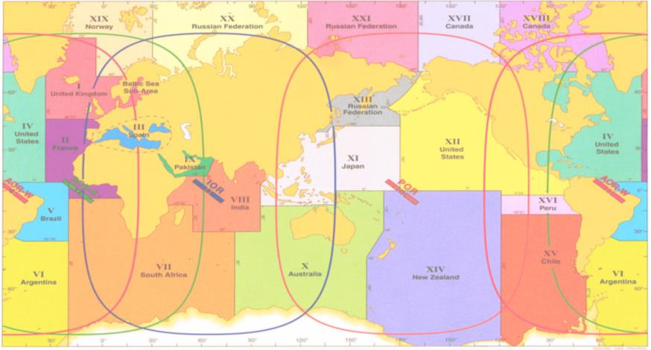
WWNWS Mission
The World-Wide Navigational Warning Service (WWNWS) is the internationally and nationally coordinated service for the promulgation of hazards to navigation that may effect international shipping.
IMO Resolution A.706(17) MSC.1/Circ.1288/Rev.1 24 June 2013

Slide 3
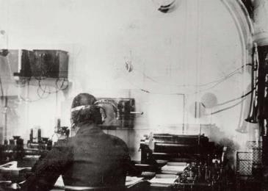
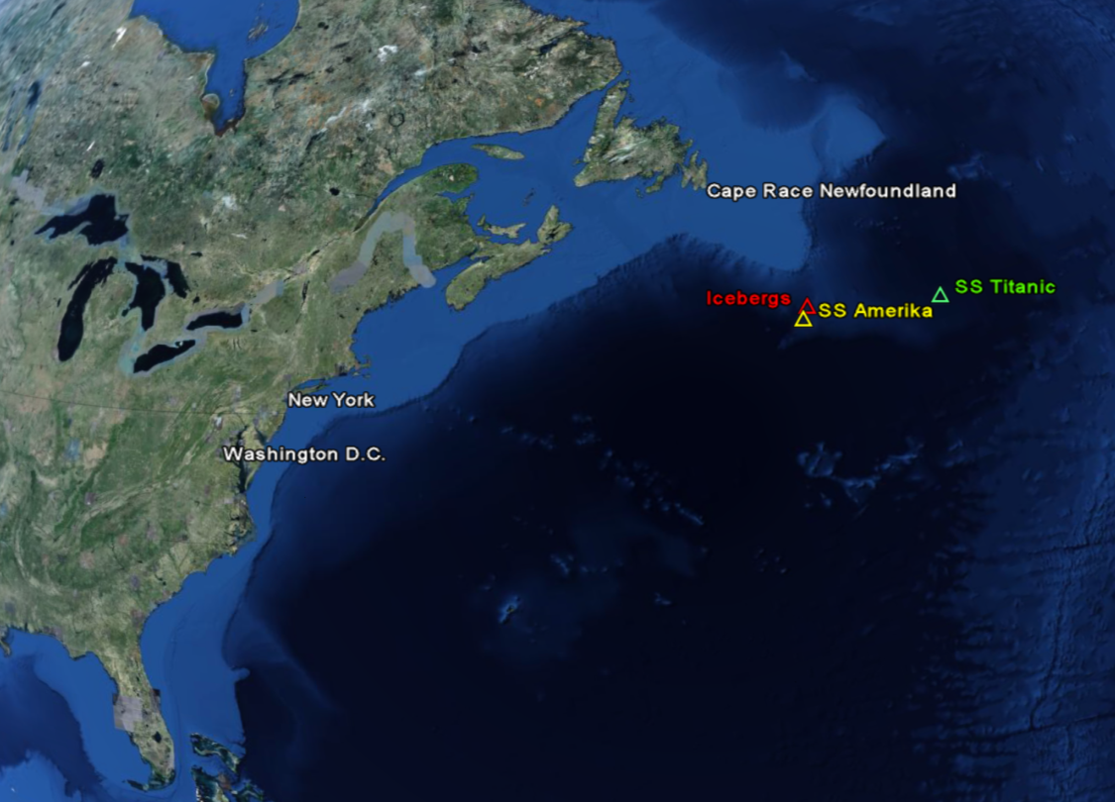
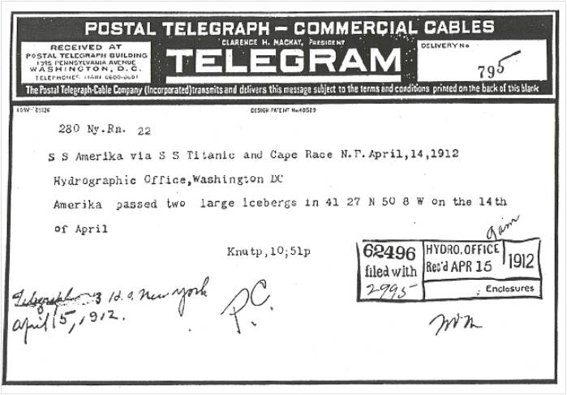
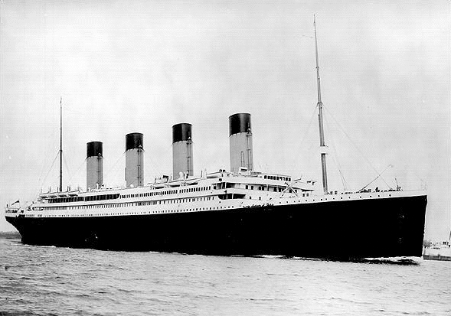
April 14-15, 1912

Slide 4
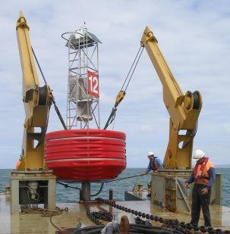
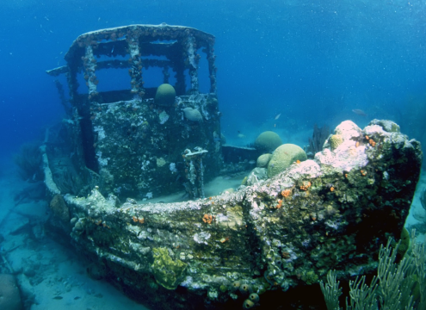
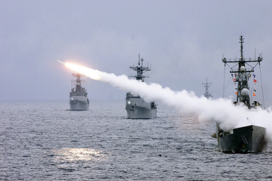
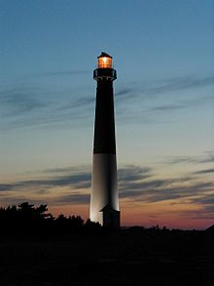
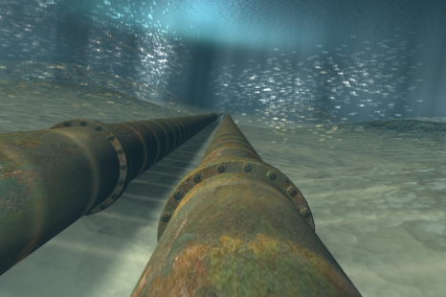
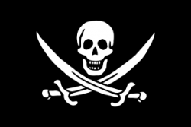
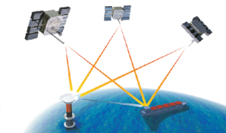
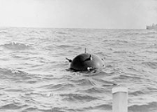
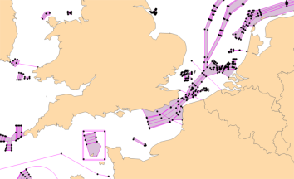
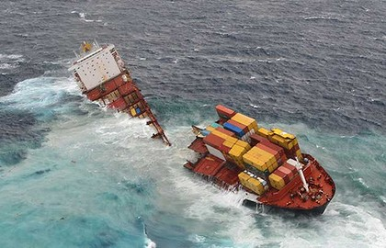
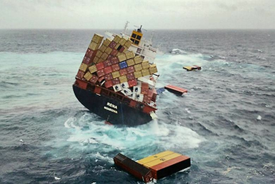
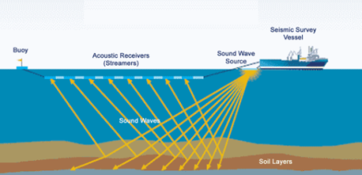
Types of Warnings

Slide 5
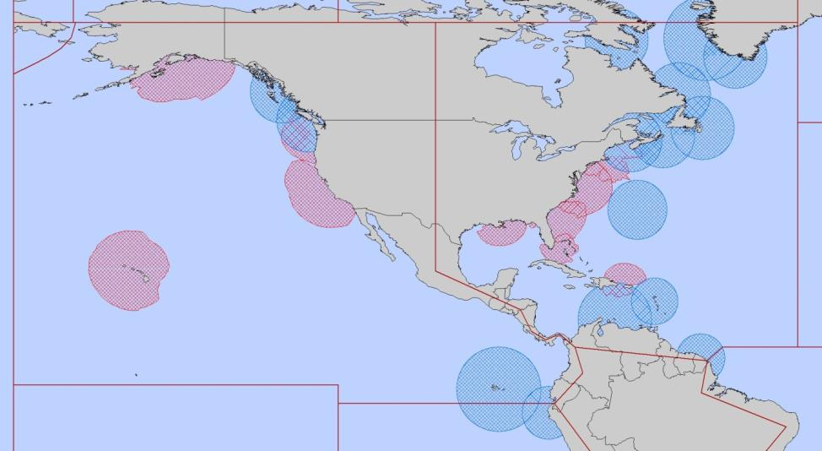
NAVAREA IV/XII Coordinator
Endeavour to be informed of all events that could significantly affect the safety of
navigation within the NAVAREA
IV
XII
IMO Resolution A.706(17) MSC.1/Circ.1288/Rev.1 24 June 2013

Slide 6
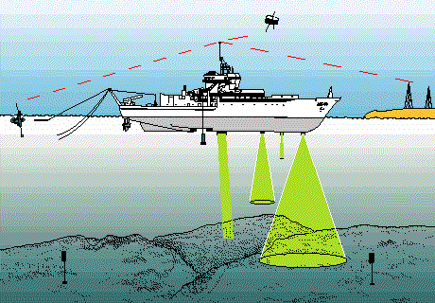
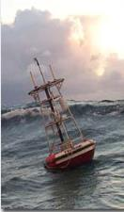
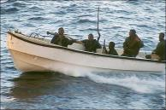
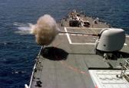
NAVAREA IV/XII Coordinator (cont.)
Assess all information immediately upon receipt in the light of expert knowledge for
relevance to navigation in the NAVAREA;
Select information for broadcast

Slide 7
National Coordinator
Endeavour to be informed of all events that could significantly affect the safety of
navigation within your national waters
IV
XII
IMO Resolution A.706(17) MSC.1/Circ.1288/Rev.1 24 June 2013

Slide 8
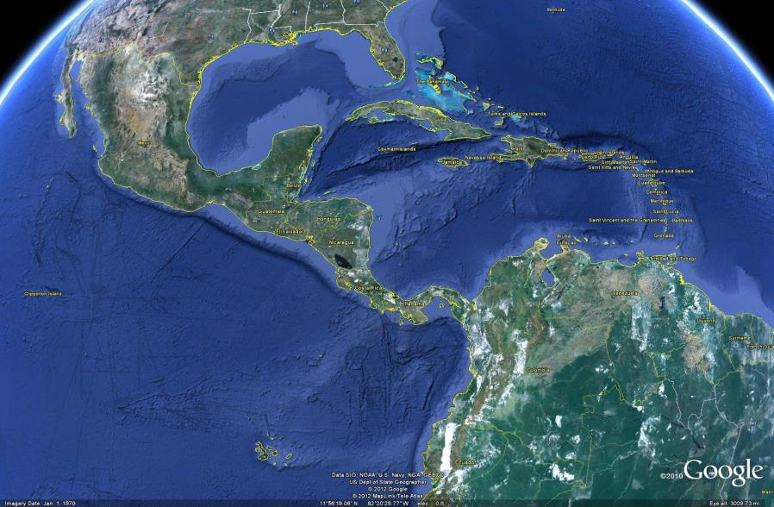
National Coordinator
Forward coastal warnings and relevant associated information for wider promulgation directly to NAVAREA Coordinator
navsafety@nga.mil
IMO Resolution A.706(17) MSC.1/Circ.1288/Rev.1 24 June 2013

Slide 9
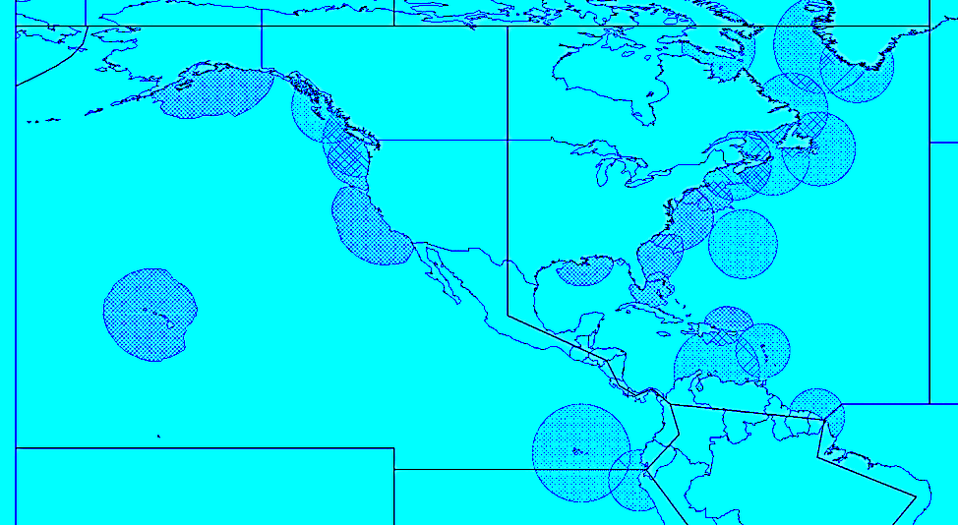
National Coordinators in the region
Cuba | Guyana
Anguilla (UK) | Haiti
Antigua and Barbuda | Honduras
Aruba (Kingdom of the Netherlands) | Jamaica
Bahamas | Martinique (France)
Barbados | Mexico
Belize | Montserrat (UK)
British Virgin Islands (UK) | Nicaragua
Caribbean Netherlands (Kingdom of the Netherlands) | Panama
Cayman Islands (UK) | Puerto Rico (US)
Colombia | Saint Barthélemy (France)
Costa Rica | Saint Kitts and Nevis
Curaçao (Kingdom of the Netherlands) | Saint Lucia
Dominica | Saint Martin (France)
Dominican Republic | Saint Vincent and the Grenadines
Ecuador | Sint Maarten (Kingdom of the Netherlands)
El Salvador | Suriname
French Guiana | Trinidad and Tobago
Grenada | Turks and Caicos Islands (UK)
Guadeloupe (France) | United States Virgin Islands (US)
Guatemala | Venezuela
IV
XII

Slide 10
IHO Capacity Building
The first phase of capacity building is MSI source gathering and dissemination.
Allows for real integration of the country into the World-Wide Navigational Warning Service (WWNWS)
The second phase is the creation of a surveying capability.
The third phase consists of the acquisition of the means to produce charts and publications independently.

Slide 11
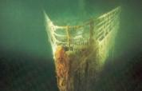
Maritime Safety Information Capacity Building Course Outcomes
Endeavour to be informed of all events that could significantly affect the safety of navigation within their coastal region.

Slide 12
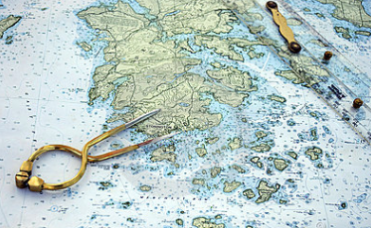
Maritime Safety Information Capacity Building Course Outcomes
Assess all information in the light of expert knowledge for relevance to navigation in the coastal region.
IV
XII

Slide 13
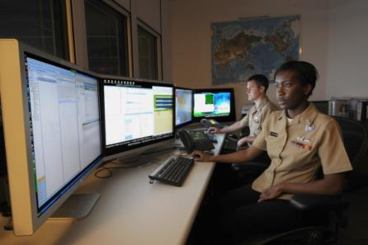
Maritime Safety Information Capacity Building Course Outcomes
Draft navigational warnings in accordance with the
Joint IMO/IHO/WMO Manual on Maritime Safety Information
Pass NAVAREA warnings for further promulgation to the NAVAREA Co-ordinator

Slide 14
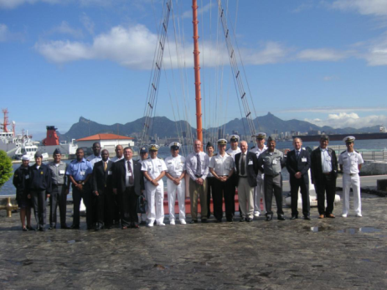
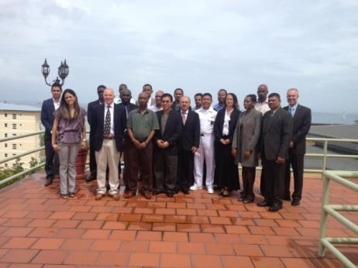
IHO MSI Training Courses (14)
2007 Jamaica (MACHC)
2007 Mozambique (SAIHC)
2008 Spain (MBSHC)
2009 Ghana (EAtHC)
2009 Oman (NIOHC / RSAHC)
2010 Namibia (SAIHC)
2010 Australia (SWPHC)
2011 Brazil (SWAtHC, SEPHC & MACHC)
2013 Trinidad (MACHC)
2014 Oman (NIOHC / RSAHC)
2014 New Zealand (SWPHC)
2014 Ivory Coast (EAtHC)
2015 Japan (EAHC)
2015 Turkey (MBSHC)
2011 MSI Course in Brazil
2013 MSI Course in Trinidad

Slide 15
MSI Training Course Data

Slide 16
MSI Training Course MACHC Data
50 students trained from 22 countries
Anguilla
Antigua and Barbuda
Barbados
British Virgin Islands
Cayman Islands
Colombia
Costa Rica
Dominica
Ecuador
El Salvador
Grenada
Guatemala
Guyana
Honduras
Jamaica
Montserrat
Panama
St. Kitts
St. Vincent & Grenadines
Suriname
Trinidad & Tobago
Turks and Caicos

Slide 17
National Coordinators in NAVAREA IV and XII
Send MSI to NGA and NAVAREA IV/XII will disseminate a navigational warning for your waters….
Fulfills the first phase of Hydrographic Services = MSI
AT NO COST TO YOU !!
Mariners will be able download your warning as a text file or as a Google Earth KMZ from NGA’s Maritime Safety Information website!
http://msi.nga.mil/NGAPortal/MSI.portal
Select the Broadcast Warnings link

Slide 18
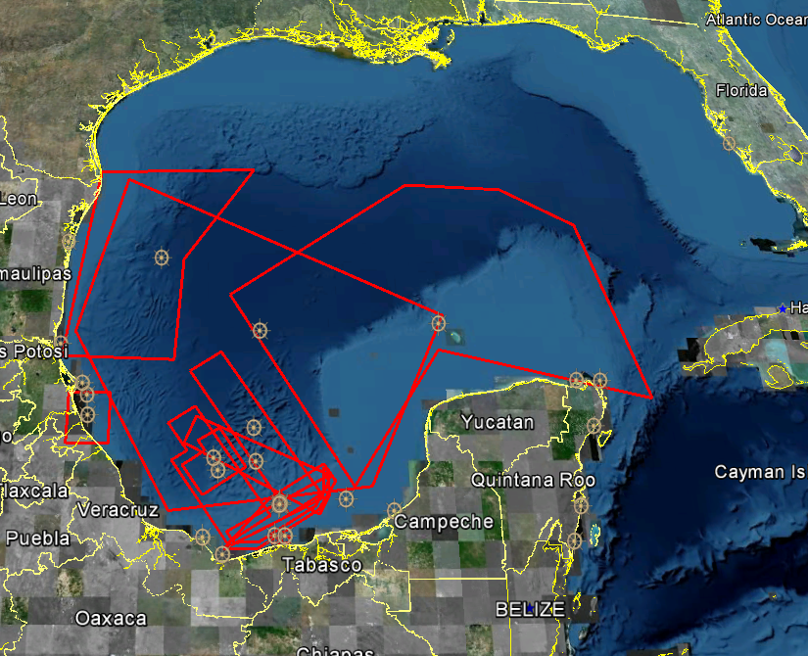
Mexico support 2015
Provided by CAPITAN DE CORBETA
Sent 394 MSI reports to navsafety@nga.mil
Promulgated 114 NAVAREA warnings
Types: Wrecks, Aids, Survey Ops
19 warnings currently in force

Slide 19
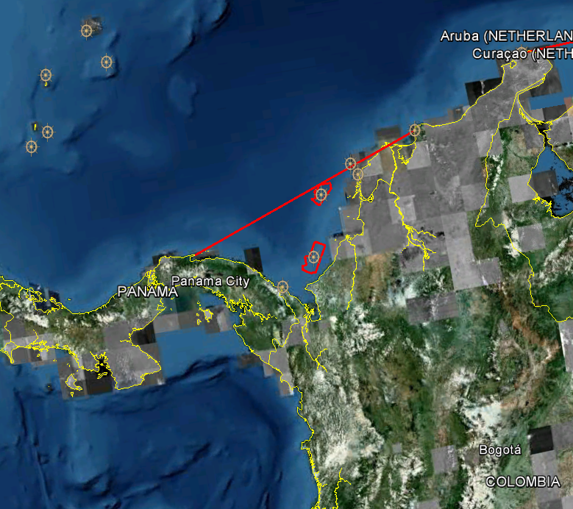
Colombia support 2015
Provided by CARLOS ALBERTO ZUNIGA GUZMAN
Sent 47 MSI reports to navsafety@nga.mil
Promulgated 33 NAVAREA warnings
Types: Unreported Vessel, Underwater and Hazardous Ops
19 warnings currently in force

Slide 20
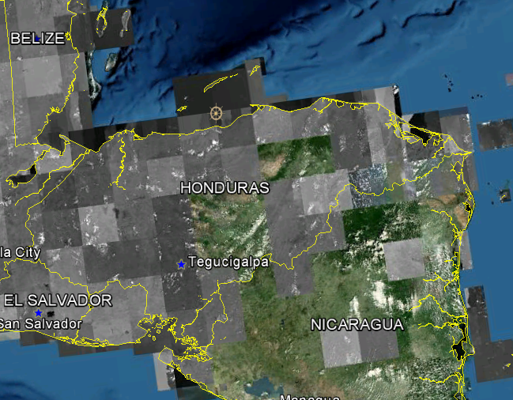
Honduras support 2015
Provided by JAVIER DIAZ
Sent 3 MSI reports to navsafety@nga.mil
Promulgated 2 NAVAREA warnings
Types: Aids, Underwater Cabeling
1 warning currently in force

Slide 21
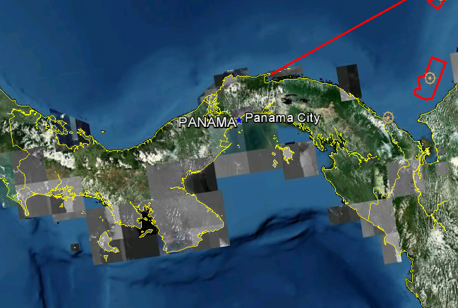
Panama support 2015
Provided by JUAN BOULLOSA
Sent 1 MSI report to navsafety@nga.mil
Promulgated 1 NAVAREA warning
Types: Restricted Area
No warnings currently in force

Slide 22
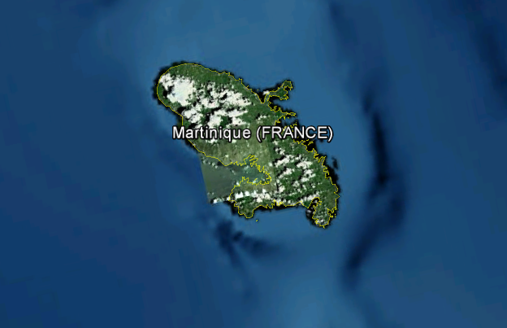
Martinique support 2015
Provided by AVURNAV FORT DE FRANCE
Sent 29 MSI reports to navsafety@nga.mil
Promulgated 24 NAVAREA warnings
Types: Gunnery Exercise
No warnings currently in force

Slide 23
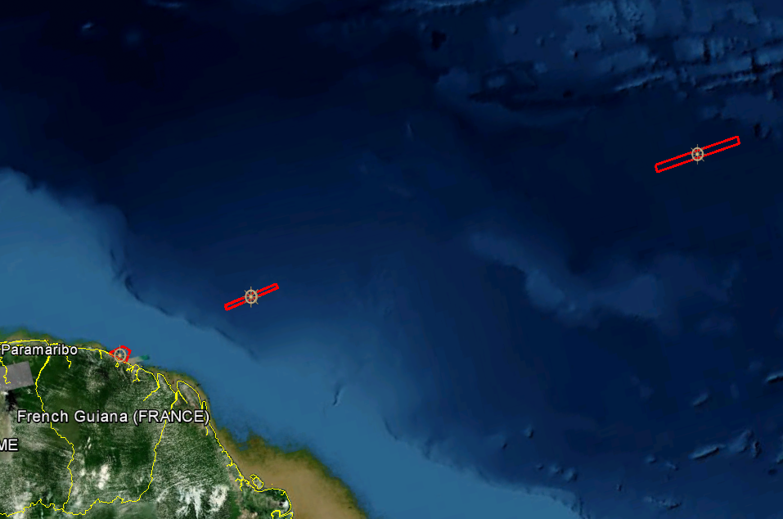
French Guiana support 2015
Provided by AVURNAV CAYENNE
Sent 43 MSI reports to navsafety@nga.mil
Promulgated 16 NAVAREA warnings
Types: Hazardous Ops
1 warning currently in force

Slide 24
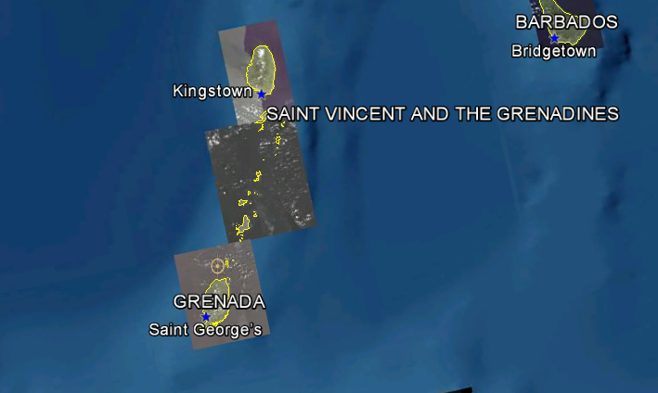
Saint Vincent and the Grenadines support 2015
Provided by DAVID ROBINS
Sent 1 MSI report to navsafety@nga.mil
Promulgated 1 NAVAREA warning
Types; Volcanic Activity
1 warning currently in force

Slide 25
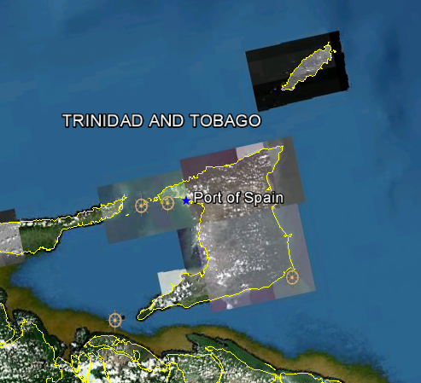
Trinidad support 2015
Provided by MARK FISHER
Sent 46 MSI reports to navsafety@nga.mil
Promulgated 20 NAVAREA warnings
Types: Underwater Ops, Aids
4 warnings currently in force

Slide 26
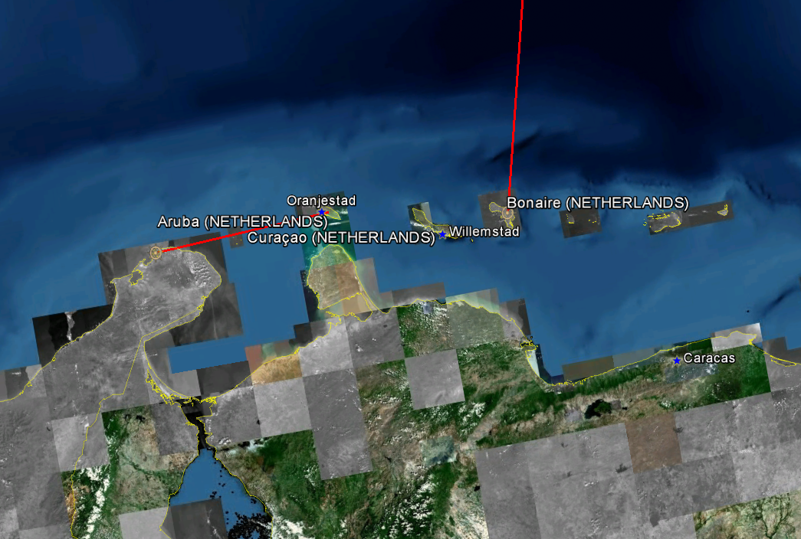
Curaçao support 2015
Provided by JRCC CURAÇAO
Sent 10 MSI reports to navsafety@nga.mil
Promulgated 8 NAVAREA warnings
Types: Drifting Vessel, Unreported Vessel
No warnings currently in force

Slide 27
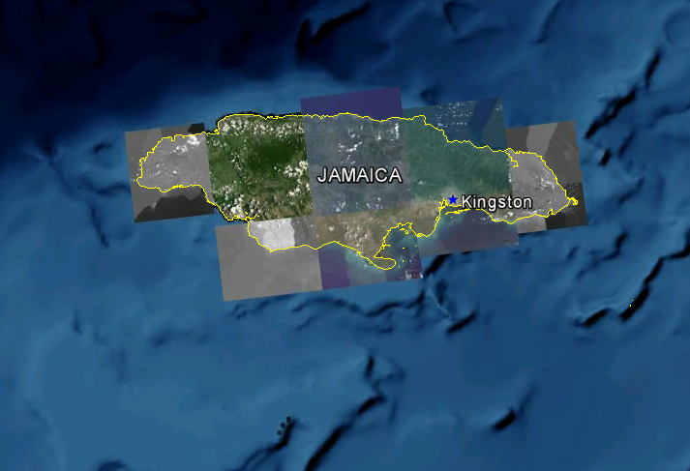
Jamaica support 2015
Reported by the Jamaica Coast Guard
Sent 6 MSI reports to navsafety@nga.mil
Promulgated 4 NAVAREA warnings
Types: Underwater, Survey Ops
No warnings currently in force

Slide 28
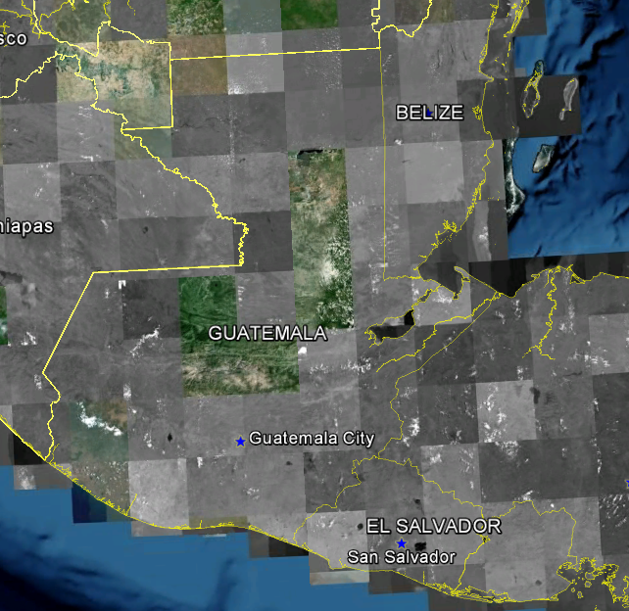
Guatemala support 2015
Provided by CAPTAIN CARLOS ALFREDO RAMOS PEREZ
Sent 5 MSI reports to navsafety@nga.mil
Promulgated 2 NAVAREA warnings
Types: Gunnery Exercise
No warnings currently in force

Slide 29
National Coordinators in NAVAREA IV and XII
Send MSI to NGA and NAVAREA IV/XII will disseminate a navigational warning for your waters….
Fulfills the first phase of Hydrographic Services = MSI
AT NO COST TO YOU !!
Mariners will be able download your warning as a text file or as a Google Earth KMZ from NGA’s Maritime Safety Information website!
http://msi.nga.mil/NGAPortal/MSI.portal
Select the Broadcast Warnings link

Slide 30
NGA NAVAREA IV/XII Thank you for your support!!
navsafety@nga.mil
IV
XII

