Slide 1
Hydrography and Cartography education: New challenges, new standards
Nicolas Seube, Andy Armstrong, Keith Miller
FIG/IHO/ICA International Board for Standards of Competence (IBSC) for Nautical Hydrographers and Cartographers

Slide 2
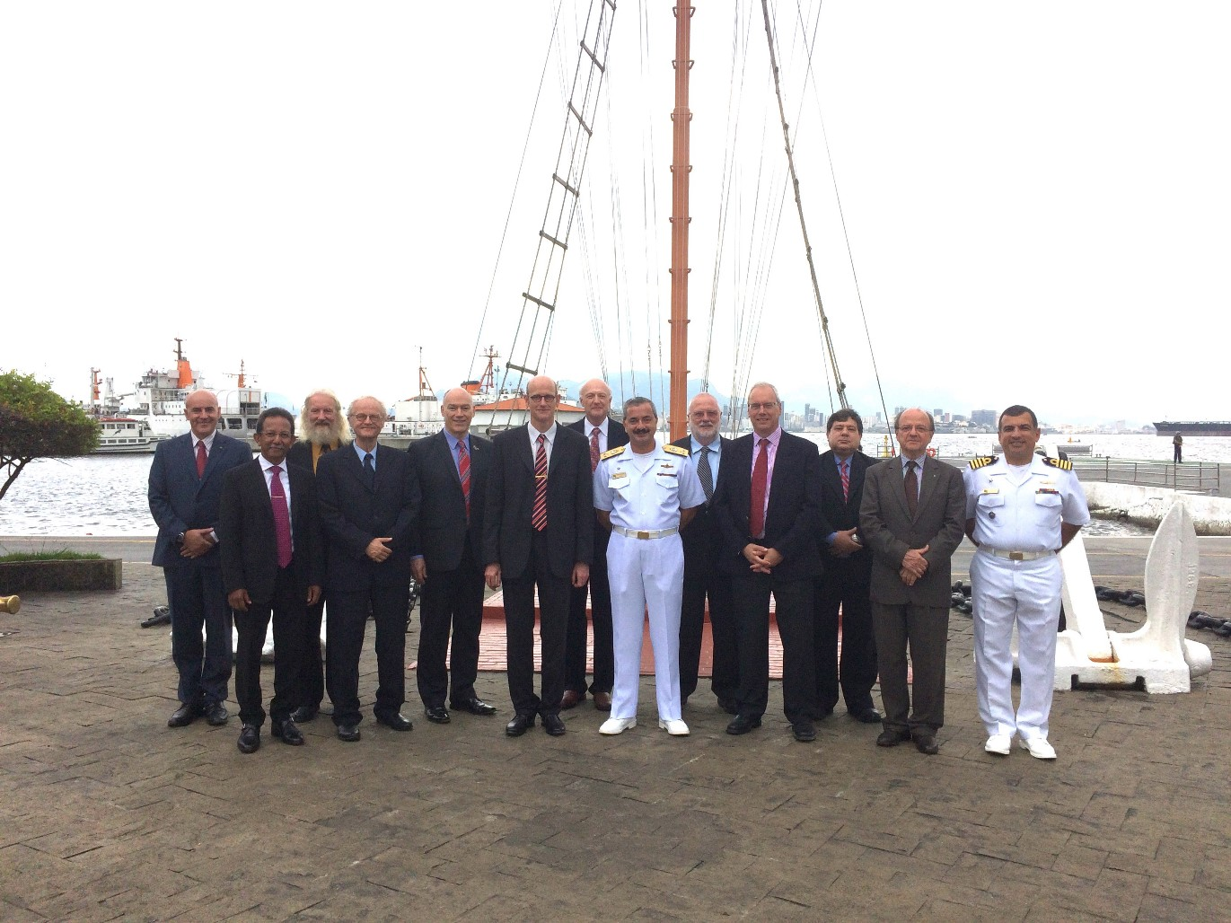
The International Board for Standards of Competences
10 members from parents organisations (4 FIG, 4 IHO and 2 ICA), from governemental, educational and civil sector;
Experienced professionals in education, hydrography and cartography, from various areas of the world (Australia, Brazil, France, Caribbean, Greece, Indonesia, New Zealand, UK, USA)
Notes:
Country list updated, Oct ‘15

Slide 3
IBSC Members Distribution

Slide 4
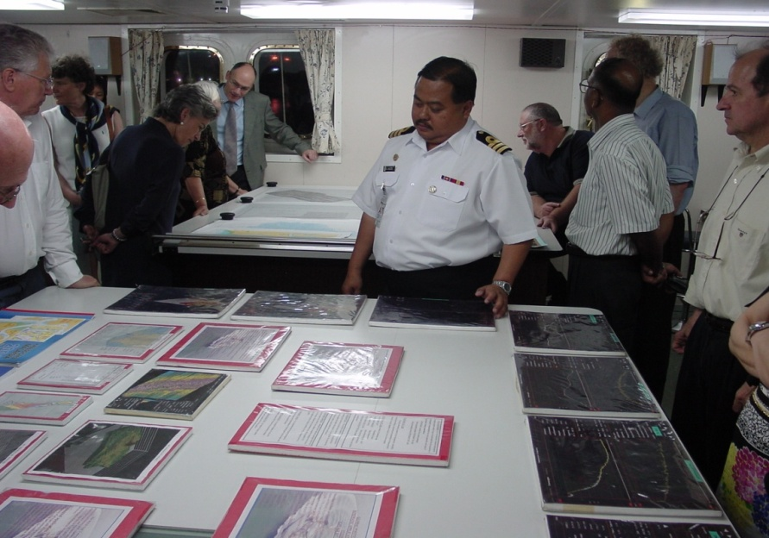
The role of the Board
Review syllabi of programmes and individual recognition schemes from education and training organizations (50 recognized programs, around 15-18 submissions in Dec. 2015);
Maintain IBSC publications
Provide guidance to education and training institutions;
Supports the IHB in the establishment of new hydrographic programs where regional training capacity does not exist.
Notes:
Submissions number updated Oct’15

Slide 5
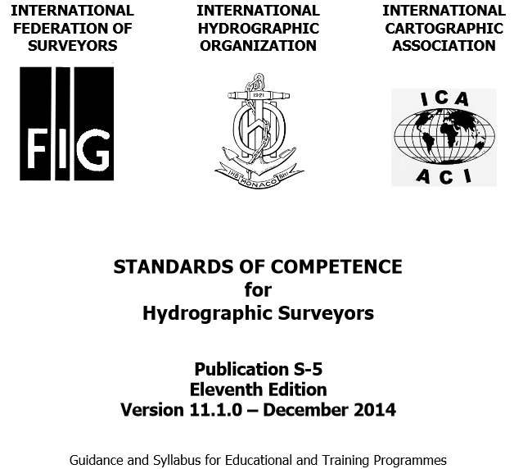
S-5: Standards of Competence for Hydrographic Surveyors

Slide 6
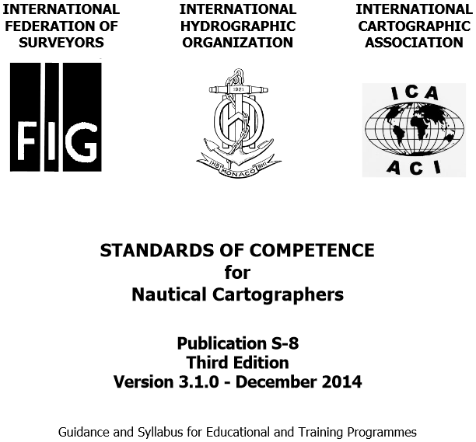
S-8: Standards of Competence for Nautical Cartographers

Slide 7
S-5 and S-8 Categories
Both S-5 and S-8 currently define standards of competence at 2 levels:
Category A
Category B
IBSC is now drafting new Standards that
Separates each of the standards at the two levels to offer fours standards: S-5A, S-5B, S8A and S-8B.
Updates content of the standards to comply with the scientific and technological developments in the fields of Hydrography and Nautical Cartography.
Realises that there have been technological developments to support teaching and learning
Uses a framework aligned with modern educational practice.

Slide 8
Mobile mapping systems
Hydrographic education
Environment
Acoustics, LiDAR
Processing
Analysis
Geodesy and Inertial measurements
Positioning (surface, subsea)
Sounding selection, generalization
Cat. A/B level
Acquisition devices and software
Wide variety of COMPETENCES
Data processing and
visualization tools
Reactivity
Autonomy
Independent thinking
Physics
Applied mathematics
ADDED COMPLEXITY
Information Technologies
Hydrography/Cartography
Education and Training
Hydrographic Services
Hydro/Carto systems and processing tools
Industry
Hydro 2010 - 8

Slide 9
Category A
Cat A standards are aimed at theoretical educational and
foundational background necessary for Hydrographers/Nautical
Cartographers-In-Charge and hydrographic/cartographic
managers who will
Develop specifications for surveys and charts;
establish quality control and quality assurance systems;
respond to the specific requirements of a full range of
hydrographic/cartographic projects.

Slide 10
Category B
Category B:
Watchleader : reports to a category A project leader
Should be familiar with fundementals and practical aspects of hydrographic surveying and/or cartographic works
In the Navy : junior officer in charge of a survey launch
In the Industry: team leader in charge of localized surveys
Standards are aimed at the Basic educational level and training of survey technicians

Slide 11
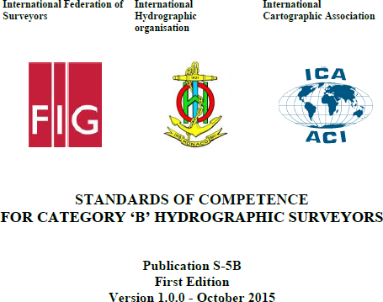
New Category B Standards: S-5B, in force by January 2016
S-5A, January 2017
S-8B, January 2018
S-8A, January 2019

Slide 12
Practical components
For both categories, the ability:
to conduct or operate hydrographic surveys in the field;
to utilize hydrographic/cartographic databases to compile and produce charts,
remains a fundamental competence, and thus an important
part of education and training through practicals (field
exercises and/or projects).

Slide 13
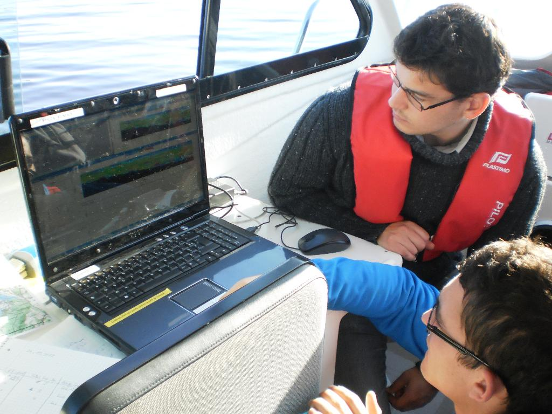
Competencies are achieved through Education
Training courses = system use;
Education :
Methodology and concept understanding;
Ability to make appropriate usage of a sensor, data processing technique, etc…
Hydrography and Cartography requires practical skills, as well as competences;
Fieldwork without training is not possible;
Project work without hydrography education is not efficient.
The standards apply to Educationnal programmes

Slide 14
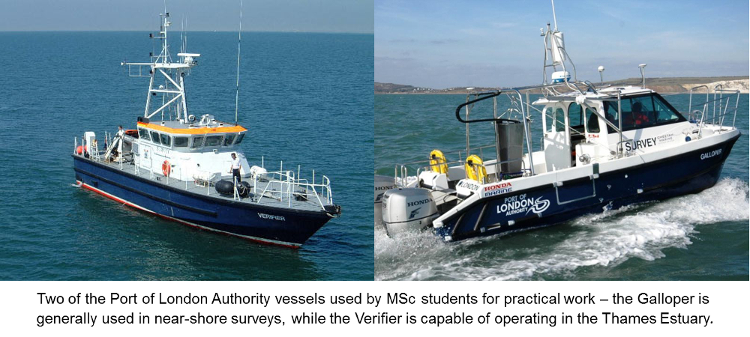
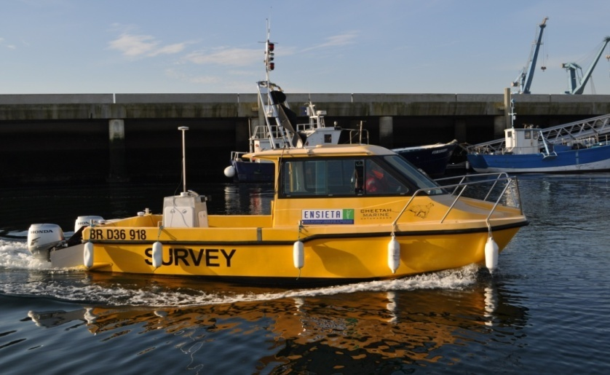
ENSTA Bretagne survey launch
The launch from CCOM UNH
Field training

Slide 15
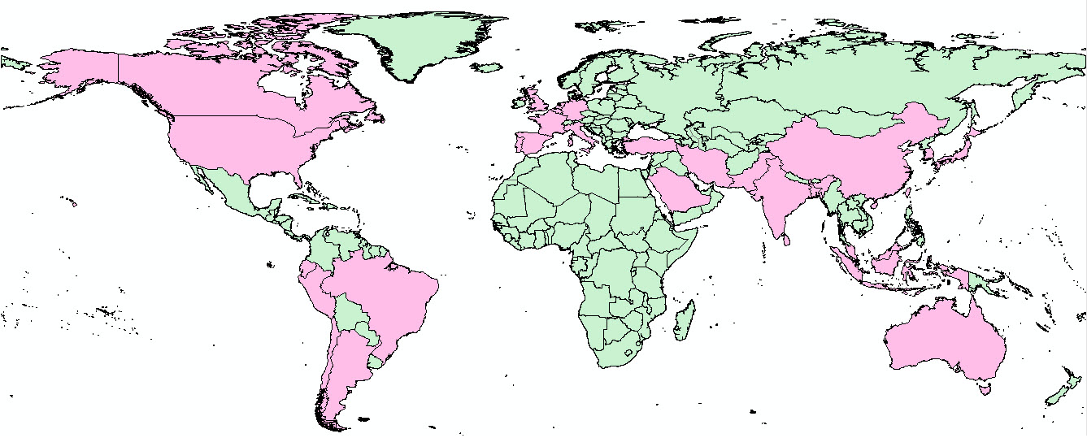
Recognized Course Distribution

Slide 16
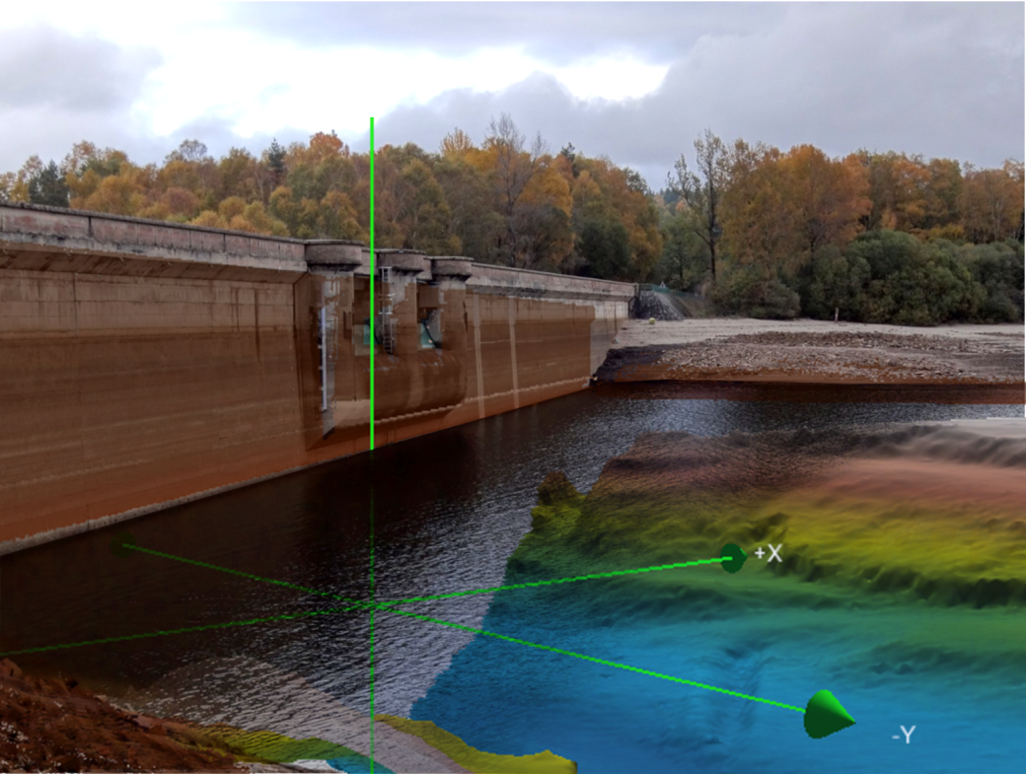
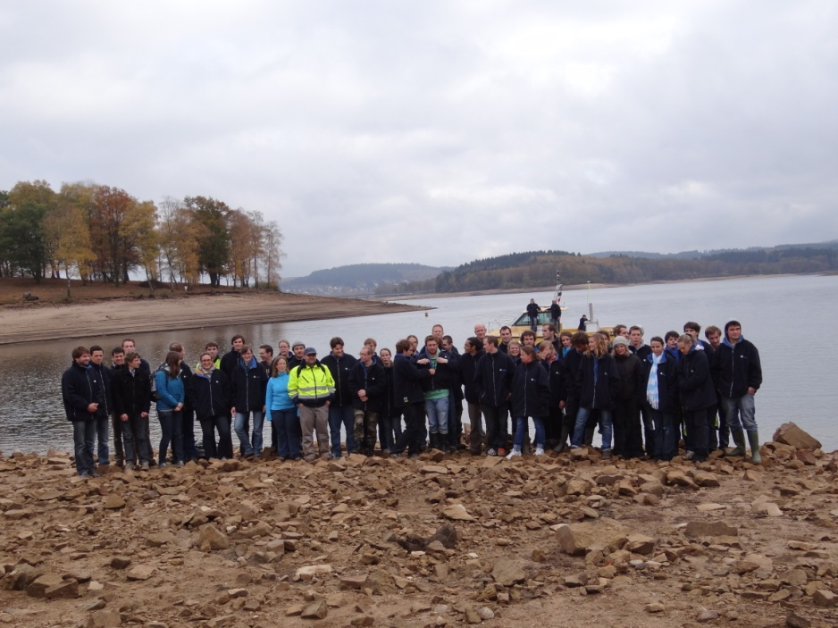
Educational Establishments
Programmes offered to military personnel, typically where the Navy is responsible for hydrography and nautical cartography at national level;
Commercial organisations;
Educational establishments such as universities and colleges;
The Board recognises Programmes, not individuals, with recognition being awarded for 6 years.

Slide 17
Recognised Programmes In the Wider Caribbean
There are currently none.
A programme offered by Columbian Navy to Navy Officers lost recognition (expired) in 2011, there has been some interest in a new offering.
Programme(s) exist in at least Mexico and Venezuela, but these have not sought recognition;
These programmes may be suited for recognition by the IBSC

Slide 18
QUESTIONS ?
Contacts:
IBSC Secretary : alberto.neves@iho.int
IBSC Chair : nicolas.seube@cidco.ca

