Slide 1
National report of the Kingdom of the Netherlands

Slide 2
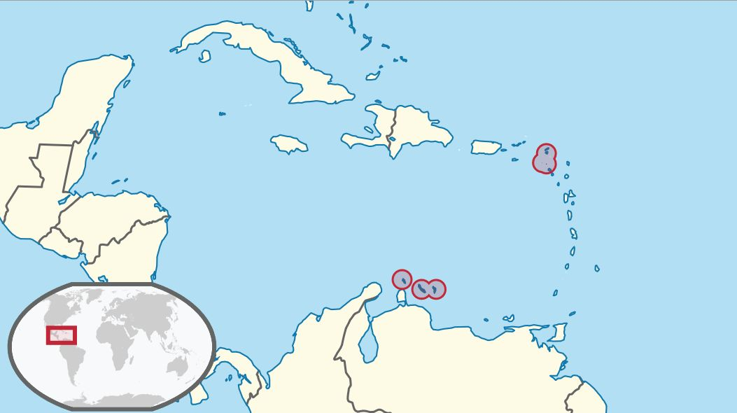
A quick recap: responsibilities of NLHO in Caribbean
windward islands
leeward islands

Slide 3
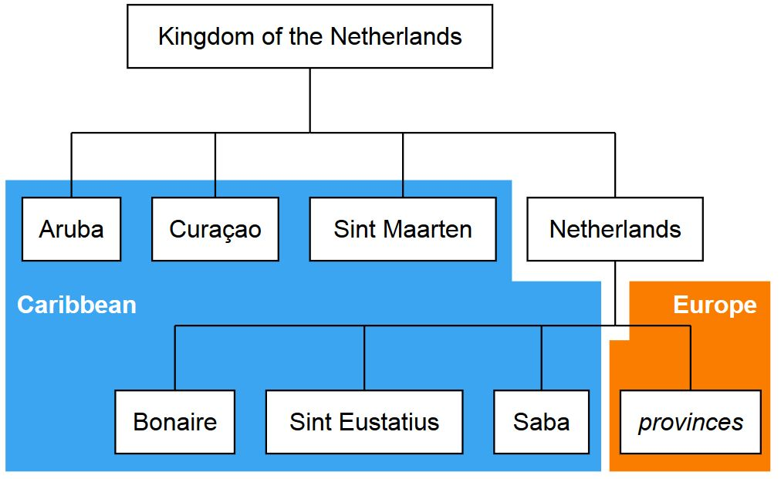
A quick recap: responsibilities of NLHO in Caribbean
leeward islands
windward islands

Slide 4
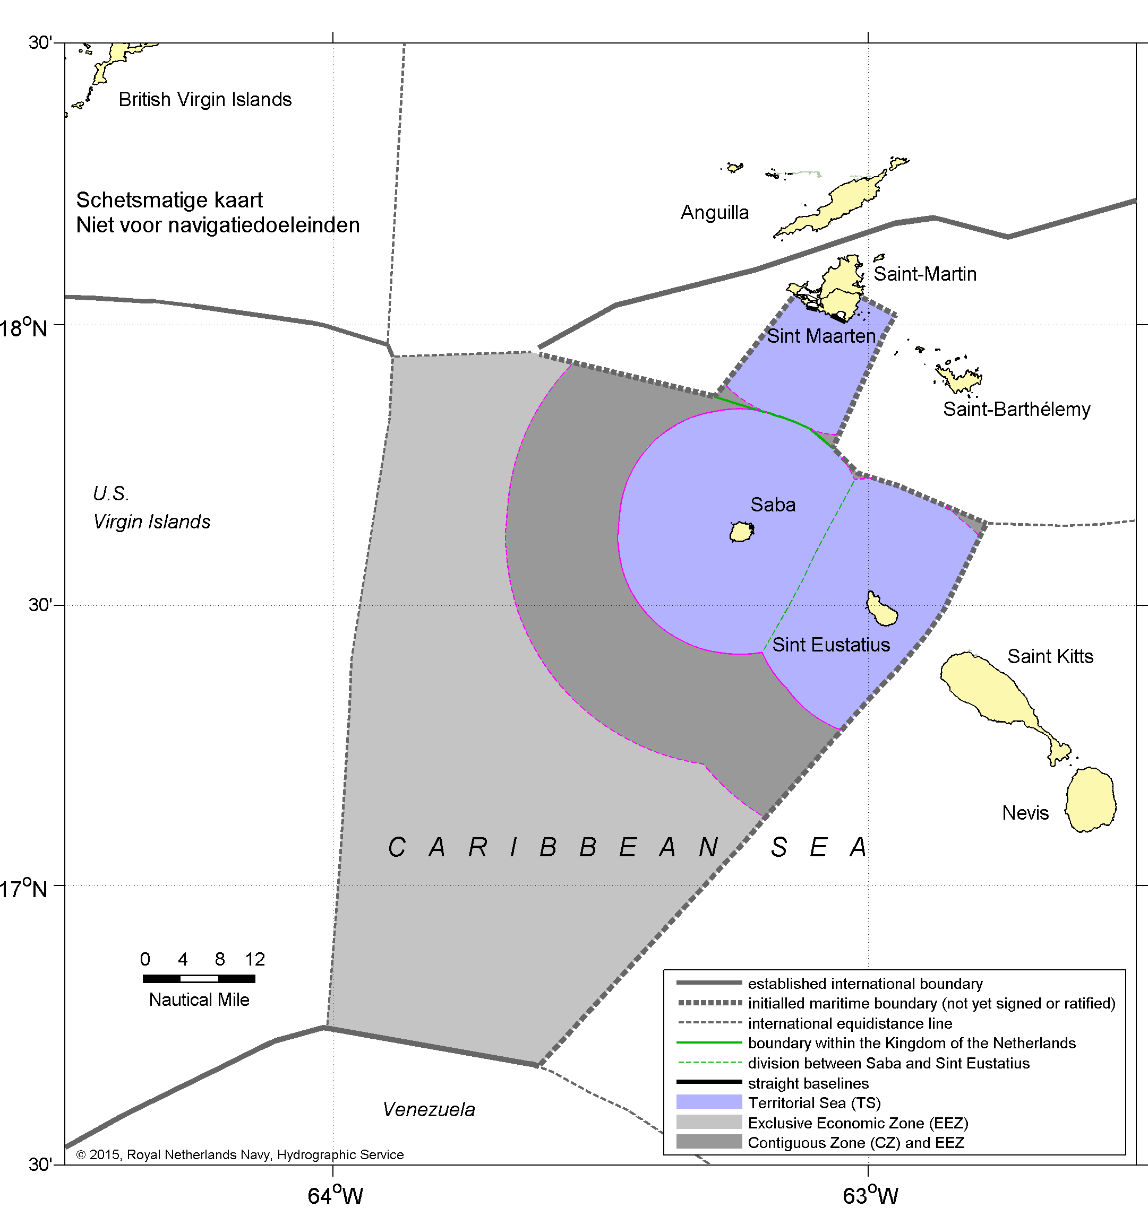
Agreement on new Caribbean all-purpose boundary

Slide 5
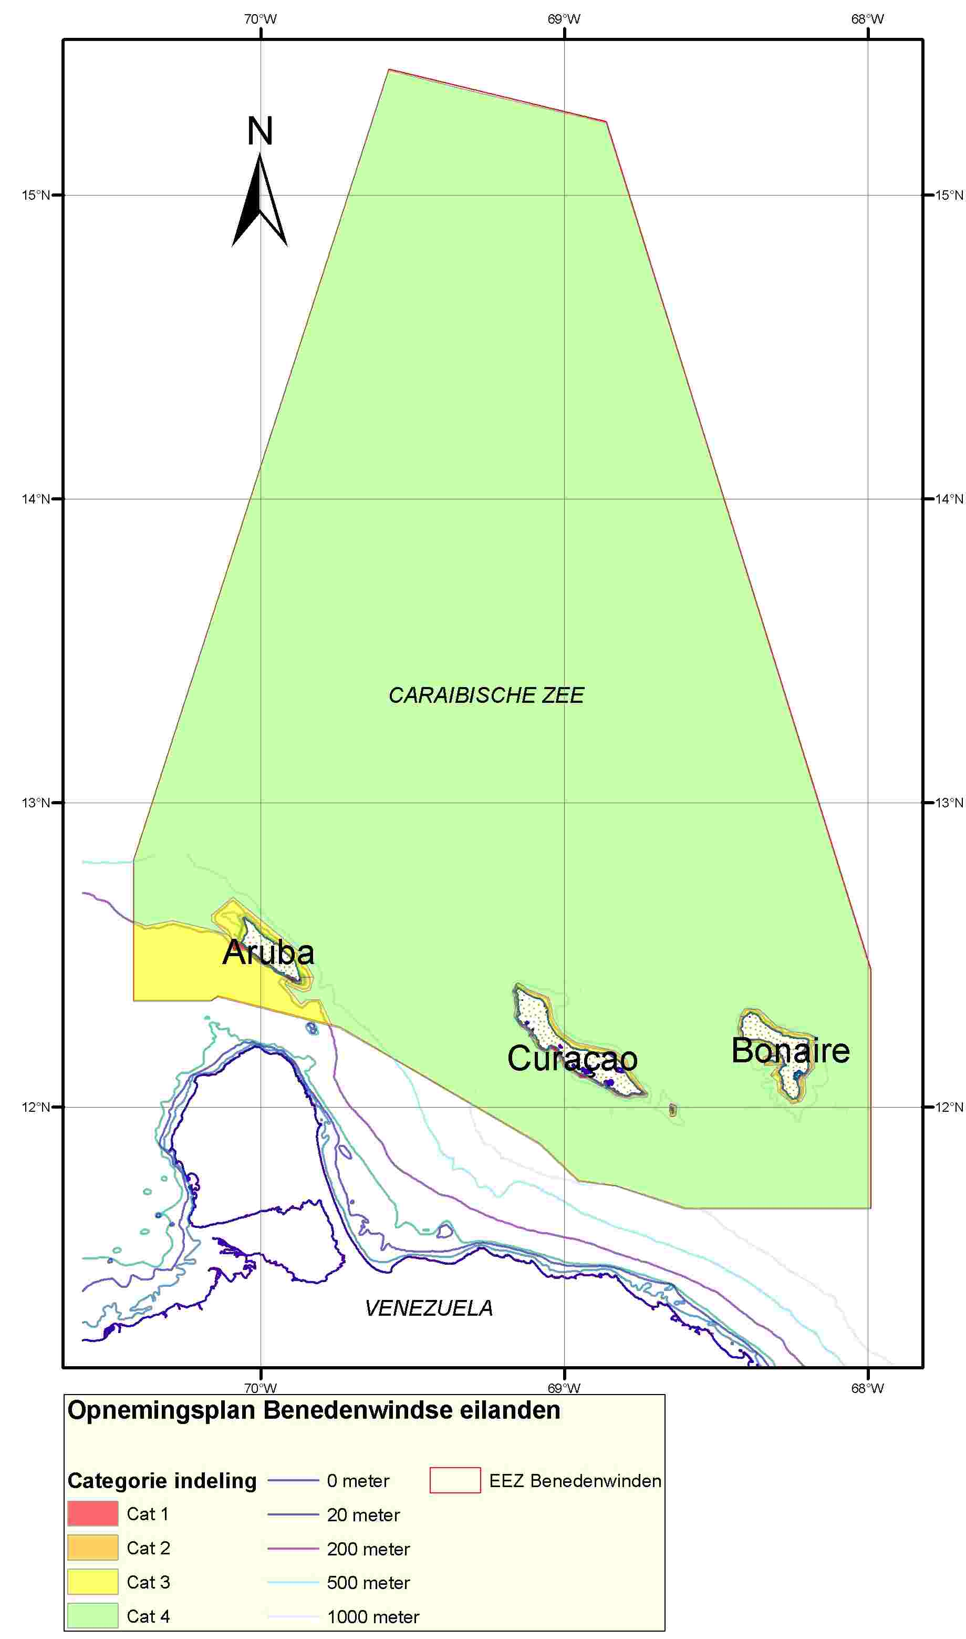
Survey policy 2015
Resurvey frequencies:
4 years (Cat.1)
12 years (Cat. 2)
24 years (Cat. 3)
50 years (Cat. 4)

Slide 6
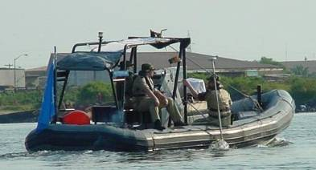
Survey capacity for deployment in 2016
Portable system, to be used on any ship of opportunity

Slide 7
C-55 status of hydrographic surveying
Leeward Islands (Aruba, Curaçao, Bonaire)
Adequately surveyed (<200m / >200m): 8% / 33%
Required re-survey (<200m / >200m): 92% / 67%
Never systematically surveyed (<200m / >200m): 0 / 0
Windward Islands (Sint Maarten, Saba, Sint Eustatius)
Adequately surveyed (<200m / >200m): 79% / 96%
Required re-survey (<200m / >200m): 21% / 04%
Never systematically surveyed (<200m / >200m): 0 / 0

Slide 8
Bilateral arrangement with Suriname
Termination per September 2016
Increased capacity & new Bilat with UKHO
Thanks to MAS for good cooperation

Slide 9
Conclusion
Satisfactory status for surveying and nautical charting in the MACHC area.
The 2016 survey campaign will improve the status of surveying of the Leeward Islands.
Continued efforts to establish maritime boundaries

