Slide 1
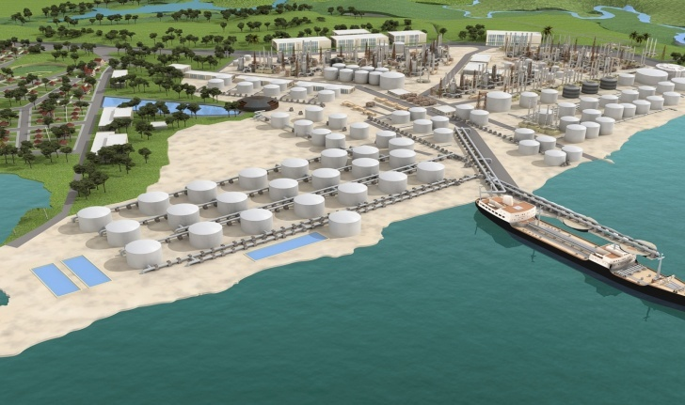
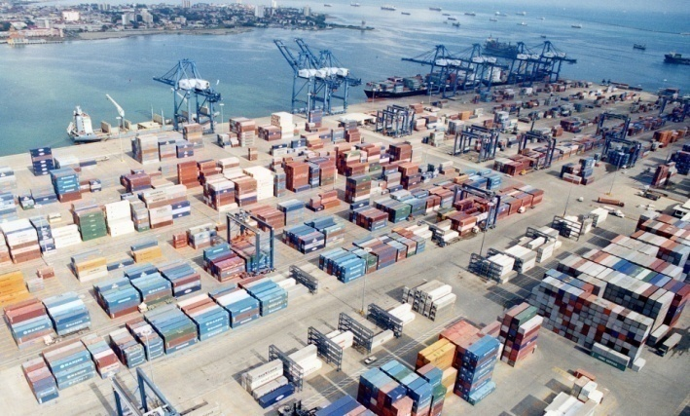
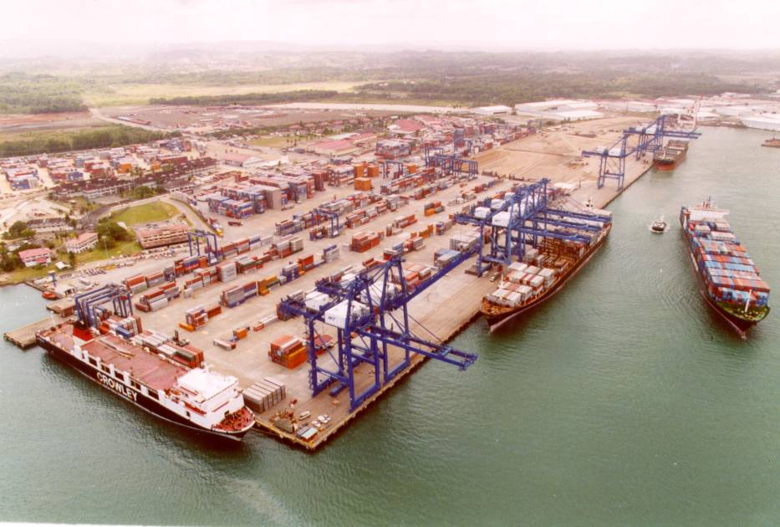
Panama Maritime Authority
Current Situation of the Hidrographyc Matters, Nautical Charts Updates and ENC
Panama September 2015

Slide 2
TIMELINE SINCE 2009
2009 – Start to looking for information to send WWNWS
Start sending information for NTM and Nautical Charts Updates
2010 – Designing new Anual Budgets for equipment, Softwares, etc.
Start to analyze the UKHO Agreement
2011 - Start Getting information and data from private hydrographic companies
(outsourcing Services)
Aids to Navigation transfered to Operations Port Departament
2012 – Membership in IALA (2 Meetings, 1 Training)
2013 - Surveys of Navoceano
2014 – Negotiation of the UKHO Agreement / New Aids to Navigation of Colon
Scheme of the ENC Nautical Charts Code for ACP
2015 – Signing of UKHO Agreement ---Royalties—Training
TSS
CHOPAN Restart Regular Meetings Presided by AMP
IHO Meetings

Slide 3
Weakness
Budget
Training
Human Resource
Strength
Panama Canal Experience
Private Ports
Opportunities
Keep Panama as a Leader in the Maritime Sector
Better Products more users
Incomes and Business Opportunities
Threats
Accidents
No Time
Comfort area

Slide 4
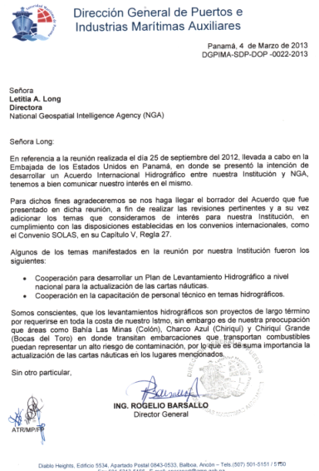

Slide 5
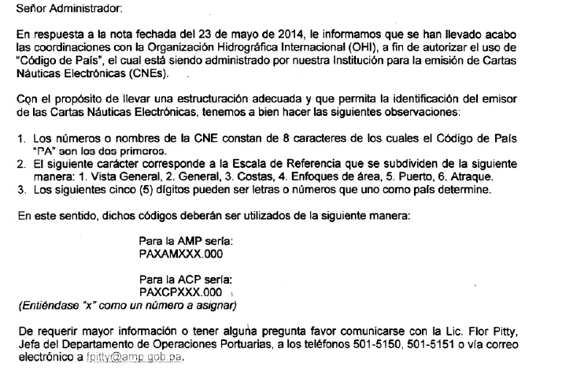
Sharing the country code for ENC´s

Slide 6
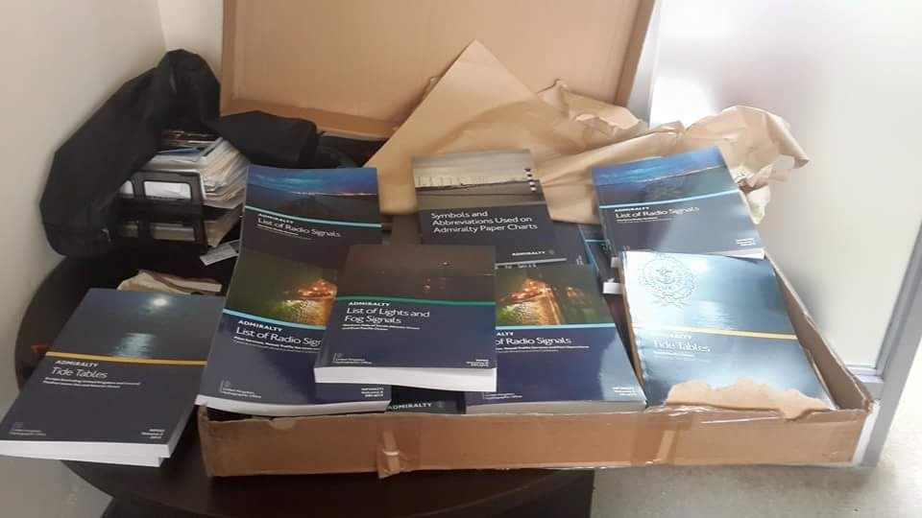
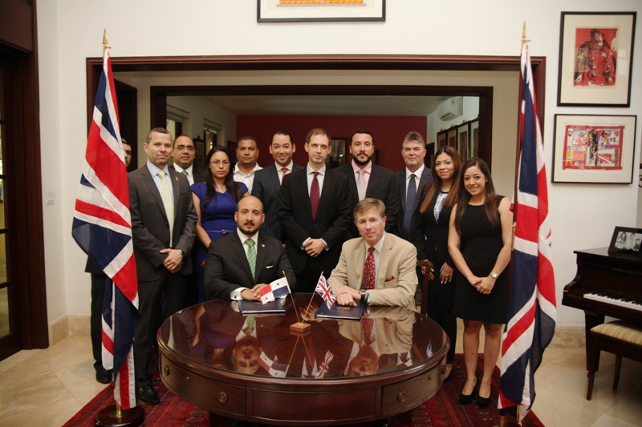
Agreement with UKHO

Slide 7
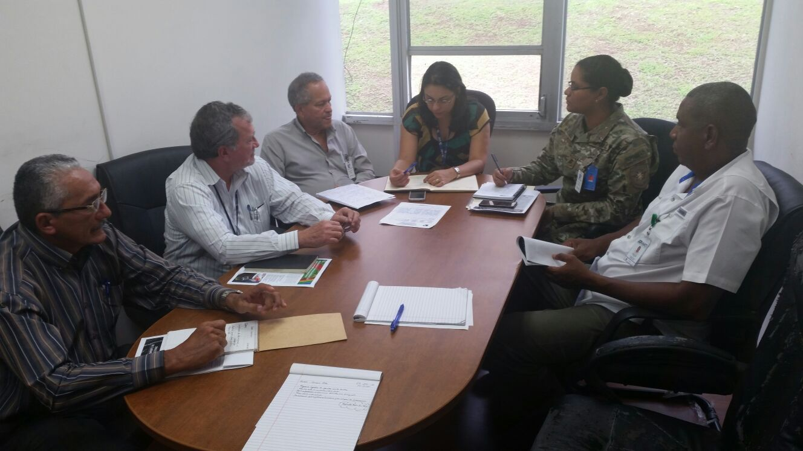
CHOPAN
Restart Regular Meetings - March 2015

Slide 8
Department of Hydrography and Nautical Cartography
MEF
Equipment
Equipment | Unidad | Cantidad
Ecosonda de doble frecuencia | unidad | 1
Equipo de GPS, con corrección de radio integrado | unidad | 1
Compensadores inerciales (MRU) para los sistemas de Multi Beam | unidad | 1
Compensadores inerciales (MRU) para los sistemas de single Beam | unidad | 1
Software para colectar data y procesarla en sistemas de Single Beam utilizamos HYPACK, AutoCAD (Hidrográfico) | unidad | 1
Lanchas para realizar los estudios hidrográficos | unidad | 1
Equipo Multi Beam | unidad | 1
Equipo Single Beam | unidad | 1
Plotter | unidad | 1
Mesa para la lectura de planos | unidad | 1
Compás de punta seca | unidad | 3
Escuadra | unidad | 3
Regla Paralela | unidad | 2

Slide 9
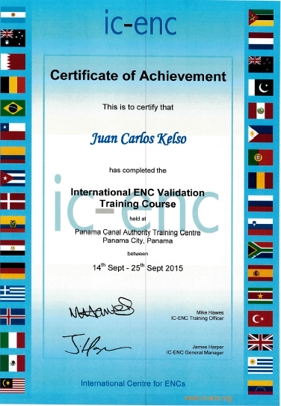
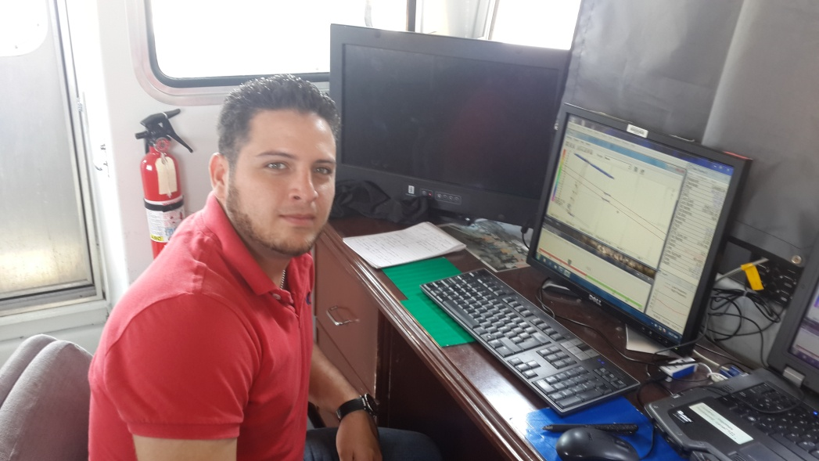
Trainings.

Slide 10
Memberships and Not Memberships
IALA
IC ENC
Note: No Member of IHO

Slide 11
Thank you

