Slide 1
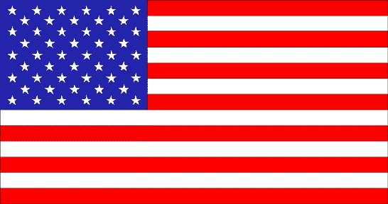
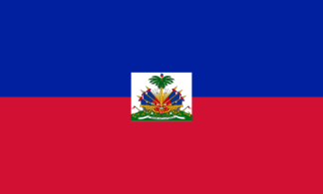
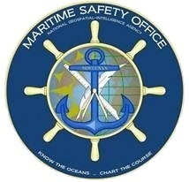
UNCLASSIFIED
Haiti / US Internship
Jim Rogers
Technical Executive
      NGA Maritime Safety Office
      07 DEC 2015
UNCLASSIFIED

Slide 2
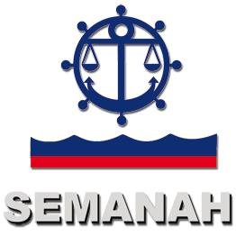


Haiti / US Internship Partners
UNCLASSIFIED
Service Maritime et de Navigation d’Haiti (SEMANAH)
National Oceanic and Atmospheric Administration (NOAA) – Office of Coast Survey (OCS)
National Geospatial-Intelligence Agency (NGA) – Maritime Safety Office (MSO)
Commander, Naval Meteorology and Oceanography Command (CNMOC)
UNCLASSIFIED

Slide 3
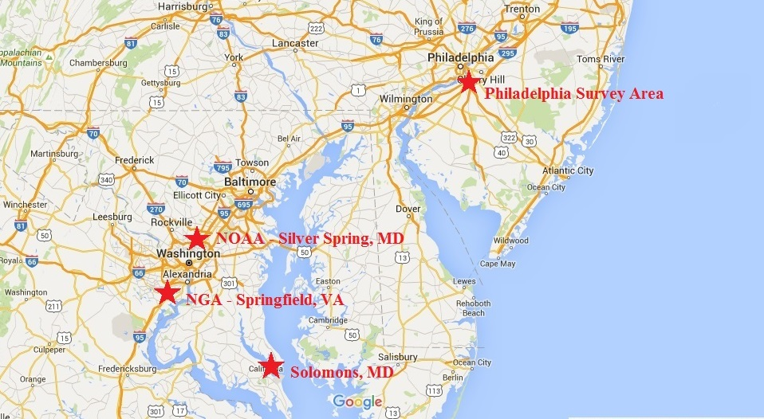
Haiti / US Internship Locations
UNCLASSIFIED
UNCLASSIFIED

Slide 4
Haiti / US Internship Timeline
UNCLASSIFIED
12 OCT 2015 – Arrive in the US (Solomons, MD)
13-16 OCT 2015 – NOAA Bay Hydro II Vessel Orientation / Equipment Familiarization
19 OCT 2015 – Bay Hydro II transits to Philadelphia, PA for Survey Operations
20-22 OCT 2015 – Bay Hydro II Survey Operations
23 OCT 2015 – Bay Hydro II transits back to Solomons, MD
26-29 OCT 2015 – Data Processing / Analysis / Survey Report
UNCLASSIFIED

Slide 5
Haiti / US Internship Timeline
UNCLASSIFIED
30 OCT 2015 – Depart Solomons, MD for Washington, DC
02-03 NOV 2015 – Visit NOAA’s Office of Coast Survey - Survey data processing / Quality Control / Marine Chart Division visit
04 NOV 2015 – NGA Maritime Safety Office Visit – Pubs / Bathy / NTM’s / SNC / DNC / ENC
05 NOV 2015 – WWNWS Visit / MSI Discussion / Visit with CAPT Brian Connon / John Lowell
06 NOV 2015 – Meetings with CNMOC / NOAA / NGA
UNCLASSIFIED

Slide 6
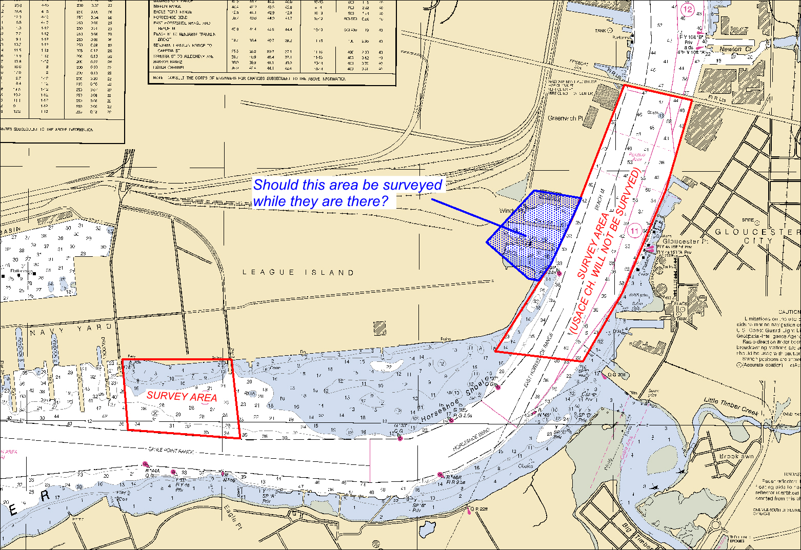
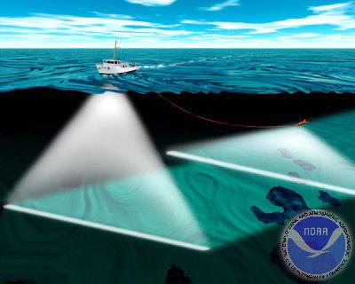
Haiti / US Internship Survey Area
UNCLASSIFIED
UNCLASSIFIED

Slide 7
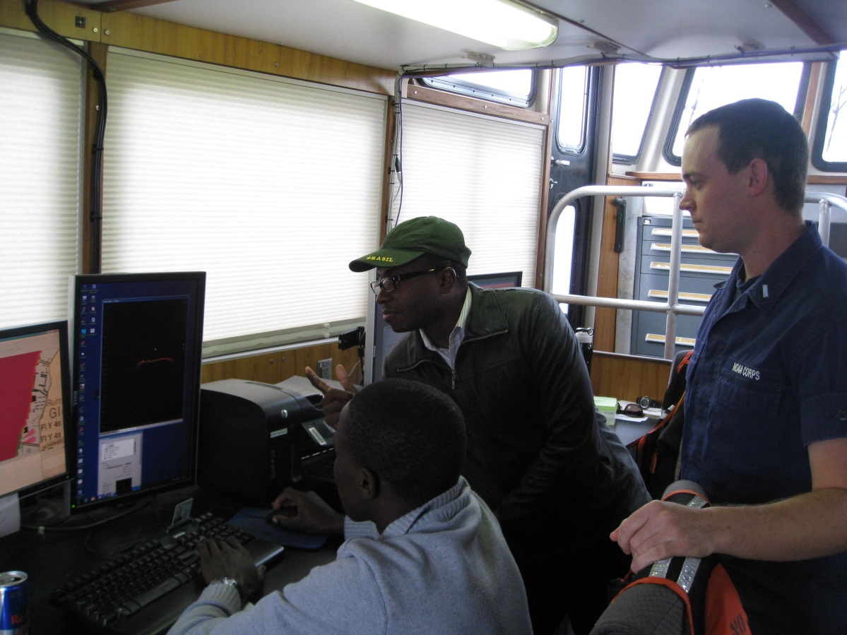
Haiti / US Internship Survey Activities
UNCLASSIFIED
Orientation
Equipment Familiarization
Hydrographic Survey
Data Processing
Analysis
Hydrographic Survey Report
UNCLASSIFIED

Slide 8
Haiti / US Internship NOAA Visit
UNCLASSIFIED
Hydrographic Surveys Division
  Final Processing
  Quality Control / Quality Assurance
Marine Chart Division
  Updating Charts with new Surveys
  ENC
UNCLASSIFIED

Slide 9
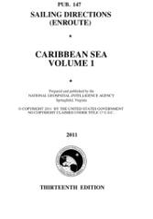
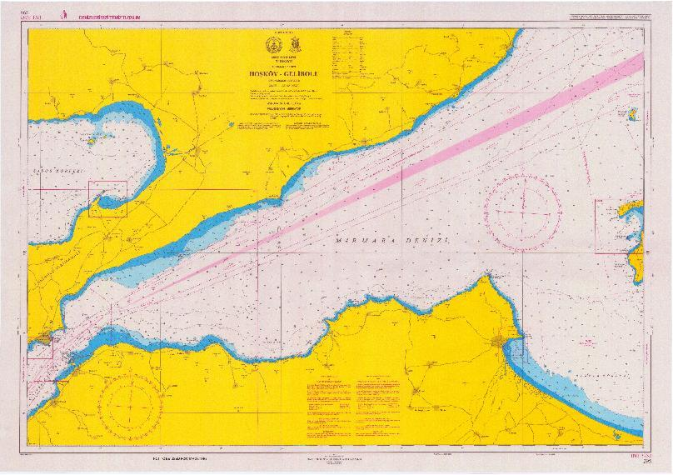
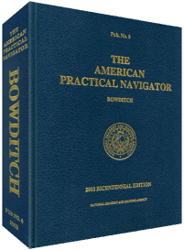
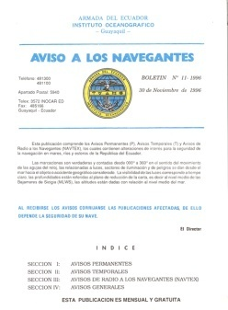
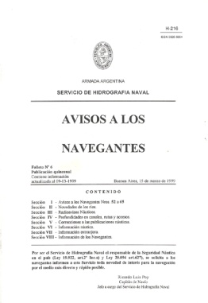
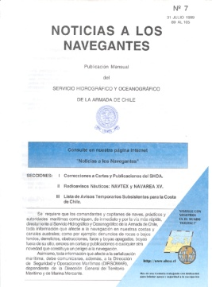
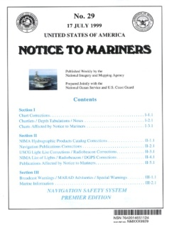
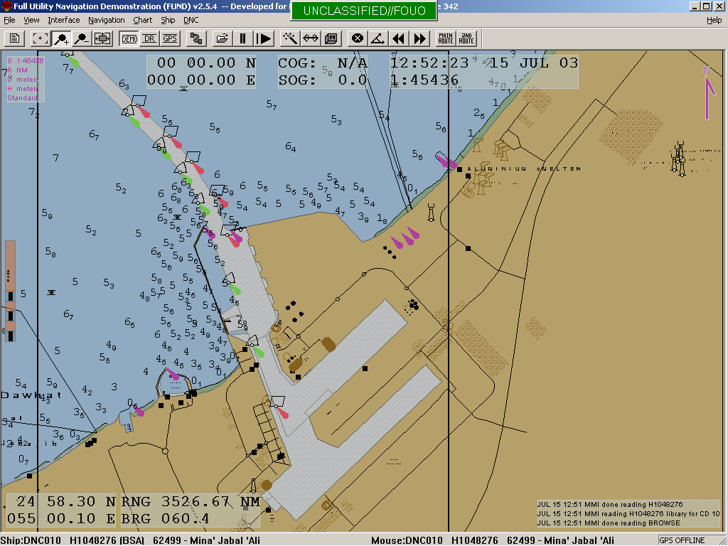
Haiti / US Internship NGA Visit
UNCLASSIFIED
Publications
Maritime Source Assessment
Bathymetry
Notice to Mariners (NTM)
Standard Nautical Charts (SNC)
Digital Nautical Charts (DNC)
Electronic Nautical Charts (ENC)
World Wide Navigational Warning Service (WWNWS)
UNCLASSIFIED

Slide 10
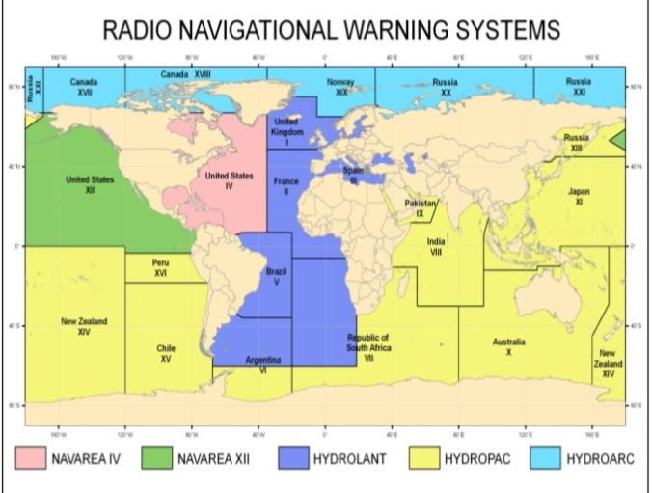
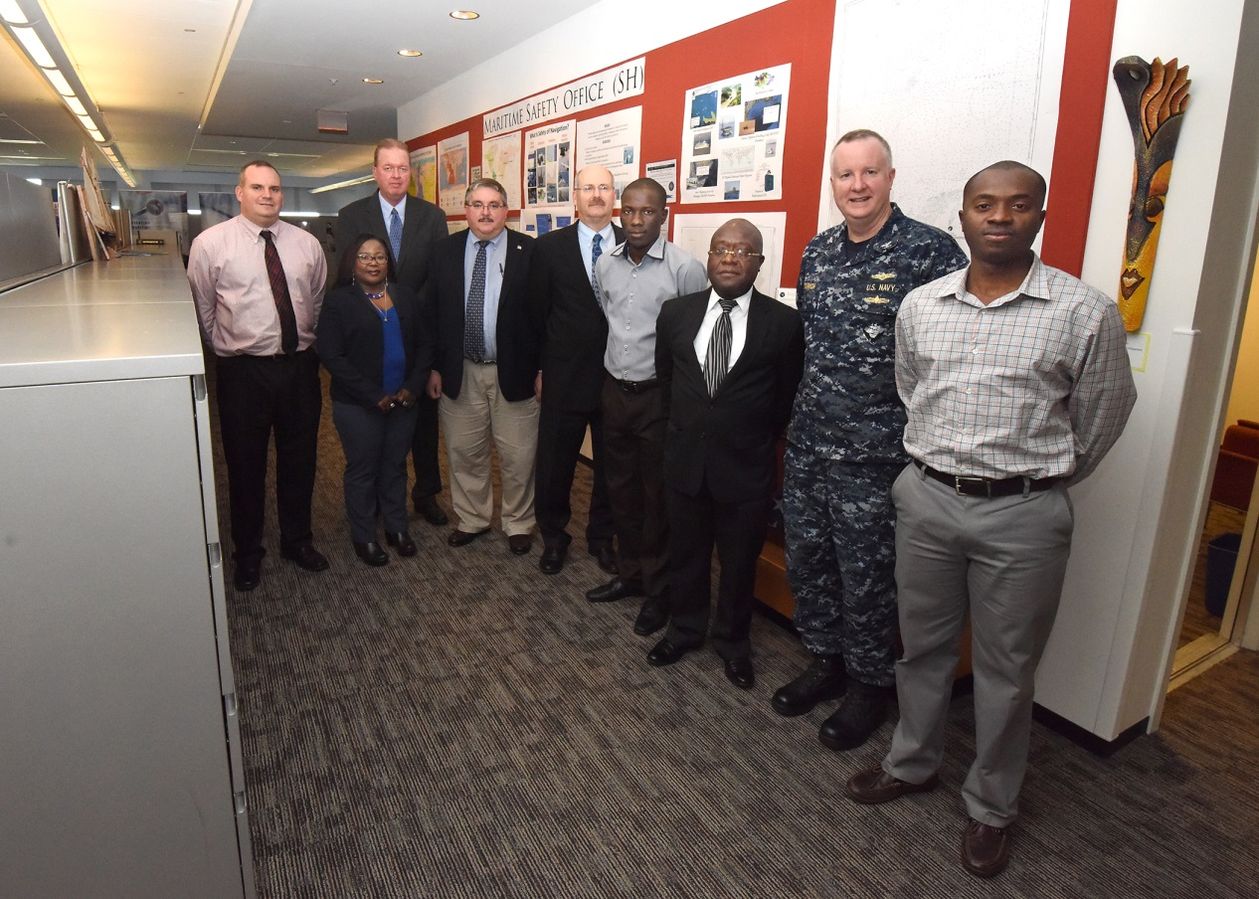
Haiti / US Internship NGA Visit
UNCLASSIFIED
MSI Discussion
Visit with CAPT Brian Connon / John Lowell
SEMANAH / NOAA / NGA / CNMOC Meeting
UNCLASSIFIED

Slide 11
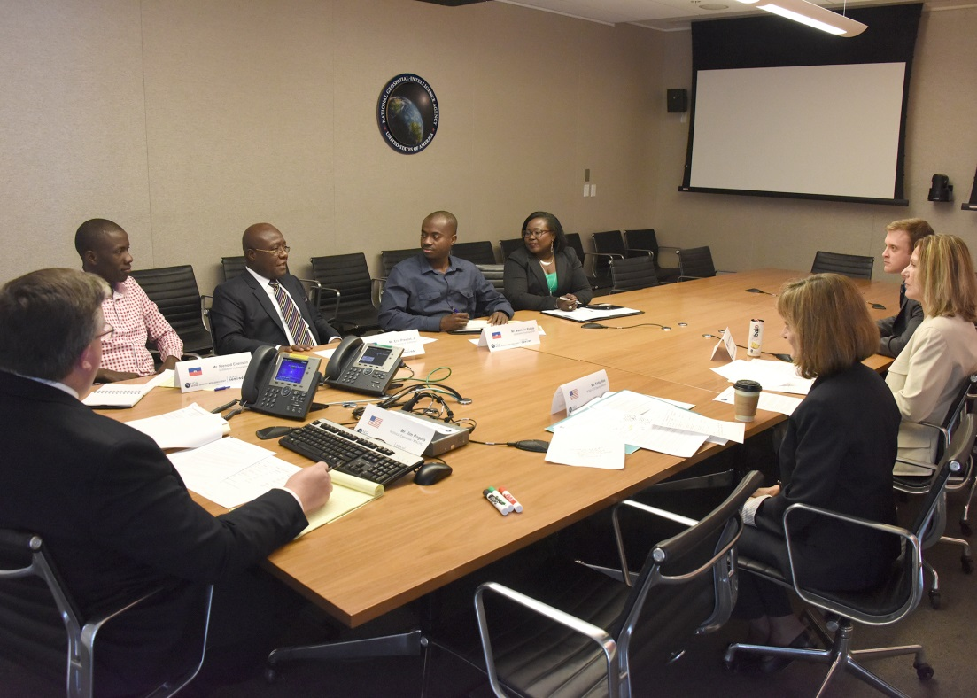
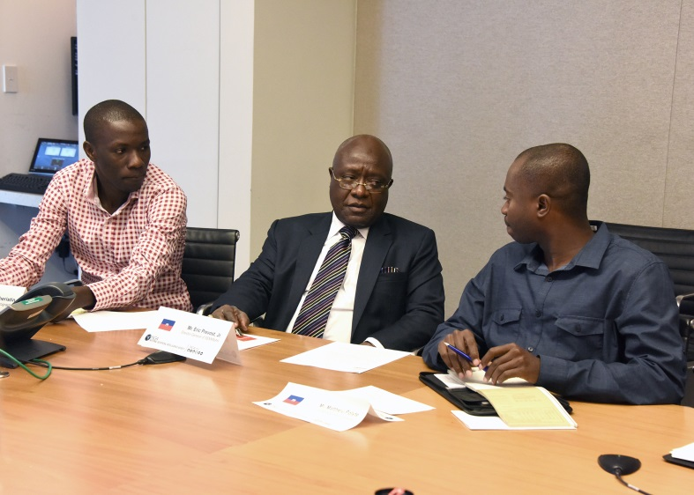
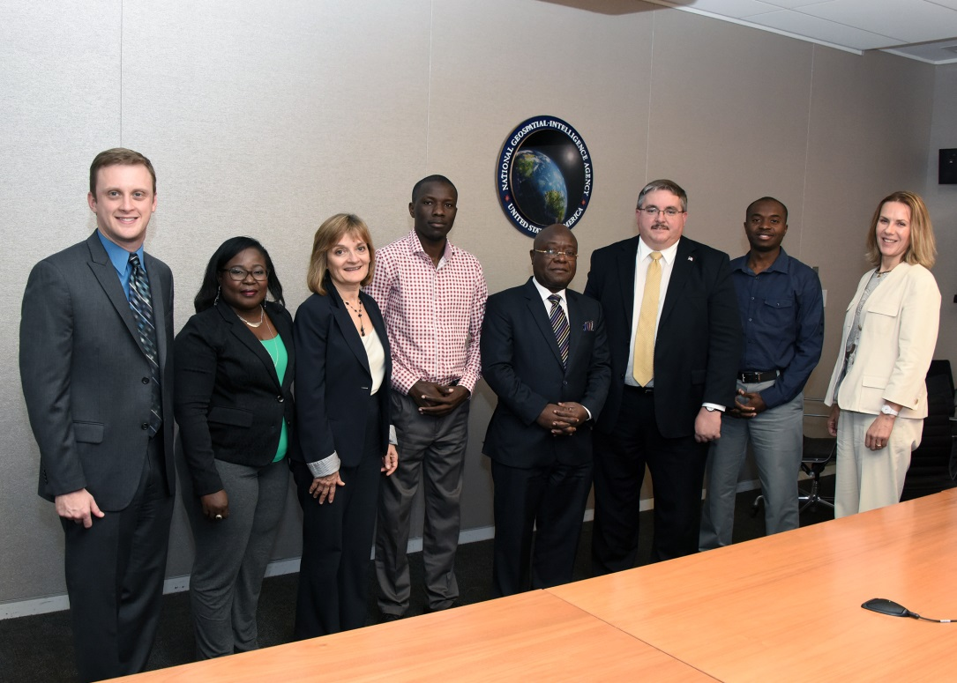
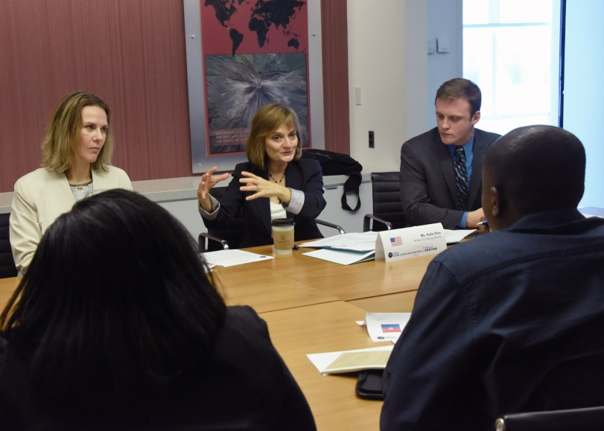
Haiti / US Internship NGA Visit
UNCLASSIFIED
UNCLASSIFIED

Slide 12
UNCLASSIFIED
UNCLASSIFIED

