Slide 1


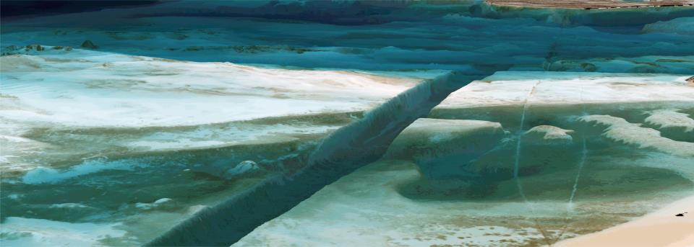
Satellite Derived Bathymetry
© ESA
Dr. Thomas Heege Don Ventura
CEO Hydrogr. Business
Devel. Manager
EOMAP GmbH & Co.KG
Germany | USA| Australia | Singapore
www.eomap.com

Slide 2
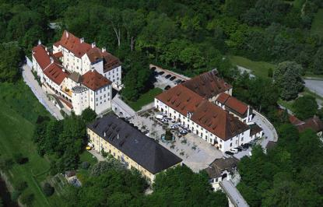
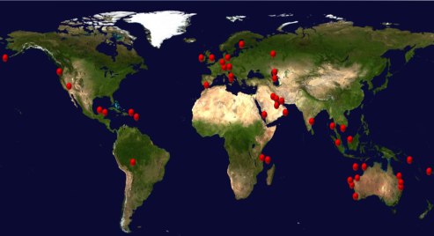

About EOMAP
Global satellite service provider for offshore and water industries
Core services: mapping & monitoring of inland, coastal and marine environments
20 years of systematic development on SDB related technologies
Headquarter and team in Castle Seefeld (30min distance to Munich)
Notes:
Founded in 2006 as Spin-Off from the DLR with HQ close to Munich, DE
Since 2013 offices in Singapore, India, USA and representatives for Australia.
Approx. 20 employees including physicist, mathematics, geoinformatics or (geo)-ecologist
Core services are mapping and monitoring of coastal and marine environments
Headquarter is located in Castle Seefeld, near Munich
Several strategic partnerships as with Digital Globe
Various award winning as GMES/Copernicus Masters 2011 and 2013

Slide 3
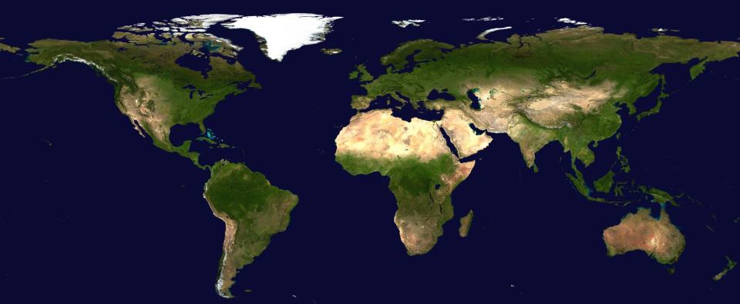






















Clients and users of EOMAP’s products and services
www.eomap.com

Slide 4



Introduction
Gaps
Filling gaps within financial capabilities
Risk reduction
Several approaches and concepts
Guidance required:
a) Which SDB approach, sensor & resolution?
b) How to integrate with other data?
c) Quality assurance & standards?
d) How to represent data in map?

Slide 5
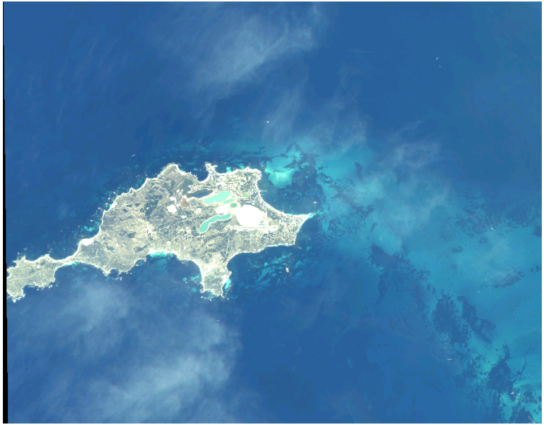
Satellite imagery
WV-2 Rottnest Island, Australia
Notes:
5

Slide 6
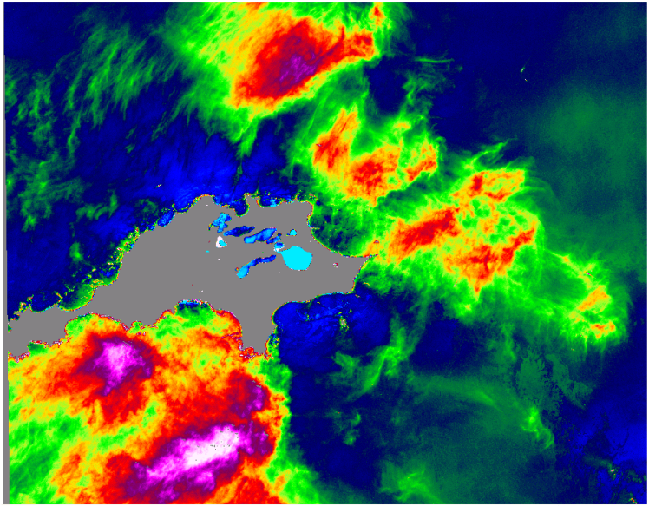
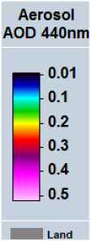
Atmospheric impact
WV-2 Rottnest Island, Australia
Notes:
6

Slide 7
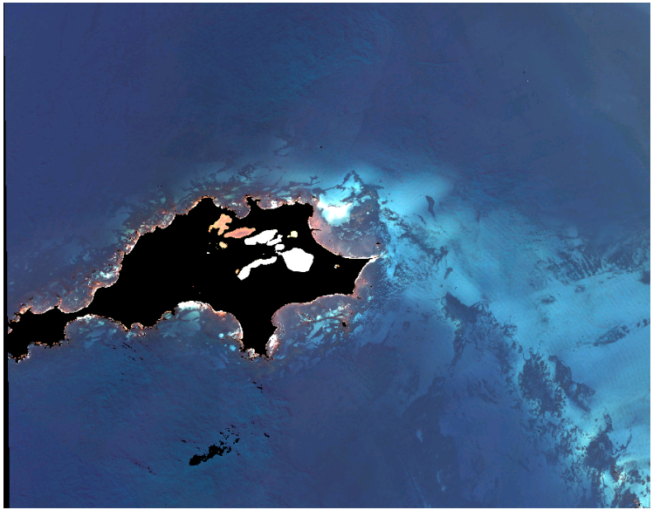
Corrected imagery: Subsurface reflectance
WV-2 Rottnest Island, Australia
Notes:
7

Slide 8
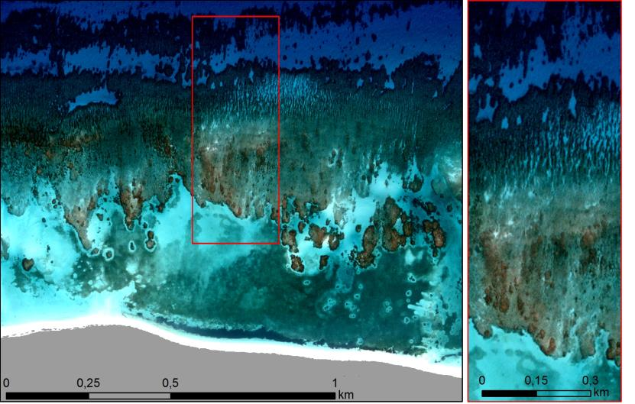
Subsurface reflectance

Slide 9
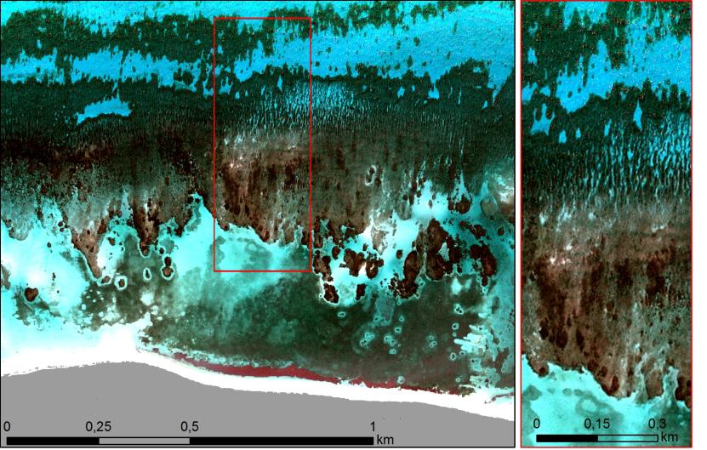
Seafloor reflectance

Slide 10
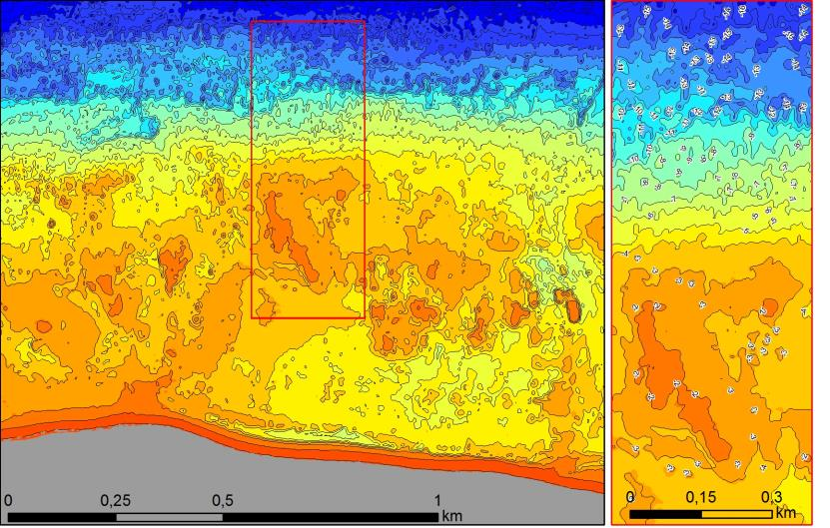

Bathymetry
Bathymetry
[m]
- 0
- 5
- 10
- 15

Slide 11
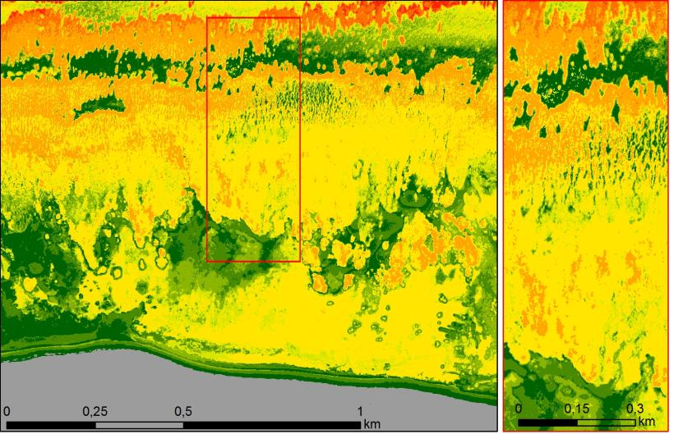

Uncertainty in meters
Uncertainty
[m]
- 0
- 1
- 2

Slide 12
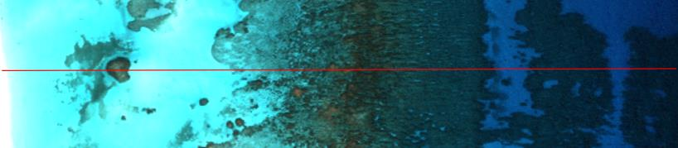
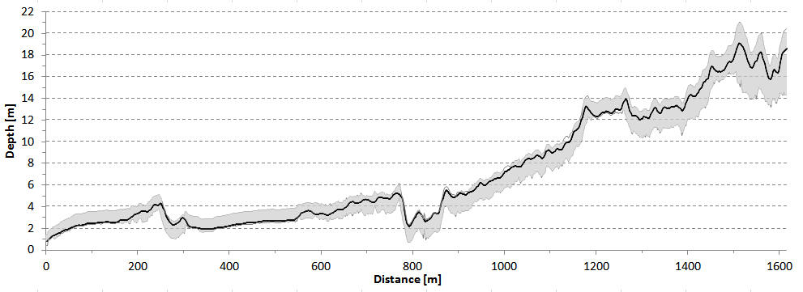
Uncertainties: Plot 1

Slide 13
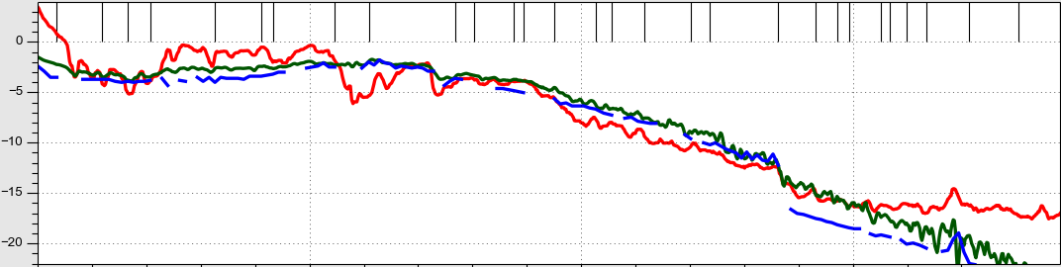
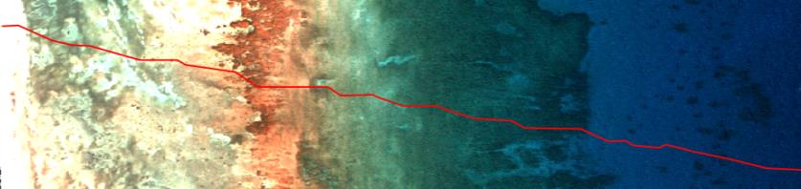
Approach & Uncertainties
Physics based (EOMAP)
Empirical
(GEBCO CookBook)
Single Beam
GEBCO CookBook method trained with 5570 single beam measurements
for 40 sq km WorldView 2

Slide 14
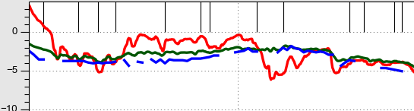

Approach & Uncertainties
Empirical (GEBCO CookBook)
Physics based (EOMAP)
Single Beam
GEBCO CookBook method trained with 5570 single beam measurements
for 40 sq km WorldView 2

Slide 15
Approaches
 | (Semi-) Empirical | Physical
Dependency on in-situ data | High | Low
Uncertainties Uncertainties forecast/trace | High No | Lower Yes
Productivity & efficiency Coverage | Lower Lower | High High
Method & Development costs | Relating brightness or ratios to water quality parameters - easy Low development costs | Resolving the light transfer - complex High development costs

Slide 16

Consistent bathymetry over all scales
Dependency on in-situ data?
High resolution: 0.5 – 2m horizontal Base maps: 15 – 30m res
Saudi-
Arabia
Qatar
Abu Dhabi
  Off-the-shelf products and fast production capabilities
  Examples: Great Barrier Reef, Persian Gulf, South-China sea, ..
  Fast on-request map generation for worldwide locations

Slide 17
Requirements <> Approaches
SDB use cases: Balance demand & cost capabilities
    Reconnaissance: survey planning
      Change detection
        uncertainties not relevant, lots of in-situ data available?
        Liabilities
      Safety aspects relevant
        uncertainties relevant?
    Expand area, fill gaps in maps
        uncertainties relevant?
        how to use & represent data?
Requirements definition, integration concept
    Spatial resolutions
    Uncertainties proved ? Forecasting and tracking?

Slide 18
Standards accounting SDB:
S44 fit for purpose? Which purpose?
 | A | B | C | D | E
THU | 2 metres | 5 metres + 5% depth | 20 metres + 10% depth | 30 metres
TVU | a = 0.25 metre b = 0.0075 | a = 0.5 metre b = 0.013 | a = 1.0 metre b = 0.1 | a = 1.0 metre b = 0.20 | a = 2.0 m b = 0.30
SEA (Full Seafloor Search) | required | not required
FEA (Feature Detection) | Cubic features > 1 metre | Cubic features > 2 metre, in depths up to 40 metres; 10% of depth beyond 40 metres | Not applicable | Cubic features of > 6m in depths up to the limits of sunlight penetration
LIN (Recommended maximum line spacing | Not defined as full seafloor search is required | 3x average depth or 25 metres, whichever is greater for bathymetric lidar a spot spacing of 5x5metres | 4x average depth
Proposal on matrix approach elements to expand existing standards:
EOMAP 2015 in collaboration with IHB and UKHO members

Slide 19
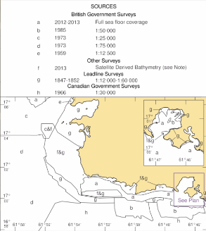
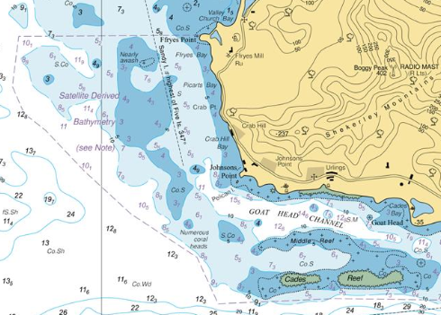
BA2066 Southern Antigua
SDB for nautical charts
EOMAPs SDB product used in the BA2066 chart, the first UKHO chart which includes SDB data.
See also the UKHO session at the shallow water conference 2015:
http://www.shallowsurvey2015.org/presentations/SS2015_Session05_Talk1_UKHO.pdf

Slide 20
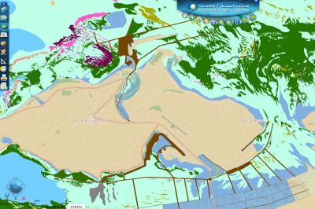
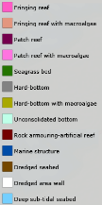
Supplementary information products: Seafloor mapping
Use Case: Environmental baseline of seafloor habitats
Clients: Environmental Agency Abu Dhabi EAD, CONABIO Mexico, Australia Ningaloo, ..
Challenge: Regulatory requirement to update the coastal habitat map Large and remote submerged area to be covered in high-resolution.
Solution and benefits:
Harmonized data processing on seafloor properties using multiple satellites
Robust and consistent measures and maps through EOMAP technologies
Fast delivery, no HSE risks, largely independent on in situ measures
Cost effective, outstanding resolution
“The mapping ..of the project has met our expectations, and we have already begun to use the delivered data in our day-to-day operations”
Anil Kumar, Director, Environment Information Management, EAD
EAD database: http://enviroportal.ead.ae/mapviewer
37 000 sqkm, layers produced by EOMAP 2013/2014

Slide 21
Integrated solutions
Integrated solutions
Integrated multi-sensor solutions with satellite data providers,
IPP Digitalglobe, EUSI, Sentinel Ground Segments
Integrated survey solutions with partner FUGRO
Integrated geo-information system solutions and online access:
eoApp services, digital map integration, …
Merging multiple data sources,
create gridded up-to date bathy datasets
(EO + crowd sources): JOIN EU-Project BASE-Platform as User

