Slide 1

REMOTE SURVEY SOLUTIONS - AN INTEGRATED ACTIVE / PASSIVE APPROACH
FUGRO-EOMAP:
Thomas Heege
Matt Bergin
Don Ventura
IHO-MACHC, Antigua
11 December 2015

Slide 2

Fugro-EOMAP Teaming – Est. Aug 2015
An agreement to collaborate where SDB and other relevant satellite-derived products prove a credible option to an integrated survey services solution
Fugro primarily responsible for:
  Project definition, planning and management
  Source data such as satellite imagery
  Ground truth data as required
  Hydrographic data review
  Preparation of all deliverables
EOMAP primarily responsible for:
  SDB planning including data parameters and data source requirements
  Data processing to produce SDB products
  Support Fugro in producing deliverables as required

Slide 3
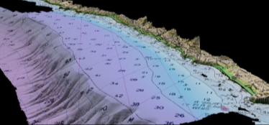

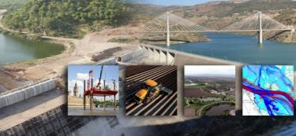

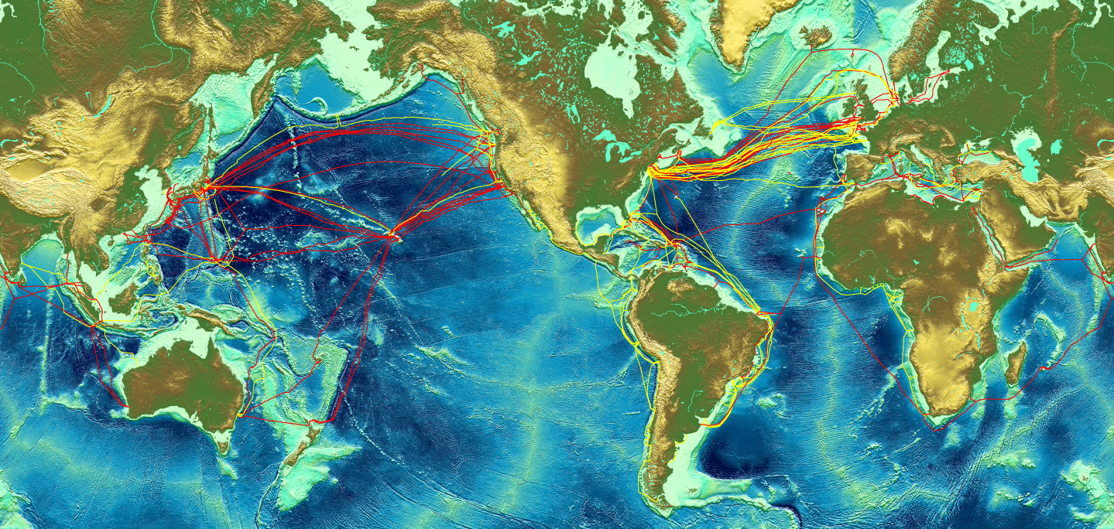


Fugro Capabilities - Our Markets
Hydrographic Surveying (Charting)
Engineering & Construction Support
Coastal Zone Management
Marine Route Surveys
Our services span a wide variety of clients where we provide both support and resources tailored to the specific needs of each. We can deliver multi-disciplined survey solutions anywhere in the world.

Slide 4

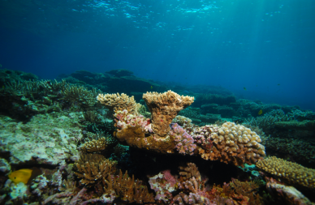
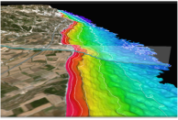
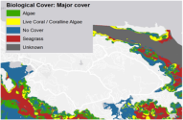
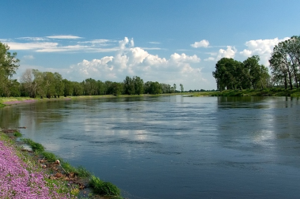
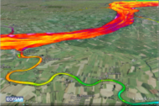
EOMAP Capabilities – Markets
Satellite Derived Bathymetric Surveys
Environmental Monitoring of Coastal Zones
and Habitat Mapping
Water Quality Monitoring

Slide 5

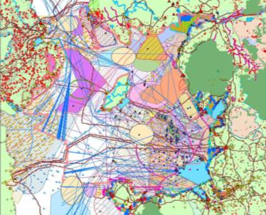
The Case for an Integrated Survey Solution
Increasing emphasis on nearshore surveys and the coastal hinterland
Mapping of land-sea interface requires a broader approach to hydrographic survey techniques and technologies
Concerns over various charting and coastal zone mapping issues:
  sea level rise due to climate change
  land subsidence through extraction of mineral and water resources
  growth of / reliance on a seaborne blue economy (efficient delivery of goods)
  coastal erosion or damage to nearshore ecosystems (habitat mapping and environmental surveys)
  Increase in population and population density along the coast places extra emphasis on monitoring
Photos: http://www.shedexpedition.com/wp-content/uploads/2014/04/Virginia-Beach-sky-view.jpg; http://gpmoorephoto.com/blog/wp-content/uploads/2012/11/Icy-Bay-Mount-Saint-Elias-Alaska-Photo.jpg;

Slide 6
Can We Trust the Low-Cost Option?
We can, if we apply an integrated approach….
SDB can provide cost-effective initial coverage of a suitable, clear, shallow-water area
We can take the initial results and do at least three things:
  Use the data to provide reconnaissance information for follow-on, more easily quantifiable survey techniques (put an otherwise poorly charted area in focus)
  Conduct more discrete, higher-resolution surveys of the most critical areas for development or coastal defense / monitoring
  Use active sensor data to refine the original SDB results to create a better-defined, integrated product which can start to attain accuracies acceptable to a wider stakeholder group
We can also start to recognize the benefits of well-developed algorithms of satellite imagery to extract even more habitat info from the coastal zone

Slide 7
Why an Integrated Approach?
Small scale / large area deliverables can be generated in a timely manner
By integrating a survey campaign, the survey team can take advantage of the results of initial remote sensing data:
  to hone the extent of survey required by the next level of technology in the campaign
  to highlight the presence of potential hazards and obstructions
  to maximize efficiency in all phases of the campaign and improve cost-effectiveness
  to accelerate the detection of major chart discrepancies and enact rapid issuance of T&P NOTAMS
Such an approach promotes efficiency in all levels of survey planning
Given the extensive geography of the MACHC, a ‘base-layer’ of SDB can accelerate the acquisition of modern data coverage
    …. from unacceptably long and protracted survey programs
    …. to acceptably manageable timelines
    …. within acceptable budget constraints
    …. with discernable progress possible for all recipients.

Slide 8

SDB-ALB Comparison Results
Agencies have independently compared results of one or two overlapping surveys in discrete regions … often over very limited areas
We undertook a wider study of four very disparate areas, with differing coastal conditions, between the complementary and more typical (in terms of coverage and domain) ALB and SDB datasets
A summary of these results have been provided previously
Conclusion:
we have a firm case to justify the utility of SDB in carefully considered scenarios
absolute accuracy might not meet current charting requirements but relative accuracy is good for reconnaissance and change detection

Slide 9
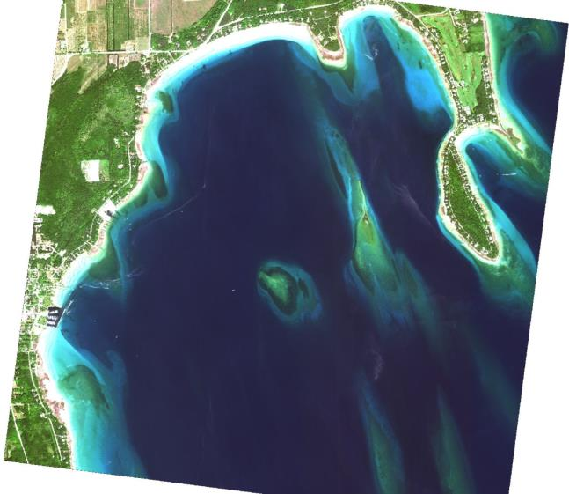
Lake Michigan

Slide 10
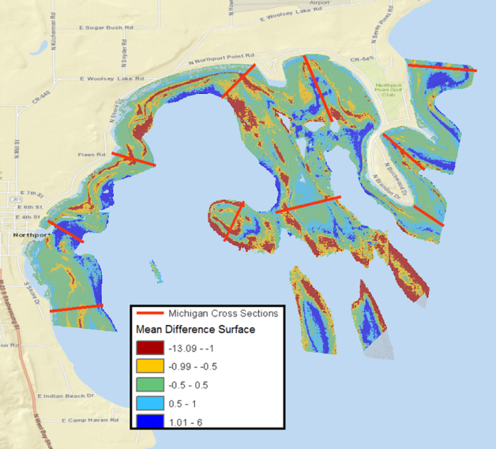
Mean Differencing Surface and Profiles
10
4
7
3
9
6
8
2
5
1

Slide 11
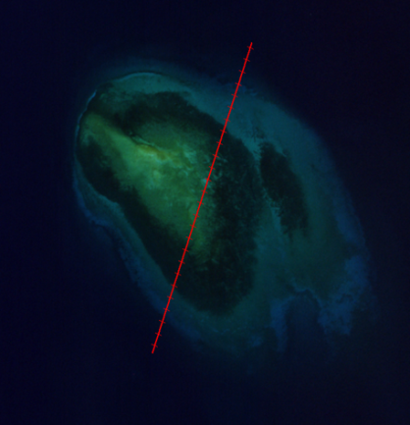
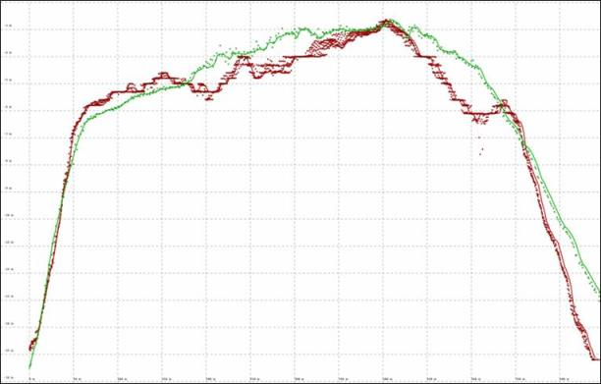
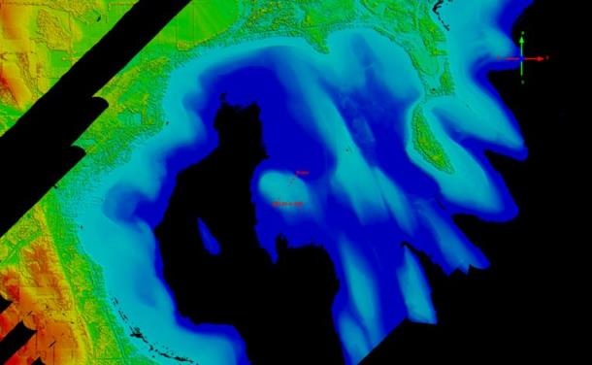
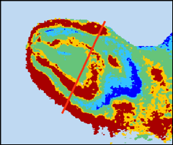
Profile 5
Grid Unit Interval (m):
X = 10
Y = 1
= SDB
= ALB

Slide 12
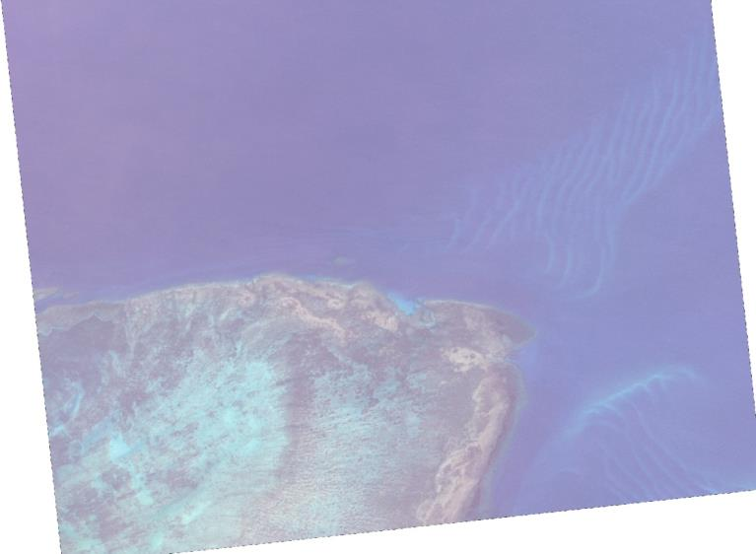
Torres Strait, Australia

Slide 13
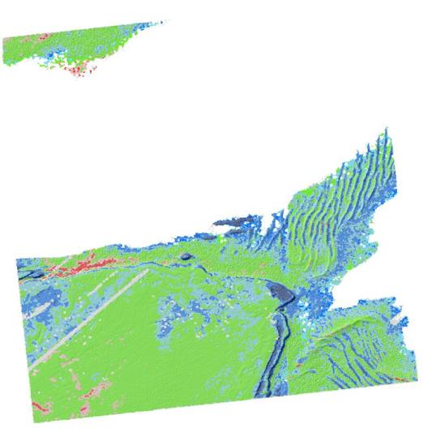
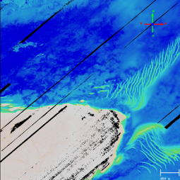
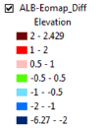
Mean Differencing Surface and Profiles

Slide 14
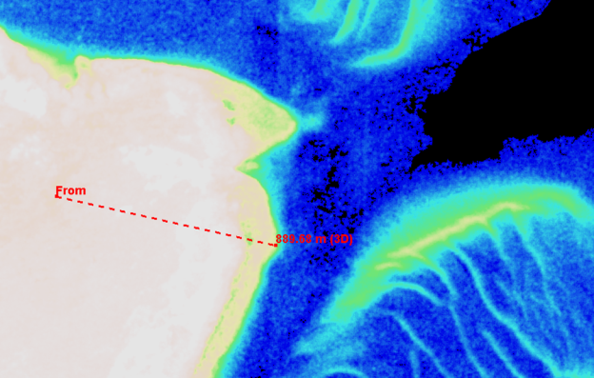
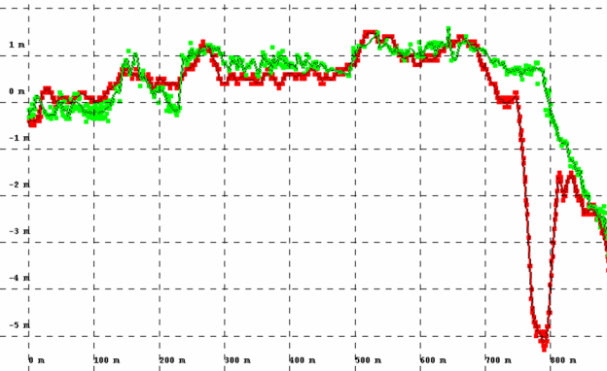
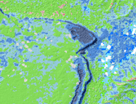
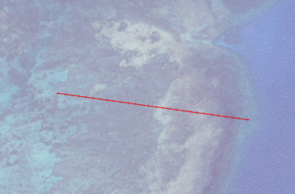

Profile 6

Slide 15
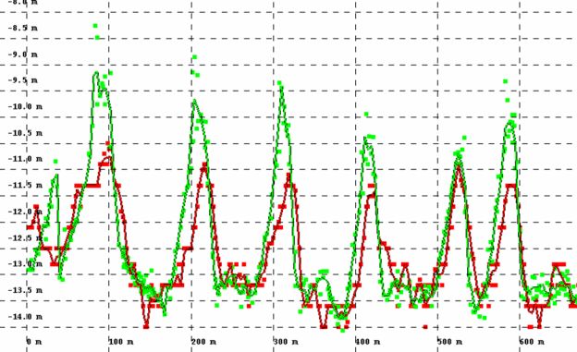
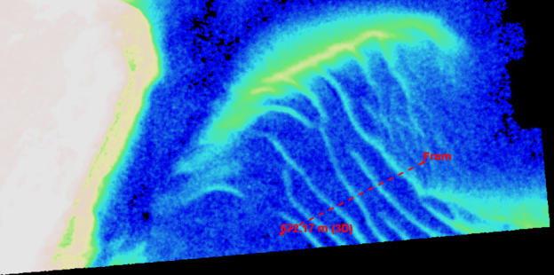
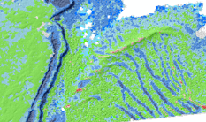
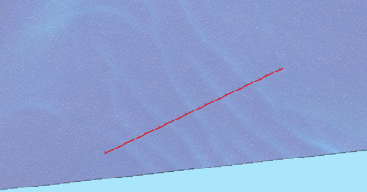
Profile 8

Slide 16
SDB Utility – Project Examples
Two examples of projects where SDB has been successfully applied:
  Example 1 - UKHO (New Chart of Southern Antigua)
  Example 2 - Shell (Qatar – Seismic Survey Support)

Slide 17
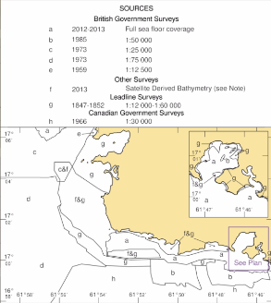
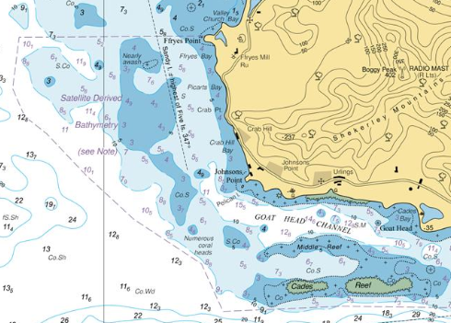
BA2066 Southern Antigua
SDB for nautical charts
EOMAPs SDB product competed against three other methods from other service providers and was used in the BA2066 chart, the first UKHO chart which includes SDB data.
See also the UKHO session at the shallow water conference 2015:
http://www.shallowsurvey2015.org/presentations/SS2015_Session05_Talk1_UKHO.pdf

Slide 18
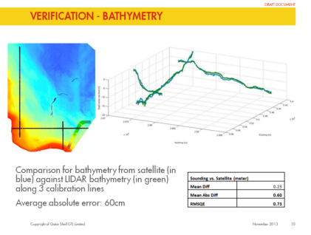
Shell Qatar Seismic Survey support
SBD for planning shallow water seismic campaigns
Client: Qatar Shell GTL limited
Challenge: Fast bathymetry survey to support seismic programs 740 sqkm offshore area to be mapped within 2 weeks.
Solution and benefits:
EOMAP physics based processing using Worldview-2 satellite data, generating a large area bathymetry map with excellent agreement to a multi-beam data set, which was limited to a single, localized area
Significant cost savings > 1 Mill USD
Project schedule efficiently supported
HSE risks mitigated
Recognized as key technology to aid
the planning and preparation
of seismic surveys
740 sqkm Qatar shallow water bathymetry survey, 2010.
doi:10.2523/17346-MS https://www.onepetro.org/conference-paper/IPTC-17346-MS
‘Supporting Qatar Shell with the execution of onshore and offshore seismic programs’ , IPTC conference 2014

Slide 19
Summary
Alternative solutions to the nearshore mapping of many areas are feasible
They will not always attain navigational charting standards
These solutions can also benefit non-charting (but related) agencies
An open minded approach can better serve a broader stakeholder group
Fugro-EOMAP’s partnership is new:
  We are aiming to combine Fugro’s considerable hydrographic survey expertise with EOMAP’s new and evolving satellite imagery technologies
  The integrated approach is still developing
  We are committed to ensuring that shallow and hazardous coastal waterways can be surveyed safely and even more efficiently
There are ways and means of improving initial results from SDB with iterative processes utilizing ALB full waveform algorithms and a ground-truth approach
There are ways and means of improving final coverage and data density which agrees within a reasonable tolerance for the benefit of many clients
Key is to quantify what we have and apply appropriate risk to the data usage

Slide 20

Thank You

