Slide 1
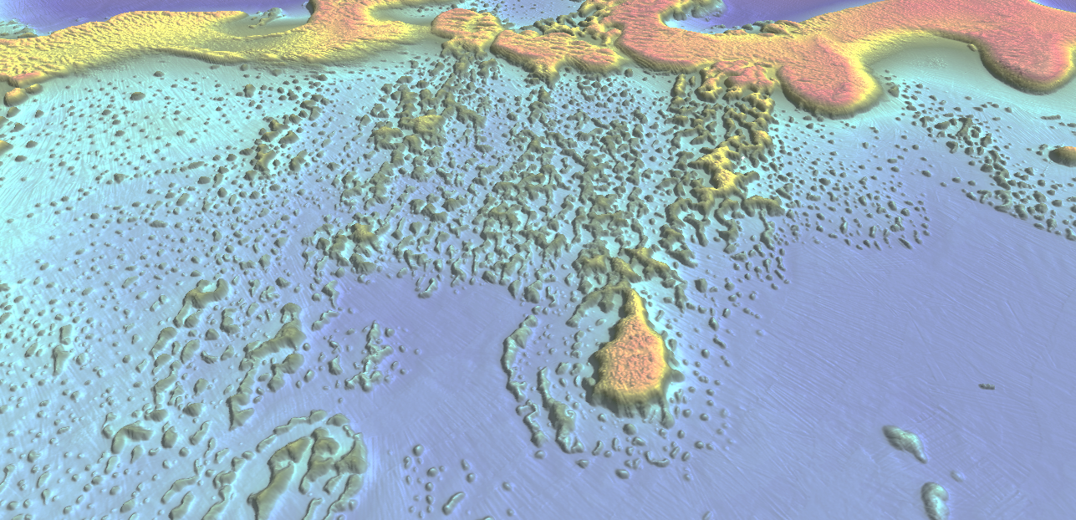
Challenges and opportunities surveying the UK’s remote Overseas Territories MACHC – December 2015 Sam Harper - Koen Vanstaen

Slide 2
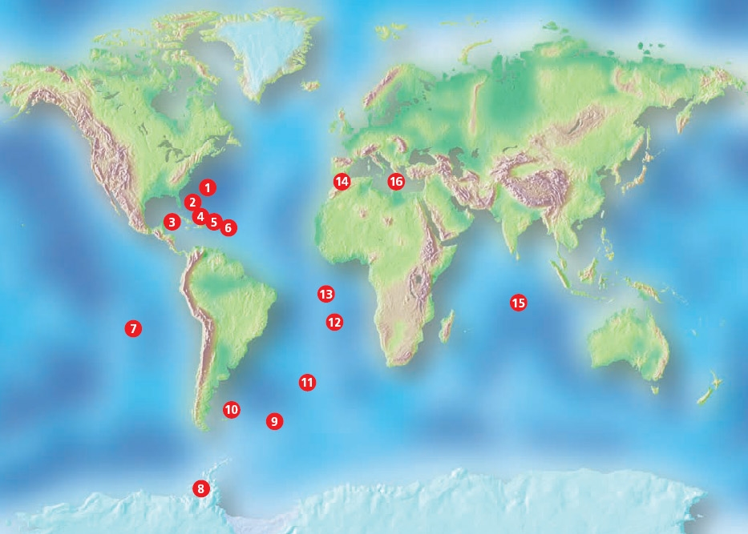
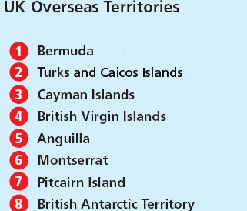
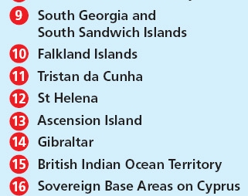
Notes:
These days the UK still has 16 Overseas Territories, located in every ocean around the word: the British Indian Ocean Territory in the Indean Ocean, Pitcairn in the Pacific and a large number spread across the Atlantic. Six of these territories are situated in the Caribbean Sea.
The vast majority of these Overseas Territories are isolated island nations, with an extensive EEZ. Compared the to UK’s EEZ which cover 700,000 square kilometres, the EEZ of all UKOTs cover 6,600,000 square kilometres.
These seas are really important to them, as often it is the main access route to bring supplied in and out of the country. The seas are a major source of food supply, and the clear blue waters and coastal scenery is what brings a lot of tourism to these places, which is a major part of the economy, or sometimes even the biggest contribution to the local economy.

Slide 3
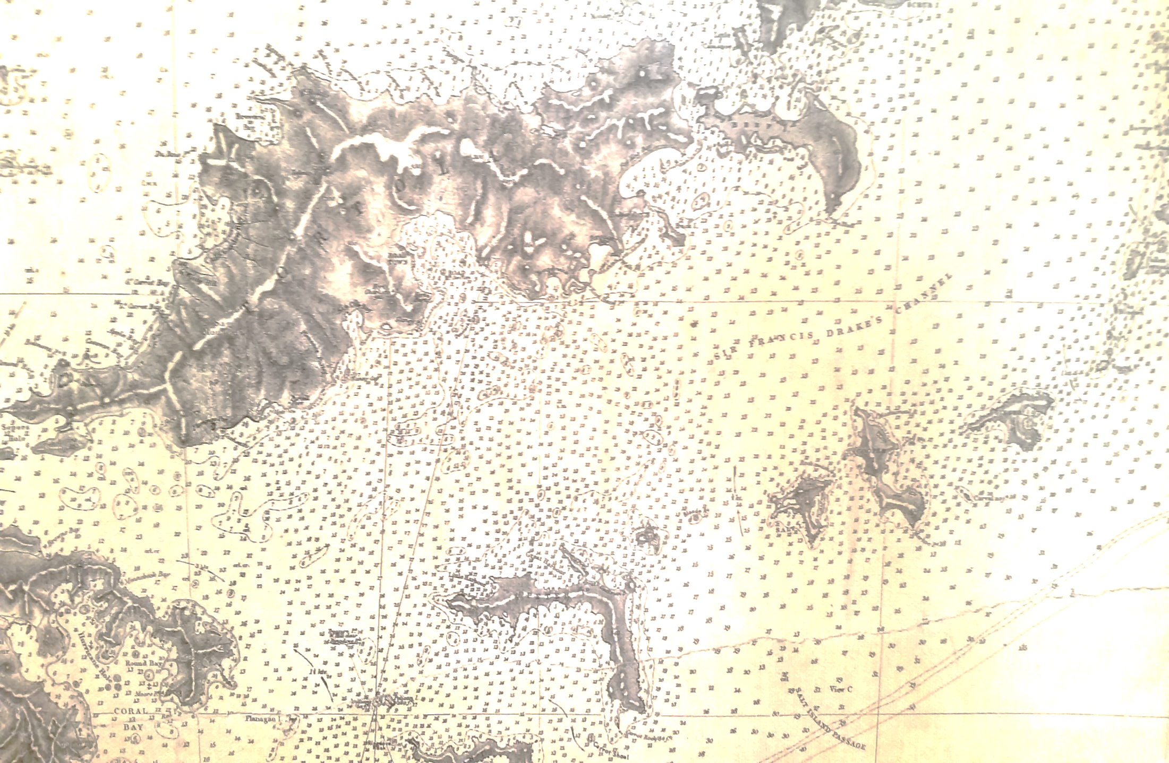
UKOT Hydrography
Majority are island nations
Hydrographic data of varying age
Often no modern surveys and no survey programmes
No local capacity and capability
Notes:
So the seas are really important, but the management of them has a few challenges.
For example, this chart is indicative of the underlying data of many modern charts across the UKOTs. A lead line survey undertaken by the Royal Navy between 1848 and 1952.
Mention what is on slides, but MACHC will of course be very familiar
And this isn’t just an issue from a purely hydrographic point of view, these areas are often situated in areas subject to natural disasters such as hurricanes, so good data help developing better plans to prepare for these events, and allows to monitor change in the environment.

Slide 4
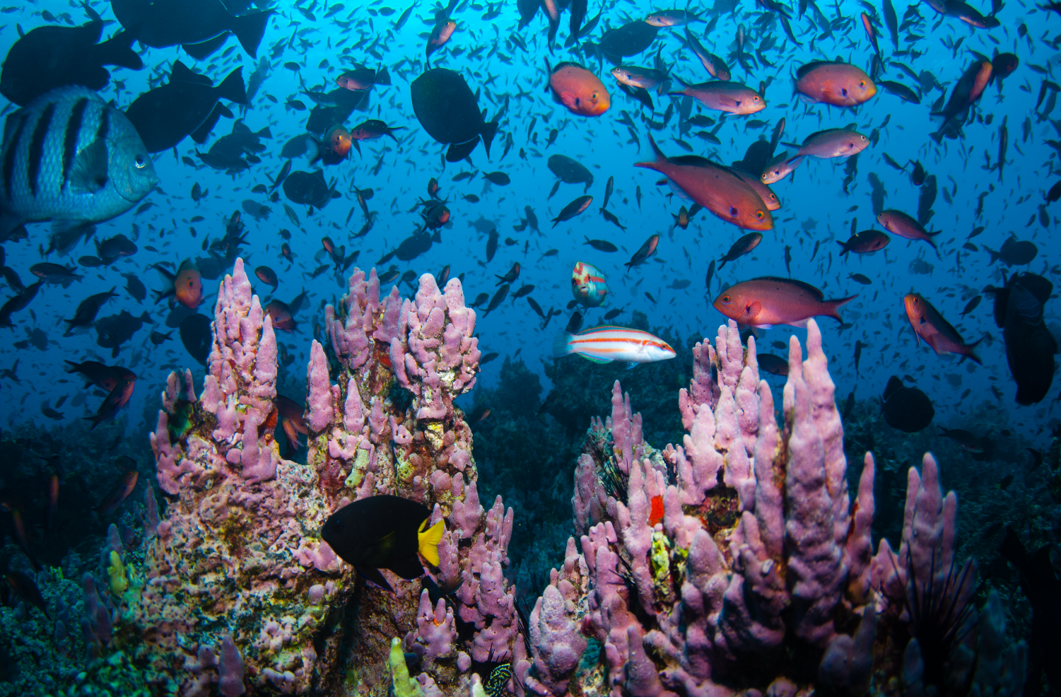
UKOT Biodiversity
Overseas Territories contain an estimated 90% of the UK’s biodiversity
Large parts of marine environment unexplored
Increasing human pressure threat to biodiversity and people
Responsibility for environmental management devolved to the UKOT governments
Notes:
The UKOT are also very well know for the rich and diverse underwater ecosystems, such as shown in this image.
It is often said that as much as 90% of the UK’s biodiversity, is actually in its Overseas Territories. As they are mostly small, oceanic islands, their biodiversity has evolved in isolation, resulting in a high proportion of endemic species, found nowhere else in the world. The 90% is mainly based on terrestrial observations, as marine observations are limited, often limited to shallow coastal areas. Many areas remain completed unexplored, and this lack of knowledge on which communities are present where, presents a real management challenge to protect them, especially with the growing human pressure on the environment from pollution to coastal developments.
So just as there is a lack of data on the hydrographic side, biodiversity data are often in short supply.

Slide 5
Collect once – Use many times
Maximise value of the survey
Applications for different end-users: from hydrography to environment
Bathymetry and backscatter
… and in a nice location
Notes:
To maximise the efficiency of any data collection, we were keen to collect as much useful data in a single survey as possible. This approach has been demonstrated successfully in the UK, where today surveys of Marine Protected Areas provide IHO Order 1a data as well as data suitable for habitat mapping.
This means conducting the survey in such a way that it doesn’t just meet IHO requirements, but also the needs of different end-users. Unfortunately, not every bathymetry data has good quality backscatter data, essential for habitat mapping.

Slide 6
Notes:
The reason why the BVI was chosen is illustrated by this map, based on data produced by MACHC. Of all the UKOTs, AIS density is highest around the BVI (see next slide). Hence when we received some funding, focussed our efforts to demonstrate the concept in that area.

Slide 8
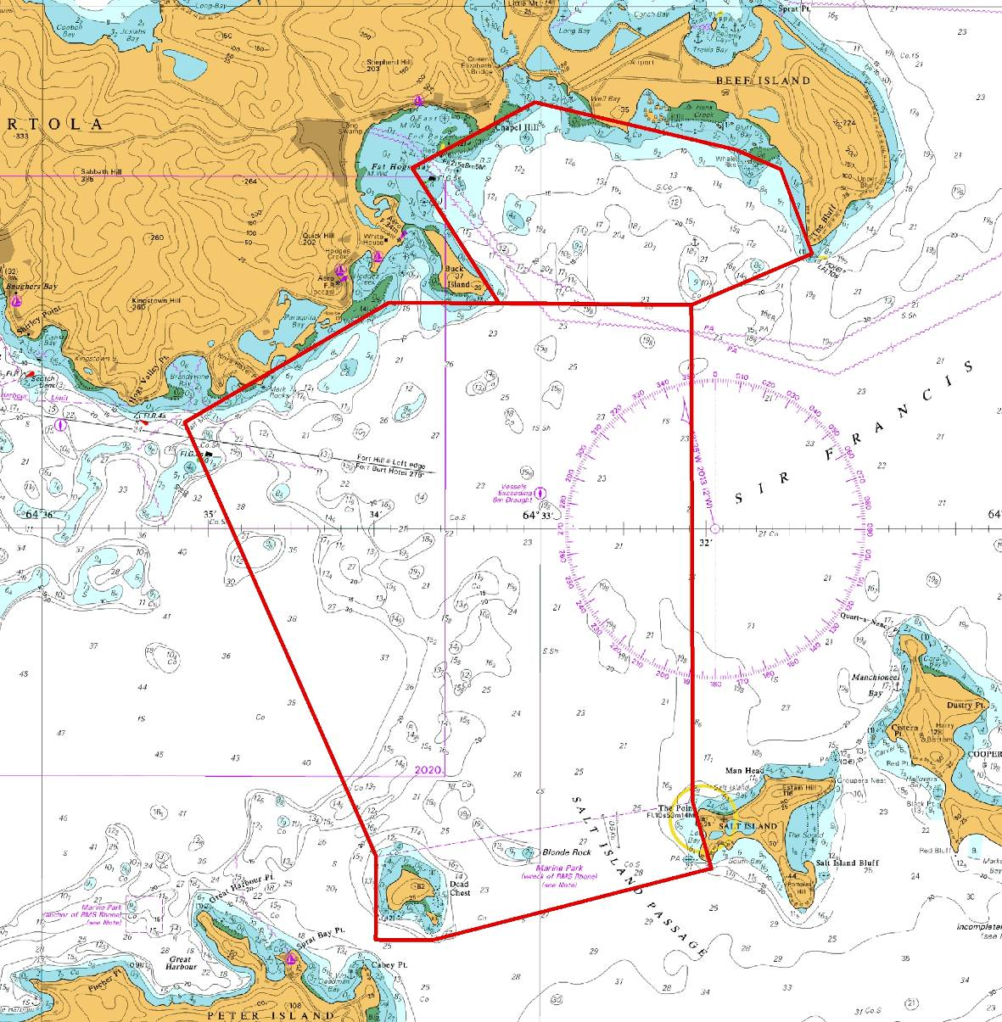
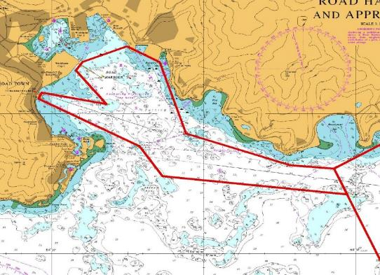
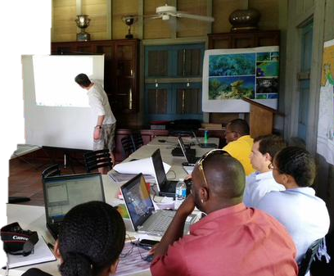
2
3
1
Notes:
The first step in the process was to work together with the large number of stakeholders, to identify an area that was of interest to all of them to demonstrate the concept. Stakeholders involved staff from National Parks Trust (project partners), Conservation and Fisheries Departments, Ministry of Natural Resources and Labour, Shipping Registry, Ports Authority, Department for Disaster Management and the Land Survey Department.
In the end these 3 priority areas were chosen. Area 1 because it covers the Rhone Marine Park to the south, an unexplored 40m channel in the middle of the area, and the approach to a yacht hurricane shelter area in the north. Area 2 was very much a fisheries interest, and area 3 is the approach to Road Harbour, the only port for shipping in and out of the BVI, and bringing thousands of cruise tourists a day to the BVI.

Slide 9
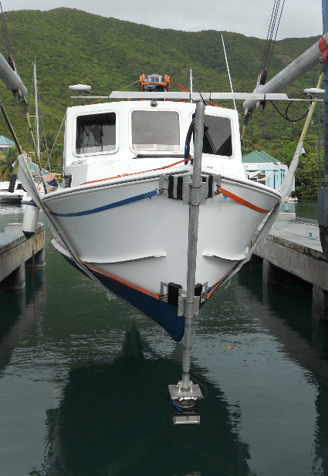
Notes:
The survey was undertaken in July-August 2014, over 25 days and covered 36km2. We used a local vessel, using equipment shipped from the UK.
Apart from tropical storm Bertha coming through, the survey went without problems,

Slide 10
Bathymetry
Backscatter
Bathymetry & Backscatter
Notes:
One of the challenges to make a survey multi-use, is making sure backscatter data are of good quality. Often people think that if you collect good bathymetry data, you get good backscatter data.. Unfortunately not…
The bathymetry requirements are very well defined in terms of needing to meet IHO criteria or country specific specifications. A few backscatter specific specifications have surfaced in recent years, but not always compatible with efficient bathymetry surveying (for example, some suggestions have been made only to use data between 20 and 40 degrees off nadir, requiring significant increase in line density, massive reducing survey efficiency from bathy point of view).
So the challenge is the find the compromise that delivers both good bathymetry and good backscatter data. It is a compromise, hence it isn’t excellent bathymetry and excellent backscatter.
So what is the compromise.
Spending some time prior to the start of the survey having a quick transit across the entire survey area to get some data from the range of substrate types and water depths, to find sonar settings that return good data in all areas. This means for example that the power is strong enough to return a signal from soft muddy bottoms, but not so strong that the backscatter data becomes oversaturated in areas with hard substrates.
Tweaking settings during a bathymetry can maximise survey coverage. But unfortunately changes in gain, pulse length, etc will affect backscatter data. Some of this can be compensated for afterwards, but the more we can avoid during the survey, the less can go wrong during processing.
Because of the above, running lines were closer than usual, as we also wanted to minimise infills, as these often create local variations and wiggly lines which can be slightly annoying when processing backscatter data.
A you need a surveyor who understands that there is more than bathymetry.
So overall, it is about spending a marginal amount of extra time, to make the survey fit for multi-purpose use. And of course, this marginal increase (say 5% extra time) is nothing compared to having to repeat the whole survey.

Slide 11
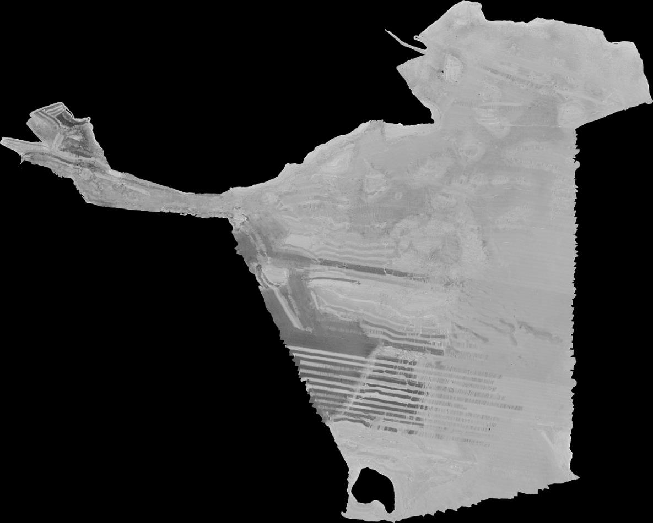
2
3
1
Notes:
So for this survey we did all of that, and ended up with this: still a bad backscatter mosaic. (point at the central western area with light/dark pattern from alternate lines.

Slide 12
2
3
1
Notes:
That issue on previous slide was a processing issue, and in the end the mosaic looked like this. And nice backscatter map, showing the harder grounds to the west, and various features throughout the area, which could be used to inform the habitat mapping work (and probably would also make it easier to inform seabed type composition for charting)

Slide 13
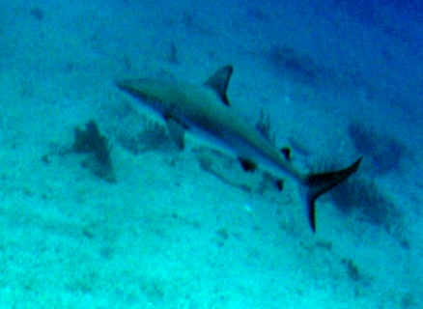
Notes:
In the next step we collected video and stills photographs across the area. Over 5,00 underwater images were collected at 64 stations, with some eaxmples shown here. Habitats ranges from seagrass (top left) to soft coral communities (bottom left) and various rays and sharks were also observed.
The combination of this data, together with the hydrographic data really allowed us to tell a few stories, which is where the collect once use many time really comes to life

Slide 14
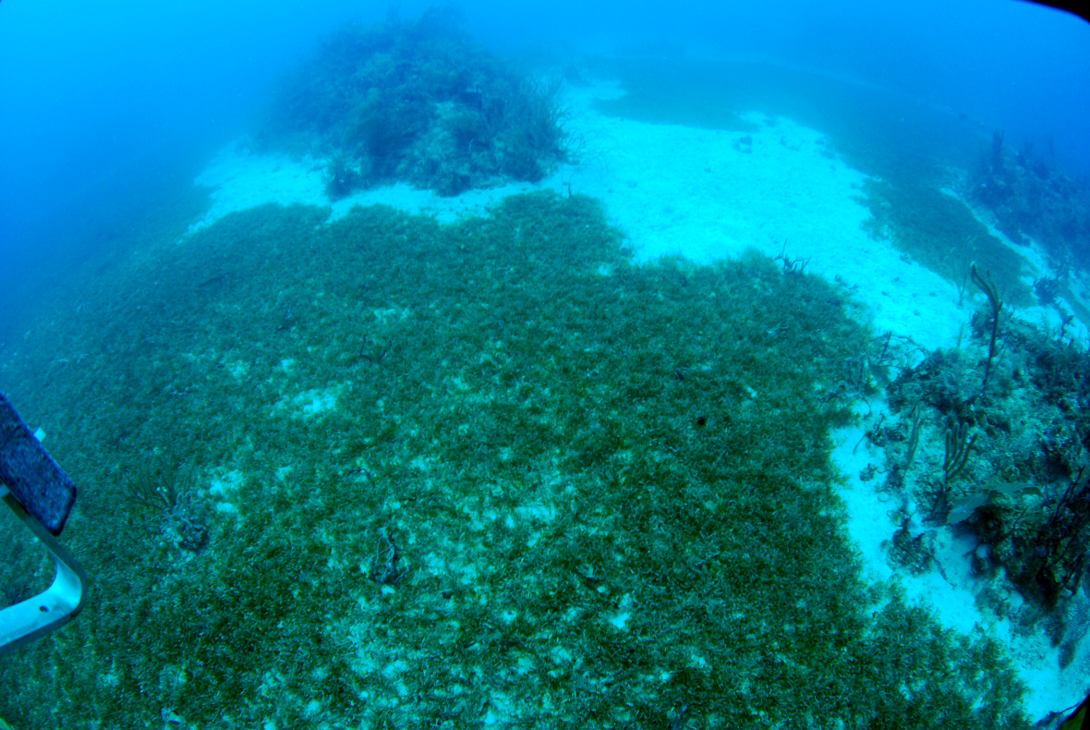
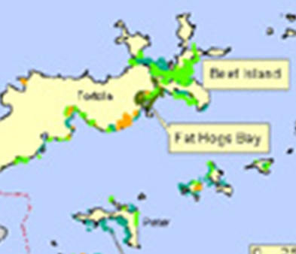
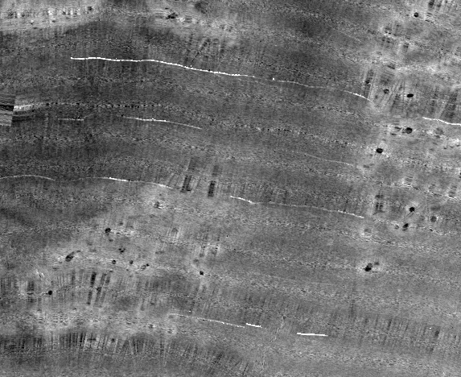
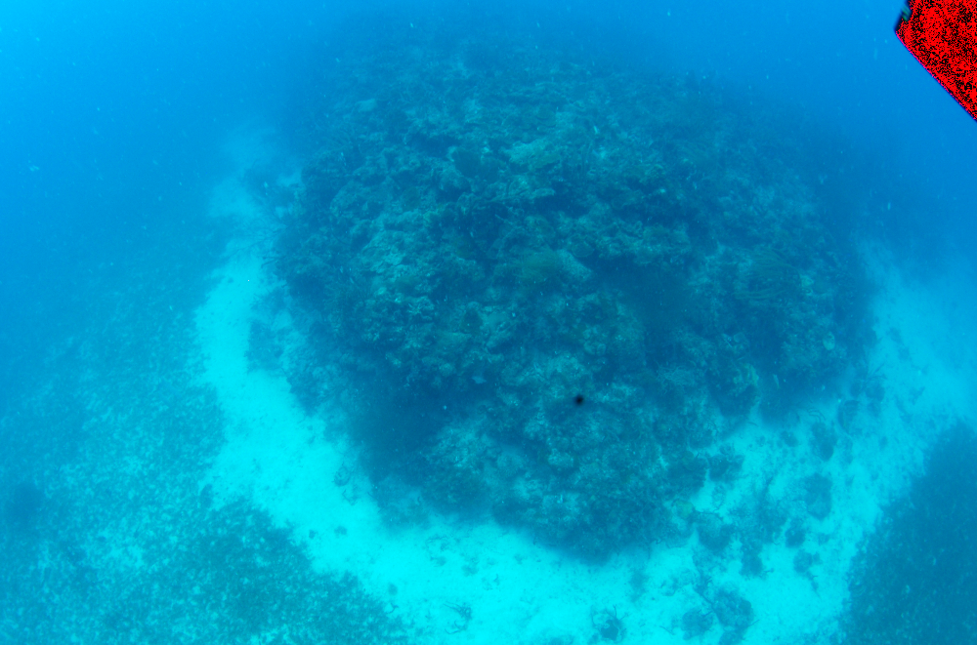
Notes:
For example, the underwater imagery showed coral bommies, surrounded by clean sand, and then seagrass. This is exactly the same as what we saw on the backscatter: the back dot (coral bommie), with a halo of light grey, and then dark grey backscatter. This allowed us to map the distribution and extent of seagrass beds. And if you know that seagrass is 35 times more efficient at storing carbon than rain forests, you understand the important role they play. We also found that previously seagrass had only been known to exist in coastal waters, but we found widespread presence in deeper waters, increasing coverage by 800% within areas surveyed.

Slide 15
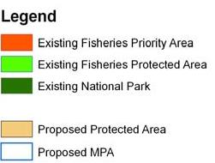
Notes:
Another example is from a fisheries management perspective. Hans Creek is locally important for commercial fisheries. A fisheries protected area was established in the past (green area) but more recently proposals were made to extend this. Without further data, the area was extended, but our data shows that the area misses many of the reef features, which will be important to these fish communities. So the data allowed to make more informed decisions in terms of protection, but will also inform future fisheries assessments

Slide 16
Notes:
And another example is this, where we observed a scar on the seabed, leading towards a coral bommie and taking a large chunk out of it. This area has a lot of this type of features, as on the chart it shows as a pilot boarding area. Just to the east and west of this area, data revealed seabed without coral bommies. Because previously we didn’t know what lied beneath, no-one knew this was having this kind of impact.
With the BVI becoming increasingly popular with mega-yachts, anchoring at night or day, there is growing recognition that they need to be better informed of the nature of the seabed in these popular anchoring areas, to avoid increasing unintended damage to the precious coral reefs.

Slide 17
Opportunities
Hydrographic surveys → Seabed surveys
Single-purpose to multi-purpose
Multiple stakeholder needs
Economic growth with minimal environmental damage
Notes:
From hydro surveyor to seabed surveyor
Doing more in one survey will make it cheaper
It is easier to get money for joined up survey, but harder to do the survey
Reinvent wheel for each new system etc
Backscatter guidelines good, but still big gap before collection
Shep smith mentioned on first day, need to better realise added value!

Slide 18
Acknowledgements
Darwin Initiative: UK Government scheme to protect biodiversity and the natural environment through locally based projects worldwide or Overseas Territories
DPLUS026: British Virgin Islands Marine Protected Areas and Hydrographic Survey Capacity Building
John Fraser and Pim Kuus - Reson UK – T20-P
QPS, Caris, Triton Imaging
Notes:
Say realisation that need for hydro data shouldn’t be looked at in isolation, received bit of funding
Mention in Caribbean

