Slide 1
Improving the Convenience of Ancillary Sensors for Hydrographic Survey Operations Kevin Wilson - AML Oceanographic

Slide 2
AML: Who We Are
Manufacturer of subsea instrumentation and sensors
Located in Sidney, BC (near Victoria on Vancouver Island)
Established in 1974
Worldwide network of agents and resellers
Hydrography
EDC
Dredging
Oceanographic applications

Slide 3
What are we known for…
Sound velocity probes and profilers
Time-of-Flight SV
Fast-response CTD
CTD, dissolved oxygen, turbidity sensing for vertical profiling or in-situ deployment
Environmental monitoring / science and research
Swappable Sensors (Xchange)

Slide 4
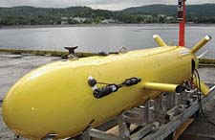
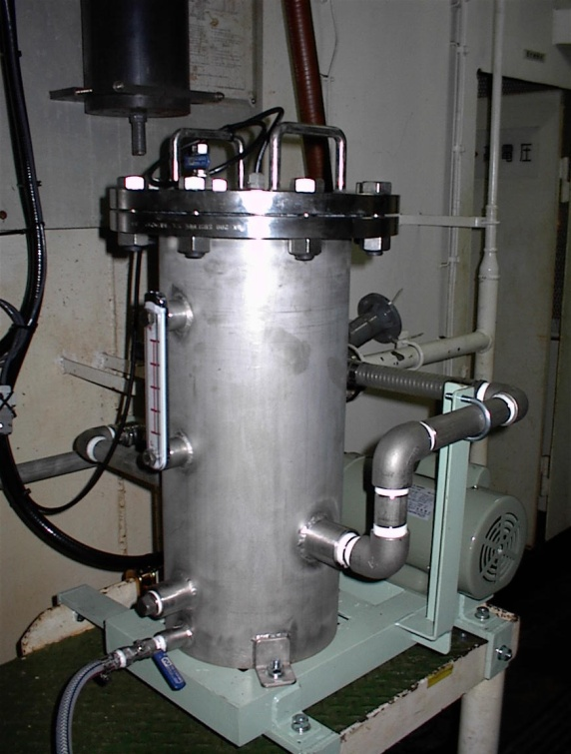
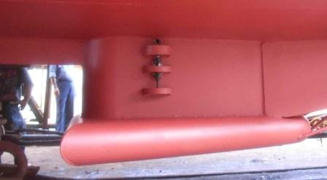
Real-Time Instruments

Slide 5
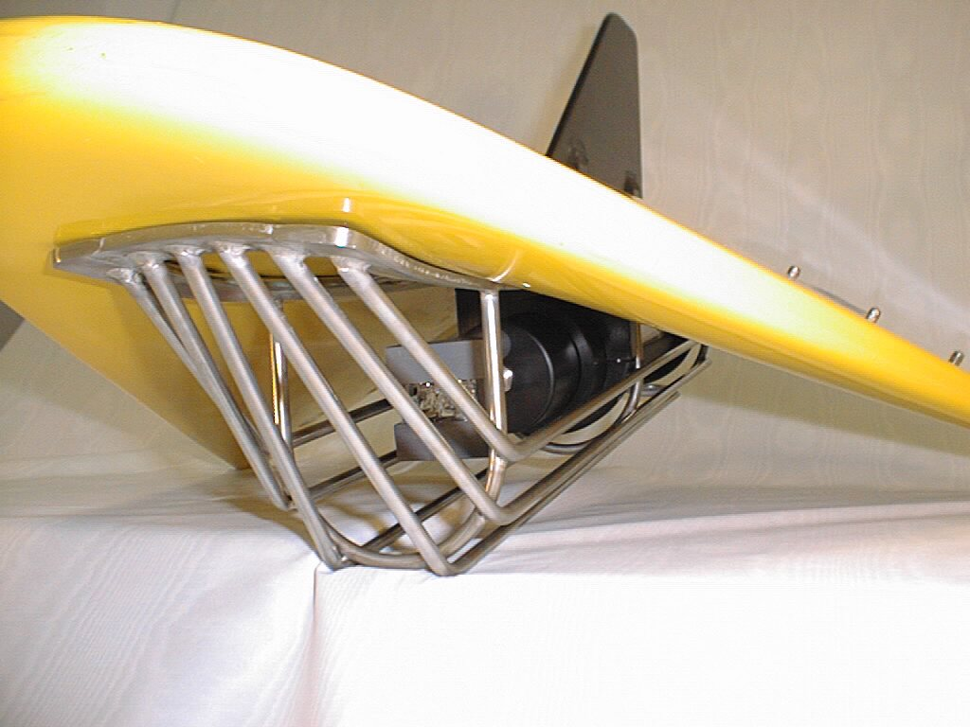
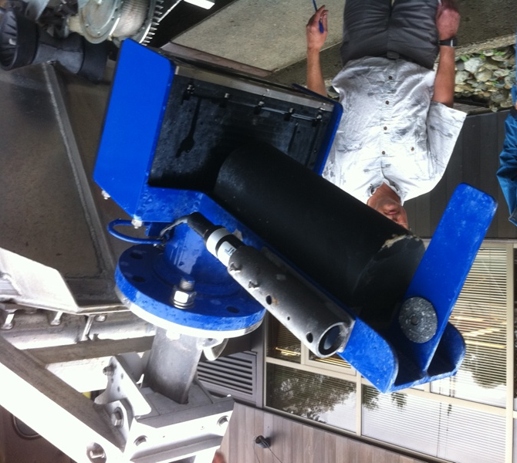
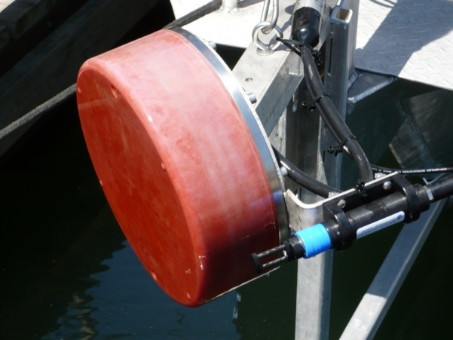
Real Time Instruments

Slide 6
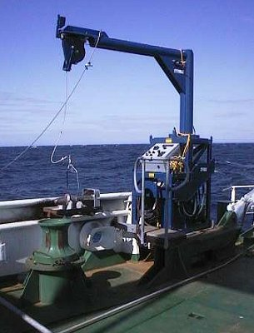
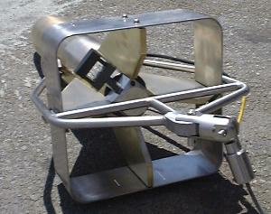
OEM Integrations

Slide 7
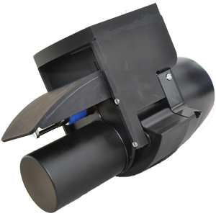
OEM Integrations

Slide 8
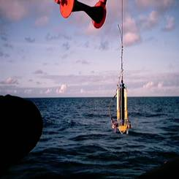
Logging Instruments

Slide 9
New Ideas in Instrumentation
Modular approach to oceanographic instrumentation, with two key elements:
X•Series Sensor Xchangeable instruments
XchangeTM field-swappable sensor heads

Slide 10
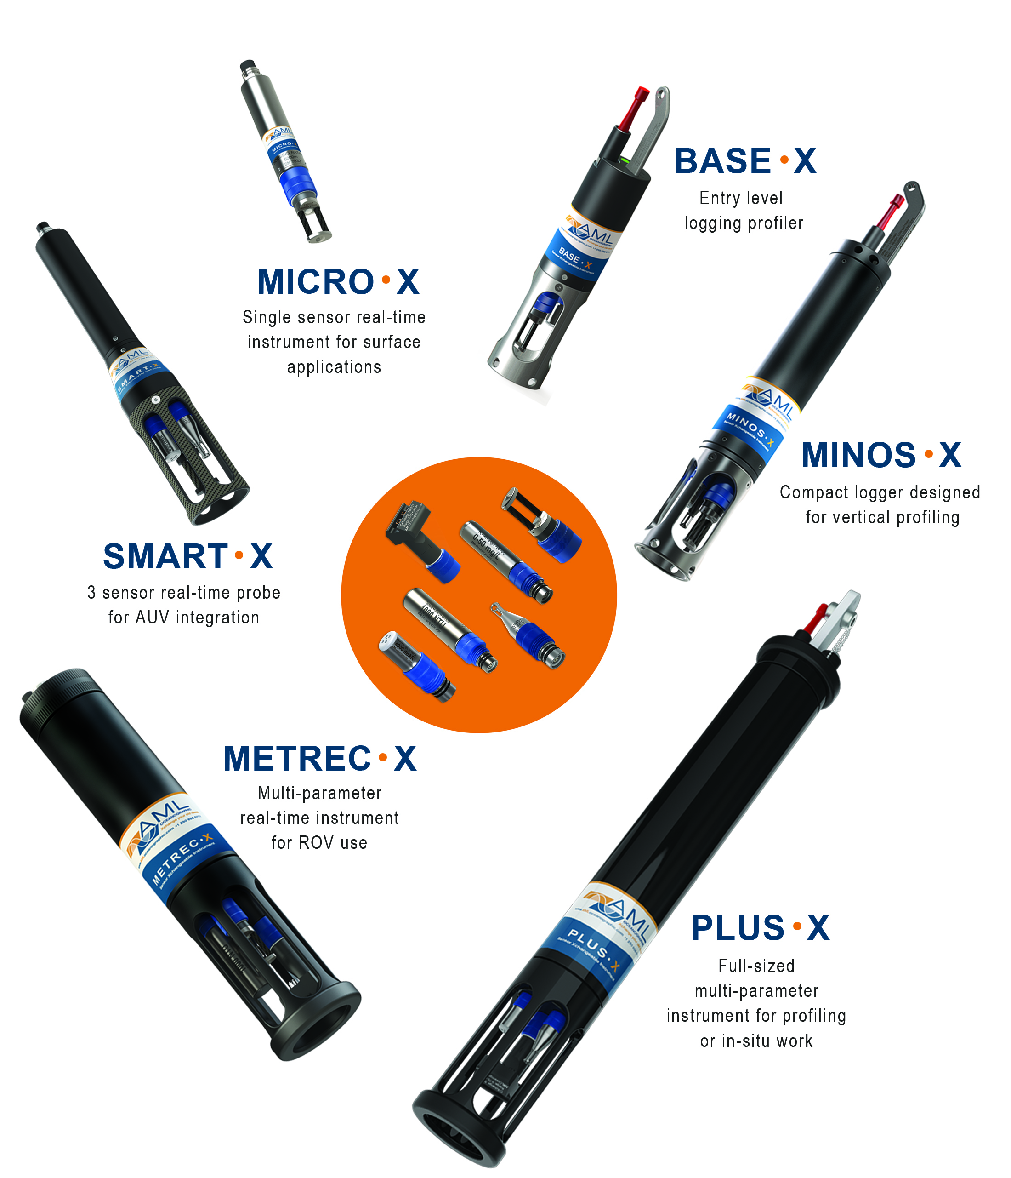
AML Approach
Family of oceanographic instruments and sensors
Sensors are swappable and interchangeable with other instruments
Sensor heads are calibrated independently

Slide 11
XchangeTM Sensor Heads Turbidity•XchangeTM, T•XchangeTM, SV•XchangeTM, P•XchangeTM, C•XchangeTM, DO•XchangeTM

Slide 12
What does this mean?

Slide 13
Why we did it..
Elimination of instrument downtime
Reduction in transportation and logistics costs (sensor calibration)
Lower cost for instrument redundancy on the vessel
One instrument – many applications
Improved quality control
More CONVENIENT!

Slide 14
Data•Xchange
Automated wireless data transfer
Remote instrument management
GPS cast positioning
Save time and wear & tear
Notes:
Download process cumbersome
Happening as instrument travels
Leverage advanced capabilities and communication
Not just sound velocity

Slide 15
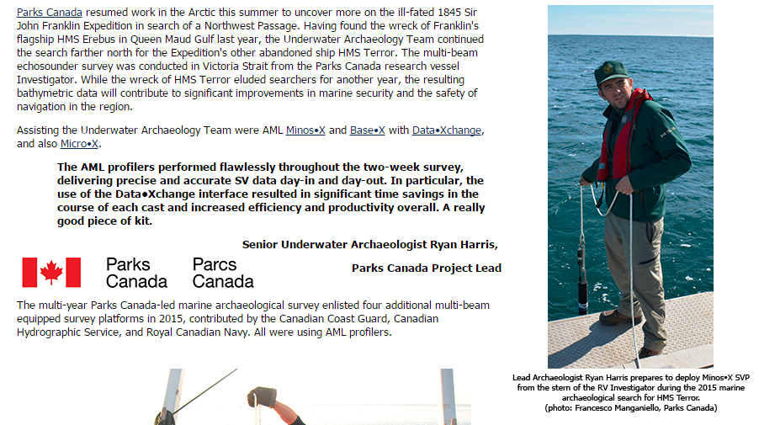
Notes:
Download process cumbersome
Happening as instrument travels
Leverage advanced capabilities and communication
Not just sound velocity

Slide 16
Short Video…
Notes:
Download process cumbersome
Happening as instrument travels
Leverage advanced capabilities and communication
Not just sound velocity

