Slide 1
SATELLITE DERIVED BATHYMETRY
Coastal mapping update

Slide 2
The Requirement
UN General Assembly Resolution on Oceans and Law of the Sea (2003):
IHO and IMO invited to continue their efforts “to increase the coverage of hydrographic information … especially in areas of international navigation …and where there are vulnerable … marine areas”.
Notes:
Vast areas with a poor knowledge that could do with an upgrading.

Slide 3
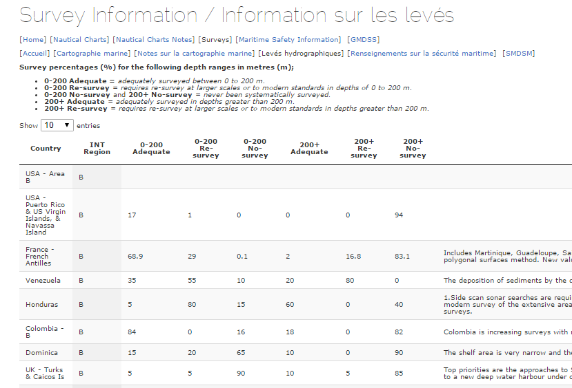
The sorry state of unexplored shallow waters
(example of C-55 Region B)
Notes:
C-55 reveals high rate of re-survey or no-survey in region B

Slide 4
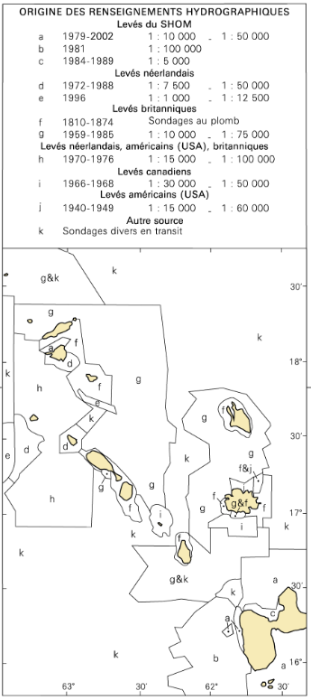
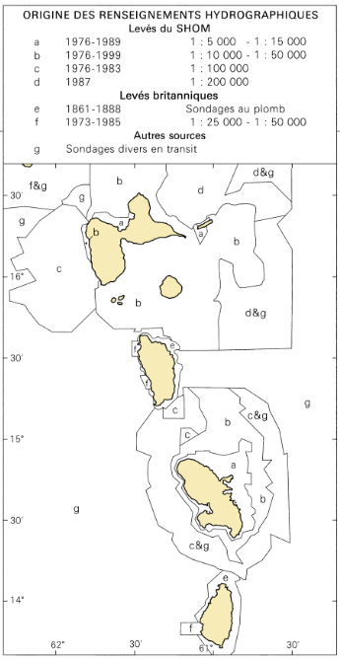
A source diagram in region B(2015)
INT Chart 4182
INT Chart 4184
Notes:
Some areas never surveyed since 19th century lead soundings.

Slide 5
What is Satellite Derived Bathymetry (reminder)?
A survey method founded on analytical modelling of light penetration
…that can yield useful and inexpensive depth information in shallow water (< 30 m) in poorly surveyed areas
but still with uncertain compliance with IHO S-44
Notes:
5

Slide 6
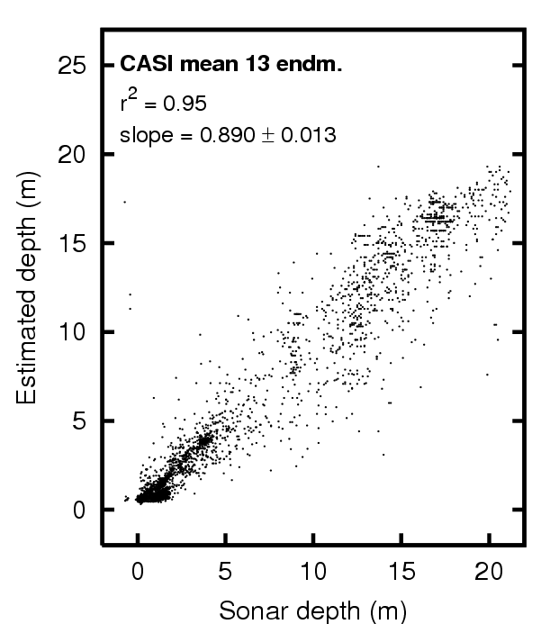
The two methods of SDB
1. In the Empiric method (Lyzenga 1978), based on the exponential attenuation of radiance, the model is warped to match in-situ measurements:
Z = A.ln(V₁-V_{1inf}) + B.ln(R₂-R_{2inf}) + C
Depth
Green
Red
2. In the Physics-based method, depths are obtained by inverting the equation of radiance received by sensor:
sensor
Courtesy
Dr John Hedley
Sensor receives this
Depth
⇨ The Physics-based method is more robust & reliable, and (in theory at least) no longer depends on ground control.
Published: Hedley & al. 2011, Remote Sensing of Environment 120, 145-1550, 145-155
Notes:
The empiric method where the aim is to assess the coefficient in a law that links Z to radiance in visible bands.
For this one needs ground truth for calibration. Outside groundtruth, Z is an extrapolated estimation.
The physics based method which is an inversion of the physic law that links the radiance to the environment (depth absorption, scaterring, reflectivity).
It uses all the points of the image, ground truth can help but you can do without.
6

Slide 7
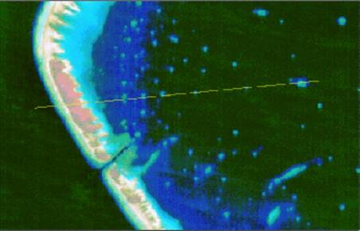
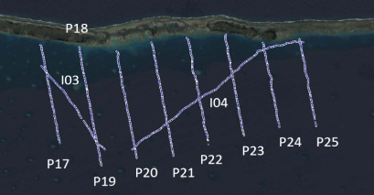
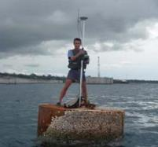
SDB early processing (Lyzenga 1978)
Needs survey lines and control points
One image calibrated at a time - Generalisation uncertain
Notes:
Need of ground truth for calibration.
7

Slide 8
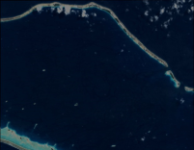
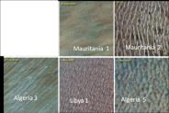
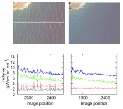
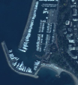
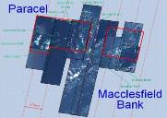
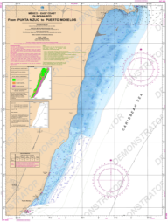
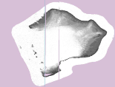
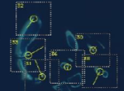
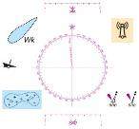
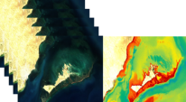
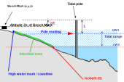
The 12 steps of SDB processing
Courtesy ARGANS Ltd.
3
2
2
4
Selection of scenes
Radiometric calibrations
Deglinting
Atmospheric corrections
Spectrometric calibrations & LUTs
Inversion (ALUTs & bathymetric modelling)
Orthorectification
LAT reduction
Mosaicing & co-registration
Validation & diagram of uncertainties
NDVI coastline, masks & topography
Production of chart
5
1
6
12
7
11
10
9
8
Notes:
On the 12 steps of SDB step 5 and 6 are specific to physics based method. Step five is spectrometric calibration that provides look-up table and step 6 is the inversion method that resolves
8

Slide 9
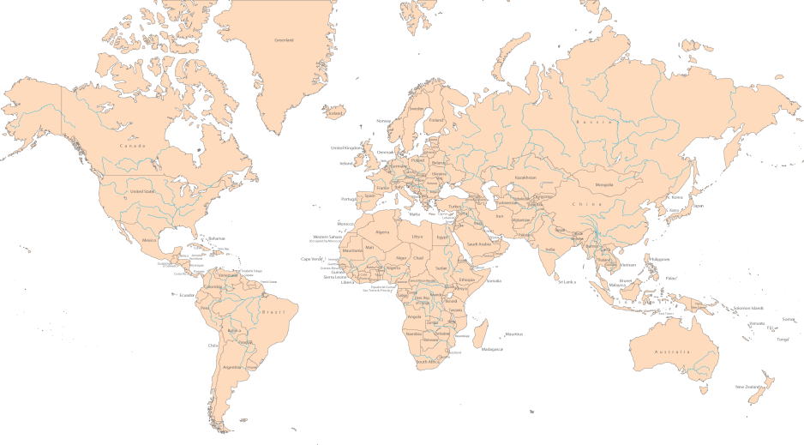
SHOM latest tests of physics-based method
The series of test were conducted together with a renowned British Physicist, expert in radiance inversion, and a major ESA player specialised in satellite calibration and validation
Geyser Reef
(next)
Tahanea atoll
Ouvea
Loyalty Is.
Notes:
Palyground for SDB.

Slide 10
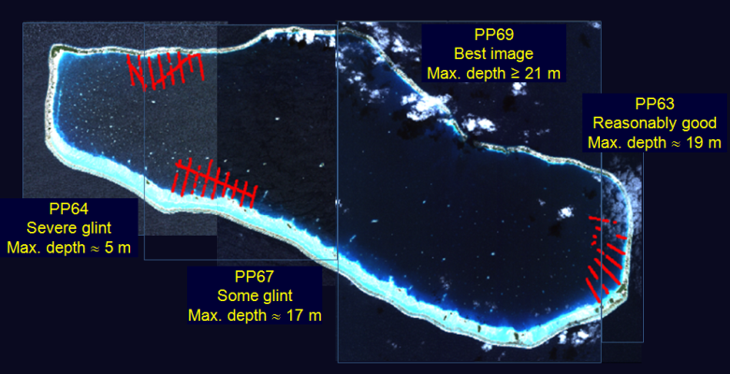
Model performances highly dependant on quality of images
Same atoll, 4 Pleiades images, 4 different valid depth ranges
Optimal performances require High Resolution images and suitable environment (wind, glint, current, sun, turbidity….)
Notes:
10

Slide 11
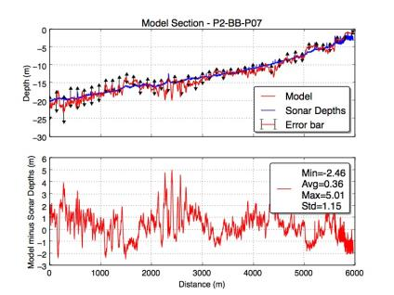
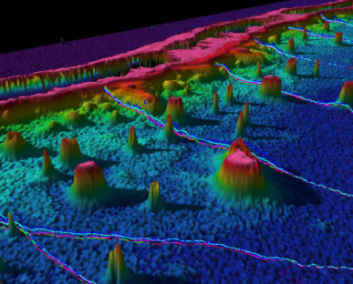
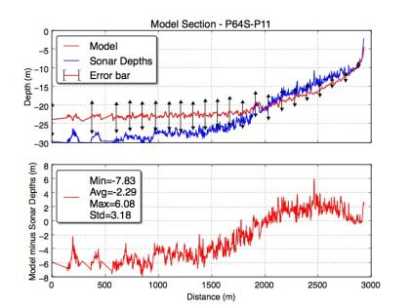
SHOM findings
Good satellite image: the Hedley model and its error bars are consistent with the survey depths down to 25 metres
Physics-based model is best although S-44 orders 1 and 2 are well out of reach.
Poor satellite image: the Hedley model and sonar survey split at around 12 metres while the module of error bars increases significantly
Physics-based model v. SBES
Notes:
11

Slide 12
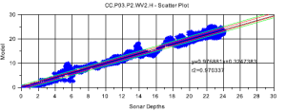
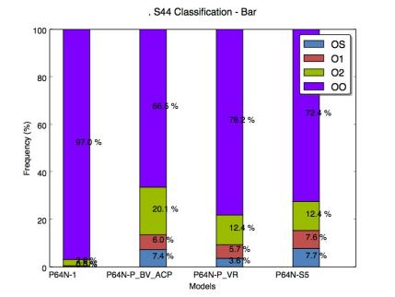
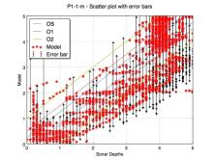
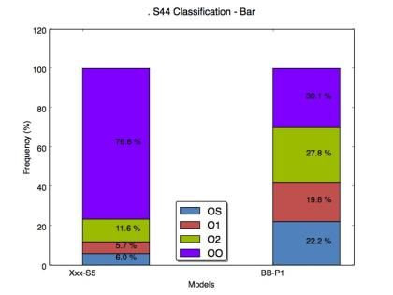
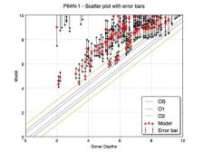
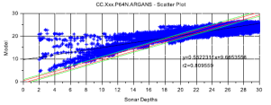
Physics-based model against S-44 Compliancy
Best image out of 6: ≈ 70 % compliant
Lyzenga
Hedley
Worst image out of 6: ≈ 28 % compliant
Notes:
Possible to bench between different models. For a considered model it is also possible to bench for different sets of depth ranges. SHOM did it ➔ for now, there is a not a depth range that makes it possible to give a S-44 classification.
Très lié qualité images.
12

Slide 13
Further developments & foreseeable improvements
Validation of the Physics-based method against MBES / lidar / hyperspectral HR surveys (Indian Ocean – 2016).
Implementation of semi-automated data cleaning & decimation tools.
Thorough comparison with S-44 orders of precision.
Tests of image stability using co-registration.
Courtesy Groupe ACRI
Notes:
13

Slide 14
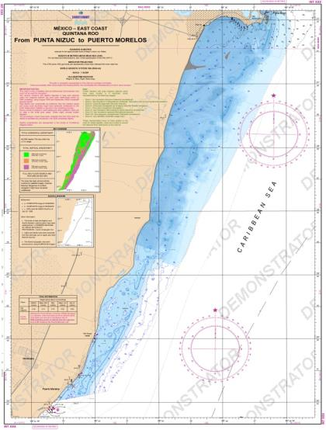
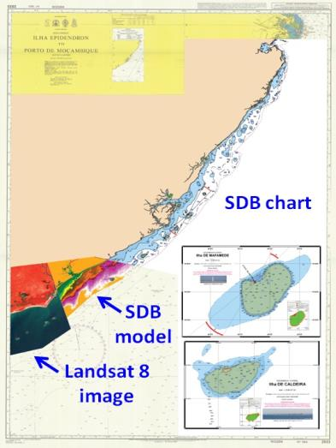
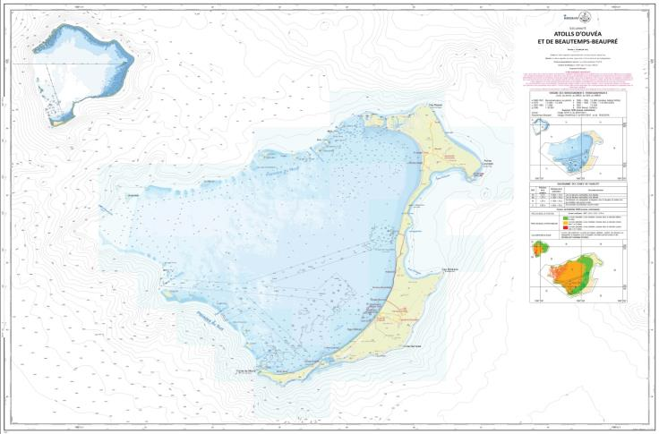
Demonstrators projects
Mozambique – WWF & ESA/ GECOMON Project.
Mexico - ESA ECOSERVE Project
Courtesy ARGANS Ltd.
Ouvea, Loyalty Islands
SHOM Bathysat Project
Courtesy ARGANS Ltd.
Notes:
From the beginings fielsheets based on Lysenga to physic based models + bar errors
14

Slide 15
SDB Processing
Cost of satellite images: anything between € 0 and € 50 per sq. km, depending on quality (approx. figures):
SATELLITE | Spatial Resolution (m) | Cost per sq. km (€)
Quickbird | 0.6 to 2.4 | 22
Pleiades | 0.5 to 2 | 5
TerraSar-X | 1 to 3 | 2.64
WorldView2 | 0.5 to 2 | 14 to 60
RapidEye | 5 | 0.95
DMC | 22 to 32 | 0.02 to 0.12
Sentinel 2 | 10 to 60 | Free of charge

Slide 16
Costs & Effective performances*
In very shallow waters < 10m
 | Acoustic (EM 2040) | Lidar (CZMIL) | Satellite (Pleïades XS)
Survey (k€ per sq. km) | 2.5 | 1.5 | 0.01
Duration (hour per sq. km) | 7 | 0.08 | 0
Processing (hour per sq. km) | 21 | 4 | 3
Total Cost (k€ per sq. km) | 3.3 | 1.7 | 0.1
Total Duration (hour per sq. km) | 28 | 4 | 3
*Rough estimates

Slide 17
Conclusions
SDB can help filling the world’s charting gaps at reasonable cost.
SDB has great potential in the MACHC environment.
There is no ideal technique that can do everything: SDB is very cost effective for first guess and global picture, Lidar and/or MBES is needed to focus on areas for high accuracy.

Slide 18
SATELLITE DERIVED BATHYMETRY
Coastal mapping update
Any questions?

