Slide 1
Update
IHO MSDIWG

Slide 2
MSDIWG ToRs
1. Objective
Support the activities of the IHO related to Spatial Data Infrastructures (SDI) and/or Marine Spatial Data Infrastructures (MSDI).
2. Authority
This Working Group (WG) is a subsidiary of the Inter-Regional Coordination Committee (IRCC). Its work is subject to IRCC approval.

Slide 3
MSDIWG ToRs
3. Procedures
The WG should:
3.1. Monitor (...) SDI activities and trends, and present information on those activities to IRCC members.
3.2. Promote the use of IHO standards and member state marine data in SDI activities.
3.6. Identify and recommend possible solutions to (...) technical issues related to interoperability between maritime and land based inputs to SDI.
3.8. Develop a syllabus for MSDI familiarization.
3.10. Submit a report annually to IRCC.

Slide 4
MSDIWG membership of MACHC region
Brazil Nickolás de ANDRADE ROSCHER
Cuba Ramón PADRÓN DÍAZ
France Stephanie VRAC
Netherlands Ellen VOS (Vice-Chair)
UK Edward HOSKEN
USA (NOAA) Lucy HICK & Maureen KENNY
USA (NGA) John W. VONROSENBERG & Sebastian CARISIO
CARIS Paul COOPER
ESRI Rafael PONCE
OceanWise Mike OSBORNE & John PEPPER (Secretary)
IHB Alberto COSTA NEVES

Slide 5
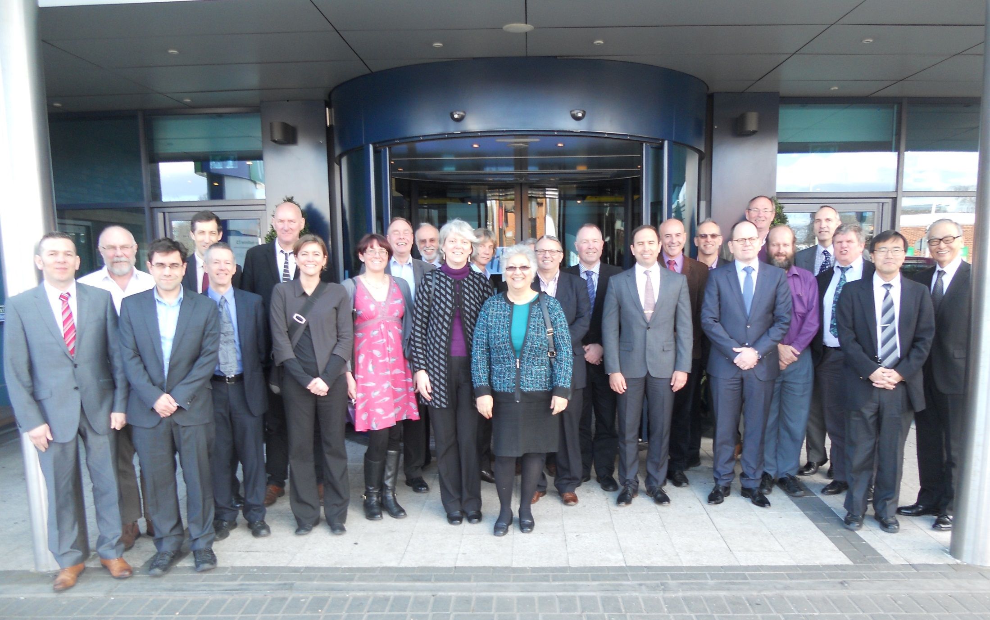
MSDIWG 2015 meeting

Slide 6
MSDIWG 2016 meeting
Tokyo, Japan:
MSDI Demonstration Workshop: 25 January
MSDI Open Forum: 26 January
MSDIWG7: 27-29 January

Slide 7
MSDIWG IRCC7 report
Remaining HSSC Actions:
Develop content for an Introduction to MSDI training course.
Consider the impact of UN-GGIM initiative on MSDIWG.
  MSDIWG contributed to “A Guide to the Role of Standards and Geospatial Information Management”

Slide 8
MSDIWG IRCC7 report
Seeking greater understanding of MSDI
Education: HOs to engage in sharing, exchange of information and experience, etc.
Application sent to CBSC-13 to deliver an MSDI training course

Slide 9
MSDIWG IRCC7 report
Towards Data Centricity
  Data custodian vs product producer
    Output focused on products rather than data
  Loss of potential
    Fraction of data collected is passed to users
  MSDI requires data in generic format
    not a particular product for a user group
  S-100 for e-navigation
    Still not ready

Slide 10
Some IRCC7 responses
Decision 20:
IRCC noted the establishment of the MSDI training
syllabus by the MSDIWG
Action 48:
RHCs to consider nominating regional representatives
on the MSDWG
Action 49:
MSDIWG to present examples of best practice MSDIs
at IRCC8.

Slide 11
Some IRCC7 responses
Action 67:
prepare supplement/additional chapter (…) to
C-17-Spatial Data Infrastructures: “The Marine Dimension” - Guidance for Hydrographic Offices
to provide guidance on (…) access to (…) data (…) collected for commercial or scientific purposes.

