Slide 1
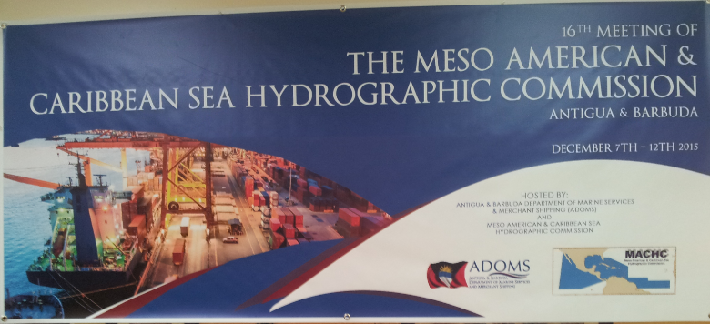
Managing Hydrographic and Oceanographic Information
for
Maritime Spatial Data Infrastructure
Derrick R. Peyton, Ed Kuwalek
IIC Technologies
Kian Fadaie
Canadian Hydrographic Service
Slide 1/78

Slide 2
Managing Hydrographic and Oceanographic Information
for
Maritime Spatial Data Infrastructure
SDI and MSDI Definition and Discussion
Canadian MSDI Project Phase I
Project Challenges
Phase II Marine Cadastre
Take Home Messages

Slide 3
SDI and MSDI
Spatial Data Infrastructure (SDI) emphasizes “unlocking” all of the geospatial information so it can be better utilized by all interested parties. The concept encompasses the hardware, software and system components required to support the integrated management and interoperability of spatial data, including the processes, standards, policies and structural relationships of all those involved.
Marine Spatial Data Infrastructure (MSDI) embraces marine geographic information. MSDI programs require the hydrographer to expand the data offering to include other types of data such as oceanographic information.

Slide 4
Approach to MSDI
A suggested approach to structuring hydrographic and oceanographic for MSDI deployment consists of three core elements;
use of internationally recognized and adopted standards,
the establishment of a technical infrastructure to allow the discovery, viewing, and potentially, the download of the information, and
the capturing of comprehensive metadata to describe the content, value and limitation of the data which is essential for effective discovery of information of interest.

Slide 5
Canadian MSDI Project Description
Two Goals…
To provide ‘data discovery’ of the geospatial datasets by visualizing their boundaries and providing a summary of their contents by creating detailed metadata in a standardized format and publishing to a web-based application or “web app”.
To populate the web app with the feature level data, basically ingesting each dataset and making its entire contents available for viewing and query at the base “feature level”.

Slide 6
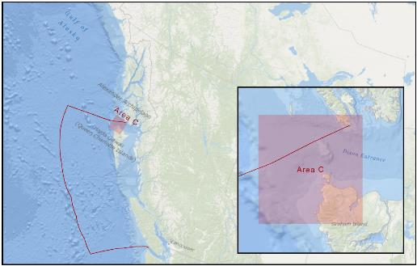
Dixon Entrance MSDI Location

Slide 7
Meta Data Collection (Discovery)
A metadata template was created based on
ISO 19115 and
the Harmonized North American Profile (HNAP) and populated with all the information that could be extracted from the supplied data.
While the ISO 19115 standard defines an extensive set of metadata elements (over 300), a small subset were considered essential for every dataset to have. These elements are referred to as core metadata elements and the metadata template aimed to capture them accordingly.

Slide 8
Web App
The ArcGIS Online service was selected since it was readily available and immediately able to showcase the potential of a deployed system.
Showcase both catalogue and feature level functionality. The catalogue shapefile was loaded into ArcGIS Online. In addition, the actual datasets were converted into shapefile, feature type by feature type, and loaded into the system.

Slide 9
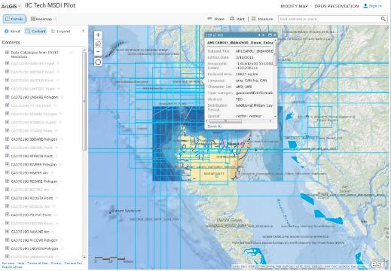
Web App

Slide 10
Project Challenges

Slide 11
Capturing Consistent Metadata
Although some metadata software tools exist to assist with collection.
they are often built into larger GIS tools or various geo-portals
don’t support proper validation other than checking for structural compliance with the ISO 19139 schema.
To overcome issues of capturing consistent metadata, a XML metadata template was developed that was compliant with ISO 19115 and XML authoring tools were used to capture the required data discovery metadata. This process was still a challenge as some basic information was frequently not available and manual XML authoring can be time consuming and error prone.
Approach
This situation not only highlights the need for access to quality metadata-authoring tools with integrated, rules based validation, but also the need to have metadata information present when datasets are exchanged for any reason.

Slide 12
Data Formats and Content
The diversity of data frequently used in marine domain makes it difficult to handle many distinct geospatial dataset types using one common platform.
Most mainstream software solutions typically support a handful of the most common formats effectively forcing the system designers to develop complex data migration routines and/or new data models capable of supporting any additional requirements. This is both domain knowledge demanding and time consuming.
Approach
This aspect should typically be covered extensively during the initial system requirements gathering and system design stages to prevent any surprises after the system deployment.

Slide 13
Data Visualization Challenges
The vast quantity of data, and different types of data, that can be made available in an MSDI leads to the potential of screen clutter, system speed, and data visualization issues, all of which negatively affect data discovery.
Approach
Provide robust filtering tools so the user can search/display only the relevant types of data that will potentially be of interest.
Do not have feature level data within the catalogue viewer itself, and just display the geographical extents and other metadata for the types of data that the user is searching for.
Keeping the MSDI visualization as simple as possible while ensuring that the data discovery aspect itself is very robust (via strong metadata cataloging), gives the user the ability to quickly search for and download the data of interest.

Slide 14
MSDI Phase II

Slide 15
MSDI Phase II
The main objective of this work is to enhance the Marine Spatial Data Infrastructure (MSDI) pilot project to add more data layers and more functionality. This will be done for the 2 areas of interests identified for the previous project (Phase I) and will:
Deliver through the web seamless data from various sources such as academia, industry, and governments (at different levels) as layers through a web application (WMS and WFS output).
Develop and integrate a seamless land-marine cadastre application through the integration of the CHS NGDA developed standard model (S-121) and ISO19152.
https://www.iso.org/obp/ui/#iso:std:iso:19152:ed-1:v1:en

Slide 16
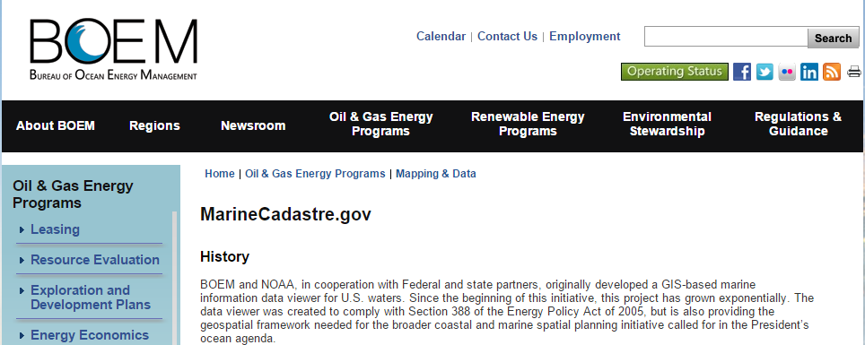
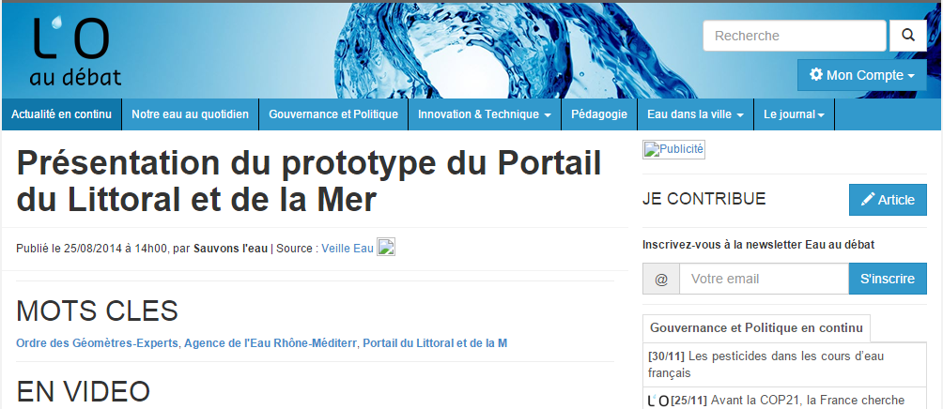
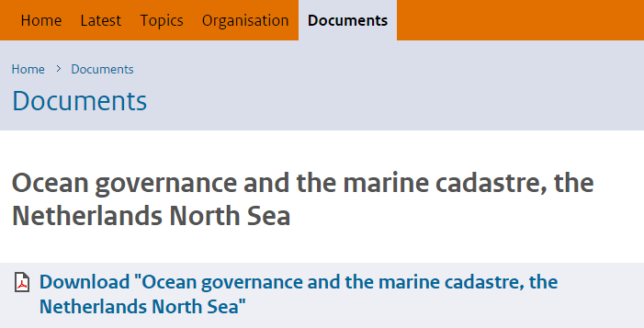
USA
France
Netherlands

Slide 17
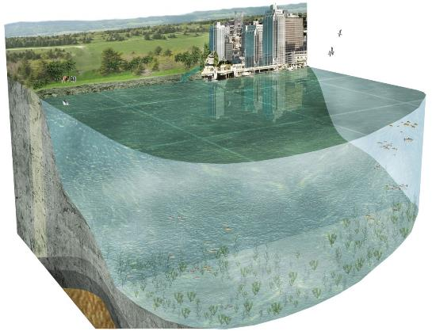
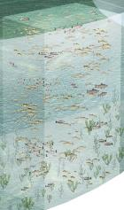
Motivation - Marine Cadastre
A marine cadastre is an integrated system of registries that allows for the systematic public recording of all recognized legal rights, responsibilities and restrictions related to the ocean space (legislative base, people, data infrastructure). (NRCan/DFO task group, 2010)
Renewable Energies
Recreation
Oil and gas resources
Aquaculture
Marine protected area
Shipping
Fishing zone
Ocean disposal
Cables and pipelines
Heritage protection
A Marine Cadastre

Slide 18
Integrated Ocean Management
A multi-purpose Marine Cadastre: Towards Integrated Ocean Management
Types of Rights, Restrictions, responsibilities
Scope of interests
Rights Owners
ABC Oil Co.
Society
XYZ fishing
Company / Nation
Specific First Nation
Society
Society
Oil and Gas Exploration
Marine Protected Areas
Aquaculture Lease
Cable /Pipeline
Aborigine Rights
Marine Conservation Areas
Migration Birds Reserves
Rights Infrastructure (Marine Cadastre)
Geospatial Data Infrastructure

Slide 19
Take Home Message
MSDI needs to be fully supported from upper government
MSDI is not just for hydrography and involves interaction and cooperation across agencies
There are several challenges in establishing and MSDI with Metadata standards being at the top of the list.
A major driver and motivator for MSDI in Canada is towards the development of a Marine Cadastre

Slide 20
Thank You
www.iictechnologies.com

