Slide 1
16th Meeting of the Meso American and Caribbean Sea Hydrographic Commission (MACHc16) the Cruise Industry Perspective
Kim Hall
Cruise Lines International Association
Director,
Technical and Regulatory Affairs
Operational & Security
December 11th, 2015

Slide 2
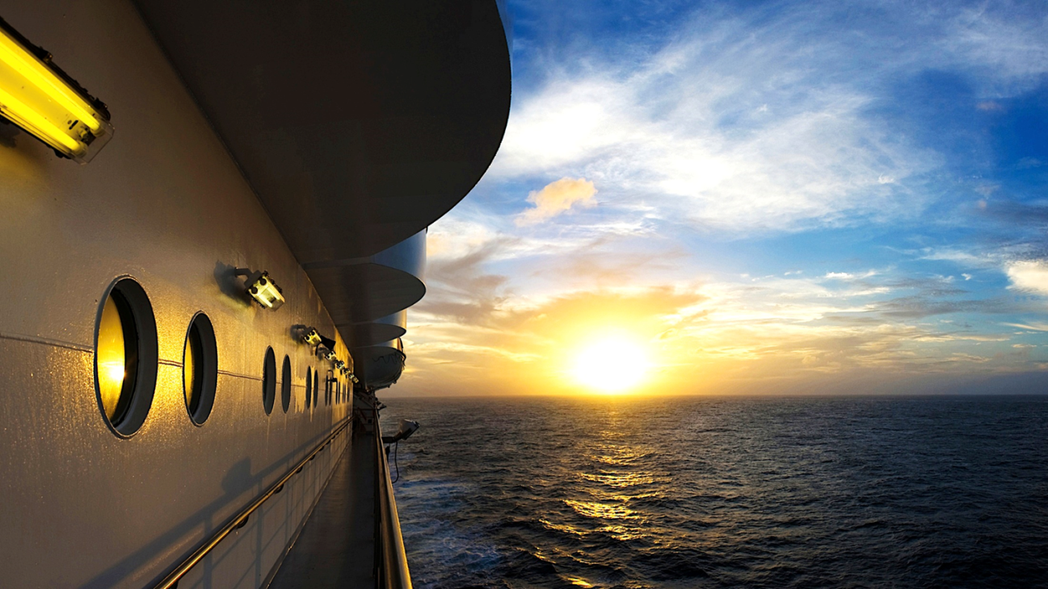

CLIA
Overview

Slide 3
Cruise Lines International Association
Unified voice of the global cruise community
Represents, advocates and promotes the common interests of the industry to external stakeholders
Global organization with 15 offices worldwide
63 Cruise line members worldwide – 95% of global cruise capacity
50,000 Travel agent members
275 Executive partners

Slide 4
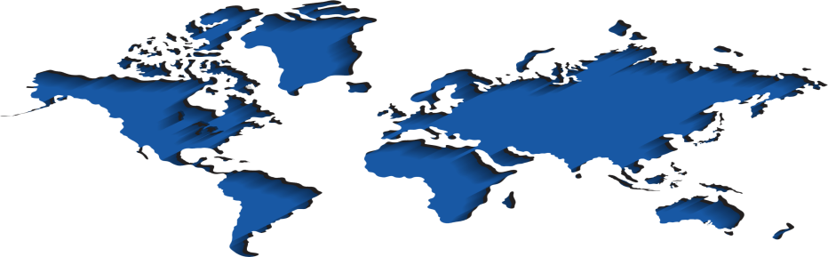
CLIA Office Locations
UK + Ireland
Alaska
Spain
Canada
Singapore
Germany
US + Global
Netherlands
Belgium +
Luxembourg
China
Brazil
Italy
Australia +
New Zealand
Hawaii
France

Slide 5
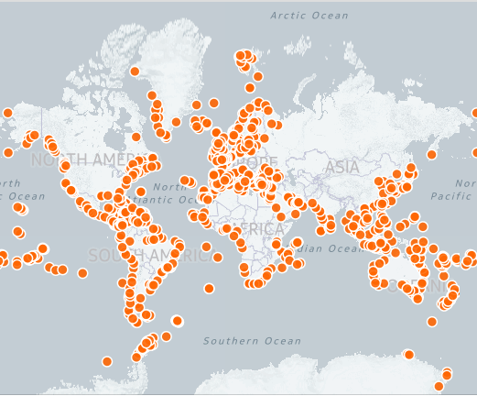
Cruise Ship Deployment
Source: Whatsinport.com

Slide 6
Technical and Regulatory Affairs Team
Advocates industry legal, legislative, and technical positions
Monitors and participates in the development of shipping policies and regulations at all levels
Actively involved in the safety of passengers and crew, as well as protecting the marine environment

Slide 7

Navigational
TOPICS

Slide 8
Topics of Interest
Safety of navigation
Caribbean/Gulf of Mexico navigational charts
Arctic cruising
  Market demand
  Operational considerations and needs
Electronic navigational charts (ENCs)
  Availability/access
  Additional features
Enhanced navigation (e-navigation)

Slide 9
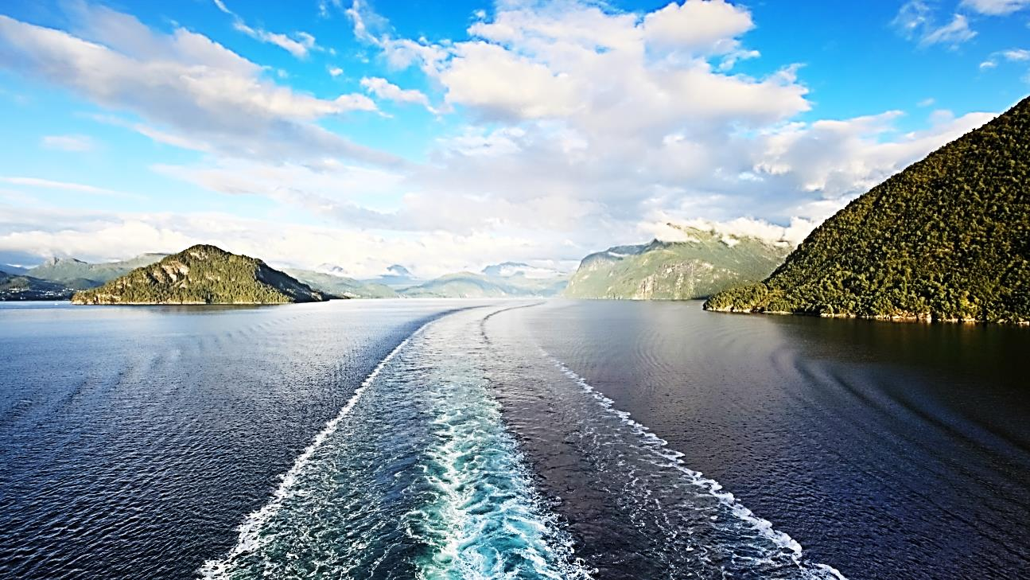

THANK
YOU

