Slide 1
16th Meeting of the
Meso-American and Caribbean Sea
Hydrographic Commission
GIS Developments in the IHB
agenda item 7.5

Slide 2
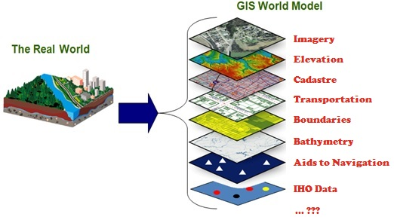
IHO GIS and Databases
IHB transition to Esri-based GIS solution underway
avoid duplication of data and inputs
enable data visualization
enable data fusion and analysis
provide GIS data layers for RHCs and Member States

Slide 3
IHO GIS and data base developments
Country Information Data base
“C-55” data base
INToGIS data base
  provides support for HOs & ICCWGs and S-11 Part B
  ENC coverage GIS analysis tools
    overlap checker
    sort and search by producer
  (strictly for IHO use only)
  ENC Coverage catalogue upgrade

Slide 4
C-55 development
Inventory by country of status of :
  charting (% covered)
  surveying (% covered)
  MSI (Yes/No)
  GMDSS (Yes/No)
aims to assist in :
  raising awareness
  prioritizing national hydrographic requirements

Slide 5
C-55 geographic reference frames and metrics
for charting and surveying:
  “area of charting responsibility”
  % covered - up to 200 metres deep
  % covered - more than200 metres deep
not so useful in a GIS!
nor in a Minister’s office !

Slide 6
Use of CATZOC quality indicator preferred for the future
  provides specific geographical context
  can be merged with other relevant geospatial information
  can be analysed to produce risk maps

Slide 7
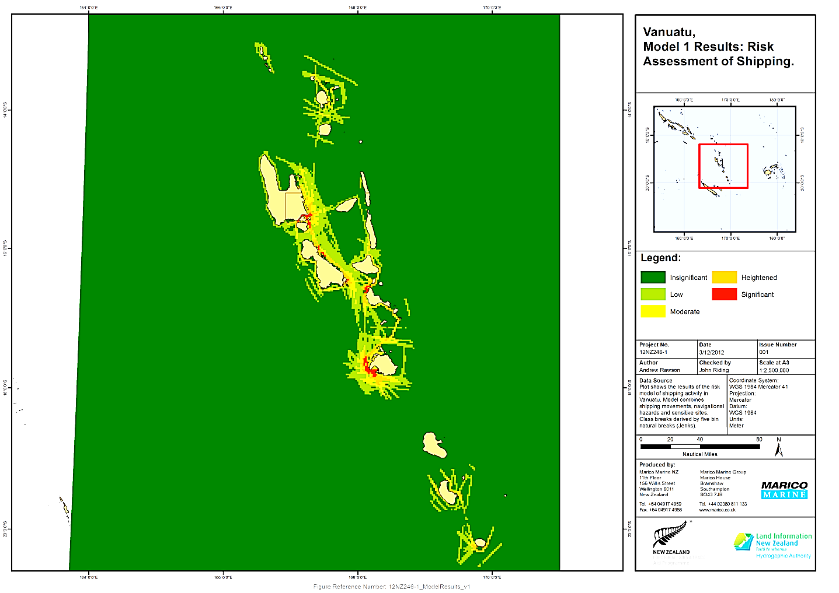
Example: Risk assessment “heat map” for Vanuatu

Slide 8
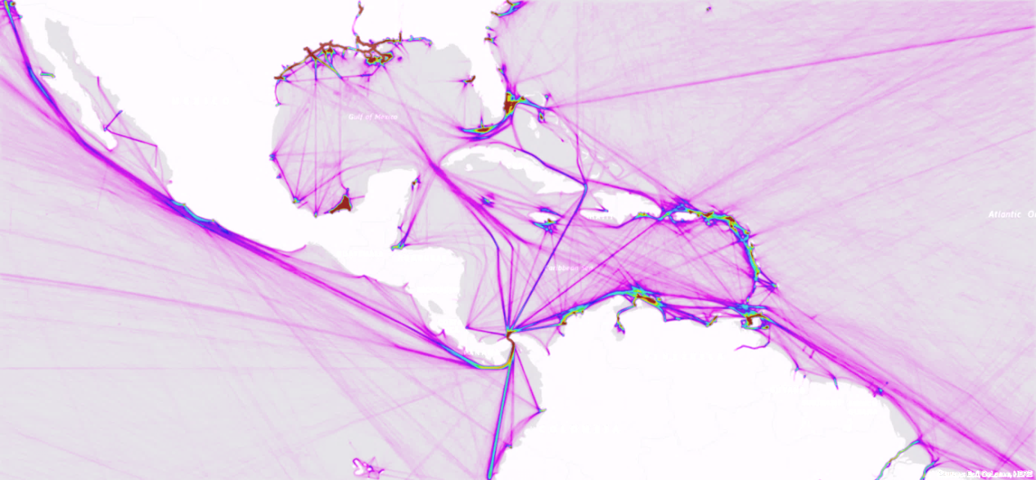
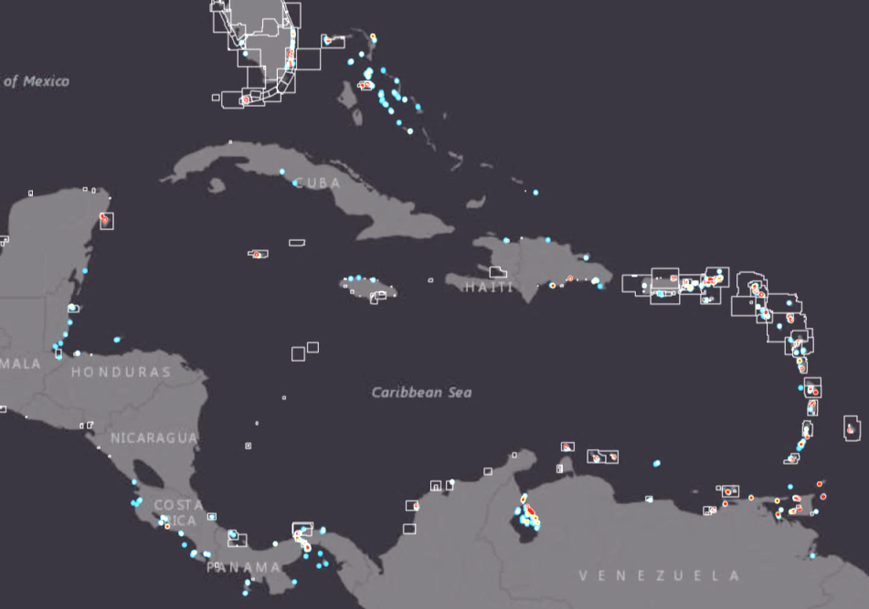
Example: NOAA Risk assessment “adequacy of ENC coverage in MACHC”

Slide 9
Current C-55 entries :
Country | 0-200m Requires re-survey | 0-200m Unsurveyed
Antigua and Barbuda | 52% | 0
Bahamas | 99% | 0
Barbados | 55% | 0
Belize | 85% | 0
Bermuda | 34% | 65%
Brazil | 30% | 0
Colombia | 0 | 16%
Costa Rica | 90% | 0
Cuba | 30% | 0
Dominica | 20% | 65%
Dominican Republic | no information available
France - Antilles Fr. | 29% | 0
France - Clipperton Is. | 26% | 0
France - Guyane | 70% | 0

Slide 10
Country | 0-200m Requires re-survey | 0-200m Unsurveyed
Grenada | 50% | 0
Guatemala | no information available
Guyana | 30% | 0
Haiti | 60% | 0
Honduras | 80% | 15%
Jamaica | 60% | 0
Mexico | 77% | 0
Netherlands - Leeward Is. | 86% | 0
Netherlands - Windward Is. | 10% | 0
Nicaragua | 95% | 0
Panama | 75% | 0
St Kitts & Nevis | 85% | 0
St Lucia | 85% | 0

Slide 11
Country | 0-200m Requires re-survey | 0-200m Unsurveyed
St Vincent and the Grenadines | 90% | 0
Suriname | 60% | 0
Trinidad and Tobago | 65% | 0
UK - Anguilla | 70% | 0
UK - BVI | 60% | 0
UK - Cayman Is. | 80% | 0
UK - Montserrat | 15% | 0
UK - Turks & Caicos Is. | 5% | 90%
USA | specific regional information not yet available
USA - Puerto Rico, Virgin Is., Navassa Is. | 1% | 0
Venezuela | 55% | 10%

Slide 12
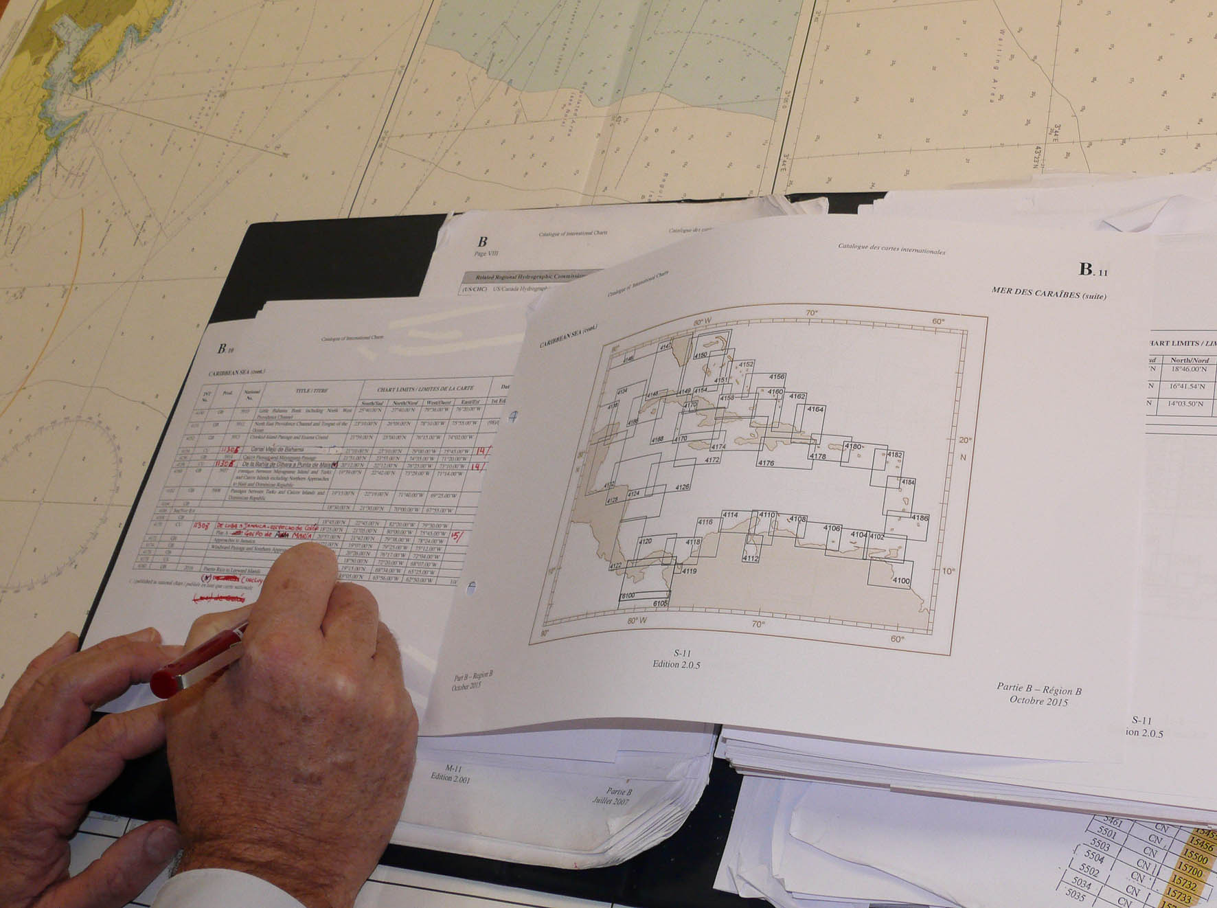
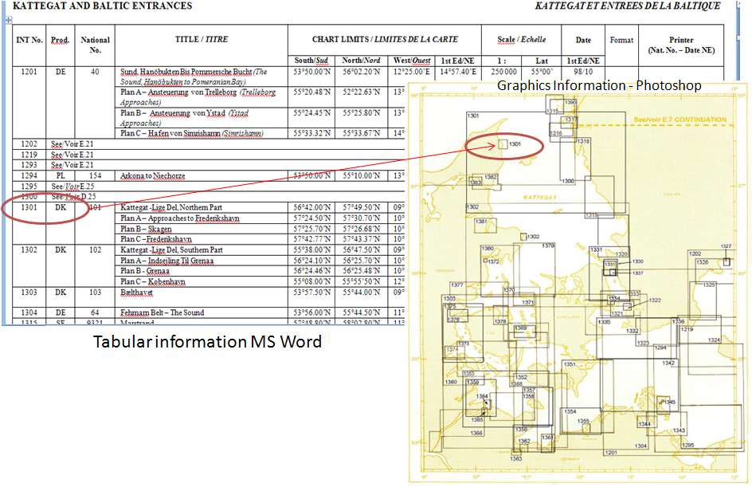
IHO S-11 Part B – Catalogue of INT Charts
…today…

Slide 13
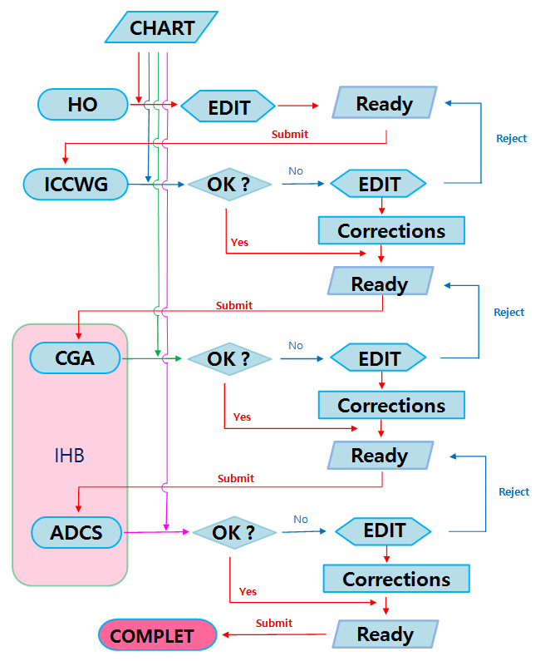
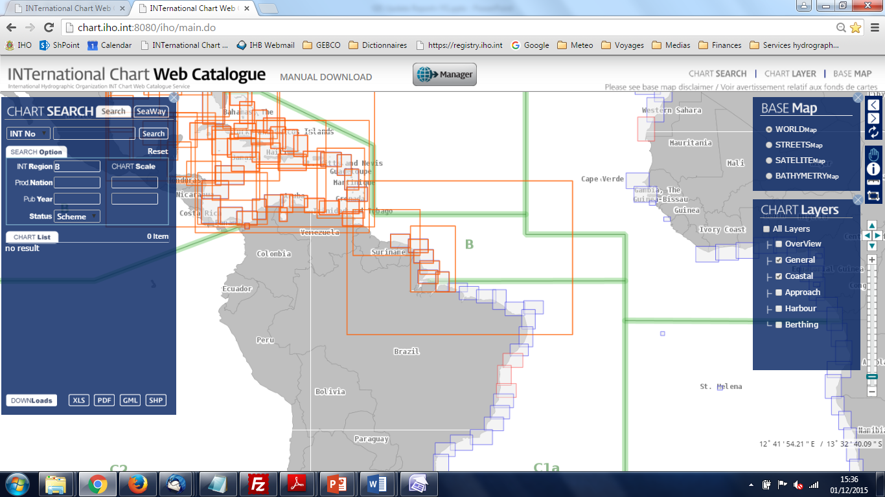
IHO S-11 Part B – Web Catalogue of INT Charts, Associated Web Services
…from January 2016…

Slide 14
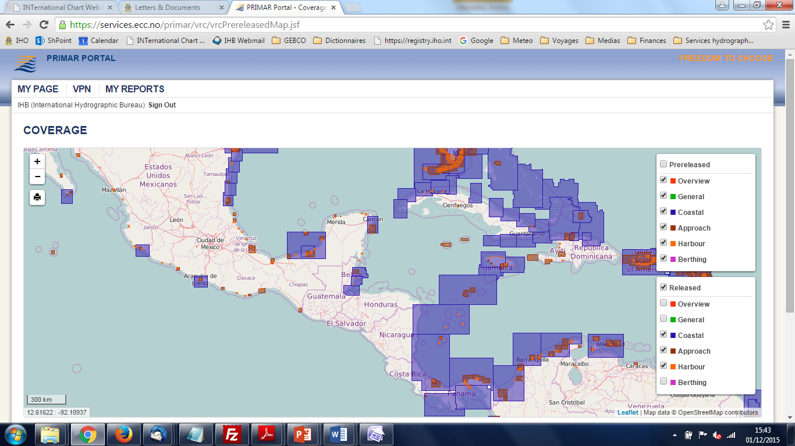
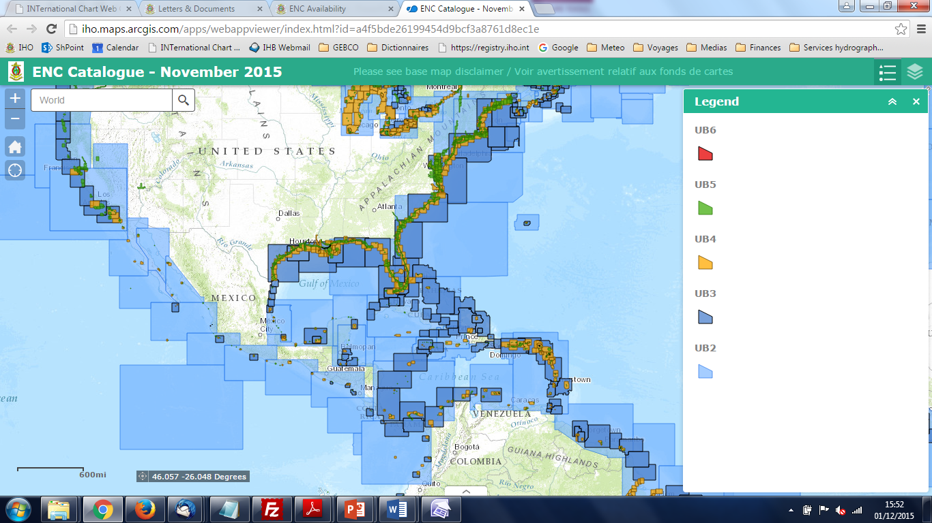
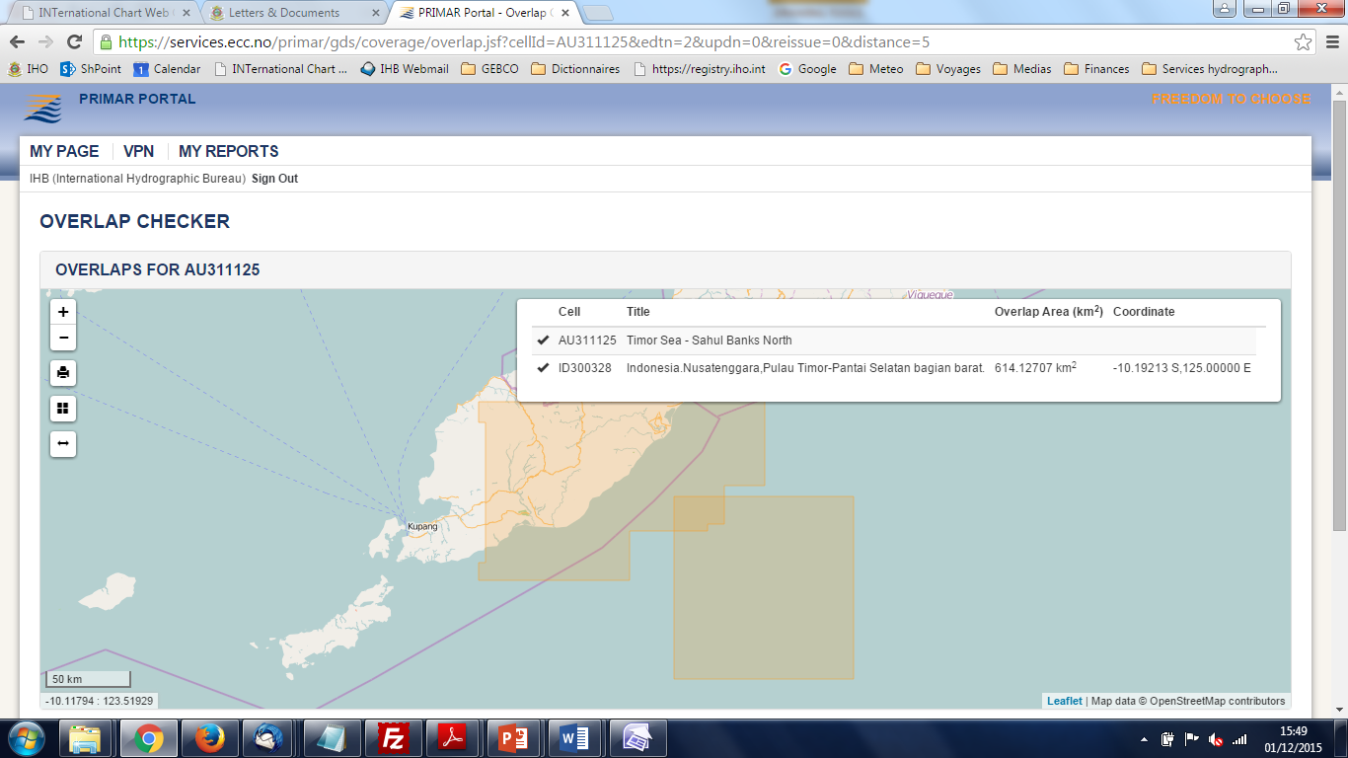
IHO ENC Catalogue, ENC Coverage and Overlap Checker
IHO CL 58/2015 refers

Slide 15
Actions requested:
MACHC note this report
All States to confirm that the published C-55 information is correct and provide updated information where it is not correct
Take any other actions as considered appropriate

