Slide 1
The Benefits of a Hands-on Approach to S-100
MACHC
Dec. 7-12, 2015
Antigua & Barbuda
Presented by: Alejandro Gerones, CARIS

Slide 2
Introduction
S-100 purpose
Support a greater variety of:
Hydrographic-related digital data sources
Products
Customers
“Beyond the scope of traditional hydrography”
Easier integration with geospatial solutions
For data and products
Greater use and lower cost of implementation
S-100 benefit
Support sustainable resource management and economic development (i.e. the Blue Economy)

Slide 3
Introduction
Many products identified in preliminary list of S-100 based product specifications
Platform needed for creation of sample products based on S-100
Create wide range of test data sets
Export content in formats for trials in S-100 enabled ECDIS
Support interoperability with other geospatial applications
Flexibility needed to support expansion and modern navigation requirements

Slide 4
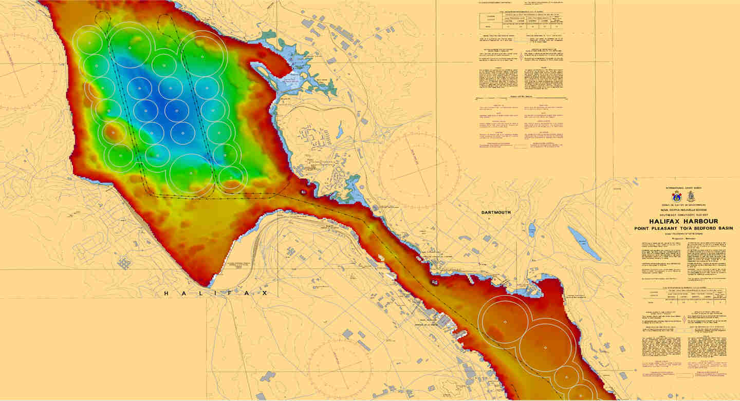
Introduction
S-100 Products
S-101 ENC
S-102 Bathymetric Surface
S-111 Surface Currents
S-112 Real Time Tidal Data Transfer
S-121 Maritime Limits and Boundaries
S-401 Inland ENC
S-411 Sea Ice
S-412 Met-Ocean Forecasts
...
Agencies can currently experiment with creation of products using existing production tools

Slide 5
S-101 ENC
Current version of the S-101 product specification
April 2014: S-101 ENC PS Draft 0.0.0
April 2014: S-101 Appendix A – Data Classification and Encoding Guide (DCEG) Baseline Version
Estimated timescale
2014-15: S-101 initial review and testing
2015-17: HO familiarization, OEM implementation
2016: S-101 Final Draft
2015-2017: ECDIS trials
2018: S-101 released for full implementation
2015-17: HO familiarization, implementation
“…a new draft version of S-101 will be made available to stakeholders giving them opportunity to begin assessing the requirements for the transition to producing S-101 ENCs.”
Source: IHO S-101 Value Added Roadmap (DRAFT – May 7, 2014)

Slide 6
S-101 ENC
Agencies can take a hands-on approach to working with S-100
Experiment with existing production tools
Gain familiarity with new complex and multiplicity attribute types
Work with information objects and assign S-100 portrayal to features
Work with the expanding registry of S-100 product specifications
Create sample S-100 datasets
Export content in exchange formats
ISO 8211 for S-101 ENCs
GML for other S-100 overlays

Slide 7
S-101 ENCs
S-101 ENC Workflow
Create New Product
Import
from S-57
Create Features
Export to S-100 File
View S-100 File
S-101
S-101
S-101
S-101
S-100 (000)
Map S-57 to S-101
S-57 (000)
S-100 (000)

Slide 8
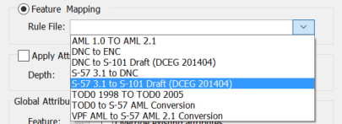
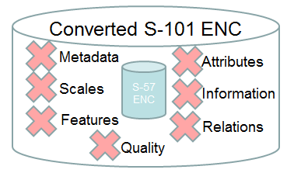
S-101 ENCs – Feature mapping
Perform automated conversion from S-57 ENC (and others) into S-101
Only a part of the solution
S-101 is a superset of S-57 ENC
Producers still need to completely populate the product…
Features
Attributes
Information
Relations
Metadata …

Slide 9
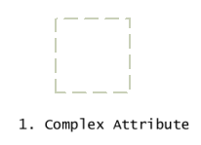
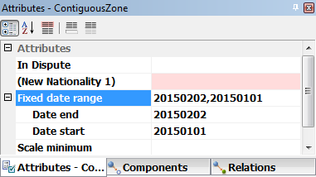
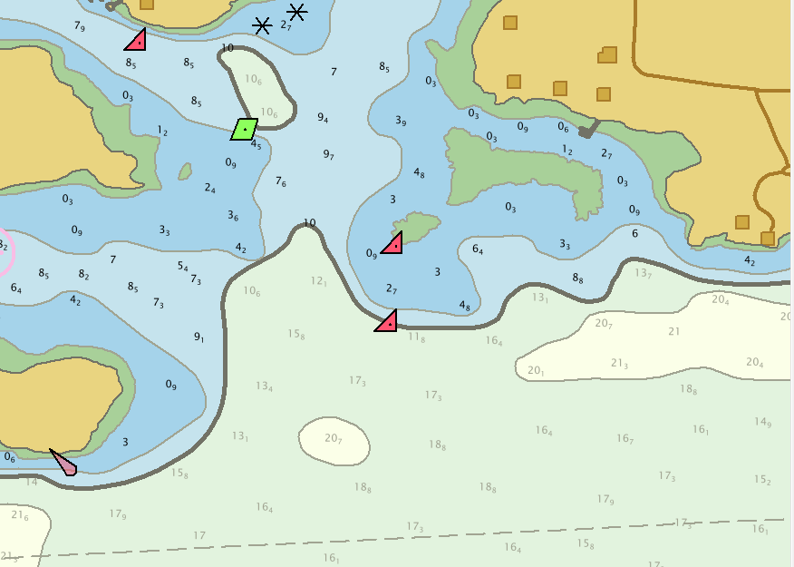
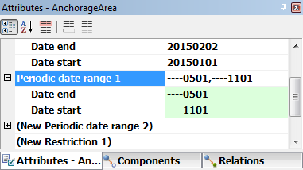
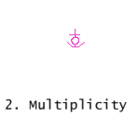
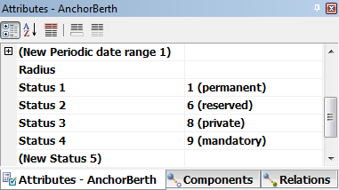
S-101 ENCs – Feature creation
Users can access familiar tools to create features and attributes using S-100 encoding
Complex attributes
Multiplicity of attribute values
Data & Time Range attribute values
Feature names
Information objects

Slide 10
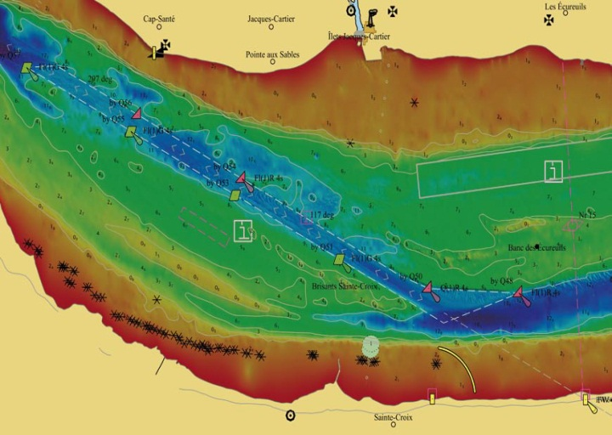
S-102 Bathymetric Surface
IHO specification for high resolution raster bathymetry product
Edition 1.0.0 – April 2012
Encoding based on HDF5 but others possible (e.g. 32 bit GeoTIFF)
Overlay for S-101 ENCs
Compliment/enhance ENC information
Water level adjustments for situational awareness or planning
Requires:
High resolution / quality survey data
Rich metadata for traceability
Process automation to support frequent resurvey schedules
Filtered ENC and S-102 in Background ¹
¹ Image: Marc Journault and Louis Maltais, Canadian Hydrographic Service and Ed Kuwalek, IIC Technologies Canada; The New IHO S-102 Standard; Hydro International, May 2012, Volume 16, number 3

Slide 11
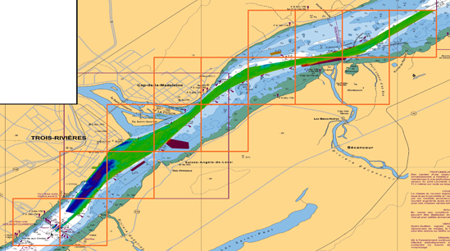
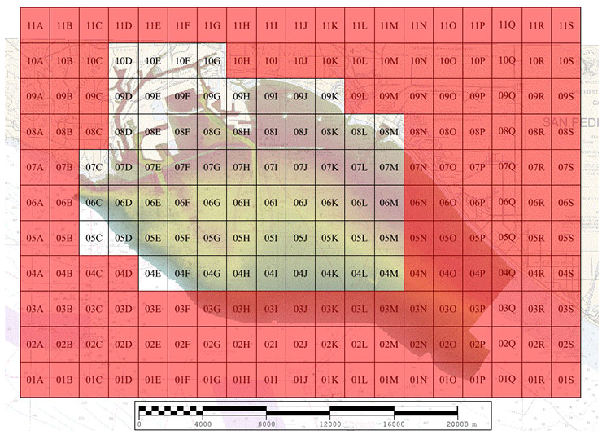
Use Cases
CHS High Definition Bathymetry Trials ²
Test in collaboration with software manufactures, mariners and other users
Data in 32 bit GeoTIFF
18 HD bathymetry cells
Datasets available for tests and trials
NOAA pilot project to produce ‘harmonized data’ to support precise navigation ³
Project area: Port of Los Angeles and Port of Long Beach, California
Producing S-102 and IENC overlays
Overlays and other sources (e.g. environmental observations and forecast products) feed into UKC system
² Source: http://charts.gc.ca/data-gestion/bathy-trials-developpment/index-eng.asp
³ Sources: https://noaacoastsurvey.wordpress.com/2015/03/23/developing-products-for-precision-navigation/
http://www.nauticalcharts.noaa.gov/mcd/enc_overlays.html

Slide 12
Education and knowledge transfer
S-100 educational / hands-on workshops
SEPRHC (Nov. 2013)
CARIS 2014 users conference (June 2014)
US Hydro conference (March 2015)
SWAtHC and SEPRHC (Nov. 2015)
S-100 / S-101 webinars and on-site trainings (Q1 2016)
General familiarization with S-100 concepts and theory
Hands-on experience with creating S-101 features and products
S-100 / S-101 self-paced online training (2016)
Deliver theory and exercises through online access
Similar to other S-57 ENC and chart production courses (www.caris.com/elearning)

Slide 13
Conclusions
S-100 allowing marine spatial data to be used, “beyond the scope of traditional hydrography”
Various S-100 based product specifications at various stages
Now is the time to assess requirements for transition to producing S-101 ENCs, and other products
Marine GIS solutions have evolved to support familiarization and trials for some products; continuing to evolve to support others
Education and training is needed for data producers to build capacity
A hands-on approach now will help agencies prepare for full implementation in future

Slide 14
Alejandro Geronés, Sales Manager for Latin America & The Caribbean, CARIS
T: +1.506.458.8533, E: alejandro.gerones@caris.com , E: info@caris.com
W: www.caris.com

