Slide 1
“e-Navigation” update
Stephen Bennett
Vice Dean IALA World-Wide Academy

Slide 2
Vision and Strategy
VTS
SRS
GNSS
COM
GMDSS
INS
IBS
CM DS
STRATEGY
IVEF
VISION
ECDIS
ENC
AIS
LRIT
VTM
AtoN
…
“Harmonised Connectivity”

Slide 3
Multi-Organisation Project
IMO
IAIN
IHO
CIRM
IEC
ICS
ITU
IALA
IMPA

Slide 4
Definition of e-Navigation
“e-Navigation” is a brand – the “e” is not specifically defined
e-Navigation is the harmonised………
Collection
Integration
Exchange
Presentation
Analysis………..
…..of maritime information onboard and ashore by electronic means to enhance:
berth to berth navigation and related services (VTS)
safety and security at sea
protection of the marine environment
“CIEPA”

Slide 5
Practical Definition
The sharing of information in real time between ships, between shore authorities and between ship and shore relating to:
Navigation
Routeing
Weather
Tides
Cargo loading; carriage and stowage
Offering substantial operating efficiencies and commercial benefits
IMO approved 5 key priorities of the Strategic Implementation Plan in November 2014

Slide 6
Main Components
PNT
Resilient Navigation
IALA WW Radionavigation Plan
Comms
Uninterrupted communications
IALA Maritime Radio Communications Plan
ENCs
Population of ECDIS
Adequate Electronic Navigational Charts

Slide 7
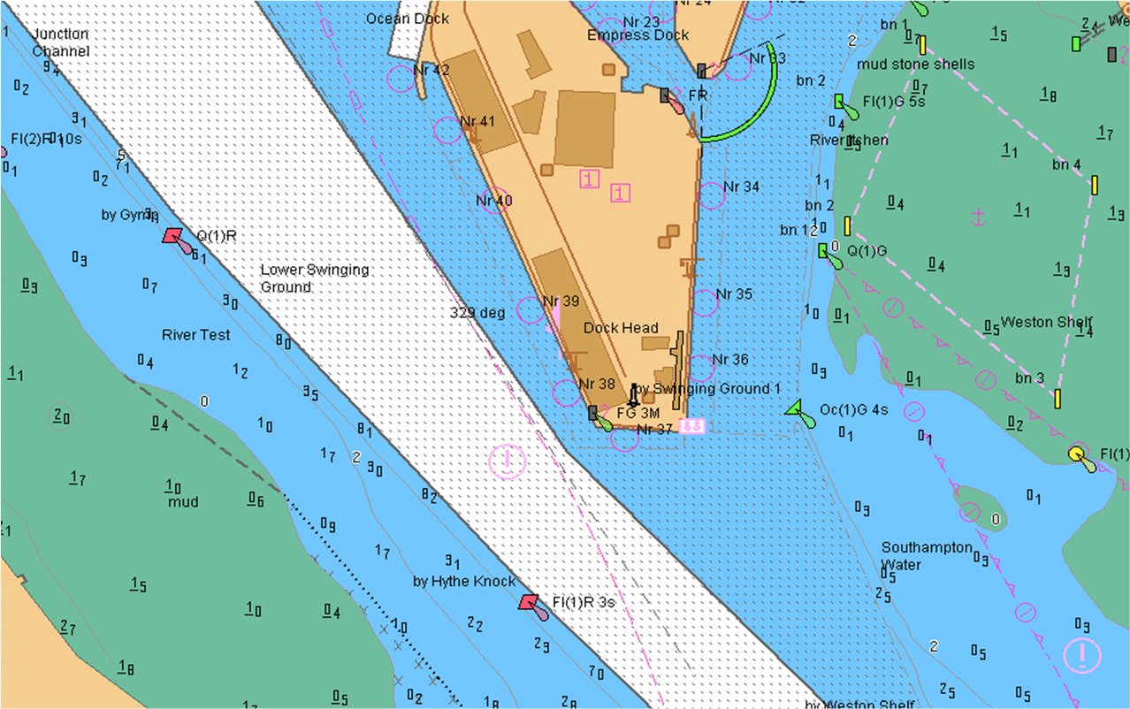
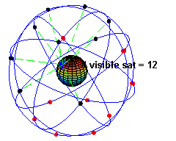
e-Navigation Vision for Comms
Provide seamless communication ship to ship; ship to shore and all shore authorities
Resilient navigation
Access to world-wide ENC coverage

Slide 8
IMO and Resilient PNT
The IMO Maritime Safety Committee has stated:
“e-Navigation systems should be resilient and ……… systems should be be robust, reliable and dependable. Requirements for redundancy, particularly in relation to position fixing systems should be considered.”

Slide 9
Mitigation Measures
Modification and/or protection of existing GNSS elements (space; ground; receivers)
May include:
Redundant systems: more GNSS (Glonass; Galileo; Beidou)
Backup systems: Loran-C; eLoran; radar map matching and radar AtoN; 3G cellular telephone-based; DGNSS radio beacon/AIS ranging (R-Mode: timing from shore to ship)
Contingency systems: Traditional AtoN (including shore radar/VTS); Nav Aids (ship radar; inertial systems; DR)
Integrity Systems: RAIM; IALA Beacon DGNSS; SBAS etc.
Competent Authorities - Risk Assessment Action Plan

Slide 10
Components of a WWRNS
WWRNS
Positioning Systems
GNSS
Terrestrial
Augmentation System
SBAS
GBAS

Slide 11
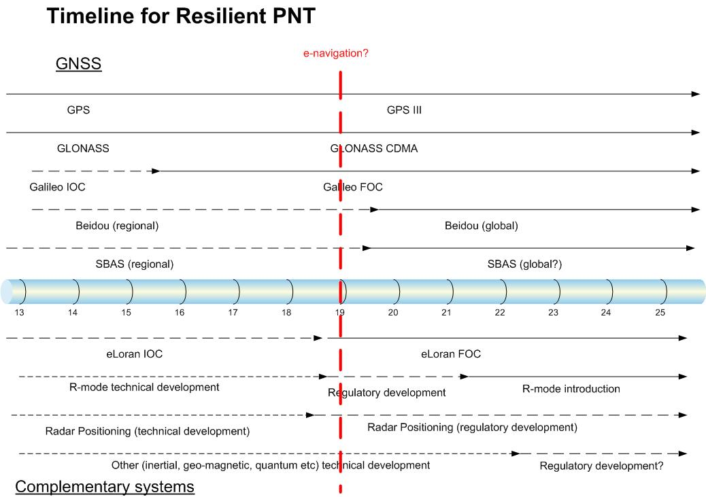

Slide 12
Ideal e-Nav Comms System
Operate automatically
Select the optimum communications technology, channel, characteristics and type of data to be exchanged based on ships’ position
Managed in accordance with a new set of rules:
Avoid latency
Ability to delay transmission and receipt of data
Value/cost of communications
Commercial priorities
Capacity of transmission

Slide 13
IALA Maritime Radio Communications Plan
78 page MRCP developed to assist in selection of radio communications systems to support e-Navigation
Core objective is to state IALA’s vision for the efficient use of the radio spectrum in the Maritime Mobile Service
Infrastructure of communications to link ship and shore is a key component of e-Navigation

Slide 14
Overview of Developments
Move from analogue to digital
Move from voice to data with time sharing techniques
Adding data services to voice channels
Time Division Multiple Access (TDMA) on AIS
Use of narrow band techniques
Close cooperation between international bodies

Slide 15
e-Navigation Development based on 7 Risk Control Options
IMO (MSC)
IALA (ENAV Committee)
Resilient PNT (RCO5)
In cooperation with other international organizations (ITU, IEC, CIRM, ICS etc.) develop functional, technical and performance standards for communications, navigation systems, portrayal, data exchange etc.
IHO leads on S-100
Lead Organization and Coordinator
Focus on prioritised ship components
GMDSS modernization

Slide 16
Modernisation of GMDSS
Integration of increased range AIS-Search And Rescue Transponders (AIS-SART) in EPIRBs and man-overboard devices
Use of AIS as a homing device
500KHz can be used to deliver large volumes of data at a high rate
VHF Data Exchange is a candidate for MSI promulgation using Application Specific Messages

Slide 17
e-Navigation Test Beds
ACCSEAS - ACCessibility for Shipping, Efficiency Advantages and Sustainability
11 partners: Denmark, Germany, Netherlands, Norway, Sweden and UK (GLA lead)
EfficienSea - Baltic
MONA LISA –Sea Traffic Management
Torres Strait – dynamic UKC project
The Marine Electronic Highway – Malacca Straits and Singapore
Smart eNav in Republic of Korea
Note: IALA is the Coordinator of e-Nav test beds
www.youtube.com/watch?v=kGJwbtow2yY&feature=player_embedded

Slide 18
Summary
IMO will address ship side issues
IALA will address Resilient PNT and Comms issues
IHO will address ENCs to populate ECDIS
e-Navigation test beds already being used
IHO and IALA continue to lead the way

