Slide 1
THE
HYDROGRAPHIC
SOCIETY OF AMERICA
PRESENTED BY:
PAUL COOPER
PRESIDENT OF THSOA

Slide 2
PRESENTATION SUMMARY
I
II
III
BEGIN
WHO WE ARE
WHAT IS HYDROGRAPHY
OUR CHAPTERS
IV
U.S. HYDRO
CONFERENCE
V
SCHOLARSHIP PROGRAM
VIII
WORLDWIDE HYDROGRAPHIC CONFERENCE
VII
HYDROGRAPHER CERTIFICATION
VI
OUR MEMBERSHIP
END
www.thsoa.org
Phone: +1 (774) 773-8470 | e-mail: admin@thsoa.org

Slide 3
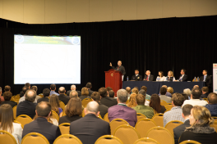
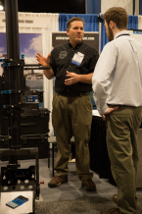
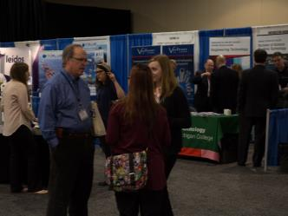
WHO WE ARE
I

Slide 4
WHO WE ARE
about us
The Hydrographic Society of America Inc., also known as THSOA, is a non-profit professional membership organization, whose main focus is to provide support to its members in the Americas.
THSOA was incorporated in the State of Maryland, United States as a non-profit organization in 1984 and was granted 501(c)(3) status as a non-profit organization by the United States Internal Revenue Service in 1984.
THSOA celebrated its’ 35-year presence in the United States on April 1, 2015. With local chapters in Houston, Southeast States, West Coast States and Latin America, our membership now stands at over 650 members.
On odd numbered years, THSOA hosts the U.S. Hydrographic Conference that draws national and international exhibitors and attendees.
www.thsoa.org
Phone: +1 (774) 773-8470 | e-mail: admin@thsoa.org

Slide 5
WHO WE ARE
our mission
THSOA is a 501(c)(3) non-profit organization committed to promoting education in offshore survey, positioning and mapping, including hydrography and related earth sciences.
www.thsoa.org
Phone: +1 (774) 773-8470 | e-mail: admin@thsoa.org

Slide 6
WHO WE ARE
our objectives
To enable technologists and others engaged in or interested in hydrography and related sciences to meet, correspond, promote, encourage and coordinate the study of such sciences in all or any of their aspects.
1
2
To accumulate, extend, increase, disseminate and publish information and knowledge relating thereto and to facilitate the exchange of information, knowledge and ideas on all subjects and related matters of interest in this field.
3
To encourage research in hydrography and the practical application of technological knowledge so developed.
www.thsoa.org
Phone: +1 (774) 773-8470 | e-mail: admin@thsoa.org

Slide 7
WHO WE ARE
our objectives (cont.)
4
To promote the better education and training of persons engaged in or intending to engage in the study of hydrography and related sciences.
5
To provide a center in the Americas for bringing together relevant issues.
6
To promote public awareness of the field and it social and environmental implications.
www.thsoa.org
Phone: +1 (774) 773-8470 | e-mail: admin@thsoa.org

Slide 8
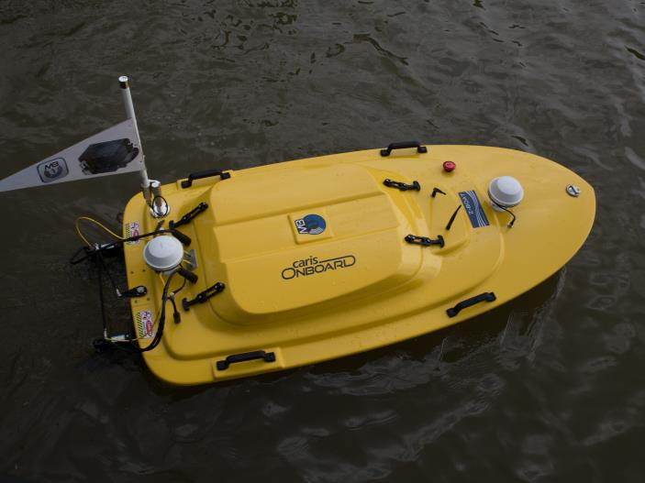
WHAT IS HYDROGRAPHY
II

Slide 9
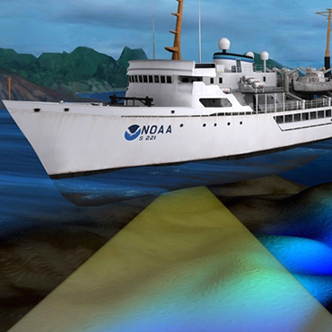
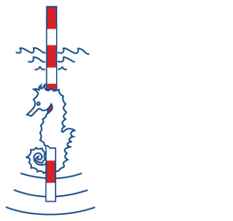
WHAT IS HYDROGRAPHY?
definition
hy·drog·ra·phy
hīˈdräɡrəfē/
Hydrography is the science of measuring and describing the physical features of bodies of water and the land areas adjacent to those bodies of water.
www.thsoa.org
Phone: +1 (774) 773-8470 | e-mail: admin@thsoa.org

Slide 10
OUR CHAPTERS
III

Slide 11
OUR CHAPTERS
HOUSTON
SOUTHEAST
WEST COAST
LATIN AMERICA
serves Houston, Texas and surrounding areas
serves Louisiana, Mississippi, Alabama, & Florida
serves those who reside west of the Rockies with the board members in Alaska, California, Oregon & Washington
Serves Latin America encompassing Mexico, the Caribbean & through to Chile and Argentina
www.thsoa.org
Phone: +1 (774) 773-8470 | e-mail: admin@thsoa.org

Slide 12
OUR CHAPTERS
Most of the society’s activities are carried out by its chapters. Organized on a regional basis, chapters provide the following:
Provide a forum for members to discuss matters of local or regional concern.
Provide programs and opportunities for members to further local and Society goals.
Conduct membership campaigns.
Encourage the submission of articles and opinions for the Society.
1
2
3
4
www.thsoa.org
Phone: +1 (774) 773-8470 | e-mail: admin@thsoa.org

Slide 13
IV
U.S.
HYDRO CONFERENCE

Slide 14
U.S. HYDRO CONFERENCE
www.ushydro2017.com
The U.S. Hydro Conference (U.S. Hydro) is held on odd numbered years and is presented by The Hydrographic Society of America (THSOA).
TECHNICAL SESSIONS
POSTER SESSION
STUDENT OUTREACH
WORKSHOPS
Various topics of interest to hydrographic surveyors & interested parties
Presentation of research information by an individual, team or company presented at U.S. Hydro.
To provide students an opportunity to interact with professional hydrographers & vendors
Core Workshops and Company workshops to those interested
www.thsoa.org
Phone: +1 (774) 773-8470 | e-mail: admin@thsoa.org

Slide 15
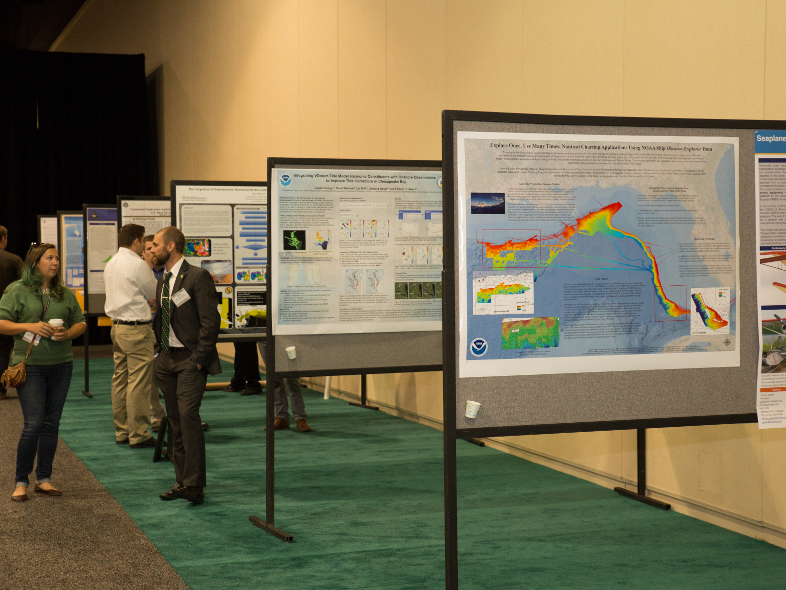
V

SCHOLARSHIPPROGRAMS

Slide 16
SCHOLARSHIP PROGRAM

2015
$34K
HOUSTON awards two scholarship yearly

NATIONAL awards five scholarships yearly

SOUTHEAST awards four scholarship yearly
www.thsoa.org
Phone: +1 (774) 773-8470 | e-mail: admin@thsoa.org

Slide 17
SCHOLARSHIP PROGRAM
requirements
NATIONAL
Available to full-time students seeking a 2-year, 4-year, or graduate degree in Hydrographic Surveying, Ocean Mapping, Geomatics, Ocean Sciences, Geographic Information System (GIS), Ocean Engineering, Electrical Engineering, or other related field.
SOUTHEAST
Available to full-time student seeking a 2-year, 4-year, or graduate degree in Hydrographic Surveying, Ocean Mapping, Geomatics, Ocean Sciences, Geographic Information System (GIS), Ocean Engineering, Electrical Engineering, or other related field. Applicants must be a current resident of Louisiana, Mississippi, Alabama or Florida or plan on attending a college in those states.
www.thsoa.org
Phone: +1 (774) 773-8470 | e-mail: admin@thsoa.org

Slide 18
SCHOLARSHIP PROGRAM
requirements (cont.)
HOUSTON CHAPTER
Available to full-time first-year or later students who are currently enrolled in a Hydrographic and/or Geophysical Survey, Geomatic/Geodetic Engineering, Ocean Sciences, Survey or Systems Engineering, Electronics, Software Development, or Geographic Information Sciences (GIS) and that can demonstrate an interest in marine or offshore survey, mapping or survey and positioning in-line with the above subjects. Applicant must be a current resident of Texas or plan on attending a college in Texas.
more info at www.thsoa.org/scholarships
www.thsoa.org
Phone: +1 (774) 773-8470 | e-mail: admin@thsoa.org

Slide 19
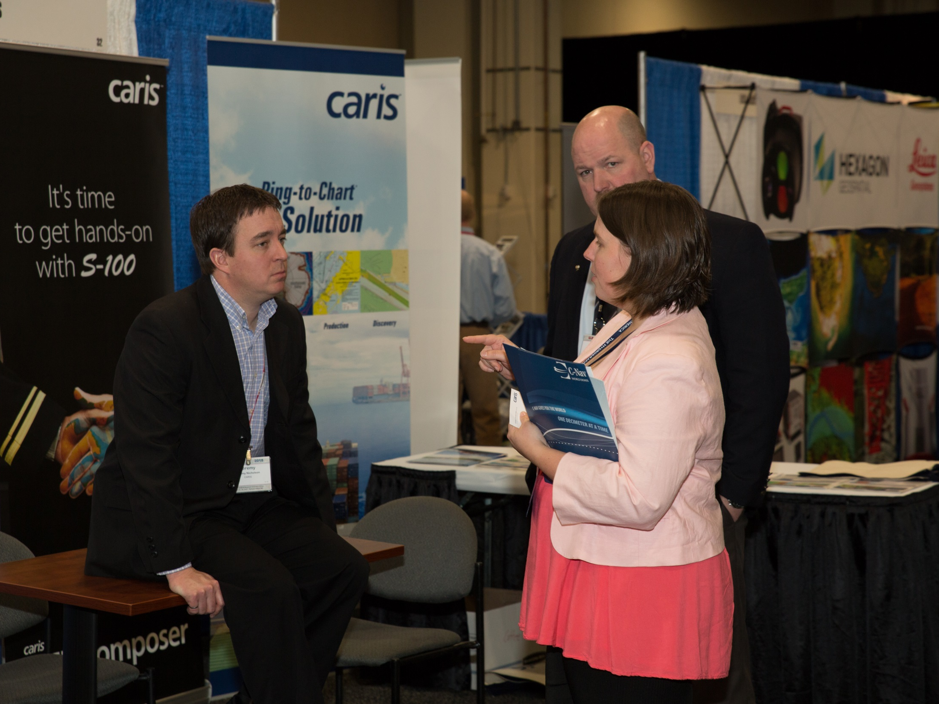
VI
visitor
OUR MEMBERSHIP

Slide 20
OUR MEMBERSHIP
basic information
Any individual or organization with an interest in Hydrography or closely related field is welcome to join The Hydrographic Society of America. No formal qualifications are required.
All memberships begin on entry and are renewed on January 1. Dues are not prorated.
Persons joining after October 1 will receive the remainder of the present year plus all of the next.
www.thsoa.org
Phone: +1 (774) 773-8470 | e-mail: admin@thsoa.org

Slide 21
OUR MEMBERSHIP
membership categories
$125
$35
$10
$15
CORPORATE
INDIVIDUAL
STUDENT
RETIRED
Any business or corporation endorsing the objectives, policies and activities of THSOA.
Any person with active professional interest in the hydrography or closely related field.
Must be a full-time undergraduate and graduate students.
(not funded by employer)
Any person who is retired from active professional interest in the hydrography field.
Must no longer employed in the business of sea surveying.
www.thsoa.org
Phone: +1 (774) 773-8470 | e-mail: admin@thsoa.org

Slide 22
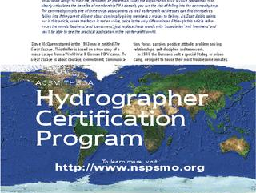
VII
HYDROGRAPHER
CERTIFICATION

Slide 23
THSOA CERTIFICATION
nsps - thsoa hydrographer certification
Program reestablished in 1981 primarily to identify those individuals that were qualified to conduct the rigorous hydrographic surveys needed by the U.S. Army Corps of Engineers and the Office of Coast Survey under NOAA.
1
Over 200 individuals have been certified as meeting the minimum five year experience requirement and core competencies of a professional hydrographer.
2
3
The exam lasts three hours and consists of 160 multiple choice questions covering a wide variety of topics suggested by the International Hydrographic Organization (IHO) and the International Federation of Surveyors (FIG).
www.thsoa.org
Phone: +1 (774) 773-8470 | e-mail: admin@thsoa.org

Slide 24
THSOA CERTIFICATION
nsps - thsoa hydrographer certification (cont.)
4
THSOA provides financial support to the U.S. Hydrographer Certification Program which is run by a 10-12 member Certification Board.
5
5
The National Society of Professional Surveyors (NSPS), administers the work of the Board. NSPS/THSOA certification is official recognition that a person has demonstrated to the satisfaction of the Certification Board that he or she is minimally competent to conduct hydrographic surveys.
6
Prospective examinees must have five years of experience in hydrographic surveying, two years of which have been in technical charge of surveys in the field. Applications, which require a detailed resume, must be reviewed and approved by the Hydrographer Certification Board prior to sitting for the examination.
www.thsoa.org
Phone: +1 (774) 773-8470 | e-mail: admin@thsoa.org

Slide 25
VIII
WORLDWIDE HYDROGRAPHIC CONFERENCE

Slide 26
www.thsoa.org
Phone: +1 (774) 773-8470 | e-mail: admin@thsoa.org

Slide 27
CONTACT US
IF YOU WOULD LIKE MORE INFORMATION YOU CAN CONTACT US BELOW
CONTACT
t 1(774) 773 8470
SEND US MAIL
P.O. Box 841361 Houston, TX 77284 USA
E-MAIL
admin@thsoa.org
board@thsoa.org
www.thsoa.org
Phone: +1 (774) 773-8470 | e-mail: admin@thsoa.org

Slide 28
FOLLOW US
social media links
FACEBOOK www.facebook.com/thsoanational/
TWITTER twitter.com/thsoanational
LINKEDIN linkedin.com/grp/home?gid=8382210

www.thsoa.org
Phone: +1 (774) 773-8470 | e-mail: admin@thsoa.org

Slide 29
QUESTIONS
AND
ANSWERS
Go ahead.
Ask away.
If you are any question regarding our society, feel free to ask.

Slide 30
THANK
YOU
Hope to see you at our events!

