Slide 1
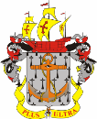
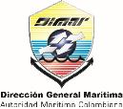

NATIONAL REPORT 2016
Centro de Investigaciones
Oceanográficas e Hidrográficas - CIOH
(Servicio Hidrográfico Nacional de Colombia)
XVII Meso American - Caribbean Sea Hydrographic Commission (MACHC)
Dagoberto DAVID VITERI

Slide 2
AGENDA
  National hydrographic Service
  Surveys
  New charts & updates
  New publications & updates
  MSI
  C-55
  Capacity Building
  Oceanographic activities
  Other activities
  Conclusions

Slide 3
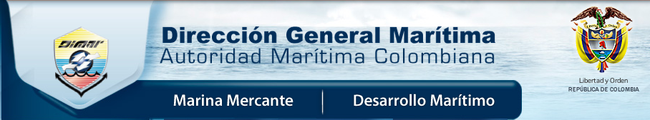
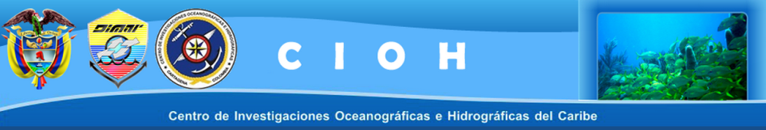
  1. Oficina Hidrográfica Nacional

Slide 4
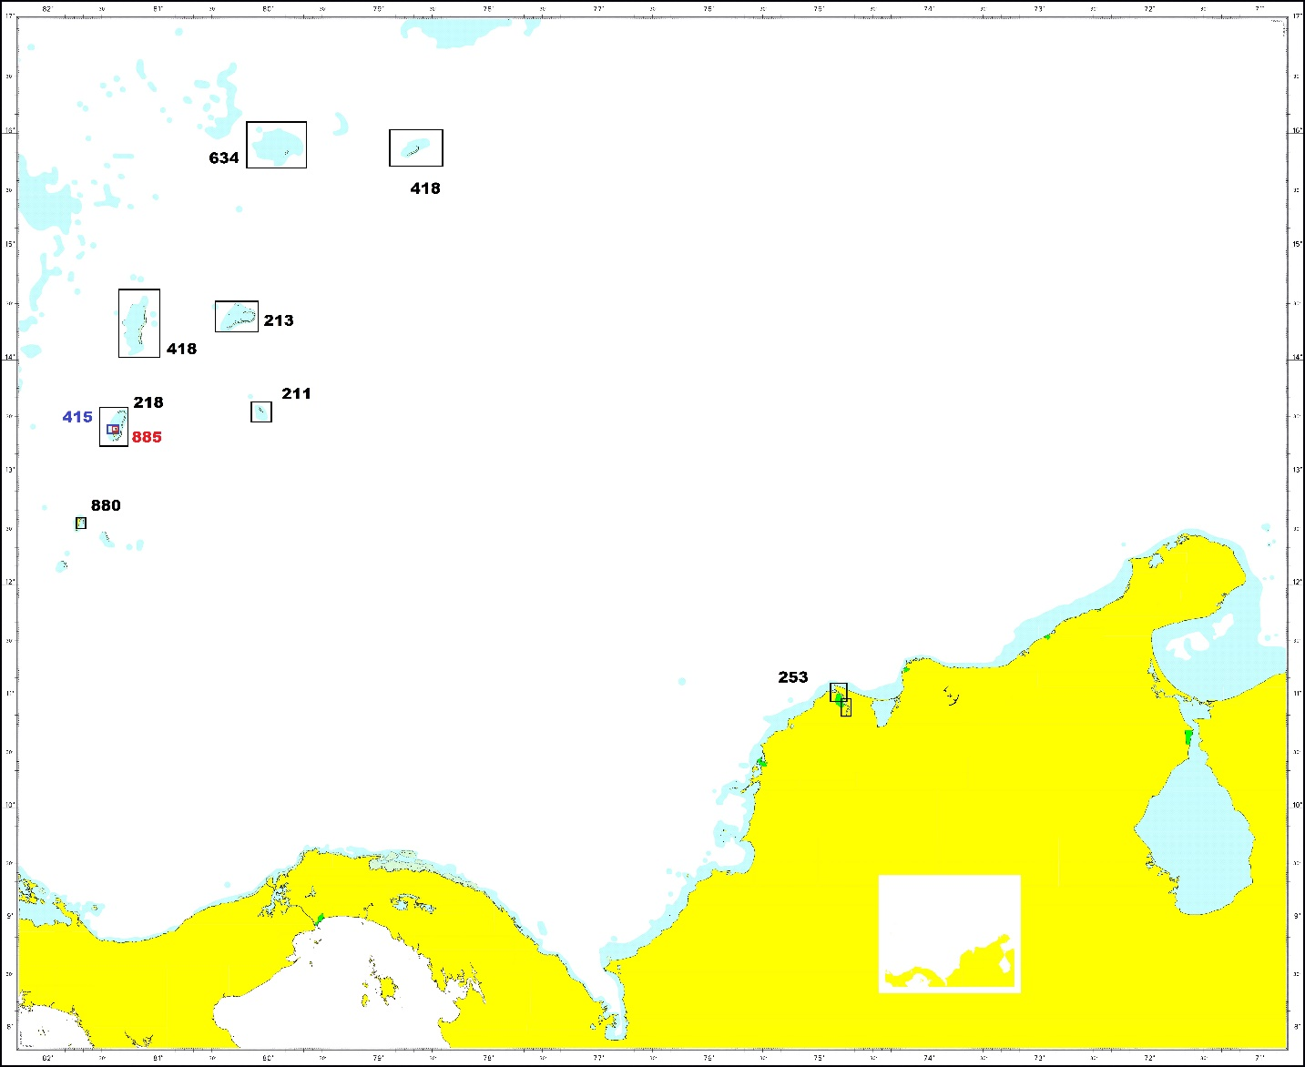
  2. Surveys Caribbean 2016
 | No. | Title
1 | 253 | Rio Magdalena
2 | 880 | Puerto de San Andrés
3 | 218 | Isla de Providencia
4 | 415 | Islas de Providencia y Santa Catalina
5 | 885 | Bahía Santa Catalina
6 | 418 | Aproximación Isla Cayos de Bajo Nuevo
7 | 634 | Aproximación Isla Cayos de Serranilla
8 | 213 | Isla Cayos de Serrana
9 | 405 | Cabo San Agustin a Punta de la Cruz
10 | 211 | Isla Cayos de Roncador
11 | 416 | Isla Cayos de Quitasueño
12 | 401 | Cabo Chichibacoa a Castilletes

Slide 5
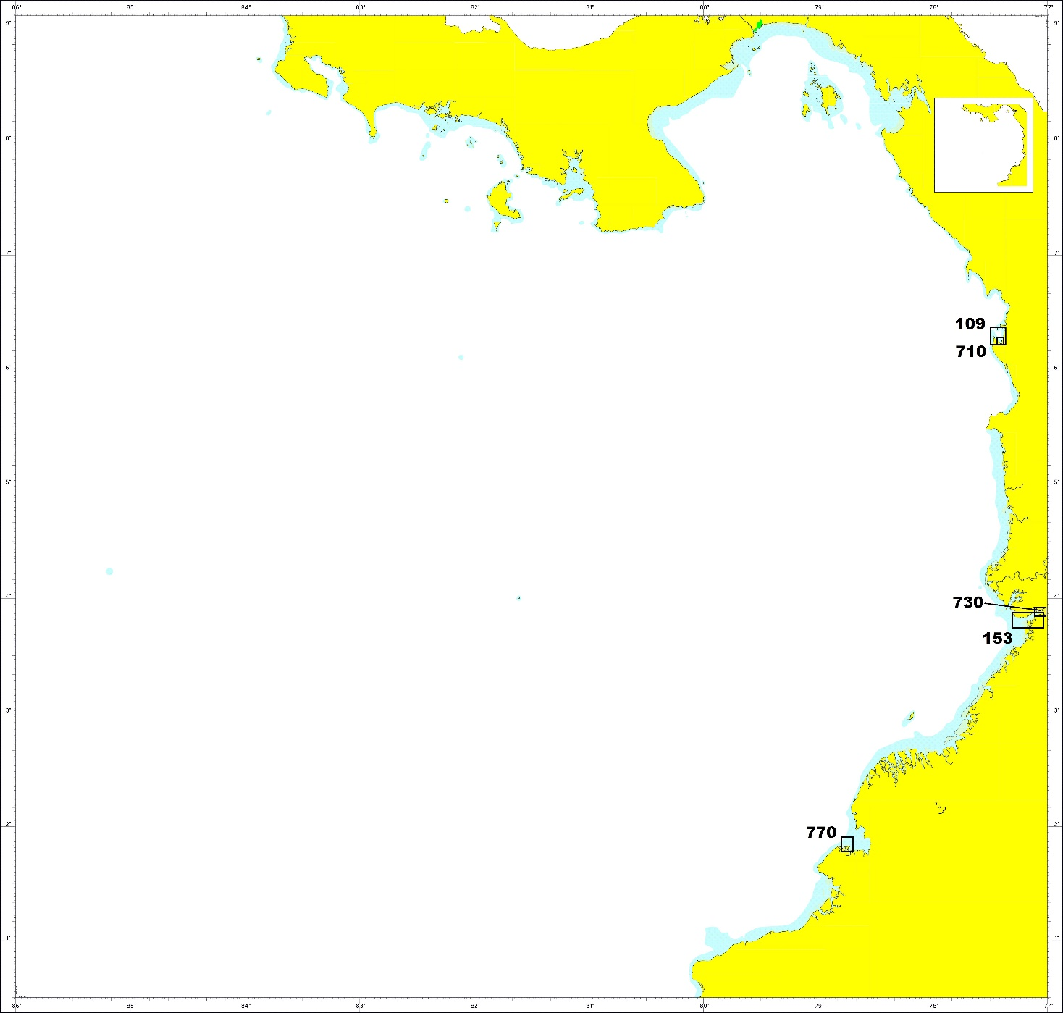
  2. Surveys Pacific 2016
Ítem | No. | Title
1 | 153 | Bahía Buenaventura
2 | 730 | Puerto de Buenaventura
3 | 109 | Aproximación a Bahía Solano
4 | 710 | Bahía Interior de Solano
5 | 770 | Puerto de Tumaco

Slide 6
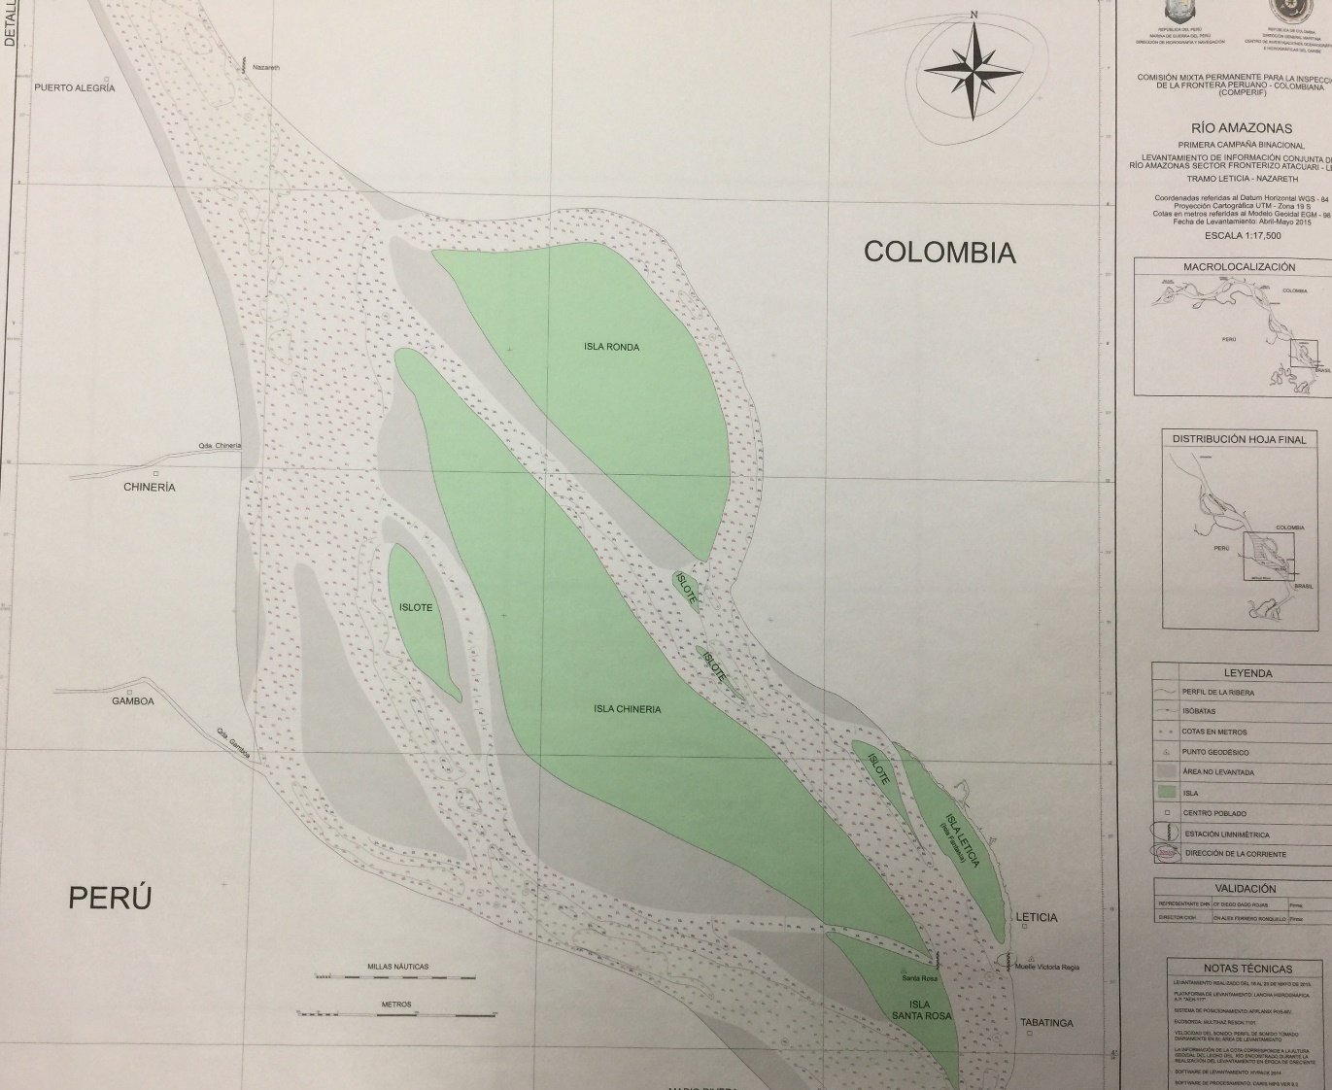
  2. Special surveys
Special surveys
 | Title
1 | Levantamiento Hidrográfico Binacional Sector Leticia-Atacuari III FASE
2 | Levantamiento de Magnetometría en la Bahía de Cartagena - Sector Bocachica
3 | Levantamiento de Magnetometría en la Sector Mamonal y Caño de Loro
4 | Levantamiento Sector Zona Bajo Mamonal
5 | Levantamiento Sector de Magnetometría Sector Canal del Dique y Pasacaballo

Slide 7
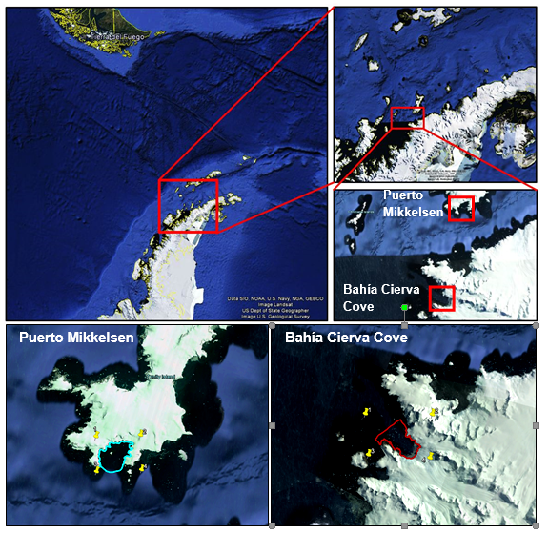
  2. Antartic Surveys 2016/17
  CO-UK
  CO-PE UK CL EC
Planed lines | Nautical miles | Days
MB_AntartidaBD1_MIkkelsen_100_0916.lnw | 74.27 | 1.85
MB_AntartidaBD2_Cierva_Cove_100_0916.lnw | 187.91 | 4.69
TOTAL | 262.18 | 6.54

Slide 8
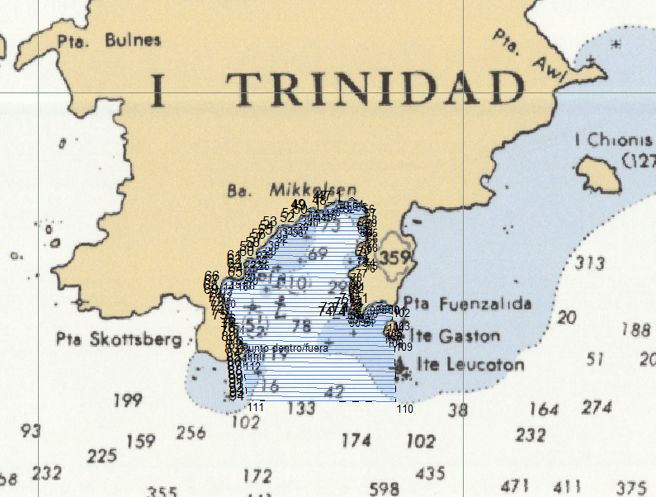
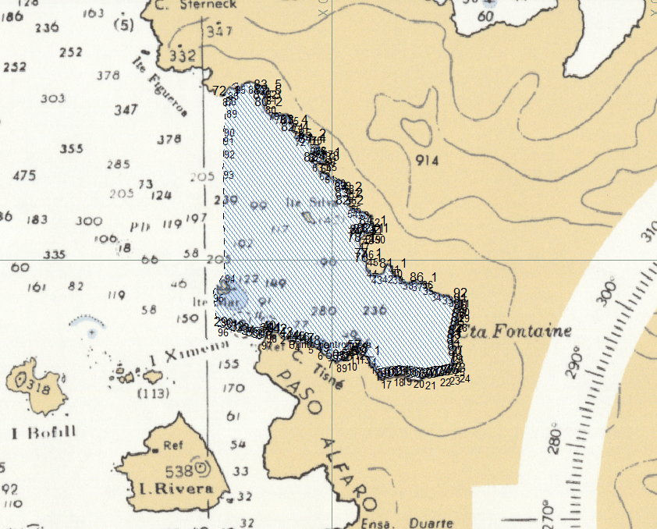
  2. Antartic Surveys 2016/17

Slide 9
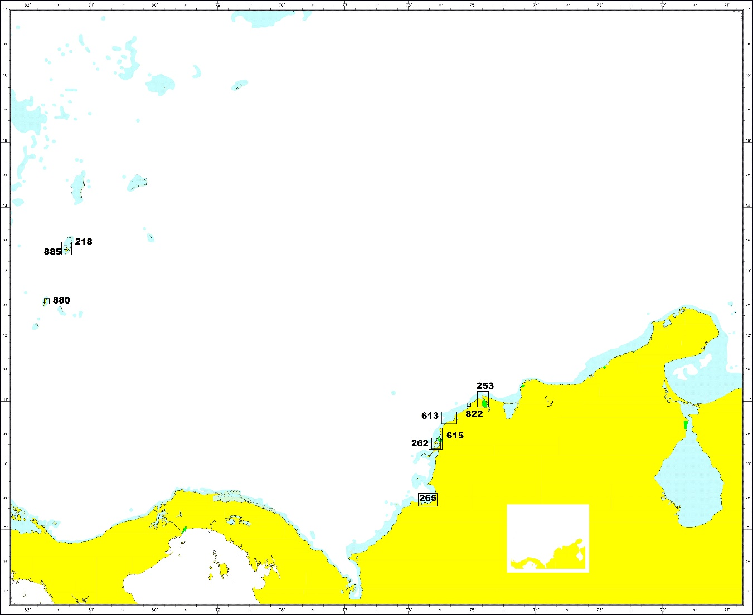
  3. New nautical charts and update
Caribbean Sea
265 Aproximación a Coveñas y Santiago de Tolú
262 Bahía de Cartagena
253 Río Magdalena
880 Puerto de San Andrés
885 Bahía de Santa Catalina
218 Isla de Providencia
613 Galerazamba a Punta Morro Hermoso
615 Punta Gigante a Punta Canoas
822 Santa Verónica a Punta Morro Hermoso

Slide 10

  3. New nautical charts and update
Num | Title
153 | Bahía de Buenaventura
730 | Puerto de Buenaventura
770 | Puerto de Tumaco
Pacific Ocean

Slide 11
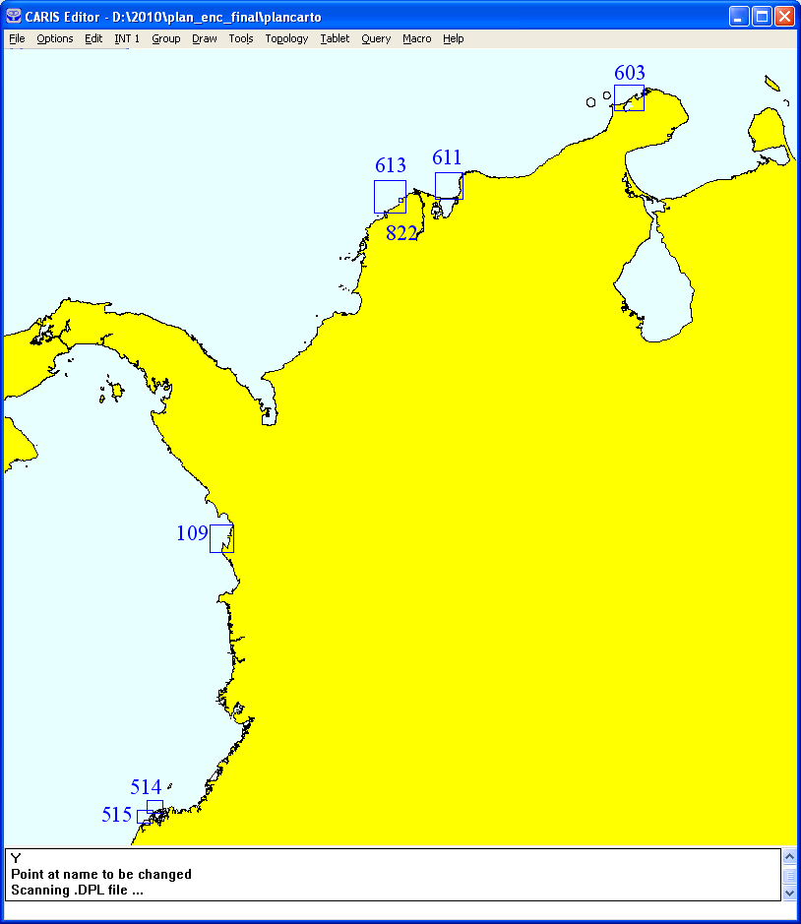
  3.
  ENC New editions
 | ENC
1. | CO400603
2. | CO400611
3. | CO400613
4. | CO400514
5. | CO400515
6- | CO400109
7. | CO500822

Slide 12
  3. Update charts Caribbean
ÍTEM | CHART No. | TITLE
01 | 625 | Bahía Colombia
02 | 008 INT 4025 | Cabo Gracias a Dios a Santa Marta
03 | 029 | Golfo de Urabá a Barranquilla
04 | 407 | Puerto Colombia a Santa Marta
05 | 404 | Punta la Vela a Cabo de la Vela
06 | 245 | Ciénaga
07 | 005 | Carta General del Caribe Colombiano
08 | 618 | Golfo de Morrosquillo
09 | 280 | Cabo Tiburón a Isla Terrón de Azúcar
10 | 406 | Santa Marta a Cabo San Agustín
11 | 612 | Aproximación a Barranquilla
12 | 028 | Barranquilla a Punta Espada
13 | 403 | Cabo de la Vela a Punta Gallinas
14 | 410 | Isla Fuerte a Punta Comisario
15 | 412 | Golfo de Urabá
16 | 603 | Aproximación a Bahía Porterte
17 | 229 | Bahía Portete
18 | 246 | Puerto Zúñiga
19 | 804 | Bahía de Santa Marta
20 | 007 | El Gran Caribe
21 | 244 | Bahía de Taganga a Punta Barro Blanco
22 | 022 INT 4122 | Isla de San Andrés a Isla de los Mosquitos
23 | 023 INT 4120 | Golfo de los Mosquitos a Punta de los Mosquitos
24 | 402 | Punta Gallinas a Cabo Chichibacoa
25 | 409 | Bajo Tortuguilla a Punta Canoas
26 | 261 | Bahía de Cartagena
27 | 833 | Bahía de Cartagena (Cnal de Acceso)
28 | 608 | Aproximación a Puerto Brisa
29 | 808 | Puerto Brisa
30 | 202 | Rada El Cove - 882

Slide 13
  3. Update charts Pacific
ÍTEM | CHART No. | TITLE
01 | 306 | Río San Juan a Boca Yurumanguí
02 | 520 | Isla Gorgona
03 | 521 | Isla Malpelo
04 | 515 | Punta Mulatos a Pasacaballos
05 | 514 | Isla Caruma a Punta Mulatos
06 | 101 | Aproximaciones a Isla El Morro
07 | 280 | Cabo Tiburón a Isla Terrón de Azúcar
08 | 308 | Punta Coco a Isla Barrera
09 | 302 | Golfo de Tribugá
10 | 032 INT 6110 | Bahía de Buenaventura a Bahía Ancón de Sardinas
11 | 303 | Nuquí a Punta Catripe
12 | 308 | Punta Coco a Isla Barrera
13 | 310 | Punta Isla Cascajal a Río Mataje
14 | 107 | Bahía de Cupica a Chirichiri
15 | 003 INT 6000 | Bahía de Panamá a Cabo San Francisco
16 | 145 | Cabo Manglares
17 | 135 | Bocana de Iscuande
18 | 137 | Boca de Sanquianga
19 | 103 | Isla Mono a Juradó

Slide 14
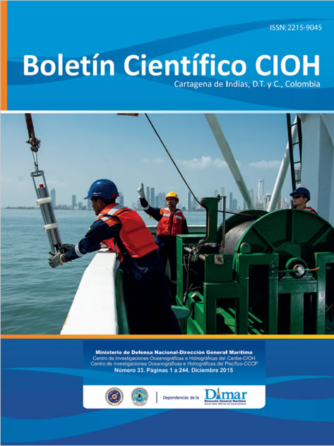
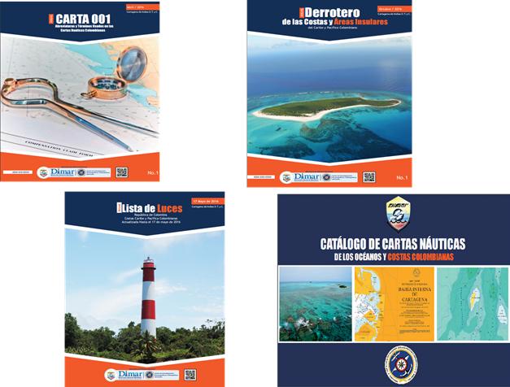
  4. New Publications

Slide 15
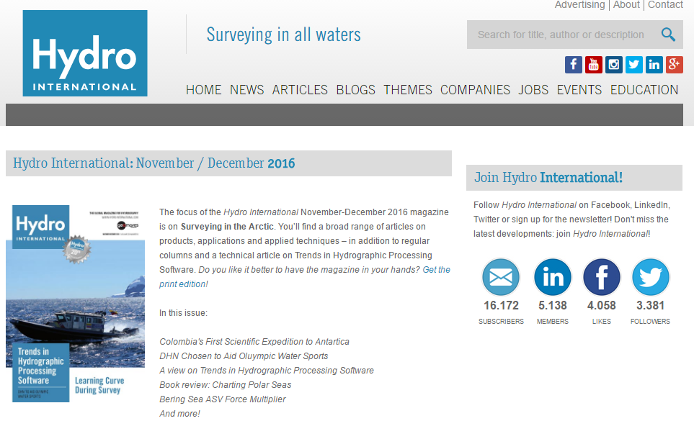
  4. New Publications

Slide 16
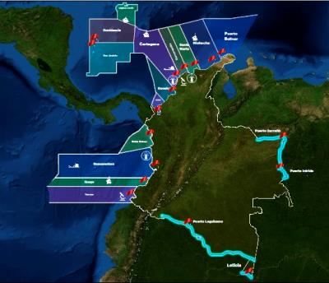
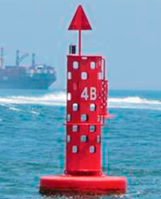
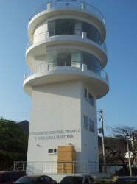
  5. MSI
Aids to Navegation IALA
VTS station

Slide 17
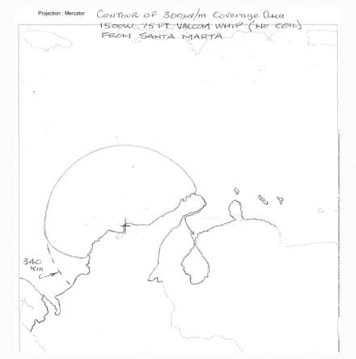
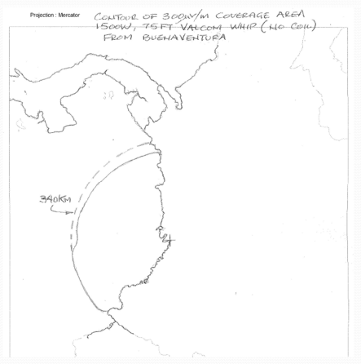
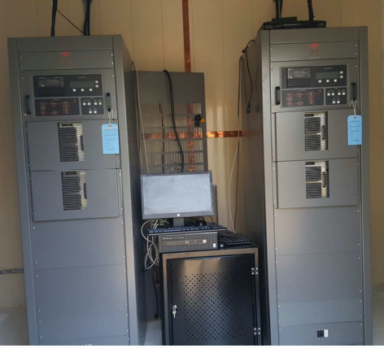
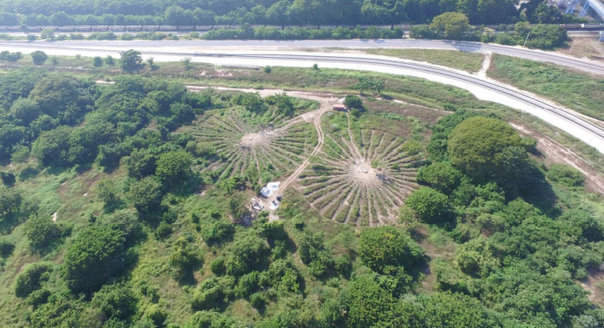
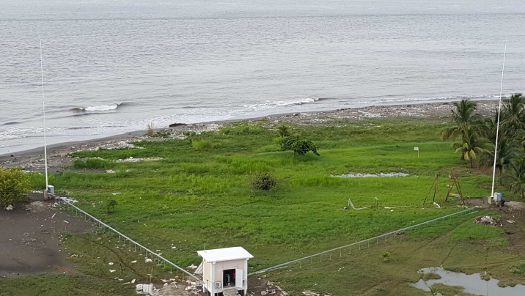
  5. MSI
NAVTEX:
518 Khz English & 490 Khz Spanish… 47 reports

Slide 18
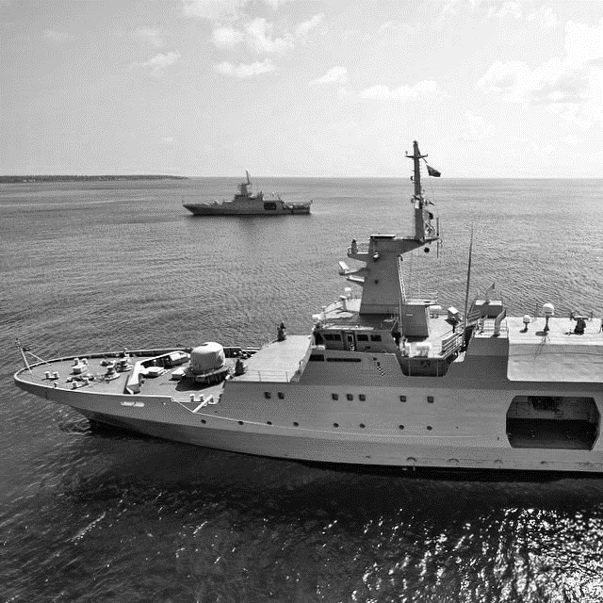
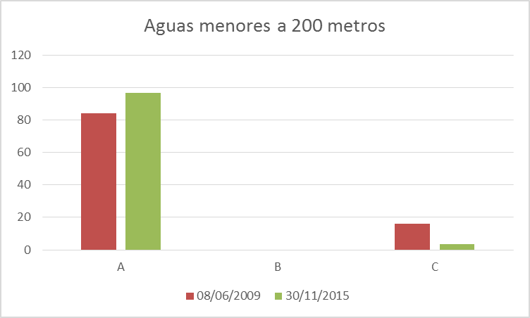
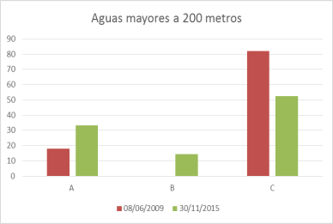
  6. C-55.
 | A | B | C
Depths < 200m | 96,7 | 0 | 3,3
Depths > 200m | 33,2 | 14,4 | 52,4

Slide 19
  6. C-55. December 2015
Purpose/Scale | A | B | C
Offshore passage/Small | 100 | 0 | 100
Landfall and Coastal passage/Medium | 100 | 0 | 100
Approaches and Ports/Large | 90.4 | 0 | 62.7
Percentage of Group A showing depths in meters | 100
Percentage of Group A referenced to a satellite datum | 100
Hydrographics Surveys
SERVICE | Yes | No | Partial | NOTES
Local Warning | X
Coastal Warning | X
Navarea Warning | X |  |  | In Cooperation to USA Area IV
Information on Ports and Harbours | X
Nautical Charting
SERVICE | Yes | No | Partial | NOTES
Master Plan |  | X |  | On going
A1 Area |  |  | X | Cover the 90 % approximately
A2 Area³ |  |  | X | Cover the 100 % approximately
A3 Area³ |  | X
NAVTEX | X
SafetyNET |  | X
Sub-area Warning

Slide 20
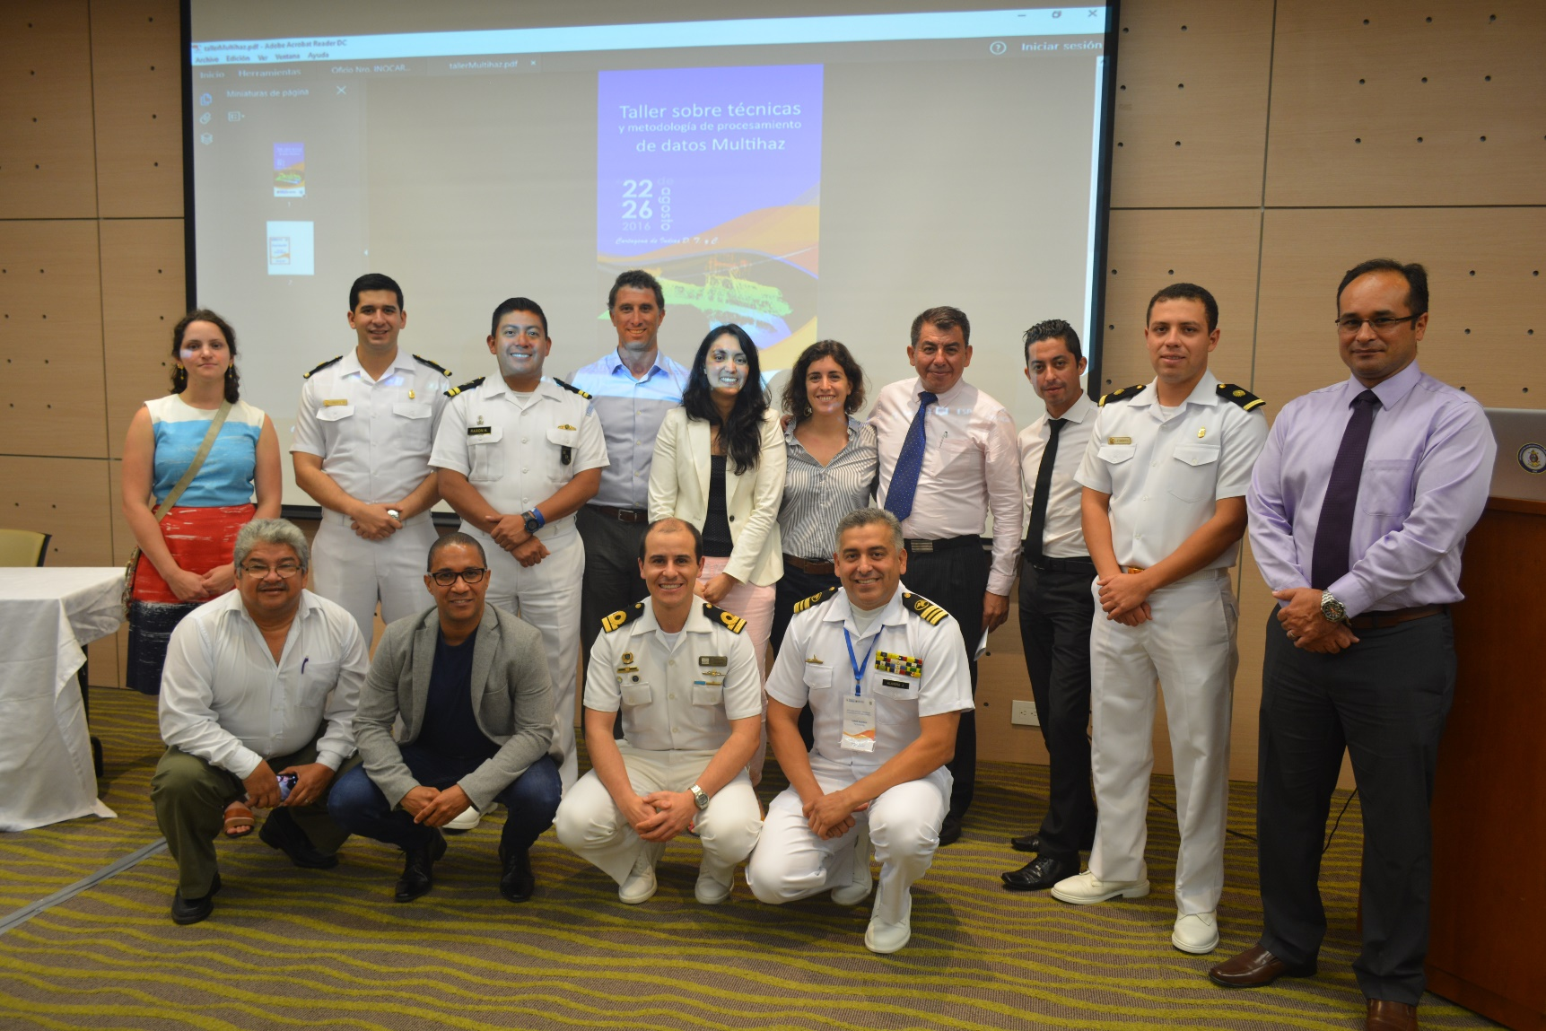
  7. Capacity Building
Workshop MBz in Cartagena
  SEPHC, MACHC and SWAtHC

Slide 21
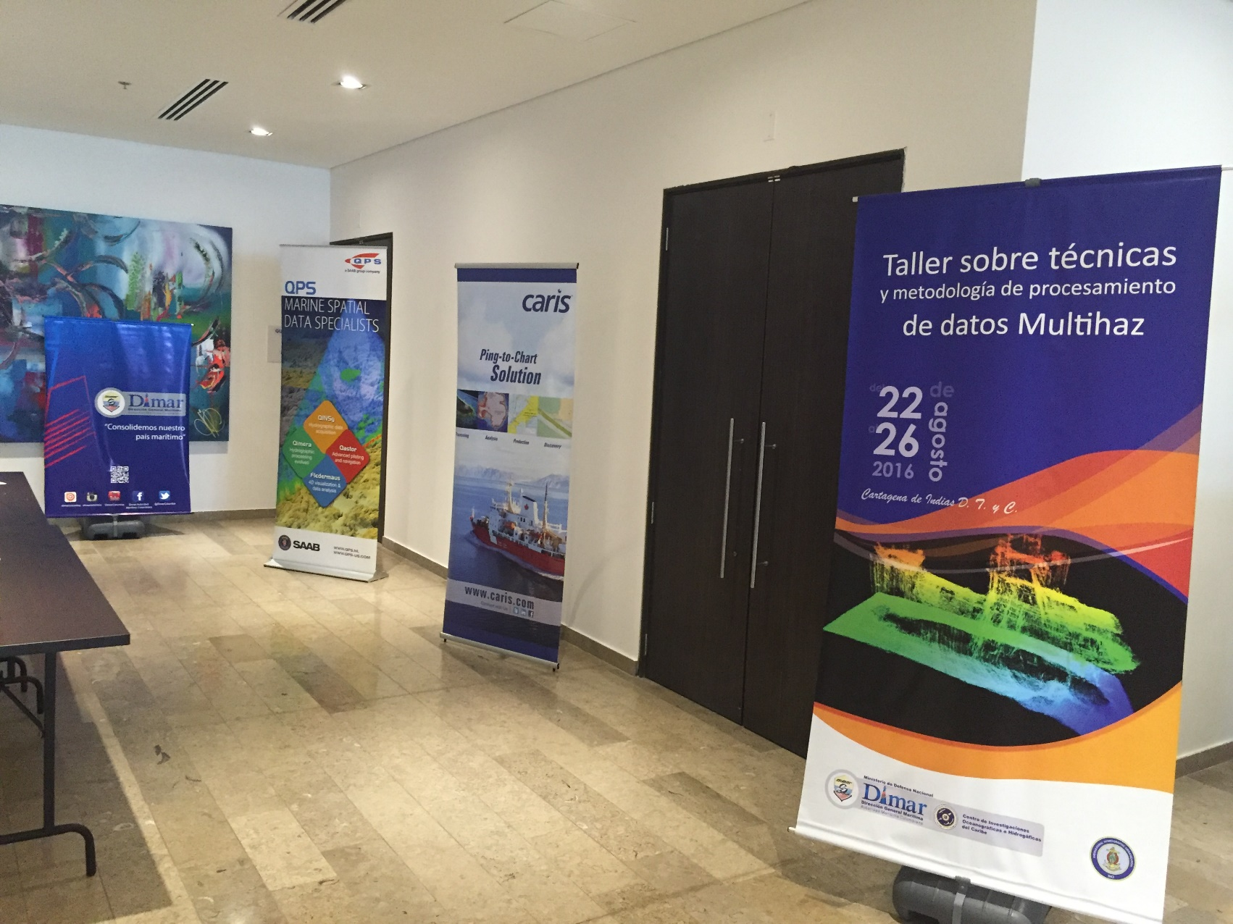
Workshop MBz in Cartagena
  30 Attendees
  8 Countries
  Companies
  2 Local Companies

Slide 22
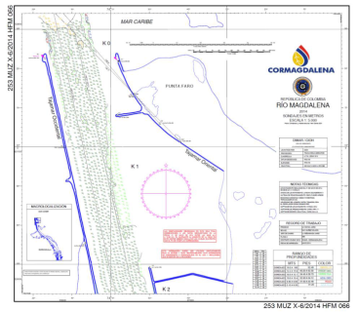
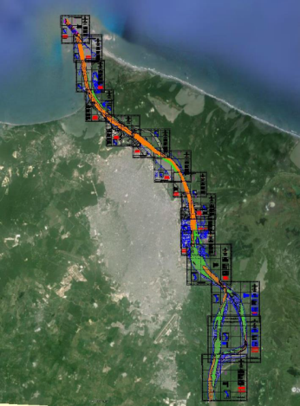
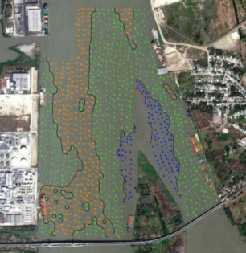
  7. Capacity Building
Surveys rivers
Hydrographic surveys with monobeam system in Access channel to Barranquilla port

Slide 23
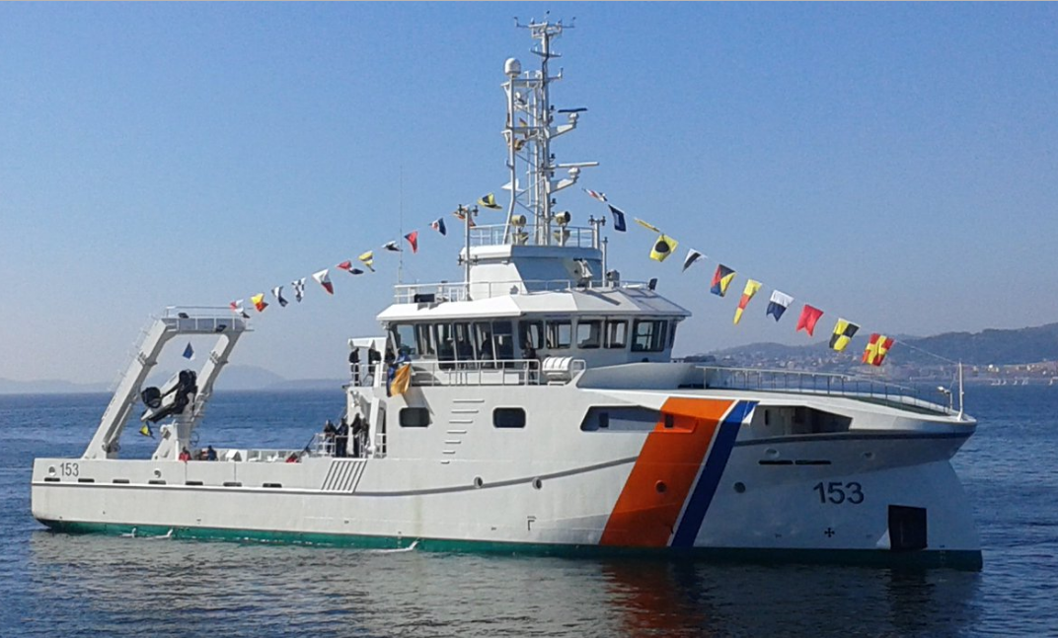
  7. Capacity Building
ARC Roncador. Hydrographic and Oceanographic vessel
Built in Spain. The next will be in Colombia COTECMAR

Slide 24
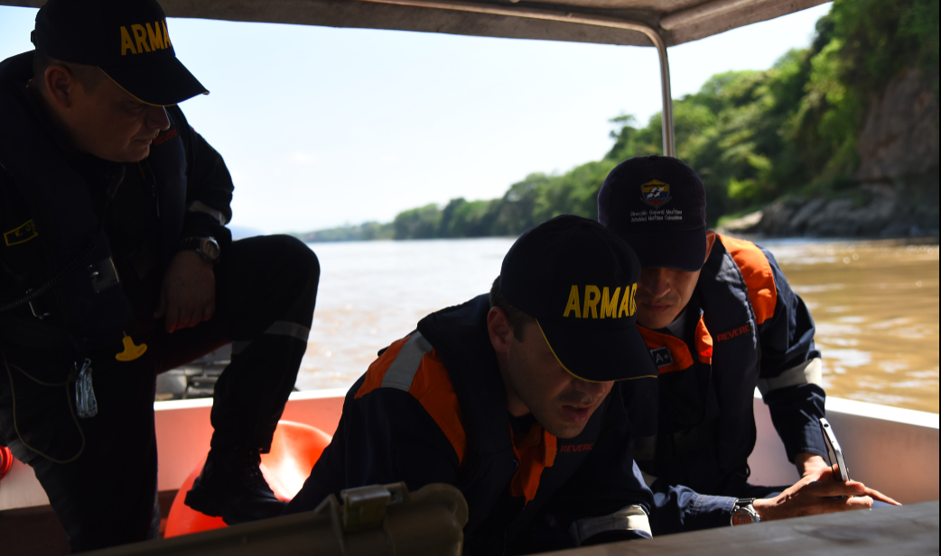
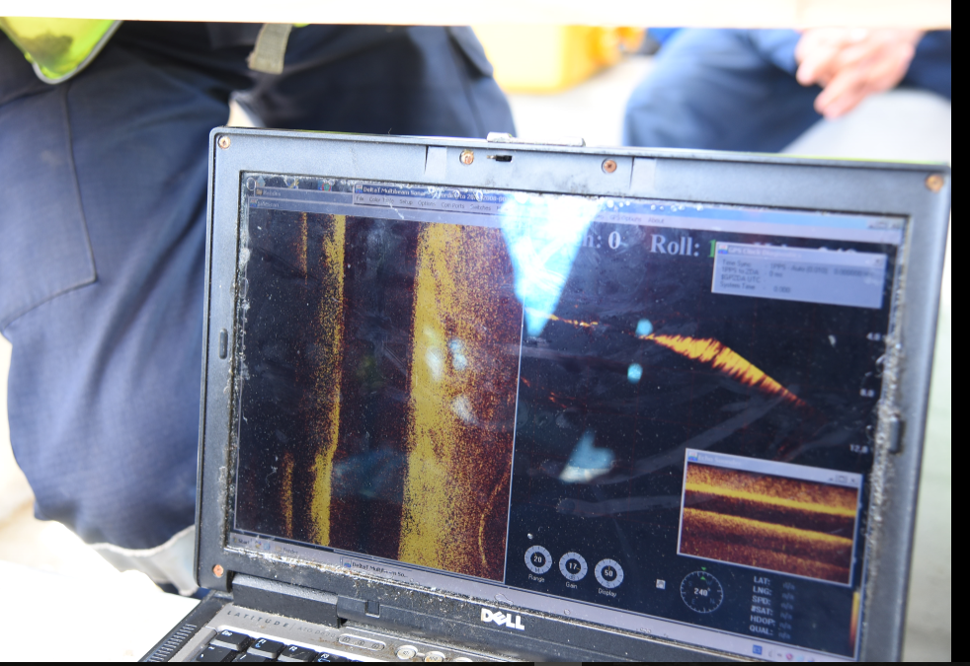
  7. Capacity Building
Searching plane in River

Slide 25
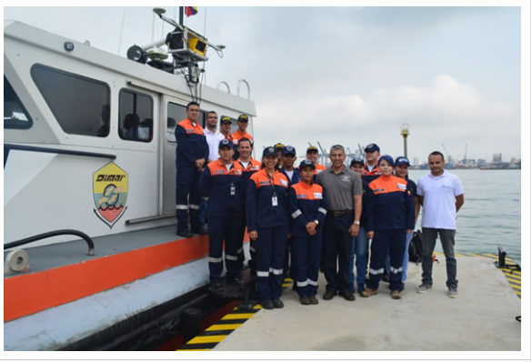
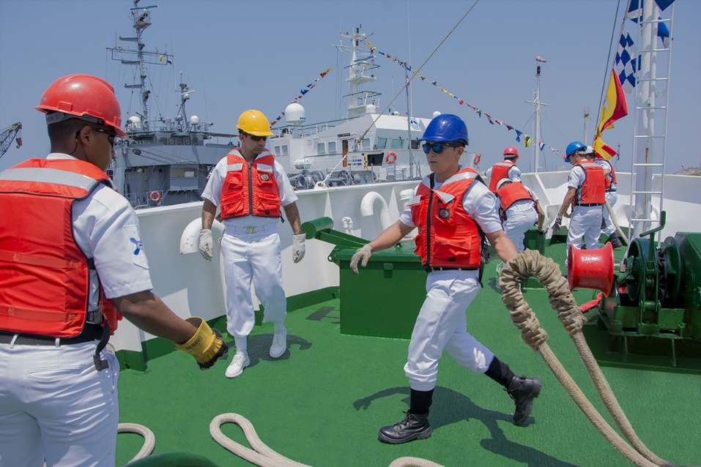
  7. Capacity Building
  Caris HPD
  Caris Hips & Sips
  Hypack
  Tide Brazil
  MSI Mexico
  MSDI Mexico
  VTS Argentina
  Validation ENC Panama UK
  17th Hydrographic Course ENSB

Slide 26
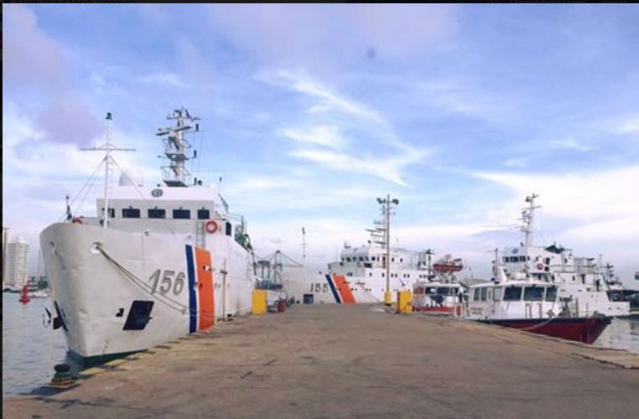
  7. Capacity Building
SISTEMA MULTIHAZ EM 302
SISTEMA MONOHAZ EA 600
PERFILADOR DE SUB-FONDO MARINO SBP 300
CORRENTÓMETRO ADCP (5KLP)
SISTEMA MULTIHAZ ATLAS MD-2-30
SISTEMA MONOHAZ EA600

Slide 27
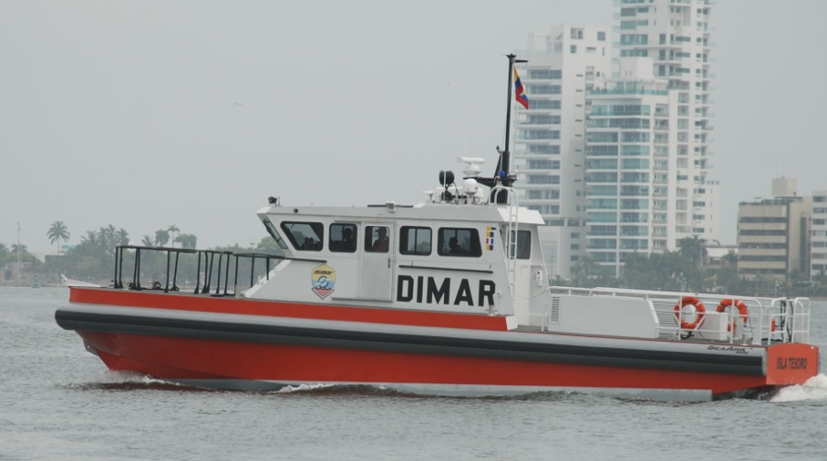
  7. Capacity Building
05 BOATS PILOT

Slide 28
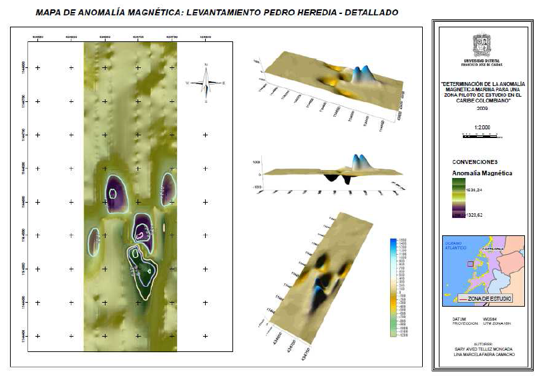
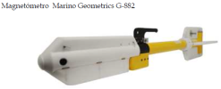
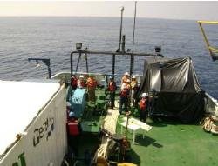
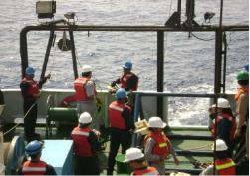
  7. Capacity Building. Geomagnetism

Slide 29
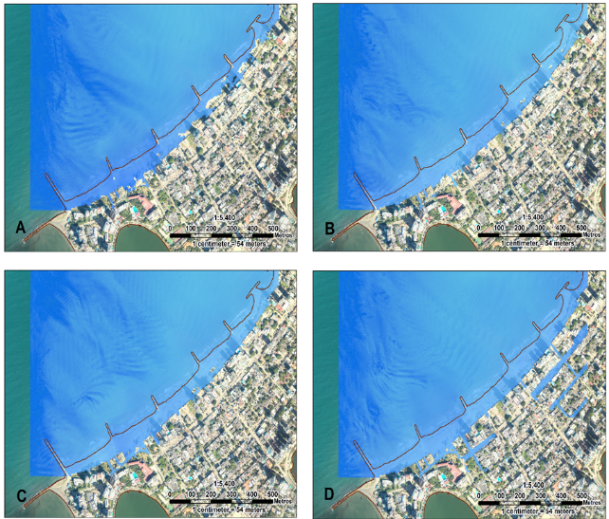
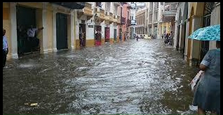
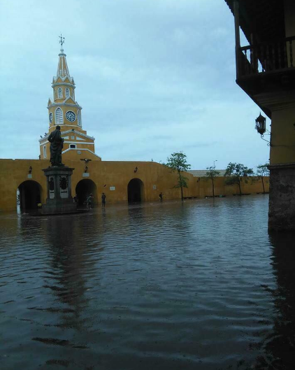
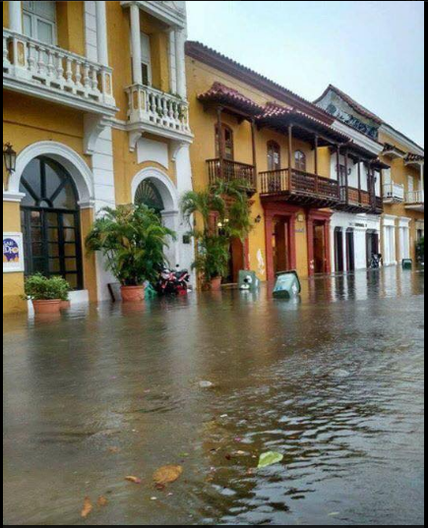
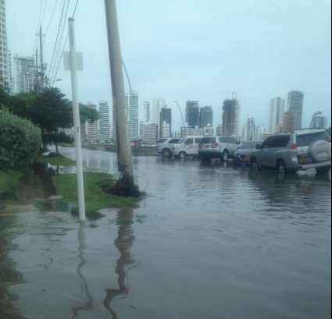
  7. Capacity Building
Calculation of flood quota

Slide 30
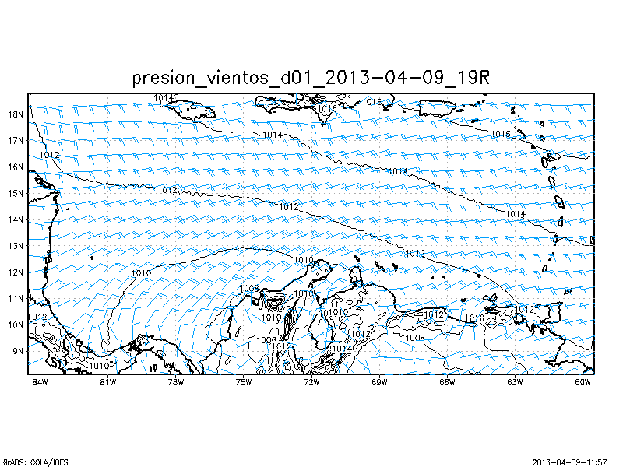
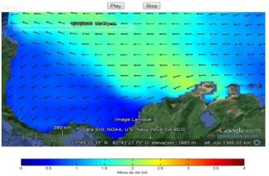
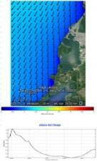


  8. Oceanographic activities
Numeric Modelation
SPOA
Forecast System DIMAR
Modelo atmosférico WRF: vientos, presión, precipitación, temperatura, humedad relativa, entre otros. Resolución - 6 km.
Modelo de oleaje CARIBWAM: Oleaje a escala regional para aguas profundas. Resolución - 18 km..
Modelo hidrodinámico: TSM, salinidad, corrientes. Escala: Regional.
Modelo de oleaje SWAN: oleaje a escala local para los principales puertos. Resolución - 0.5 km.

Slide 31








  8. Oceanographic activities
Information local scale - Support Off shore activities
Currents, temperature and salinity
Spills model
Waves
Meteorological

Slide 32

  8. Oceanographic activities

Slide 33



  8. Oceanographic activities
TSUNAMI CENTER ALERT (CAT).
Capcity to predict the movement, size, force by wave tsunami. All to support the national risk committee

Slide 34

  8. Oceanographic activities

Slide 35

TSUNAMI CENTER ALERT (CAT).
CISN DISPLAY

Slide 36



ARC Quindio (Ret) Coral reef place
  8. Oceanographic activities

Slide 37



Environmental Protection
  8. Oceanographic activities

Slide 38
  9. Other activities
The HO participated in the XXXIII meeting of the General Ocean Bathymetric Chart (GEBCO) Steering Committee held in the city of Valparaíso, Chile
a. Provided the bathymetric information collected during the first Colombian scientific expedition to Antarctica, to GEBCO
b. During the celebration of Science Day, the CIOH presented the results of the project "Bathymetric Model Derived from High Resolution Satellite Images" developed jointly with the Agustín Codazzi Geographic Institute during the last three years.
International seminar about producer hydrocarbons agencies. The meeting led by the National Hydrocarbons Agency with the support of the Ministry of Mines and Energy of Colombia brought together regulatory agencies, companies, organizations and public and private institutions from Europe, Asia, the Middle East and the Americas

Slide 39
  10. Conclusions.
Colombia HO will continue doing marine scientific research in the oceans and rivers of Colombia, giving support to the people, bringing peace to the national territory and contributing with other countries for the maintenance of the safety in the navigation and the cleanest of the oceans.

Slide 40
Thanks
“Consolidando nuestro País marítimo”
“CIENCIA Y SOBERANÍA”

