Slide 1
National Report Guatemala
Captain
ERIK ROLANDO SANCHEZ CONTRERAS
General Director of Maritime Affairs (DMA)

Slide 2
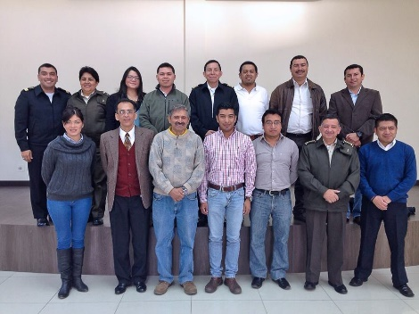
Hydrographic Office/Service:
Directorship of Maritime Affairs and National Commission of Hydrography and Oceanography (CIIHO).

Slide 3
HYDROGRAPHY & OCEANOGRAPHY
DIRECTORATE
Promote the link between hydrography and oceanographic agencies both national or international.
Follow up on the commitments made by Guatemala as active part of the IHO & the MACHC.
Perform & supervise hydrographic surveys in national waters.
Coordinate research trough the national commission of Hydrography and oceanography, CIIHO

Slide 4
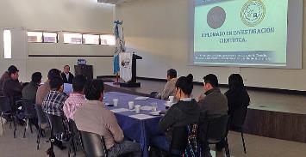
National Commission of Hydrography and Oceanography (CIIHO)
Regulation law that it creates, Government Agreement 254-85 (civilians and military scientist)
Formed by
Ministry of National Defense (Chairmanship)
Ministry of Communications (Ports and Meteorological Institute)
Ministry of Agriculture (Directorate of Fisheries)
National Geographic Institute
Ministry of Foreign Affairs (Directorship of International Limits and Waters)
Ministry of Energy and Mines

Slide 5
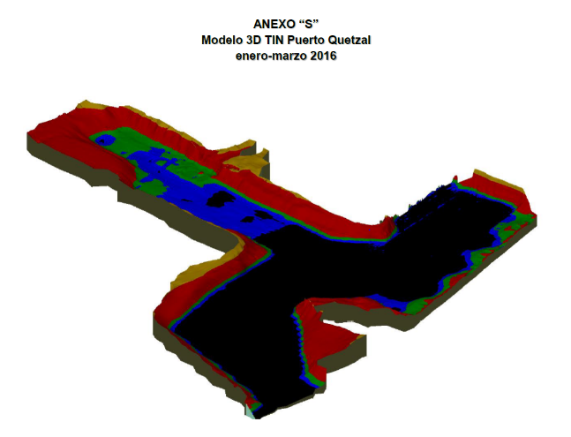
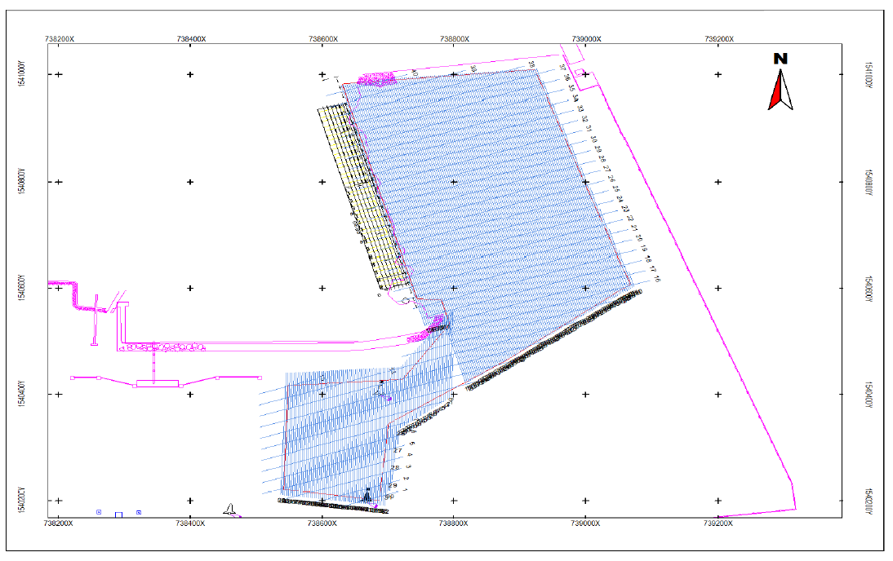
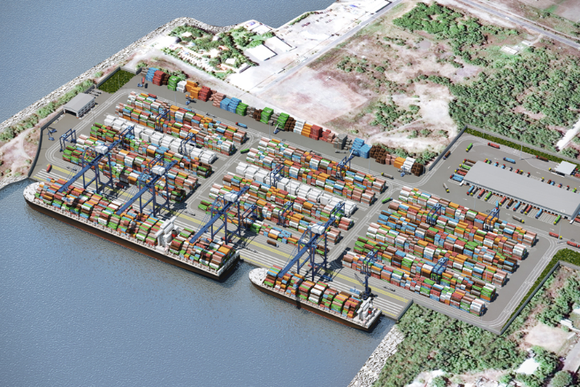
Surveys 2016: Quetzal port TCQ

Slide 6
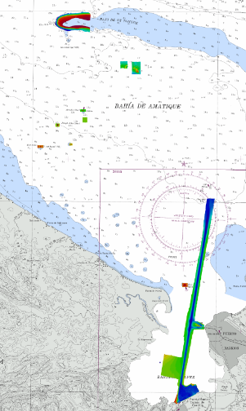
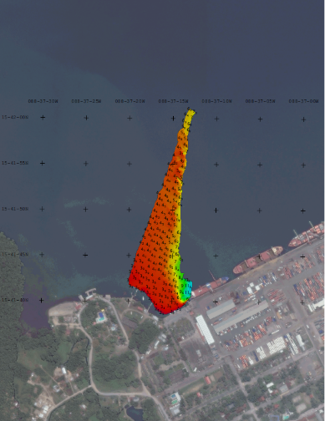
Amatíque Bay Special Order

Slide 7
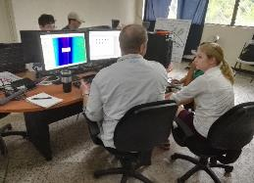
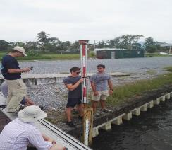
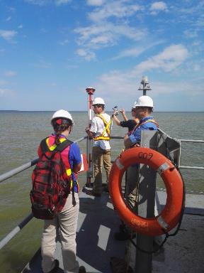
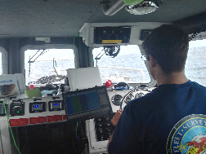
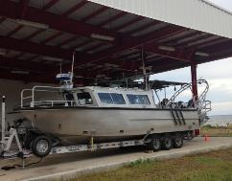
Amatíque Bay H. Survey

Slide 8
New charts and updates:
Guatemala doesn’t have resources for the production of nautical charts. However, in the past US promulgated new charts and updates of Guatemalan Waters. Consequently, the Directorship of Maritime Affairs is trying to sign the agreement with the United Kingdom Hydrographic Office (UKHO)

Slide 9
New publications:
Not applicable. US promulgate nautical publications of Guatemalan Waters
MSI:
NGA (US) is the NAVAREA IV and XII Coordinator within the IMO/IHO World-Wide Navigational Warning Service. (Including maritime areas of Guatemala). Consequently, the Department of Hydrography and Oceanography has direct communication with this agency in order to share maritime safety information.

Slide 10
IHO PUBLICATION C-55
Status of hydrographic survey of all navigable waters, including internal waters, out to the limits of the EEZ: Survey coverage, where:
A = percentage which is adequately surveyed.
B = percentage which requires a re - survey at larger scale or to modern standards.
C = percentage which has never been systematically surveyed.
 | A | B | C
Depths < 200m | 10 | 60 | 30
Depths > 200m | 0 | 0 | 100

Slide 11
Capacity Building
Training course on hydrographic data processing, one Navy Officer, 12-15th of July, Veracruz, Mexico
Training course on Maritime Safety Information in the island of St. Lucia 16-18th August
Workshop on multibeam data processing, one Navy Officer, 22-26th August Cartagena Colombia,
Symposium on Oceanography, fisheries, aquaculture and Climate Chance, three Navy Officers, 21-23th September, San Carlos University, Guatemala.
Course of Ocean Observation and Hydrographic surveys in Busan, two Navy Officers, September 26th till October 14th , City of Busan, Republic of Korea.
Training course on Marine Spatial Data Infrastructure in Veracruz, one Navy Officer, 03-07 October, in Veracruz, Mexico.
Training course on Maritime Safety Information, one Navy Officer, 28-30th November, Veracruz Mexico.
E-learning Basic Course of Hydrography, 14 navy officers, Directorship of Maritime Affairs, Guatemala, still on going.

Slide 12
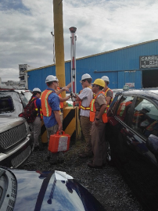
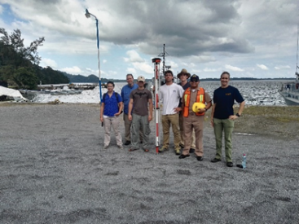
Other activities:
Aids to Navigation
Geo-positioning of the aids to navigation using GPS GNSS in Amatíque Bay, during the hydrographic survey with Fleet Survey Team.

Slide 13
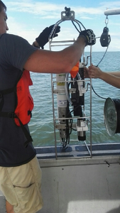
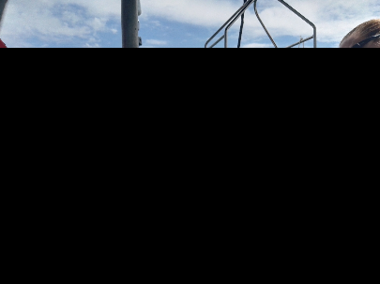
Seafloor Samples and Oceanographic information
Profiles of temperature, salinity and depth, moreover, seafloor sampling as part of the hydrographic survey in Amatíque Bay.

Slide 14
Conclusions:
Guatemala promotes research throughout the National Hydrographic and Oceanographic Commission, uniting human and material resources with the purpose of creating spatial data of the country. Moreover, other governmental institutions like universities and Ngo´s, however, the change of government and authorities has a direct effect in the national activities.
Interagency cooperation is vital for Guatemala in order to achieve the international responsibilities. Besides that, our national capacities are growing with the support of the MACHC, however, the lack of equipment is our main weakness.

Slide 15
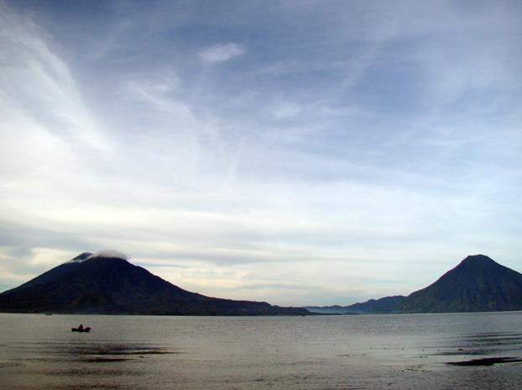
Thank you!!

