Slide 1
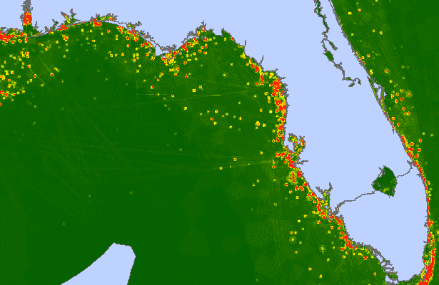
Establishing Survey Priorities through the Assessment of Hydrographic Health (Gap x Risk) Katie Ries, NOAA December 2016 MACHC Meeting

Slide 2
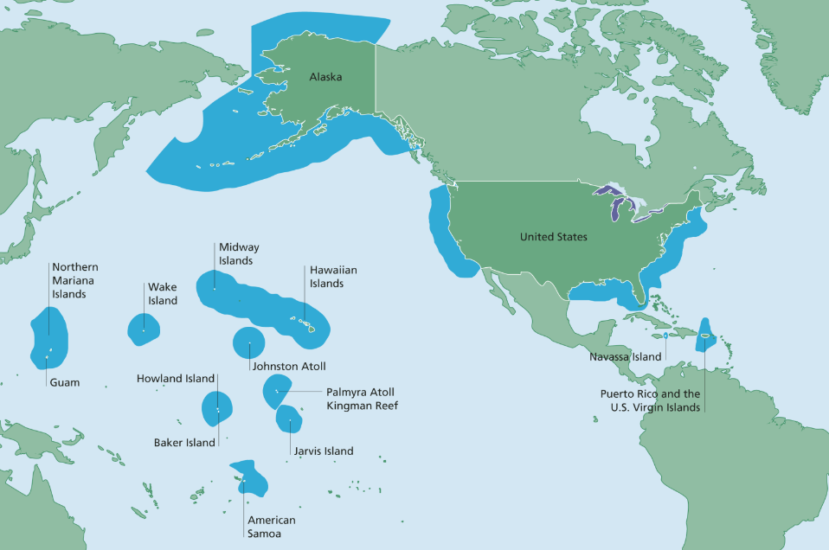
Coastline: 95,000 miles
EEZ: 3.4 SNM

Slide 3
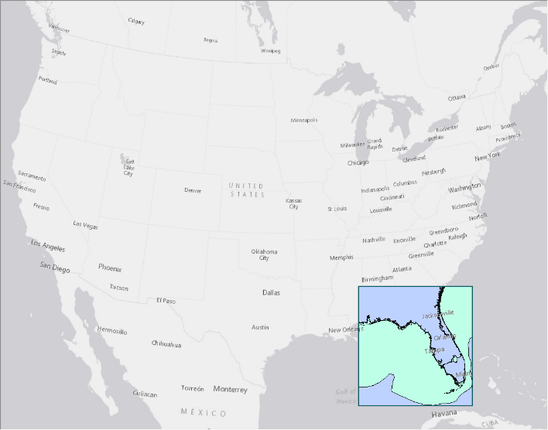
An Updated Approach
Test area…

Slide 4
A Model of Hydrographic Health
Hydrographic Gap
The difference between the desired and present survey score; the larger the gap, the worse the hydrographic health.
Hydrographic Risk
Modeled as the risk to surface navigation due to inaccurate depths or unknown hazards; the greater the risk, the worse the hydrographic health.

Slide 5
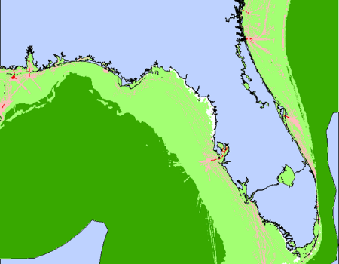
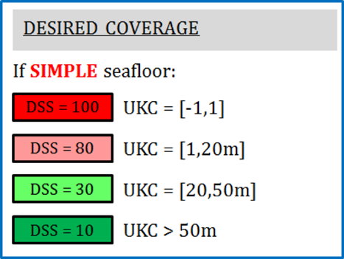
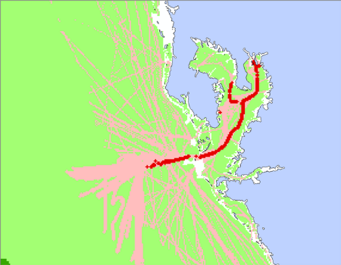
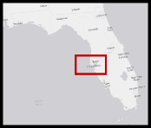
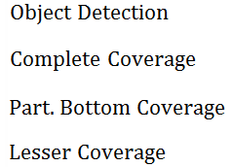
Title
Under Keel Clearance:
Join AIS records with AVIS database to query vessel draft.
Compare with local depth to estimate Under Keel Clearance.
Define coverage requirement based on proximity to seafloor.

Slide 6
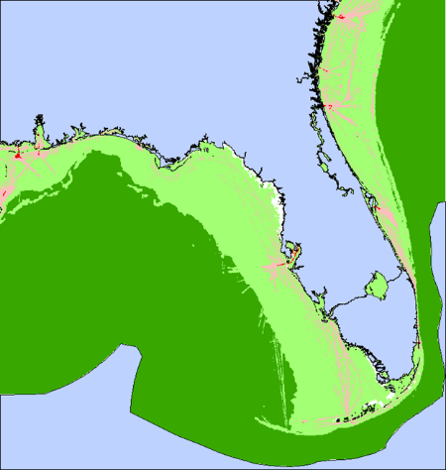
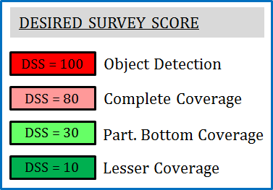
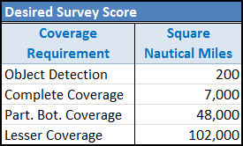
Title
Desired Survey Score

Slide 7
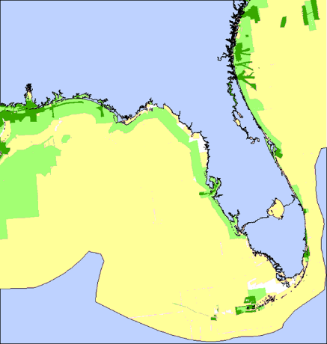
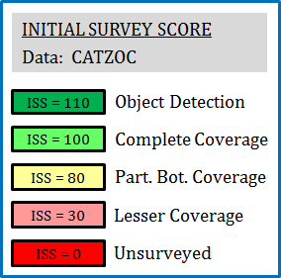
Title
The Present Survey Score is combination of the Initial Survey Quality, the Changeability of the area, and the Time Elapsed since the area was last surveyed.
Initial Survey Quality is strictly a function of CATZOC.

Slide 8
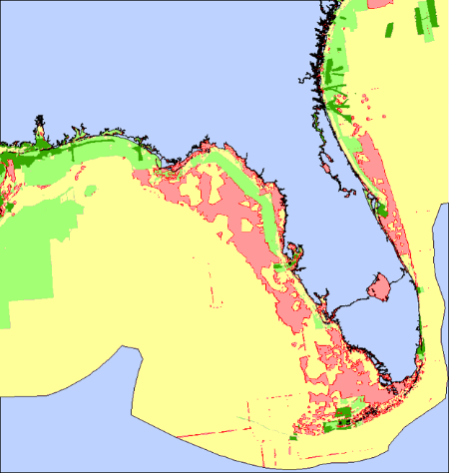
Title
All Depreciation Terms: Past to Present
Initial Survey Score
Present Survey Score

Slide 9
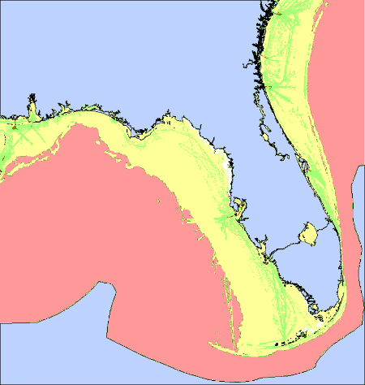
Title
Hydrographic Gap: Desired – Present Survey Score
Desired Survey Score
Present Survey Score

Slide 10
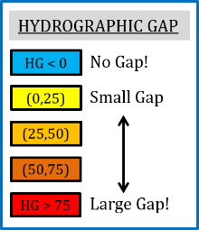
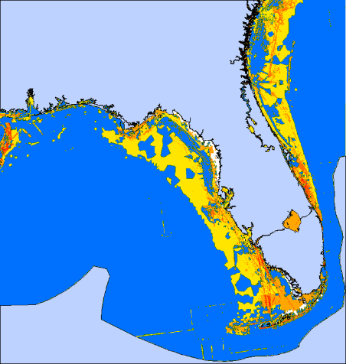
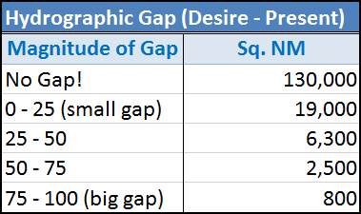
Title
Hydrographic Gap: Desired – Present Survey Score

Slide 11
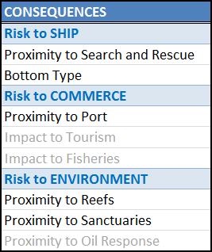
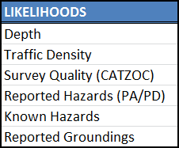
Title
Total Risk = Risk to Ship +
Risk to Commerce +
Risk to Environment
* Terms in gray not presently incorporated into model.
Model designed to be modular in nature… include what you can.

Slide 12
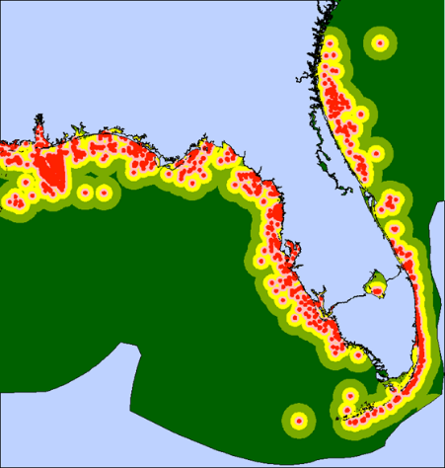
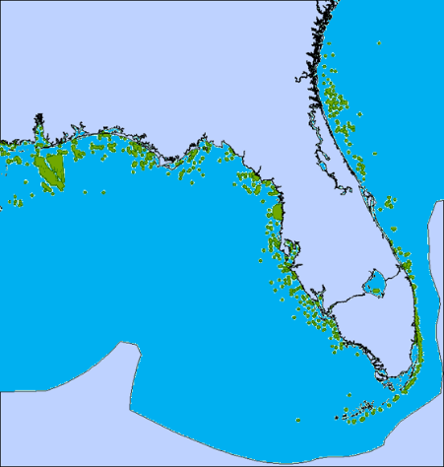
Title
Consequence to Reefs (dependent on vessel type):
Tanker
Other

Slide 13
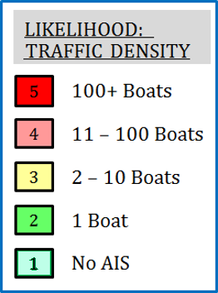
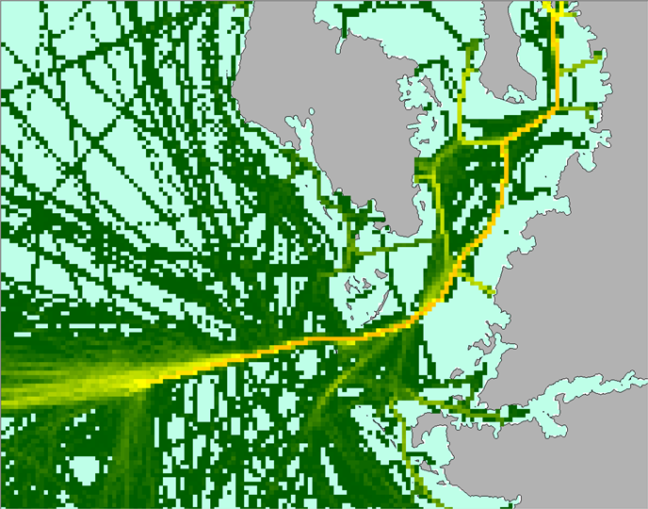
Title
Likelihood due to Traffic density (Unique vessel count):

Slide 14
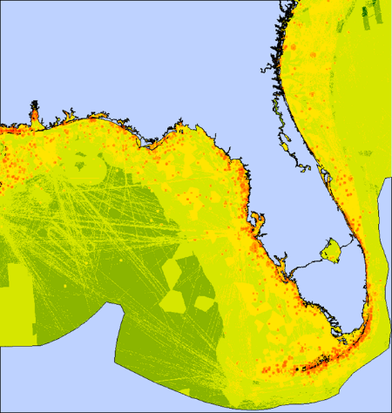
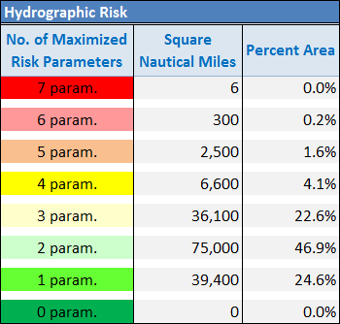
Title
Hydrographic Risk: (average 2.1)

Slide 15
Title
Hydro. Gap
Hydro. Risk

Slide 16
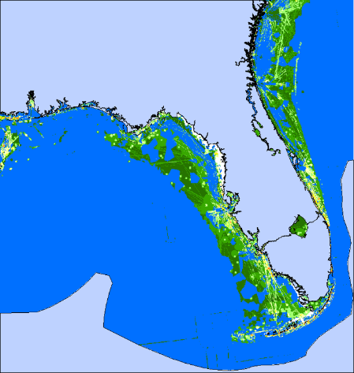
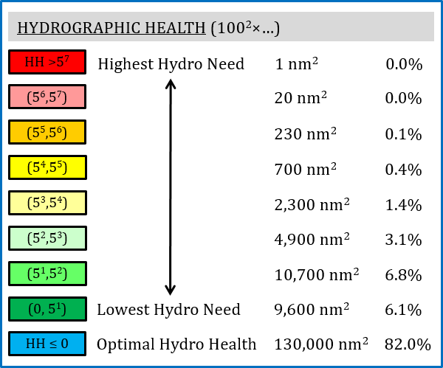
Title
Hydrographic Health:
What to do with this information?

Slide 18
This is a substantial improvement over previous methods.
Dynamic and data driven
Captures annual change instead of a false assumption of a one-and-done approach
This only looks to the safety of surface navigation, primarily grounding risk.
This is not the only use of the chart nor the only purpose of navigation, and therefore it is not the only input into deciding where OCS will survey.

