Slide 1
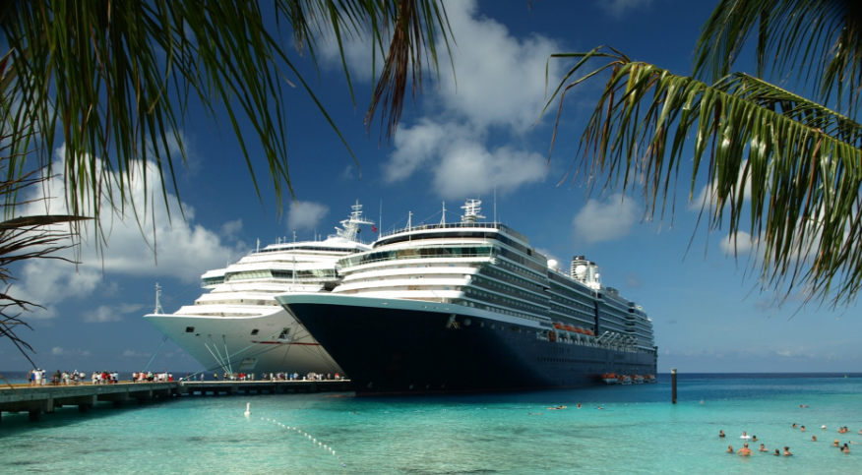
Risk Assessment of Maritime Navigation across the Greater Caribbean Region (GCR)
Dawn Seepersad
Student - PhD Geoinformatics
The University of the West Indies

Slide 2
Introduction
This study will conduct a risk assessment of maritime navigation across the GCR.
In this presentation a case is made for conducting a risk assessment across the GCR.

Slide 3
About the Presenter
The University of the West Indies:
Student - PhD. Geoinformatics Programme
MSc. Geoinformatics
BSc. Geomatics Engineering and Land Management
GIS Assistant – Niue Hydrographic Risk Assessment
Land Information New Zealand (LINZ), Wellington
GIS Intern – Flood Risk Assessment of the Greater Toronto Area
York University, Canada

Slide 4
Problem
The availability and quality of hydrographic data and support for navigational practices across the GCR might be improved to:
Support safety of life at sea
Reduce the risk of marine pollution
Support the expansion of economic development

Slide 5
Factors Affected by the Problem
Trade and marine traffic
Economic expansion
Advantages of our geopolitical location
Freight cost and international competitiveness
Salvage challenges for mega-ships
Obligations under SOLAS & MARPOL

Slide 6
1 – Hindrance to the Rate of Increase in Trade & Marine Traffic
Developing economies
Developed economies
WTO Agreement Implemented
Volume of Exports of Developed, Developing and Transitioning Economies: 1990 – 2009
Index: 2000 = 100. Source: WTO Secretariat Estimates

Slide 7
2 – Limit to Economic Expansion in the GCR
Most trade takes place in the ocean space because of competitive transportation costs and economies of scale.
100
80
60
 | Maritime
 | Air
 | Other
Percentage
40
20
0
Food & Line Animals
Beverages & Tobacco
Animal & Vegetable Oils
Animal & Vegetable Oils etc.
Chemical products
Classified Manufacturers
Machinery & transport equip
Other manufactured articles
International and Regional Trade of Goods that occur across the Greater Caribbean Region, 2003. Source: (Sanchez and Wilmsmeier 2009)

Slide 8
2 – Limit to Economic Expansion in the GCR
Potential for positive growth of export across CARICOM
Trinidad’s exported value for 2015: 12 bn USD
Export Growth of All Products – CARICOM
40
20
Annual export growth between 2014 – 2015, %
0
The bubble size is proportional to the exported value in 2015 of countries
- 20
- 40
- 15
- 10
- 5
0
5
10
Annual export growth between 2011 – 2015, % Source: International Trade Centre

Slide 9
2 – Limit to Economic Expansion in the GCR
The Caribbean is the number once cruise line destination in the world
Cruise Line Destinations
Source: Cruise Lines International Association (CLIA) (2016)

Slide 10
3 - Advantages of the Geopolitical Location of the GCR would not be Recognized
Transshipment triangle allows for hub and spoke as well as spillover opportunities.
(Sanchez and Wilmsmeier 2009)
Freeport
Rio Haina
Kingston
Port of Spain
Colon
Cartagena
Puerto Cabello
10

Slide 11
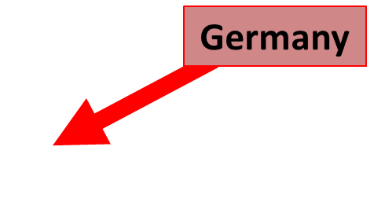
3 - Advantages of the Geopolitical Location of the GCR would not be Recognized
Alaska
China
USA
/Marine Traffic 2016
11

Slide 12
4 – Increase of Freight Cost may Decrease International Competitiveness
Lower freight cost can come from:
Increased traffic and volume
Better transport technology
Lower insurance costs, berthing fees and port handling charges
12

Slide 13
5 - Potential Increase of Marine Incidences & Salvage Challenges for Mega-Ships
Billion dollar shipping loss scenario:
19 000 container vessel capsizes/sinks resulting in total loss of the vessel and subsequent removal of the wreck.
Hull loss | $200m
Cargo loss | 19,000 containers at $35,000 per container = $532m
Removal of wreck and liabilities | $300m
Total | $1 bn long-term pollution

Slide 14
6 - Inability to Fulfill International Obligations
Safety of Life at Sea (SOLAS) Convention, requires contracting governments to provide navigation safety services
MARPOL Convention - preventing and minimizing pollution from ships - both accidental pollution and that from routine operations

Slide 15
Strategy for Risk Assessment of Maritime Navigation
Redefining LINZ Strategy to the Greater Caribbean Region

Slide 16
Existing Strategies for Risk Assessment & Prioritization of Surveys
Strategies for risk assessment & prioritization of surveys have been developed maritime departments including:
Land Information New Zealand
Canadian Hydrographic Service
Arctic Region Hydrographic Commission
National Oceanic and Atmospheric Administration

Slide 17
Use of LINZ Risk Assessment Strategy in the GCR
It is risk based and transparent against a detailed set of criteria
S-AIS vessel position information are used for the identification of shipping routes
The weighted overlay method is used therefore improving the accuracy of the results
It geographically identifies the cost or benefit of hydrographic surveying
The strategy was developed for a marine environment which is similar in many instances to the GCR’s.

Slide 18
LINZ Hydrographic Risk Assessment
Weighted Overlay Method
3 Criteria:
Vessel Traffic – potential loss of life & potential pollution
Likelihood – factors likely to cause a marine incident
Consequence – factors likely to be affected by a marine incident
Hydrographic Risk = Traffic * Likelihood * Consequence

Slide 19
Key Datasets Required for the Model
Vessel Traffic Criteria | Likelihood Criteria | Consequence Criteria
Satellite automatic identification system (S-AIS) | Met-ocean conditions Navigational complexity Aids to navigation Bathymetry Navigational hazards | Environmentally sensitive areas Culturally sensitive areas Economically sensitive areas

Slide 20
Weighted Overlay
1.
The study area is divided into grid cells.
The cell size determined by the granularity of the data.
New Zealand North Island
Beyond 12nm – 2km
Inside 12 nm – 1km
Harbor limits – 500m
New Zealand South Island

Slide 21
Weighted Overlay
Each cell value for each input is multiplied by the input’s weight of importance.
The resulting cell values are added for each criteria (vessel traffic, likelihood and consequence).
Hydrographic Risk = Traffic * Likelihood * Consequence

Slide 22
Results
Establish relative level of risk
Use ‘heat’-map to show risk levels at different locations
Assist policymakers in prioritizing chart improvements & other safety mitigations
Level of Risk
 | Nil
 | Insignificant
 | Low
 | Moderate
 | Heightened
 | Significant

Slide 23
LINZ Cost Benefit Analysis
Parameters of Cost Benefit Analysis include:
Cost of surveying
Loss of life reduction benefit/yr
Pollution reduction benefit/yr
Economic development benefit/yr
2% interest rate
Sum of benefits
A 10 year forecast is made where the benefits are realized once the surveying is completed (i.e. year two).

Slide 24
Proposed Research
There are limitations to directly implementing the LINZ strategy within the GCR
General Objective:
To conduct a risk assessment of maritime navigation across the GCR
Specific Objectives:
Mapping of:
Areas of risk within the maritime navigation areas across the GCR
The economic feasibility of risk management and mitigation plans

Slide 25
Proposed Strategy
To conduct a risk assessment of maritime navigation across the GCR:
To adopt the LINZ strategy as a foundation
Better define the risk criteria components to fit the GCR
Conduct the cost benefit analysis using direct costs and contingent valuation methods

Slide 26
Stakeholder Support
Requirements to move forward:
Support from experts to construct the weighted overlay
Evidence of the compliance with SOLAS and MARPOL regulations for your region, for example is there a VTS?
Information regarding:
Shipping
Navigational practices

Slide 27
Conclusion
The risk assessment of maritime navigation across the GCR for the prioritization of hydrographic surveys is necessary for the:
Safe and efficient navigation of vessels.
Protection of environmental and cultural resources within the maritime environment
Potential economic expansion
To prepare the GCR for future demands in the maritime transport system
As a regional project support is required from stakeholders.

