Slide 1
17th Meso-American & Caribbean Regional Hydrographic Commission Meeting
14-17 December 2016
Data Management and MSDI – Successes and Challenges
John Pepper
Secretary - IHO MSDIWG

Slide 2
Spatial Data Infrastructure (SDI)
SDI is “the relevant base collection of technologies, policies
and institutional arrangements that facilitate the
availability of and access to spatial data” .
Ref: Global Spatial Data Infrastructure (GSDI) Cookbook
It covers ...
processes that integrate technologies, policies, standards, and people
the structure of working practises and relationships across data producers and users for access, sharing and analysing geospatial information across government and commerce
hardware, software and system components necessary to support the processes
BUT it is not a central repository for data

Slide 3
SDI Operating Framework
the discovery of what data exists
the creation of foundational, coordinated ‘core geographic reference’ datasets
dataset interoperability
data publishing
data sharing including rights management
co-operation and communication between stakeholders

Slide 4
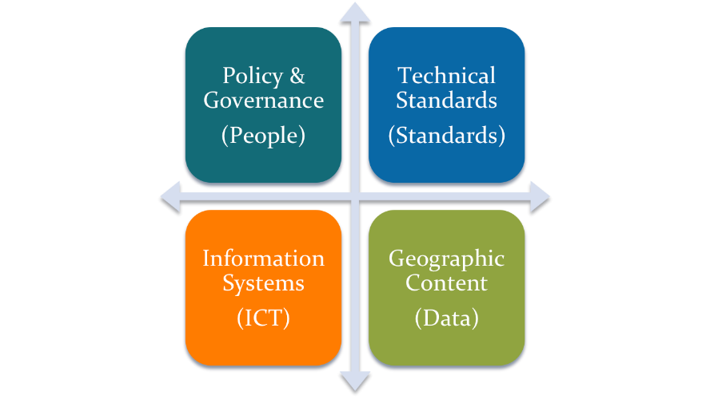
SDI Components - Four Pillars
KEY POINT

Slide 5
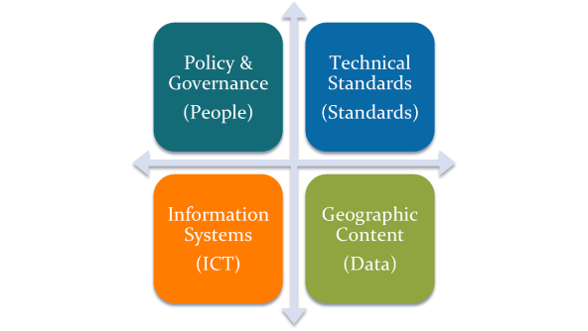
Education
Guidance Notes
Literature
Wikis
Knowledge Bases
Training
Mentoring
Sharing Best Practice
Consulting
Capability Building
Capacity Building
SDI SUCCESS

Slide 6
Policy and Governance
SDI Policy - Legislative (Act or Order)?
Mandatory or Optional participation?
Organisational Culture
People Skills and Knowledge
Training and Education
Change Management
Best Practise

Slide 8
Technical Standards
Standards should be treated as “enablers”
Use sector based standards with which the IHO is already compliant
SDI standards requirements ensures:
conformity
consistency
best practise is reflected but ...
can stifle innovation as is inflexible and
can be difficult to understand and implement

Slide 9
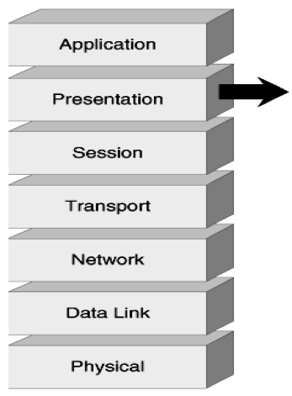
Information Systems (ICT) Open Systems Interconnector Model
7
6
5
4
3
2
1
Products & Services

Slide 10
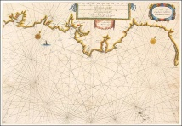
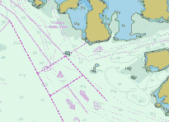
Geographic Content (Data)
Reference Data (e.g. Bathymetry, Structures, Borders)
Application Data (e.g. Caution Areas, Natural Resources)
Business Data (e.g. Environmental Statistics)
Personal Data (e.g. Supplier Contact Details)
Internal or Working Data (e.g. Product Schemes)
Publications and Services (e.g. Thematic Chart)

Slide 11
Bad to Good to Best Data Management
http://5stardata.info

Slide 12
MSDI 4 Pillar Model
Policy & Governance
(People)
Technical Standards
(Standards)
Information Systems
(ICT)
Geographic Content
(Data)
Our greatest challenges are here!
© OceanWise, 2011

Slide 13
Where are we now?
An increase in understanding and appreciation of the value and benefit of Data Management “best practise” and MSDI.
Governance at the organisational and / or data level still remains a challenge.
No coherent strategy or funding for MSDI related activities.
Decision makers do not understand MSDI

Slide 14
Where are we now?
Lack of a data policy/strategy
Legacy datasets and work practices do not support SDI.
Communicating with other departments not yet routinely happening
Lack of investment per se and specifically in people skills.
HO’s still do not like sharing their data…
…BUT

Slide 15
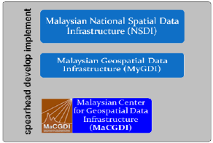
Success stories are starting to appear…
North Sea/Baltic Sea MSDIWG
Arctic SDI
Danish MSDI
Malaysian NSDI
NGIA
NOAA
France

Slide 16
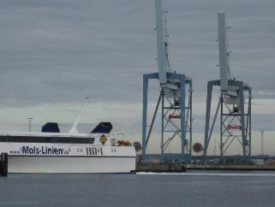
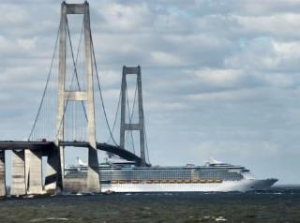
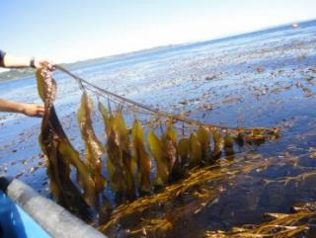
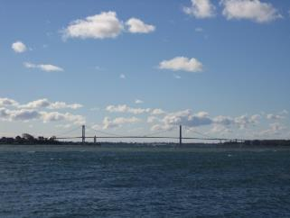
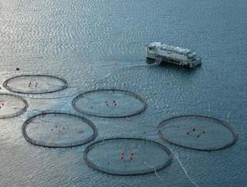
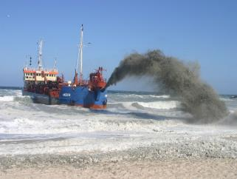
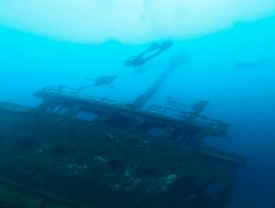
MSDI from a regional approach
BS-NSMSDIWG

Slide 17
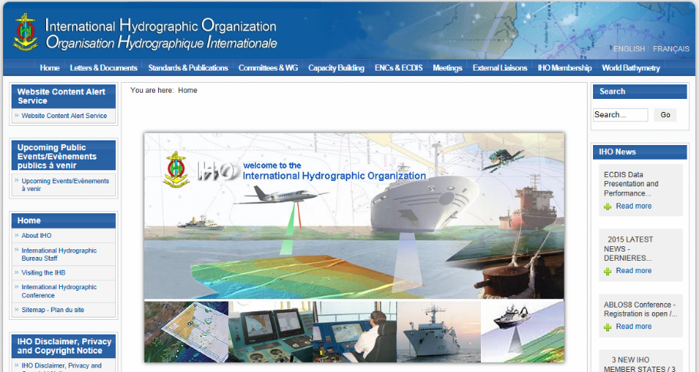
The IHO - MARINE SPATIAL DATA INFRASTRUCTURE value chain IHO IRCC MSDIWG RHC (BSHC, NSHC, ARHC) BS-NSMSDIWG Arctic MSDIWG

Slide 18
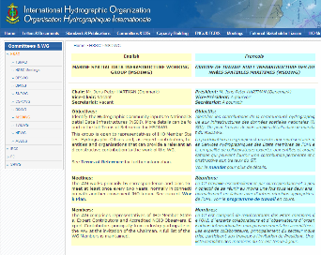
IHO - MARINE SPATIAL DATA INFRASTRUCTURE WORKING GROUP (MSDIWG)
Objectives of the IHO MSDIWG:
- Identify the Hydrographic Community inputs to National Spatial Data Infrastructures (NSDI).
- Monitor national and international SDI activities
- Promote the use of IHO standards and member state marine data in SDI activities.
- Liaise, as appropriate, with other relevant technical bodies
- Propose any Technical and/or Administrative Resolutions that may be required to reflect IHO involvement in the support of SDI.
- Identify actions and procedures that the IHO might take to contribute to the development of Spatial Data Infrastructure (SDI) and / or MSDI in support of Member States.
https://www.iho.int/srv1/index.php?option=com_content&view=article&id=483&Itemid=370&lang=en

Slide 19
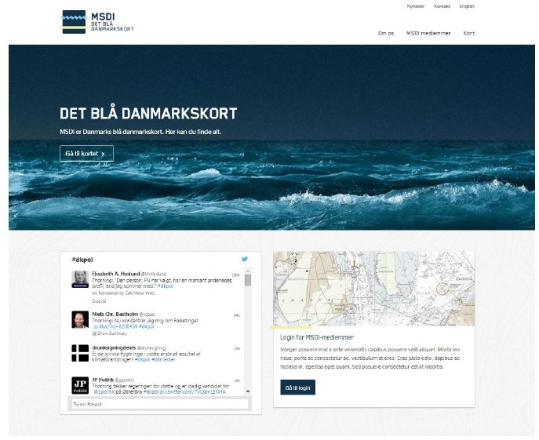

Slide 20
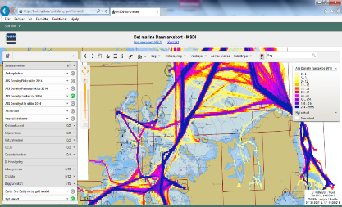
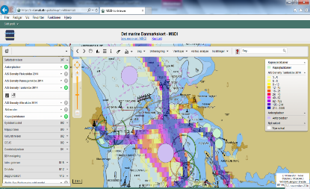
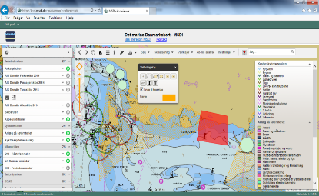
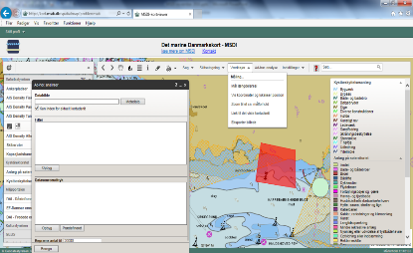

Slide 21
MSDIWG 2015-20 Action Plan Highlights
Monitor and report to national, regional and international MSDI activities - ONGOING
Develop e-learning facility for MSDI and Data Management - IN HAND
Develop Training Syllabus for Data Management and MSDI - COMPLETED
Provide Outreach to Academia and other bodies to promote MSDI - ONGOING
Creation of OGC Maritime Domain Working Group - COMPLETED
Develop MSDI conceptual model – ONGOING
http://www.iho.int/mtg_docs/com_wg/MSDIWG/MSDIWG8/MSDIWG8-01.4a-WorkPlan.pdf

Slide 22
MSDIWG 2015-20 Action Plan Highlights (2)
Revision of Special Publication C-17; “Spatial Data Infrastructures – The Marine Dimension”. COMPLETE (to IRCC9 for approval )
Submission to the 1st Session of the IHO Assembly - “Realising the benefits of Spatial Data Infrastructures in the Hydrographic Community” COMPLETED
Communications - ONGOING:
Establish Linkedin MSDI Group - COMPLETED
New MSDI White Paper - SCHEDULED FOR 2017

Slide 23
What Next?
The challenges are comprehensive and reflect the strength of feeling across the HO community.
There remains a need for a comprehensive programme of education, training and capacity building in Data Managegemtn and MSDI.
ALL RHC’s might benefit from Data Management and MSDI training?
IHO remains concerned that if change does not happen quickly, then other agencies will fulfil the hydrographic data supply role for wider use.

Slide 24
Is this the future for Navigation?
The HO may not be the primary source for the data used in nautical charting?
Navigational service providers accessing data from various sources and delivering direct to vessels over web services (cached where necessary)?
Sources such as weather, ship routing, traffic and logistical data can WILL be included
HOs can play a part in this fast developing geospatial matrix or they can continue to focus on a product which for many could well become less relevant as more flexible alternatives become available

Slide 25
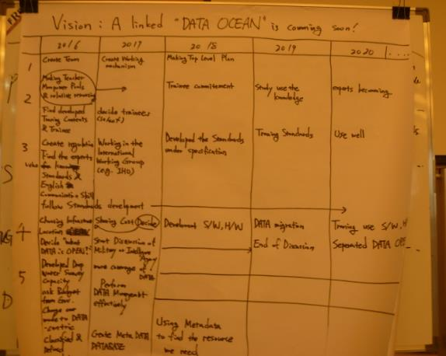
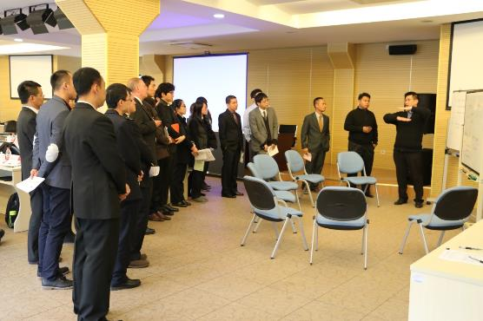
I know what I would do!
“A linked DATA OCEAN is coming soon!”
Photos: EAHC CB MSDI Managers Training Course; Shanghai, 18-22 January 2016

Slide 26
MSDI WG No 8, hosted by CHS meets 31st Jan - 2nd Feb 2017 in Vancouver, Canada All MS are welcome to join the Group!
Any questions ?
John.pepper@oceanwise.eu
Notes:
Gilles Bessero: Stay tuned for follow up actions!
Hydrographers do not risk to run out of survey s to be done!

