Slide 2
National Reports to the 18th MACHC Conference
Hydrographic office/ Services:
The Belize Port Authority is a Statutory Body falling under the Ministry of Transport & National Emergency Management. It is administered by a Board comprising of a Chairman (representing the Minister), two ex-officio members (Fin Secretary & CEO) and seven other members nominated by the Minister for appointment period of two years.
The role and function of the Belize Port Authority are;
Maritime safety
Designated Authority for ISPS code
Port Security
Licensing and registration of domestic vessels
Licensing of masters
Port State Control
Regulatory oversight of Ports.
Hydrographic surveys
The Authority has an annual budget of about $1,820,031.00 USD to carry out the daily functions and from this the Safety and Security Department’s budget for 2017 was $202,269.15. This year the Belize Port Authority made a significant investment in building its new administrative building that has allowed for us to operate and carry out our functions more effectively and efficiently. We are strategically located next door to the Belize National Coast Guard.

Slide 3
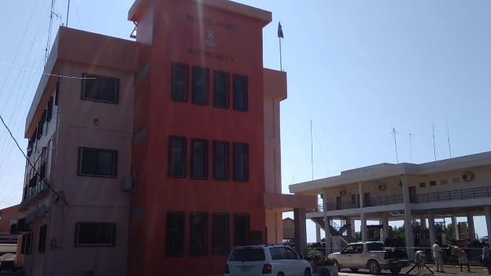

Slide 4
To carry out the responsibilities of the Authority there are seven departments which is shown in the following organogram with 81 total staff and 6 staff dedicated to Aton and Hydrographic work.

Slide 5
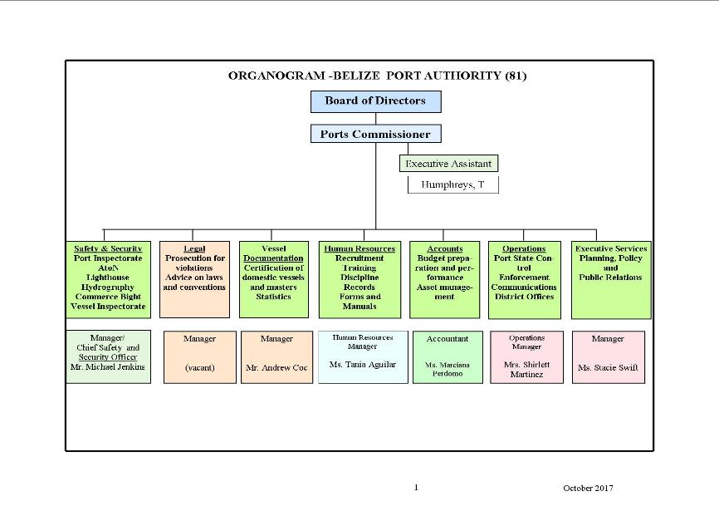

Slide 6
The Safety and Security Department of the Belize Port Authority is responsible under the Belize Port Authority Act Chapter 233; Part III Duties and General Powers’ section 3 to maintain, improve and regulate the use of any port and services and facilities therein as it considers necessary or desirable. To provide for such ports and the approaches thereto pilotage services, beacons, buoys and other navigational services and aids as it considers necessary or desirable.
It is also our obligation under SOLAS Chapter V Regulation 9, to provide updated nautical information to the mariners.

Slide 7
Surveys:
Harvest Caye the new cruise Port in the south of the country has been in operation for only one year and bathymetric surveys has only been conducted in this area. The following are the latest surveys of the area where the information received is being used to identify an anchorage position for days when two cruise ships will be calling to port. At present Harvest Caye has one berth hence any additional calls on same day will require anchoring out at sea. Without sea floor mapping providing a safe anchorage would have definitely pose a challenge.

Slide 10
New charts & updates:
Through the UKHO and the Commonwealth Marine Economies Programme the country of Belize is privileged to be awarded funding to conduct some much needed Hydrographic surveys in the following areas;

Slide 12
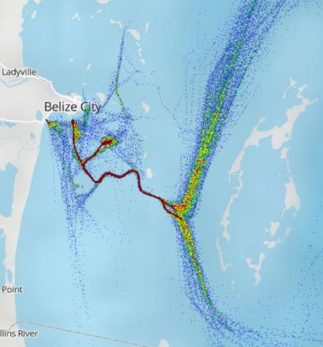

Slide 13
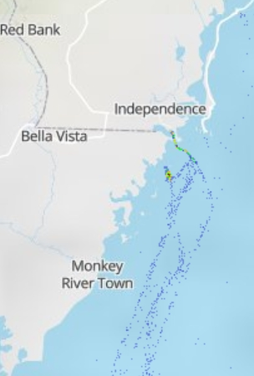

Slide 14
New Publications & updates:
The Authority has not made any new publications for 2017. It is important to note that the surveys initially conducted by the Belize Port Authority in 2013 with the Hydrographic equipment gifted to us through the Gulf of Honduras project created a new uncharted route that our pilots became comfortable using. Harvest Caye a Norwegian Cruise line development has confirmed this route and is now the only used approach to the Big Creek Port Facility and Harvest Caye cruise facility with vessel draft greater than 7.8 meters.
MSI : The Belize Port Authority reported navigational warnings to Navarea IV maritime safety watch for non- functioning aids, grounding of vessel within the English Caye Channel, and the removal of features such as fish havens from our Admiralty Chart #522.

Slide 15
Capacity Building
Since the 17th MACHC meeting the Belize Port Authority was able to get one significant training done for an officer in the Safety and Security Department. Mr. Zachary Young was selected to attend the ATONs Management Course Level 1 in Suriname. His knowledge gain has helped the Authority tremendously.
Mr. Omar Eriksson Dean of IALA conducted a technical needs assessment visit to Belize where we were able to show him to what standard we are and how we conduct ATON maintenance.
Mr. Eriksson was also able to assist the Belize Port Authority by conducting an assessment of our VHF radio communication.
The recommendations made by Mr Eriksson on both our Aton Service and our radio communication has been well received and we here have already started to implement what has been suggested. The compilation of a national list of lights registry has started. The Authority has also since his visit purchase new lights to replace what is missing in the access channel and to have additional to minimize the down time of ATONs functionality

Slide 16
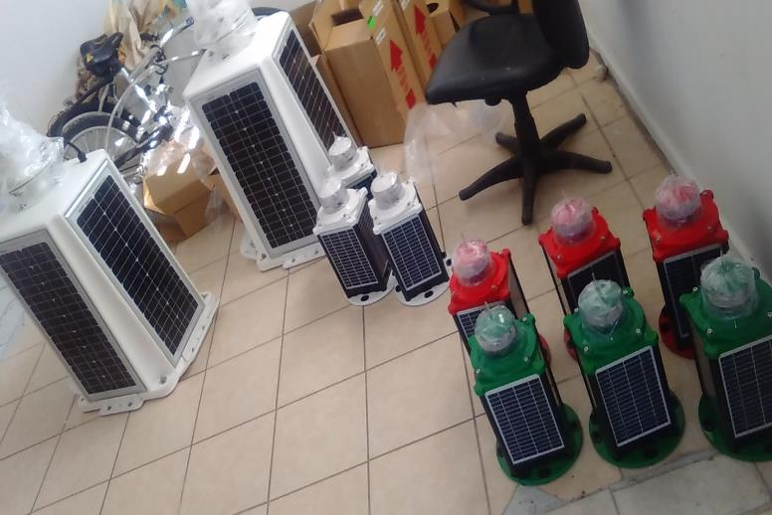

Slide 17
The Authority also received a visit from Mr. Chris Thorne and Mr. David Parker from UKHO where they conducted an assessment of the hydrographic section. David along with the team attempted for several hours actually a couple of days to get our equipment connected but was unsuccessful in doing so. It is our priority to get equipment assessed by a recommended service provider so that an official report on status can be had which would validate either we fix/repair or purchase new suit of hydrographic equipment

Slide 18
Other activities:
The Belize Port Authority hosted the RIPECA Central American Port Forum in 2017. This group discussed many new developments within the maritime domain including the need for hydrographic surveys to be continuously updated for the safety of navigation, the protection of the environment and the overall economic growth of each country and collectively as a region. At this conference Belize also signed on to the search and rescue (SAR) agreement with the other Central American Countries.

Slide 19
Conclusion
Large scale sea floor mapping of Belize’s coastal waters is still a major priority, not for commercial shipping but for the many pleasure yachts that visit our country. The lack of these critical surveys has increased the cumulative negative effect on the environment and the overall development of the country. The Belize Port Authority which recognizes the importance of updated bathymetric surveys is still seeking to be self sufficient in providing this important information to our charting authority. We realize the significant cost in mobilizing contracted surveyors and the tremendous work load that UKHO has and the likelihood that when immediate verification surveys are needed outside help might just not be available. With this said Belize would surely want our hydrographic suit of equipment received through the Gulf of Honduras project sent to a service provider to see their functionality but also has realized that these were had many years ago and their use may not be as efficient. The side scan sonar deployed in our waters poses a high chance of it being damaged by floating debris brought down by the many tributaries. The Belize Port Authority with some much needed support is ready to put its limited resources into purchasing a multibeam echo sounder and train our officers to use it.
Belize will continue the improve our capability to conduct our own surveys and will work closely with UKHO to see what will be our next step in achieving this goal after the CME program has been completed. The Belize Port Authority will stay committed to its obligations and provide the necessary maritime information through nautical publications and notices.
Thank You!

Slide 20
Thank You!

