Slide 1
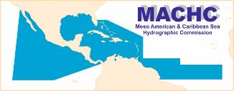

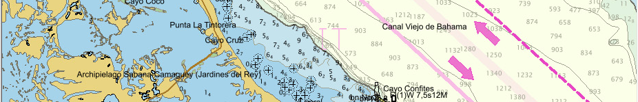
REPORT BY THE HYDROGRAPHIC AND GEODETIC SERVICE
OF THE REPUBLIC OF CUBA
18th MESO AMERICAN AND CARIBBEAN SEA
HYDROGRAPHIC COMMISSION MEETING

Slide 2


1. STRUCTURE OF THE HYDROGRAPHIC AND GEODETIC SERVICE OF THE REPUBLIC OF CUBA (HGSC)
ONHG
HYDROGRAPHIC AND GEODETIC NATIONAL OFFICE
Fulfills the functions of representing the Cuban State and executing the State policies
GEOCUBA BUSINESS
GROUP
Conducts productive activities and marketing

Slide 3
2. HYDROGRAPHIC SURVEYS
NEW HYDROGRAPHIC SURVEYS WITH CARTOGRAPHIC PURPOSES
EQUIPMENT | ORDER OF PRECISION (S44) | REGION OR PLACE | NEW BATYMETRIC DATA FOR NAUTICAL CHARTS
Single beam echosounders | I y II | Tract of coastal sailing from Punta Maisí to Cabo Cruz | 11534, 11536, 11537
Swath Echo Sounders (EM-2040C) | Special and I | Bahía del Mariel Bahía de Nuevitas Bahía de Puerto Padre Puerto de Casasa | 11824, 11825 11858, 11859, 11860 11866 11855

Slide 4
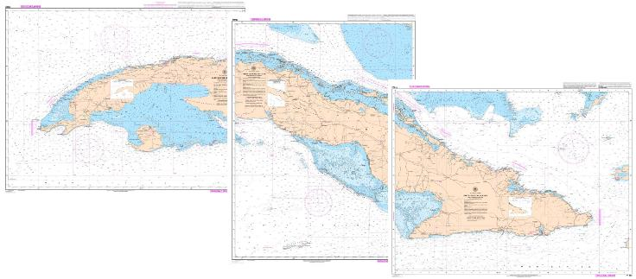
2. HYROGRAPHIC SURVEYS
CURRENT CHALLENGES
WE DON'T HAVE THE APPROPRIATE TECHNOLOGY FOR THE HYDROGRAPHIC SURVEYS IN SHALLOW AND DANGEROUS WATERS.

Slide 5
3. ELECTRONIC NAVIGATIONAL CHART
Current Status of the ENC Production
USAGE BAND | TITLES | STATUS
 |  | IC ENC |  | IN PRODUCTION
 |  | DISTRIBUTION | VALIDATION | 2017 | 2018
2 | 4 | 0 | 0 | 4 | 0
3 | 26 | 22 | 0 | 2 | 2
4 | 15 | 3 | 2 | 6 | 4
5 | 14 | 9 | 2 | 2 | 1
6 | 1 | 0 | 0 | 1 | 0
TOTAL | 60 | 34 | 4 | 15 | 7

Slide 6
3. NATIONAL PAPER CHARTS
New Charts
No. | Range of Scale 1: | Paper Chart Quantity | BSB Quantity
1 | Smaller than 300 000 | - | -
2 | 200 000 - 100 000 | - | -
3 | 75 000 - 30 000 | - | -
4 | Larger than 25 000 | 4 | 4
Total |  | 4 | 4

Slide 7
3. NATIONAL PAPER CHARTS
New Editions
No. | Range of Scale 1: | Paper Chart Quantity | BSB Quantity
1 | Smaller than 300 000 | - | -
2 | 200 000 - 100 000 | - | -
3 | 75 000 - 30 000 | 17 | 17
4 | Larger than 25 000 | 8 | 8
Total |  | 25 | 25

Slide 8
3. NATIONAL PAPER CHARTS
Currents Cartographic Coverage
No. | Range of Scale 1: | Paper Chart Quantity | Quantity BSB
1 | Smaller than 300 000 | 8 | 8
2 | 200 000 - 100 000 | 51 | 40
3 | 75 000 - 30 000 | 45 | 30
4 | Larger than 25 000 | 75 | 66
Total |  | 179 | 144

Slide 9
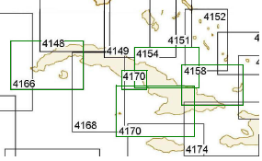
3. INT CHARTS
INT Charts (4)

Slide 10
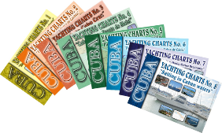
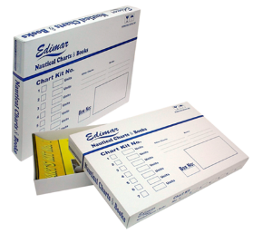
3. OTHER CHARTS
STATUS OF THE YACHTING CHARTS: 8 Albums

Slide 11
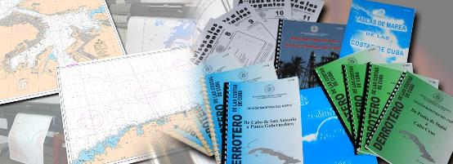
3. NAUTICAL CHARTS AND PUBLICATIONS
CURRENT CHALLENGES
WE DON'T HAVE:
SOFTWARE FOR ENC VALIDATION.
UPDATED CARIS LICENSES.
ACCESS TO HIGH RESOLUTION SATELLITE IMAGES.

Slide 12
4. NAUTICAL PUBLICATIONS STATUS
NOTICE TO MARINERS (Monthly).
ANNUAL SUMMARY NOTICE TO MARINERS.
LIGHTS LIST OF CUBA.
SAILING DIRECTION (9 fascicles).
TIDE TABLES OF CUBA.
NAUTICAL ALMANAC.
SYMBOLS, ABBREVIATIONS AND TERMS USED ON CHARTS (INT1).
CHARTS AND NAUTICAL PUBLICATIONS CATALOGUE.

Slide 13
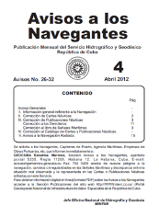
5. MARITIME SAFETY INFORMATION (MSI)
CURRENT STATUS
NOTICE TO MARINERS (MONTHLY) AND ANNUAL SUMMARY IS AVAILABLE ON THE WEBSITE www.iderc.cu
CURRENT CHALLENGES
WE DON'T HAVE INFRASTRUCTURE FOR:
NAVIGATIONAL INFORMATION BROADCAST (S-53).
GMDSS IMPLEMENTATION (IMO Publication 970 - GMDSS Handbook).

Slide 14
6. c-55
BASIC DATA
No. | Description | Data | Updating
1 | Nation / Maritime Zone. | Cuba | Cuba
2 | Code ISO of the Nation / Maritime Zone. | CU | CU
3 | ID. Region | NC | NC
4 | Nation or Maritime Zone | N | N
5 | EEZ (km² x 1000) | 362.9 | 362.9
6 | Length of Coastline | 2500 km | 2500 km
8 | Last Updating | December 2016 | December 2017
9 | IHO Membership | S | S

Slide 15
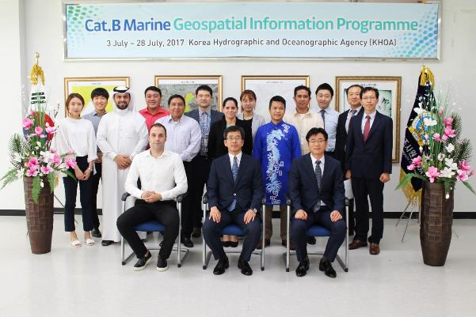
7. CAPACITY BUILDING TRAINING RECEIVED
Phase 3 of Category “B" Marine Geospatial Information Programme, sponsored by the Republic of Korea, (KHOA), Busan, ROK, 05 June – 30 July 2017.

Slide 16
7. CAPACITY BUILDING
TRAINING NEEDED
HYDROGRAPHY
NAUTICAL CARTOGRAPHY
ENC VALIDATION
MARITIME BOUNDARIES
MARINE SPATIAL DATA INFRASTRUCTURE

Slide 17
8. OCEANOGRAPHIC ACTIVITIES
MAIN INSTITUTIONS
ONHG AND GEOCUBA (HGSC).
INSTITUTE OF OCEANOLOGY (MINISTRY OF SCIENCE AND TECHNOLOGY).
MARINE RESEARCH CENTER OF THE HAVANA UNIVERSITY.
MAIN ACTIVITIES
OCEANOGRAPHIC DATA COLLECTION AND MEANSUREMENTS IN SPECIFIC AREAS.
GENERATION OF NUMERICAL MODELS (SMS, SISCOM, ROMS).
MODELING OF TRAJECTORY FORECAST.

Slide 18
9. CONCLUSIONS
  The Republic of Cuba has an area of hydrographic responsibility of 362 900 km², the 92,5% are surveyed and the 49,5% requires re- surveys to modern standars of IHO.
  The series of nautical charts produced and printed by the Republic of Cuba cover the jurisdictional waters of its responsibility and comply with the IHO international standards for Paper Charts, Raster (BSB), Vectorial Chart (S-57) and INT Charts.

Slide 19

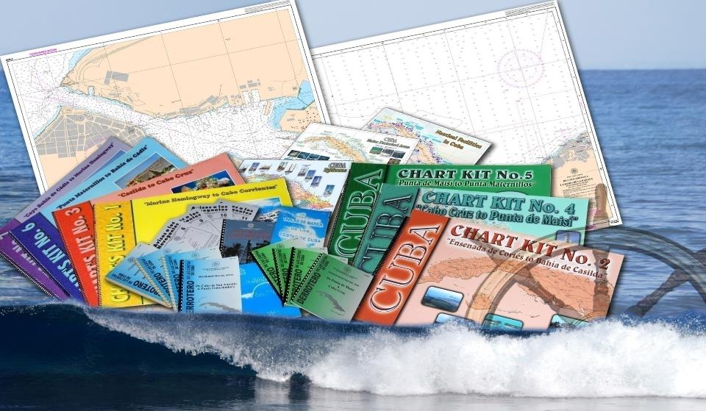
THANK YOU

