Slide 1


18th Meso American-Caribbean Sea Hydrographic Commission Conference
29 November – 2 December 2017
Cuba- Varadero
Suriname National Report
Bernice Mahabier,
Manager Nautical Management
Maritime Authority Suriname

Slide 2
Table of Contents
Introduction
Hydrographic Office Service
Surveys
New charts & updates
New publications & updates
MSI
C-55
Capacity building
Oceanographic activities
Other activities
Main achievements during the year,
Main challenges and/or obstructions,

Slide 3
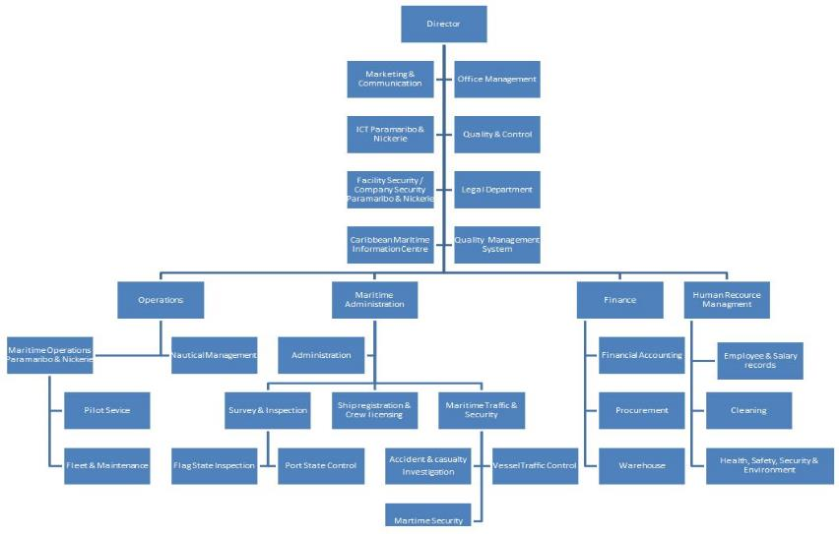
Maritime Authority Suriname

Slide 4
Hydrographic office
Nautical Management
Hydrography & Fairway Management
Nautical Planning and Development
Cartography &MSI

Slide 5
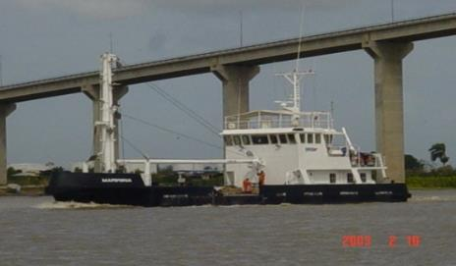
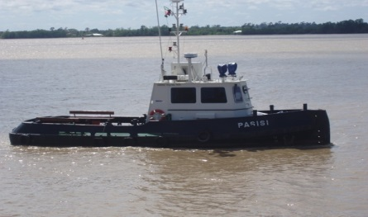
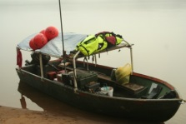
Survey vessels

Slide 6
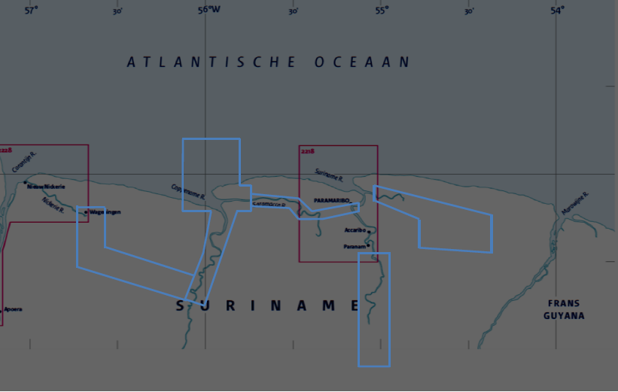
Chart overview

Slide 7
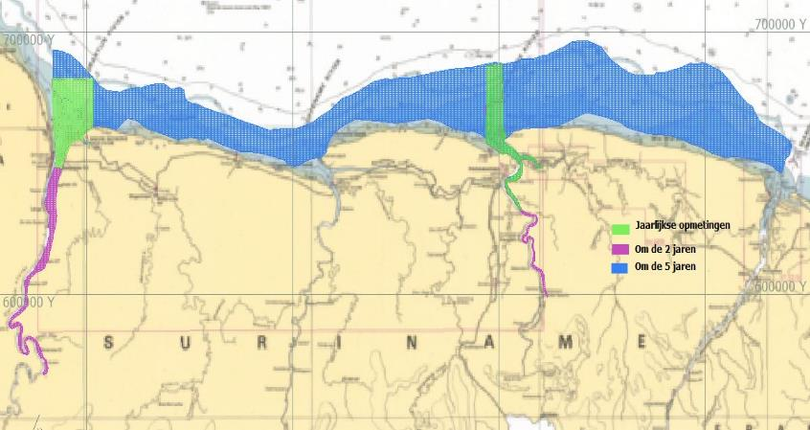
Overview Survey Area

Slide 8
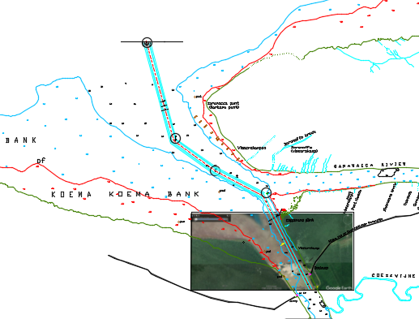
Coppename river project
Project:
Assessment shipping channel, river users and other activities
Stakeholder meetings
Survey of navigation channel and berth’s
(in use and potential areas)
Planning of ATON’s
Production of Chart and ENC

Slide 9
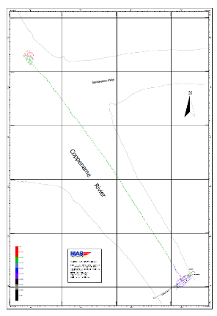
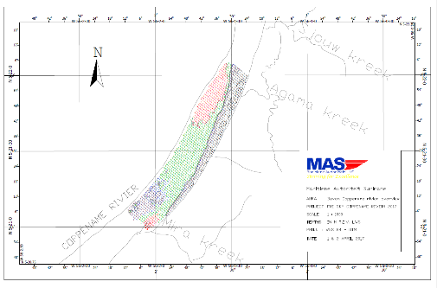
Coppename river surveys 2017
For the planning of outdated national chart 2225

Slide 10
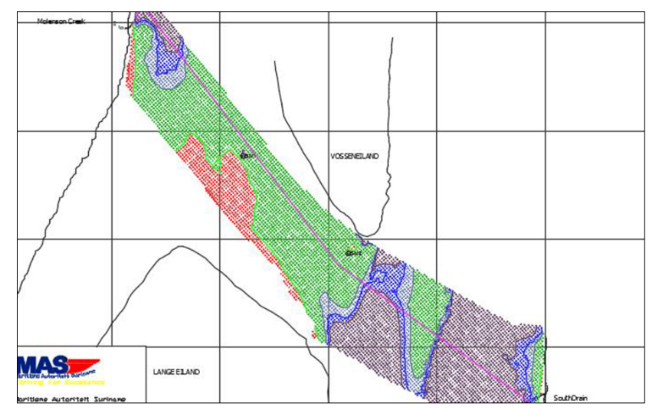
Survey of ferry route 2017
Notes:
Highlite location where suriname river and Corantijn river- Coppename river in 2017

Slide 11
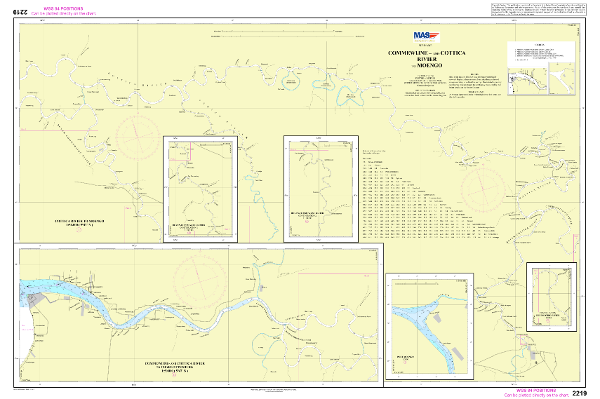
Resurvey Commewijne river

Slide 12
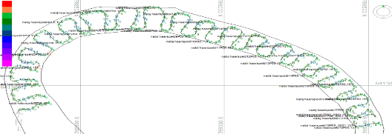
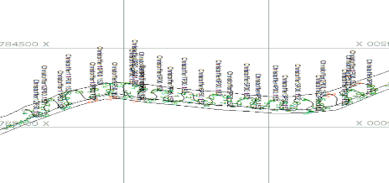
Resurvey Commewijne river

Slide 13
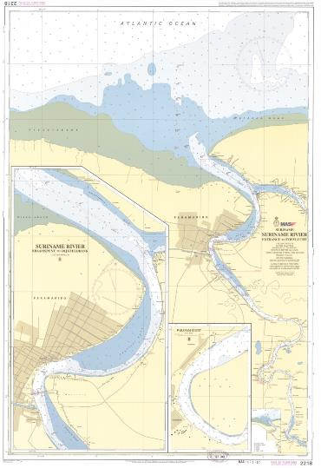
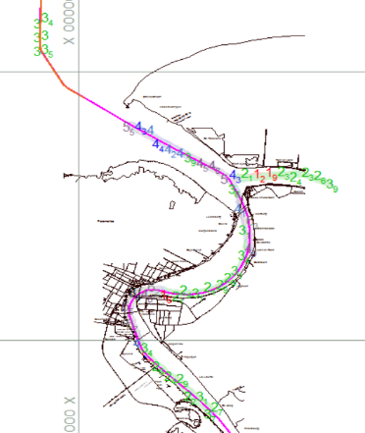
Resurvey Suriname river 2017
Notes:
Suriname on a regularly basis survey areas along the shipping routes and in the approaches to ports. Last year the coastal zone is surveyed till a depth of 10 meters with a corresponding distance of 27 km. of the coastline.
The latest survey of the approach to the main port is dated from 2007. The MAS is now preparing a new survey. MAS is also preparing new surveys of the approaches to other ports.
MAS provides high quality hydrographic services to private companies and also offers services in the Region.
IHO publication C-55 (last updated 1 September 2009) shows that many governments have still to put in place an effective organisation for the promulgation of information of importance to safe navigation and the protection of the environment, either as navigational warnings or as inputs to those hydrographic offices with responsibility for charting.
(The purpose of IHO Publication No. 55 (C-55) is to provide base data for governments and supporting international organisations as they consider the best means by which to implement responsibilities set out in Chapter V, Regulation 9, of the Safety of Life at Sea (SOLAS) Convention. It also informs IHO input to the United Nations’ Global Maritime Assessment).
To collect and process the data MAS has:
Two single beam echo sounders on survey vessels
One RTK base station and two receivers on the vessels
One portable single beam echo sounder
GPS voor positioning
Hypack software pakkage

Slide 14
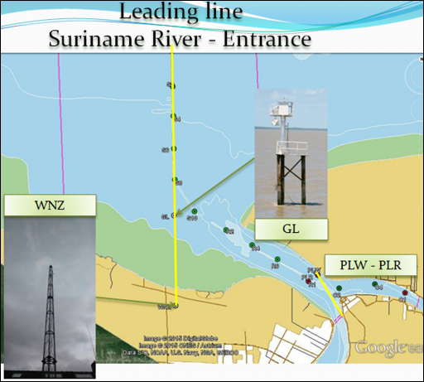
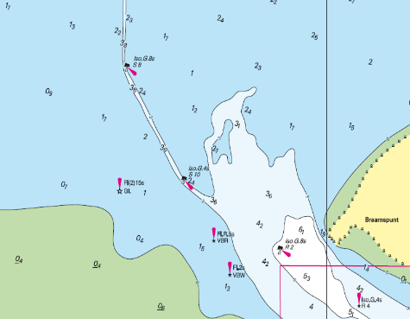
Leading line Suriname River
Leading Line VBH- VBL

Slide 15
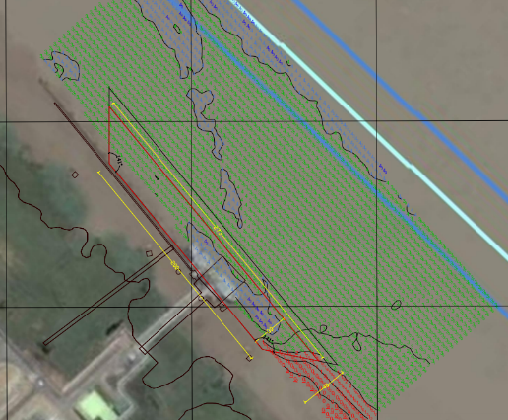
Additional surveys
Monitoring of specific areas
Survey of harbor for dredging or nautical depth determination.
Investigative surveys
Notes:
Due to the request for larger size vessels getting at the inland berths. Upto last year Ships length were 120- 140m , currently demand for ships upto 200m in length. We facilitate the operators what the dredge depth must be , specify risk and mitigations that needs to be taken into account. ( Maritieme Administration, Pilots and Hydrographers) .

Slide 16
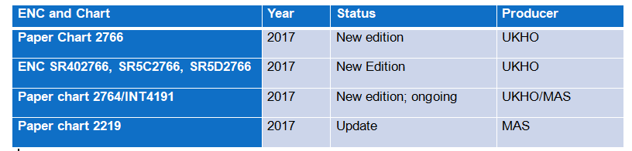
Charts and ENC’s Update 2017

Slide 17
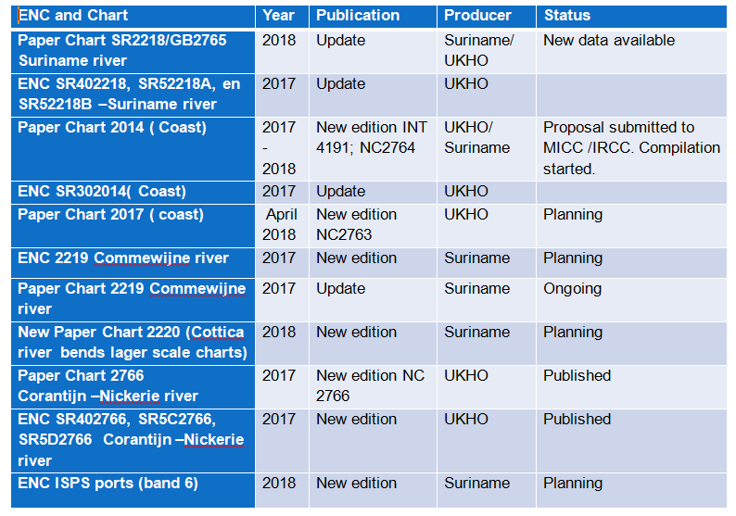
Planning of Charts and ENC’s 2017-2018
Notes:
The nautical paper charts of the Suriname waters are produced by the NHO. Suriname provides the hydrographic data. Regarding chart production, Suriname hope to sign a new MoU with the NHO this year, to guarantee the updating of the resisting paper charts and the production of ENCs. Until than de the charts are updated by Notice to Mariners. For now the UKHO produces ENCs of the Suriname waters. It is our desire to take on the responsibility, but we lack some capabilities. At least we want to be able to view our ENCs and share in the benefits, because we invest a lot in collecting and processing of the data.

Slide 18
New publications and updates
Tide table 2018
List of Lights 2018
The release of Shipping Notices for the nautical accessibility of ISPS certified ports and for all rivers .( minimum depth , average tidal rise Neap tide and Springtide, harbor and ship requirements)
Notes:
The nautical paper charts of the Suriname waters are produced by the NHO. Suriname provides the hydrographic data. Regarding chart production, Suriname hope to sign a new MoU with the NHO this year, to guarantee the updating of the resisting paper charts and the production of ENCs. Until than de the charts are updated by Notice to Mariners. For now the UKHO produces ENCs of the Suriname waters. It is our desire to take on the responsibility, but we lack some capabilities. At least we want to be able to view our ENCs and share in the benefits, because we invest a lot in collecting and processing of the data.

Slide 19
Marine Safety Information
Existing infrastructure for transmission
Partial radio warnings for coastal area through VTC .
NtM published in local papers and website, emailed to mariners.
NtM submitted to the NAV Area coordinator
Currently
Drafting of a plan for infrastructure in accordance with GMDSS Master Plan
Fase 1: VHF coverage Area A1 :currently VHF channel 16 communication for 20NM in approaches to ports
Fase 2: MF coverage Area A2

Slide 20
Marine Safety Information
SERVICE | Yes | No | Partial
Local Warnings | X (NtM)
Coastal Warnings |  |  | X
Port Information | X
NAVAREA Warning | X
Master Plan |  |  | X
Area A1 |  |  | X
Area A2 |  | X
Area A3 |  | X
NAVTEX | X
SafetyNET |  | X

Slide 21
C-55
Status of hydrographic survey of all navigable waters, including internal waters, out to the limits of the EEZ: (Please refer to the guidance given in the introductory text “Analysis of the Status of Surveys”.)
Survey coverage, where:
A = percentage which is adequately surveyed.
B = percentage which requires re-survey at larger scale or to modern standards.
C = percentage which has never been systematically surveyed.
The constant flow of sediments from the Amazone River creates migrating mud banks along the coast which move in westward direction. These banks have great impact on the river systems; therefore have impact on the approaches to the ports.
Notes:
Routine re-surveys are required in the port areas, which lie in unstable river regimes.
All coastal waters are subject to frequent change because of sediment deposit, and a number of areas in the east part particularly require investigation.

Slide 22
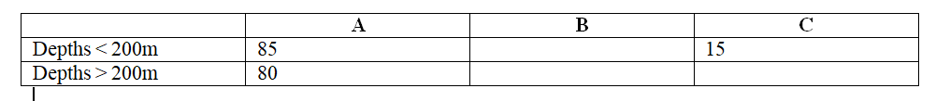
C-55
1.2 Status of hydrographic survey of all navigable waters, including internal waters, out to the limits of the EEZ of dependent territories:

Slide 23
C55
2.1 Status of nautical charting within the limits of the EEZ
Coverage of charts published by your organisation, where:
A = percentage covered by INT series, or a paper chart series meeting the standards in M-4.
B = percentage covered by Raster Navigational Charts (RNCs) meeting the standards in S-61.
C = percentage covered by ENCs meeting the standards in S-57.
Purpose/Scale | A | B | C
Offshore passage/Small | 50 |  | 0
Landfall and Coastal passage/Medium | 50 |  | 50
Approaches and Ports/Large | 100 |  | 60
Percentage of Group A showing depths in metres | 100
Percentage of Group A referenced to a satellite datum | 80

Slide 24
Capacity building
Training received
IALA -Level1 Aids to navigation manager course, May to June 2017, Suriname .
KOICA- Training for Ocean Observation and Hydrographic Surveying (Policy-maker) September 2017, Seongnam & Busan, Republic of Korea
Required Internship/ training:
Tidal analysis
Side Scan Sonar image interpretation
Multibeam data acquisition and processing
Data management
SDI for wider use
Notes:
Early this year two employees have been trained in hydrography at B level.
One employee follows a 12-month Postgraduate training course in Ocean Bathymetry at the University of New Hampshire, USA.
And one prepares to attend a Multibeam Course in November in Brazil.
Future plans:
The MAS wants to set up a cartographic unit. The MAS has neither nautical cartographers nor equipment (software) to produce Paper charts or ENCs. So we want to train two of our employees in nautical cartography and ENC production. And if it’s possible to get minimal equipment (software).
The MAS has no level “A” Hydrographers, just level “B” Hydrographers.
LAT determination
ENC compilation
Extension of tidal station in coastal area
Extension of base points along coastal area and riverbanks.
Extension survey area
New equipment to meet IHO standards.
(Side Scan, GIS, MB)

Slide 25
CB Support
Training offered:
IALA manager level 1 training course –
Form October – November 2018- Paramaribo Suriname

Slide 26
Bilateral projects
Member of IC-ENC for ENC validation and distribution
MoU Suriname – UKHO- ENC and paper Chart production
MoU Suriname – France-co-production of boundary chart
MOU MAS- IALA- training center and membership
In progress
MoU Suriname – Brazil DNH for capacity building
MoU MAS - University of Suriname
MoU MAS - Polytechnic College

Slide 27
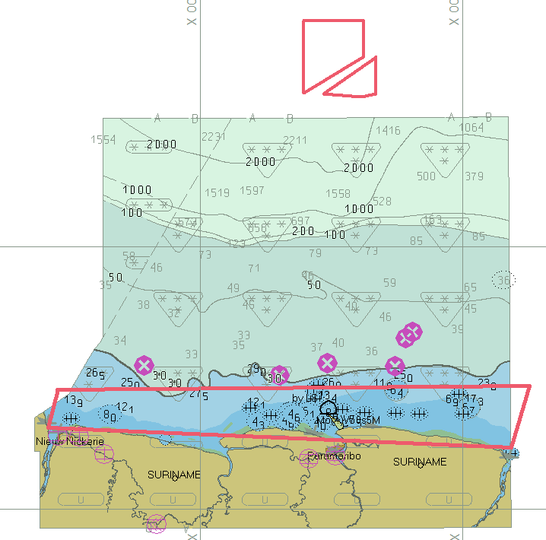
Oceanographic activities
Offshore seismic project and drilling along the coast of Suriname by the National State oil Company

Slide 28
National project with hydrographic component
Establishment of Suriname Maritime Academy in conjunction with IALA for training in Aids to Navigation
Drafting of Risk assessment project
Preparation IMO Audit for 2018 (IMSAS)

Slide 29
Other activities
National Working groups:
National Climate Outlook Forum (NCOF)
MAS participated in the National Post-deforestation 2000 – 2009 and 2000 – 2015 Land Use Land Cover Maps project organized by the Forest Cover Monitoring Unit of the Foundation for Forest Management and Production Control (SBB) as an initiative of the Amazon Cooperation Treaty Organization (ACTO).
Global Climate Change Alliance (GCCA)+ Suriname Climate Change Adaptation project office and activities Government of Suriname, the European Union and the UNDP
Notes:
Increase of existing information and knowledge related to the effects of climate variability and change, including the development of targeted data collection, analysis and dissemination in related sectors of water management, hydro and meteorological services.
Strengthening of human capacity and systems for management and conservation of Mangroves. Reducing the negative effects of human action on mangroves; supporting enabling conditions to stimulate mangrove regeneration; and adaptation in the agriculture subsector.

Slide 30
Other activities
Participation in IHO Working Groups
MEIP
MICC
Geospatial studies
Climate change : WWF -Suriname establishing a national database for environment
Disaster prevention
Flood modeling for Paramaribo

Slide 31

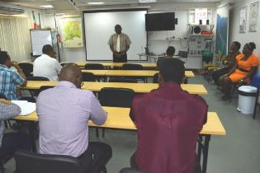
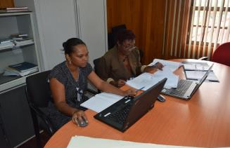
Establishment of the Suriname ATON Academy ( SAA)
Accreditation of the SAA based on IALA Recommendation E-141

Slide 32
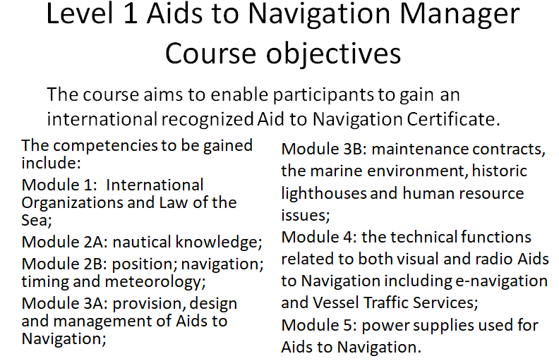

Slide 33
SOLAS V Regulations
4 -Navigational Warnings: WWNWS
9 – Hydrographic Services
10 – Ships Routeing
11 – Ships Reporting Systems
12 – Vessel Traffic Services
13 – Aids to Navigation Services
19-2.4 – AIS

Slide 34
Countries that expressed interest :
Mexico, Columbia, Belize ,Argentina ,Guatemala, Guyana, Trinidad& Tobago, St. Kitts & Nevis, Venezuela, Barbados and Suriname.
Difficulties encountered: Availability of resources and language barrier
Participants for the manager course 7 : Belize ,Argentina ,Guatemala, Guyana,St. Kitts & Nevis, Barbados and Suriname

Slide 35
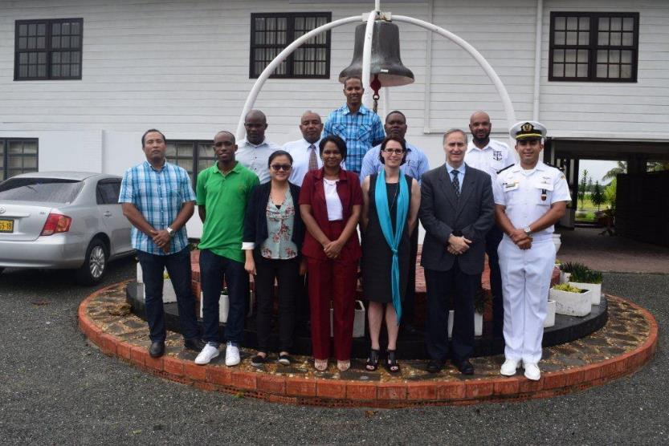

Slide 36
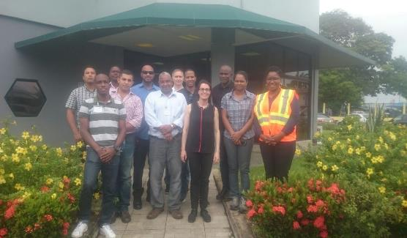
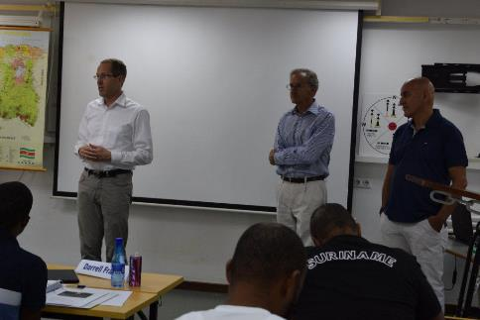
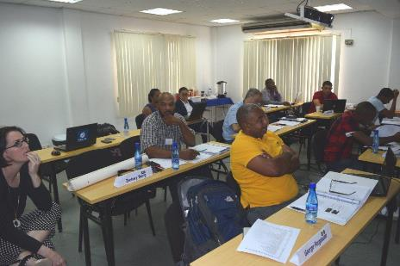
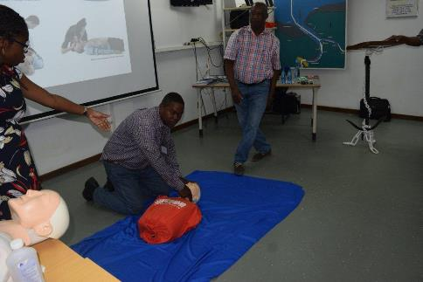

Slide 37
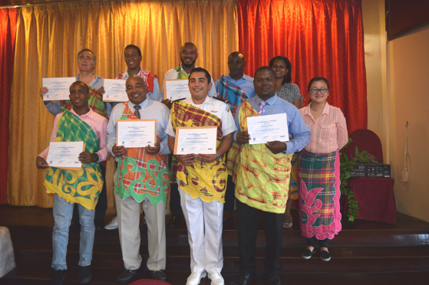
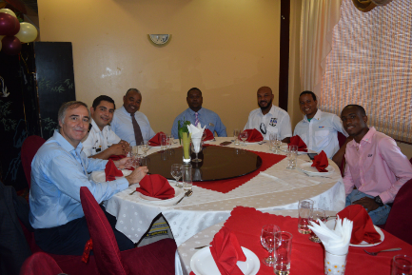

Slide 38
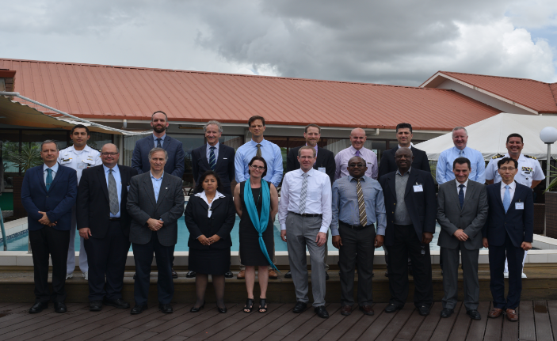
Hosting of the IHO –15th CBSC meeting from June 7-9 ,2017 in Suriname

Slide 39
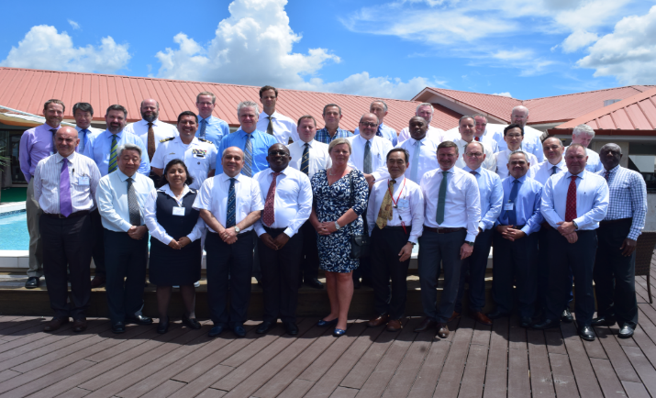
Hosting of the IHO – 9th IRCC meeting from June 12 -14 ,2017 in Suriname

Slide 40
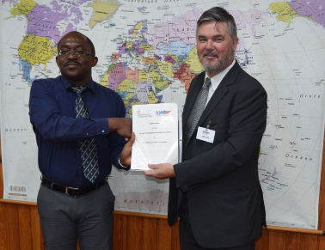
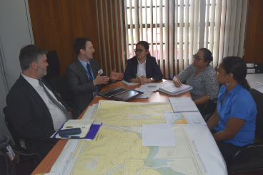
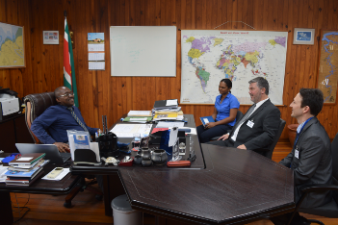
UKHO Technical 21st February visit regarding chart production

Slide 41
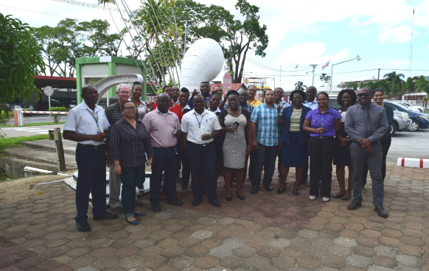
ISO 9001:2015 certification -3years

Slide 42
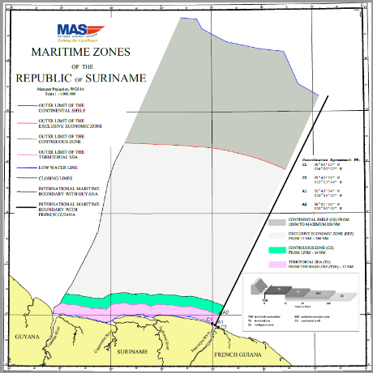
Maritime boundaries
National legislation on Maritime zones completed
Maritime boundary with France completed

Slide 43
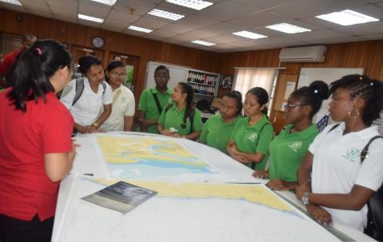
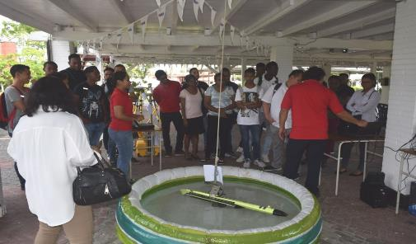
World Hydrography Day

Slide 44
Main challenges and/or obstructions
Obstructions/ Challenges
Delay is purchase of MB system
Data management( less people more products)

Slide 45
Conclusions
Great efforts has been made to garantee save navigation in the Surinames waters, but Suriname is aware of the challences we have to face in the future.

