Slide 1

Hydrographic Data Management
Workflow Management System
MACHC18 – Varadero, Cuba

Slide 2
Learning Objectives
Understand the purpose of Workflow System
Understand the Workflow Automation
Understand Project concepts and operational
Understand challenges/advantages

Slide 3
Introduction to Workflow system

Slide 4
Purpose
The Workflow Management System will support for running HDM production workflows and manage teams to engage in
  Production
  Tracking
  Monitor work progress
  Collaborate for data exchange

Slide 5
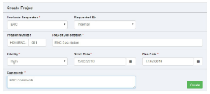
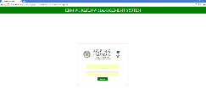
Workflow Management – Components
Data Dissemination
Project Management
Resource Allocation
Reports
Track Project activities (dashboard)

Slide 6
WfM – Key Capabilities
Create standardized business process
Production line for multiple Products
Sequencing Tasks and Processes
Create Projects and Manage
Assign Tasks to appropriate Personnel and Manage
Communicate about important project events Automatically
In-built Quality Control mechanism
Collaboration between Hydro & GIC

Slide 7
WfM – Key Capabilities
Store Project information in a Single Repository
Track work progress with
  Reports
  Historical project information
Structure of the organization integrated within the Workflow System
  Users
  Groups
  Roles
Grant and track access to the system
  Log actions
  Control application functionality
  Production of statistical information

Slide 8
Advantages
Advantages
  Automated workflow and rules
  Systematic approach to run product production with effective and efficient process
  Manage Task allocation at one step
  Building Project/Product Metadata
  Inbuilt quality cycle
  Tight collaboration between teams
  Measure and analyze the production progress
  Faster adoption of best practices
  Nautical Publications efficient production and management

Slide 9
Challenges
Challenges
  Adoptability
  Accountability
  Consistency of data inputs
    Naming convention
    Metadata

Slide 10
Workflow manager - organization

Slide 11
HDM Organization Model
Notes:
Project Manager will initiate project
Project Lead will prepare datapack, metadata and task allocations
Quality Lead verify product
Quality Analyst verify process results
Cartographer/Hydrographer will perform production activities in BDB/HPD
Collaboration between Hydro & GIC for data dissemination

Slide 12
User Roles & activity mapping
Project Management
  Project Manager – Initiate project, monitor progress, control process and Sign-off the project
  Project Lead – Prepare datapack, populate metadata, allocate users, monitor progress
Production
  Cartographers & Hydrographers – Plan activities, Perform Tasks, update task progress, log comments
Quality Control
  QA Lead/QA Analyst – Plan activities, perform tasks, update task progress, accept/reject results
Data Dissemination
  GIC Manager – Request product, monitor progress, access HDM products for dissemination

Slide 13
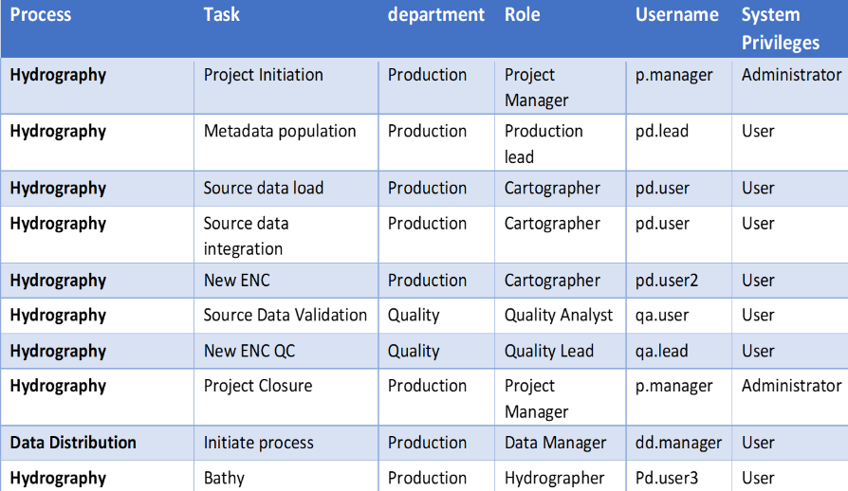
HDM – Roles
Notes:
Project Management
Project Manager – Initiate project, monitor progress, control process and Sign-off the project
Project Lead – Prepare data pack, populate metadata, allocate users, monitor progress
Production
Cartographers & Hydrographers – Plan activities, Perform Tasks, update task progress, log comments
Quality Control
QA Lead/QA Analyst – Plan activities, perform tasks, update task progress, accept/reject results

Slide 14
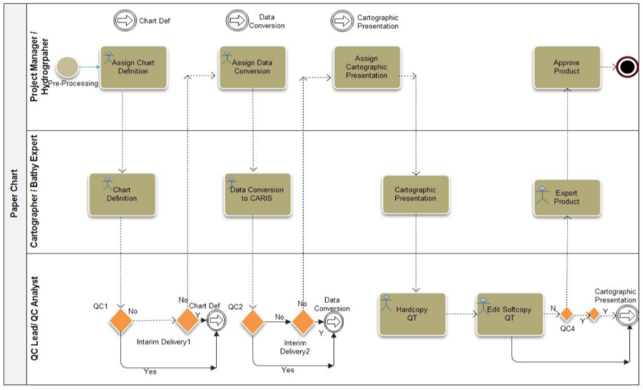
Sample Workflow for Paper Chart Production

Slide 15
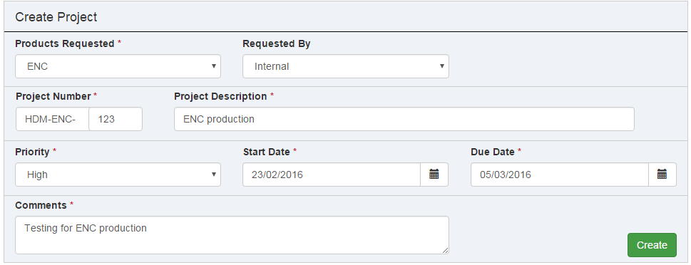
WfMS screenshots – Project Initiation

Slide 16
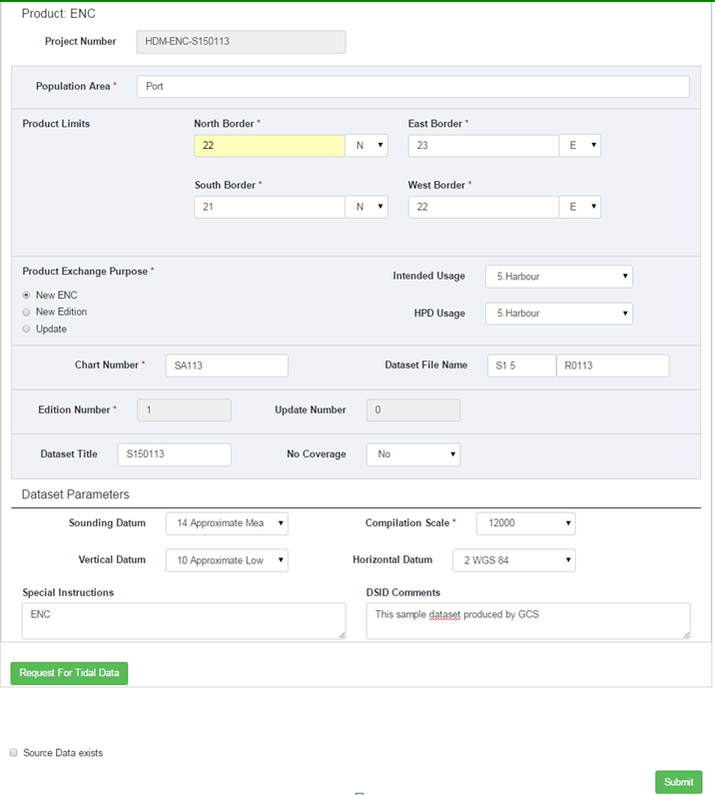
WfMS screenshots – Project Metadata
Notes:
ENC

Slide 17
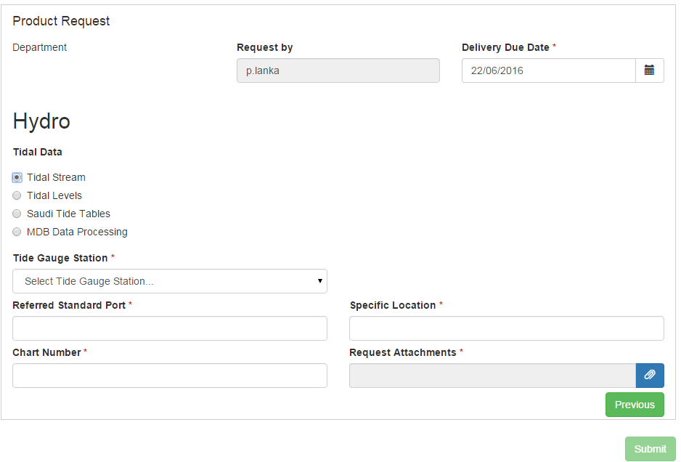
WfMS screenshots – Data Request

Slide 18
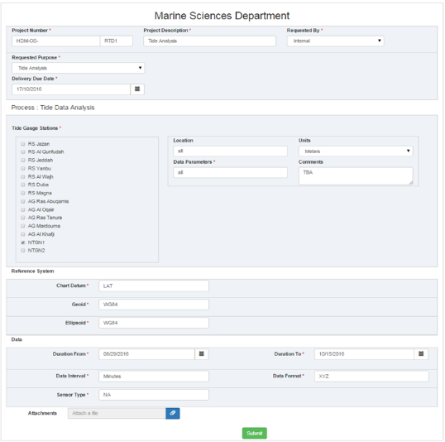
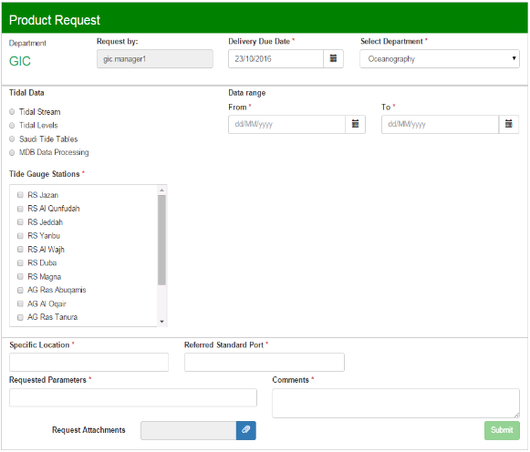
WfMS screenshots – Collaboration

Slide 19
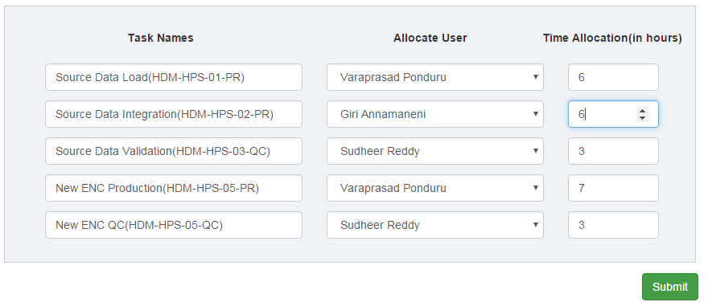
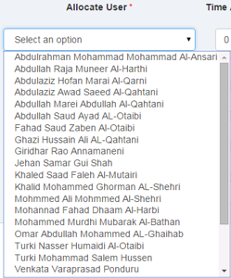
WfMS screenshots – Task allocation
Based on product type, system will pick predefined tasks from workflow
Users are displayed based on task type
  i.e. production/QC
Allocate estimated time for task completion and tracking progress

Slide 20
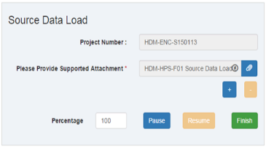
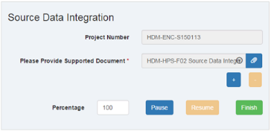
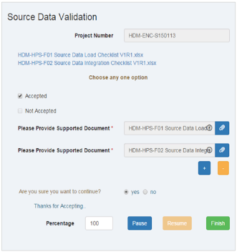
WfMS screenshots – Tasks forms
Based on task, task form will displayed
User can log work breaks and task progress (0-100%)
Track Quality results
Store task check lists in database

Slide 21

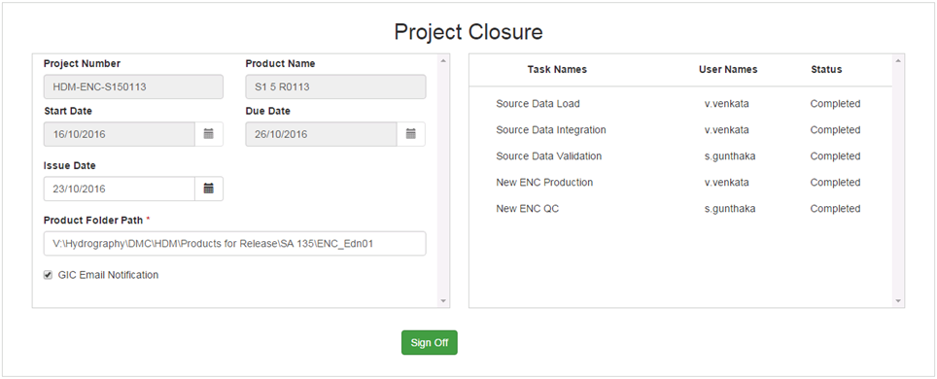
WfMS screenshots – Project closure
Project sign-off complete production cycle
Sharing data
Notifications to teams

Slide 22
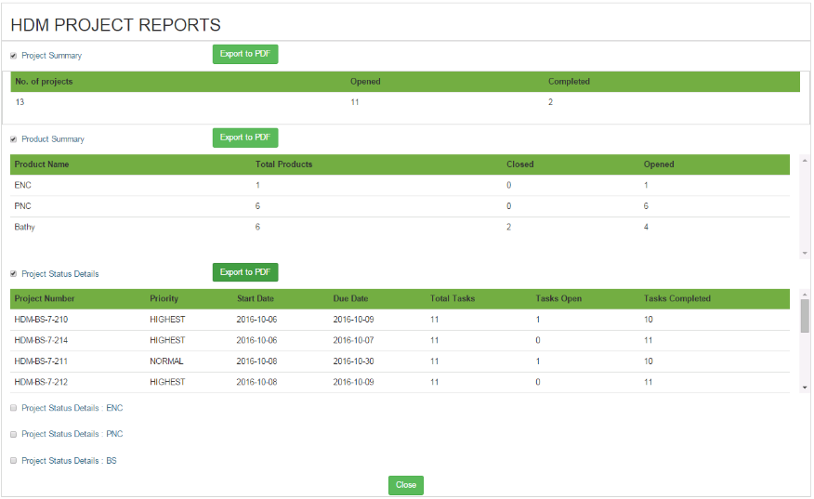
WfMS screenshots – Project Monitoring
Notes:
Reports & Dashboards

Slide 23
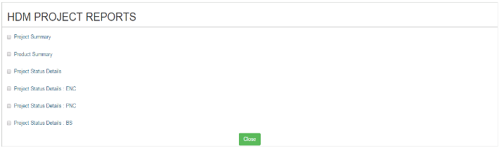
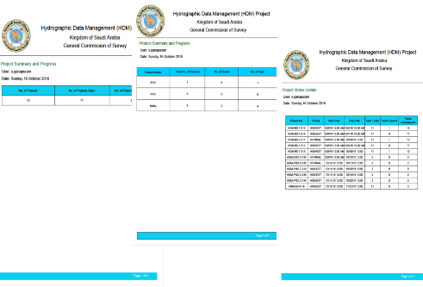
WfMS screenshots – Reports & Dashboards
Reports
Report outputs - PDF

Slide 24
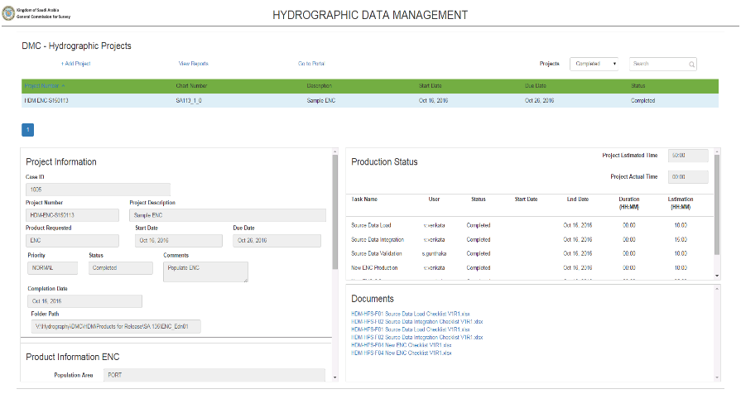
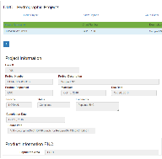
WfMS screenshots – Reports & Dashboards
Project / Product Metadata

Slide 25
Benefits and Capabilities
Standardized systematic production process
Integrate and organize quality control
Enhance collaboration and communication within Hydrographic Offices
Centralized platform with end to end real time project management
Export Metadata: reports, graphs, presentations
Manage Nautical Publications
Notes:
A solution that increase
Productivity
Automates production process
Improves production monitoring
Engages the entire hydrographic office within a single platform
Ultimately it should lead to improved cost efficiency with the office

Slide 26
Thank You

