Slide 1
International Centre for Electronic Navigational Charts
GENERAL UPDATE
18th MACHC
1

Slide 2
Agenda for MACHC18
IC-ENC Operational Update
IC-ENC Membership & Offices
IC-ENC Core Services
  ENC Production Support for HOs
  IC-ENC Validation
MACHC specific support
Further Information
2

Slide 3
Our Mission
  To provide services, at a low cost, to ENC Producers that ensure their ENCs are:
  # compliant to the international standards,
  # consistent across the global dataset,
  # and readily available for use.
  This is so that shipping can navigate safely, efficiently and confidently, whilst ensuring other maritime users are using the same approved data.

Slide 4
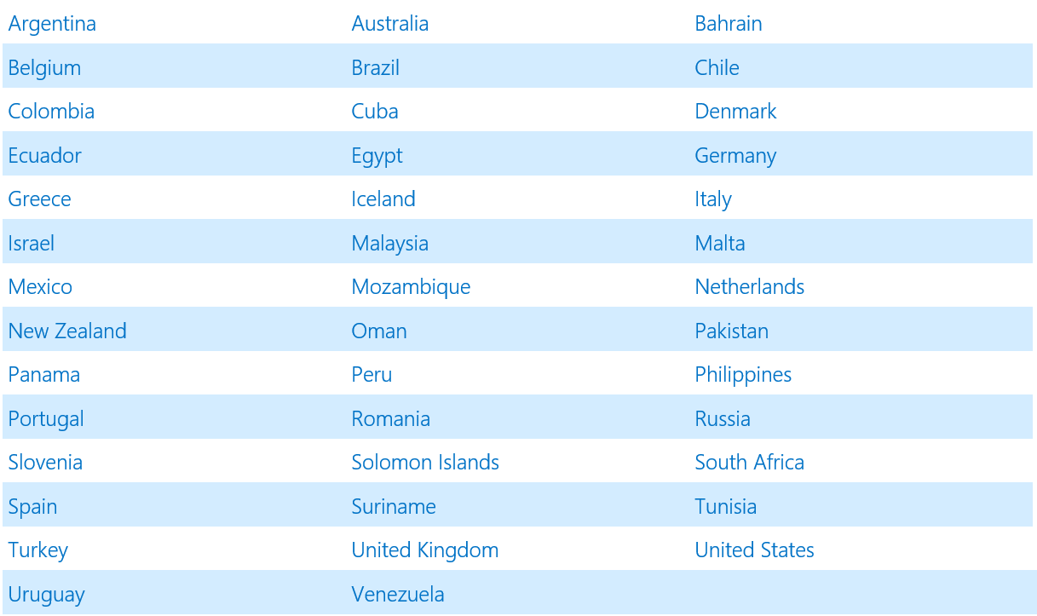
IC-ENC Members (42)

Slide 5
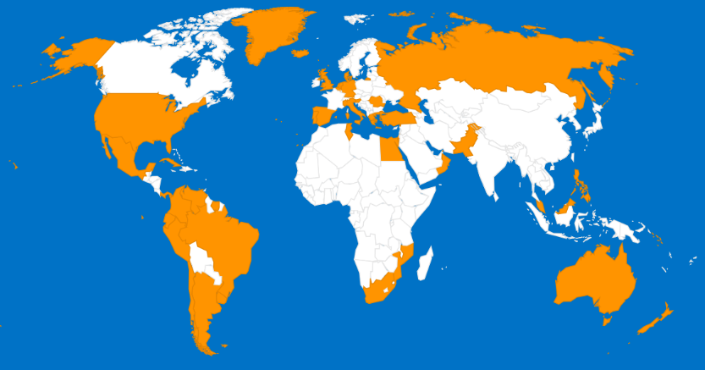
Membership & IC-ENC Offices
(Australia, Brazil, UK, US)
IC-ENC Head Office -
Taunton, UK.
5

Slide 6
IC-ENC Core Services
ENC Production Support
ENC Validation
ENC Distribution
Revenue Management & Financial Reporting
6

Slide 7
Production Support Services
IC-ENC ENC Validation Training courses
  3 bronze level yearly
Technical Conference
  Yearly
Internal validation
  IC-ENC Errors Database
  eGlobe ECDIS software supply and support
HO production staff work alongside IC-ENC validation team in IC-ENC offices
7

Slide 8
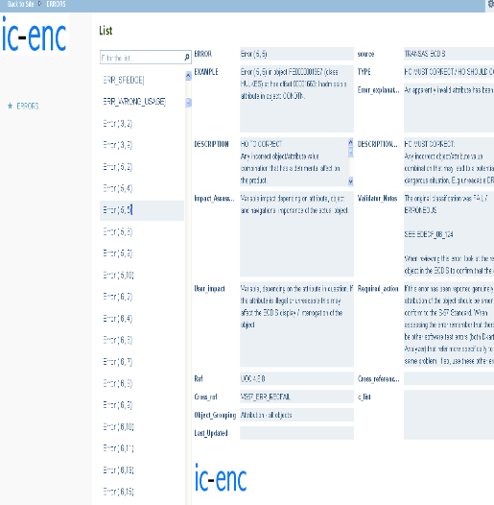

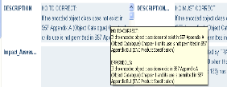
IC-ENC Errors Database
Over 1500 messages from validation software, ECDIS and other IC-ENC sources
Designed to assist HOs with their own internal validation of ENCs
Includes advice on how important an issue is, and what action to take to fix the problem
8

Slide 9



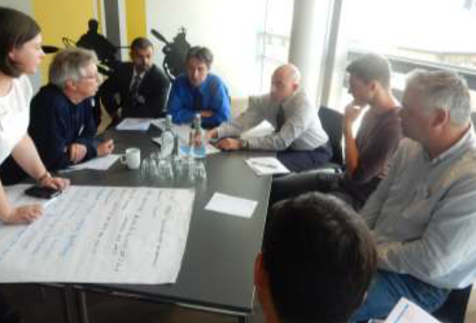
Technical Conference:
ENC issues relevant to all members…

Slide 10
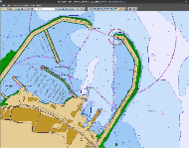
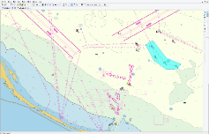
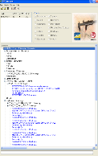
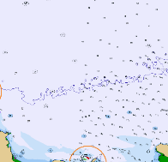
IC-ENC Validation
Software analysis
  Assessment of S-58
  Exchange set checks
IC-ENC validation team expertise
  Consistency Checks
  ECDIS Checks
10

Slide 11
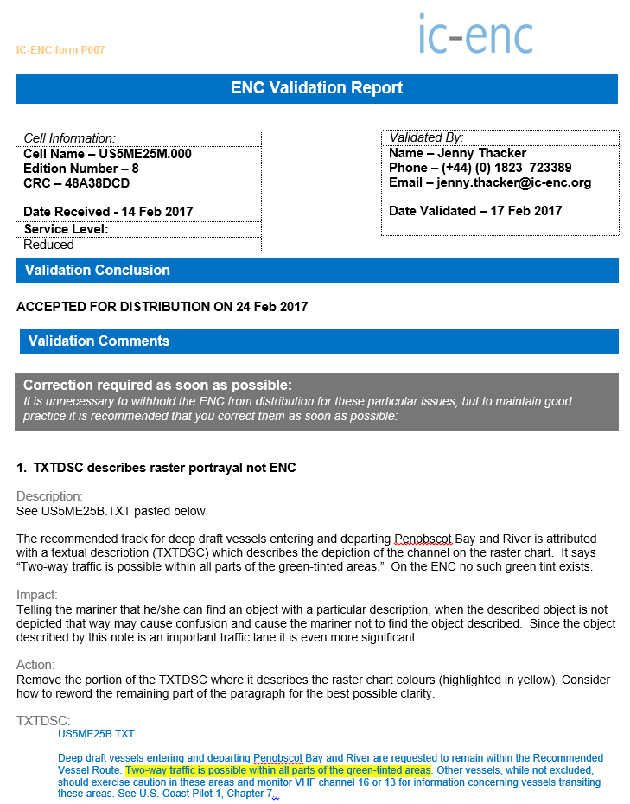
The Feedback Report
Feedback Report to our members for each cell
Created from the error classifications and decision making from validation
Reports issues back to HO
Is member dependent “Partnership Agreement”
11

Slide 12
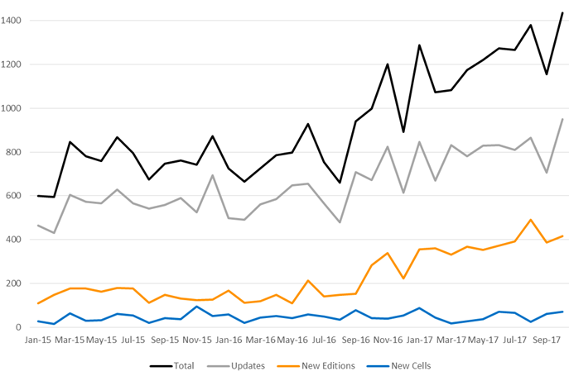
Volume of Validations per month

Slide 13
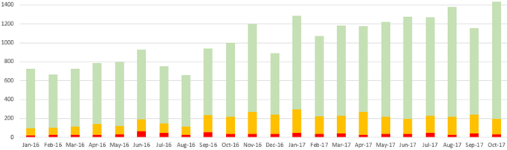
Feedback provided
Red: It can be seen that each month IC-ENC identifies, and prevents from being released, a significant number of safety critical issues (about 50 per month)
Amber: Additionally, about 200 validation report per month contain advisory comments regarding improving the data quality
Green: No action recommended – usually small Update files

Slide 14
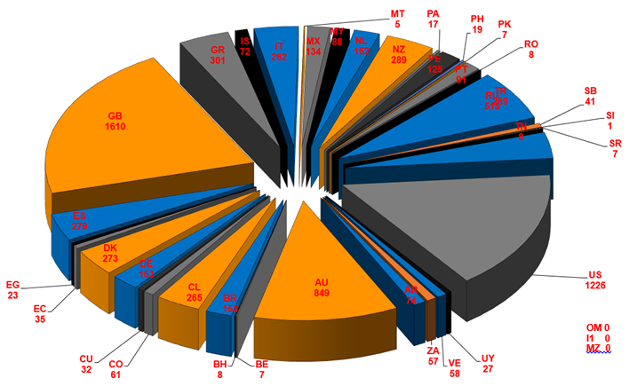
IC-ENC ENC Folio – 7611 ENCs
October 2017
14

Slide 15
IC-ENC MACHC specific:
Supports the MICC conference calls
Provides six monthly update of approved ENC data to MACHC ENC Online
RHC ENC overlap report
US and Brazil regional offices:
  Correct time zone
  Spanish language support
  Local/regional knowledge

Slide 16
MACHC region ENCs available
Producer | Berthing | Harbour | Approach | Coastal | General | Overview | Total
Brazil |  |  | 5 | 5 | 2 |  | 12
Colombia | 3 | 19 | 16 | 7 | 2 |  | 47
Cuba |  | 7 | 3 | 22 |  |  | 32
France (PRIMAR) | 5 | 24 | 10 | 4 | 4 |  | 47
Mexico | 14 | 72 | 37 | 11 |  |  | 134
Netherlands | 5 | 13 | 5 | 1 |  |  | 24
Panama CA | 2 | 5 |  |  |  |  | 7
Panama MA |  | 5 | 3 | 2 |  |  | 10
Suriname |  | 4 | 2 | 1 |  |  | 7
United Kingdom | 7 | 76 | 54 | 34 | 22 | 10 | 203
USA | 5 | 129 | 72 | 15 | 5 | 4 | 230
Venezuela | 3 | 35 | 16 | 5 |  |  | 59
 | 44 | 389 | 223 | 107 | 35 | 14 | 812

Slide 17
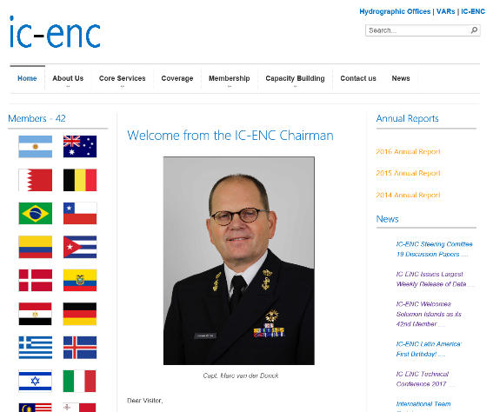
For further information… www.ic-enc.org

Slide 18
Summary
Core Services:
  Production Support, Validation, Distribution, Revenue Management
Currently serving 42 Member HOs, and supporting about half of the world’s ENCs
Specific support to MACHC
18

Slide 19
QUESTIONS?

