Slide 1
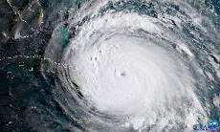
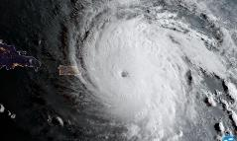
UNCLASSIFIED
NGA Hurricane Irma / Maria Support
Meso American – Caribbean Hydrographic Commission (MACHC)
Jim Rogers
SFHN Technical Executive
NGA Maritime Safety Office
James.E.Rogers@nga.mil
02 DEC 2017
UNCLASSIFIED

Slide 2
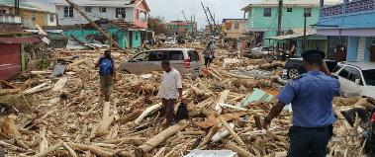
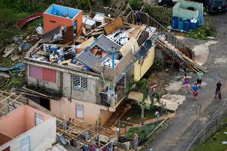
Hurricane Irma & Hurricane Maria
UNCLASSIFIED
Hurricane Irma and Hurricane Maria affected the Eastern and Central Caribbean Sea region as well as the Eastern area of North America.
The region was affected during the period of 30 AUG 2017 – 30 SEP 2017 by both Hurricanes.
Hurricane Irma and Hurricane Maria brought Hurricane force winds, heavy rains, and flooding throughout the region.
UNCLASSIFIED
Notes:
During the period of 20 AUG 2017 – 30 SEP 2017 the MACHC Region was under threat from two major Hurricanes.
Both Hurricane Irma and Hurricane Maria became Category 5 Hurricanes inflicting heavy damage to whatever was in their path.

Slide 3
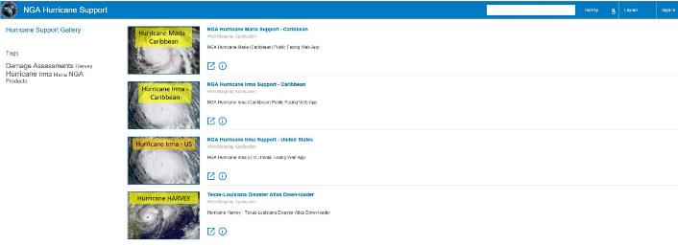
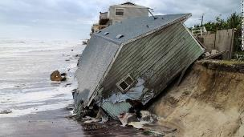
NGA Support to Hurricane Irma / Maria
UNCLASSIFIED
NGA Website created
UNCLASSIFIED
Notes:
In response to the Hurricanes NGA stood up webpage on the WWW making various products and data available to support Hurricane Relief efforts.
NGA Webpage: https://www.nga.mil/Pages/default.aspx
Hurricane Support Webpage: http://nga.maps.arcgis.com/apps/MapAndAppGallery/index.html?appid=85c45e071293405ba0926b75d740f83e

Slide 4
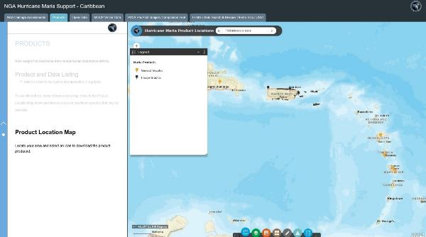
Product Locations
UNCLASSIFIED
Product Location Map
UNCLASSIFIED
Notes:
On the Products tab the user can see the available products shown geospatially on a Product Location Map. The user can click on the Product features on the map for more information about the product.
The user can also see a products listing where they can click on the product and view it or download it.

Slide 5
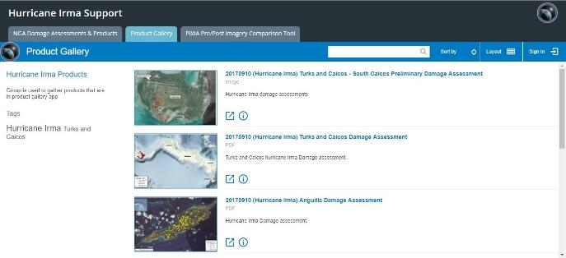
Products
UNCLASSIFIED
Products
UNCLASSIFIED
Notes:
- In the products listing a user can see thumbnails of the available products and also a linked name that they can click on to open up the product.

Slide 6
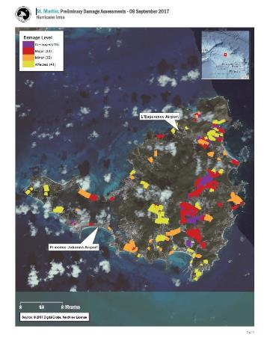
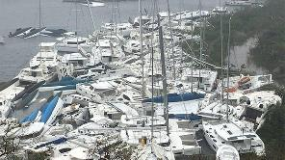
Products
UNCLASSIFIED
Damage Assessment
UNCLASSIFIED
Notes:
Hurricane Damage Assessment’s are one of the products that are available from the Products tab on the webpage.
This example is a Damage Assessment of St. Martin showing varying degrees of damage across the Island.

Slide 7
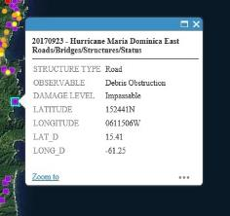
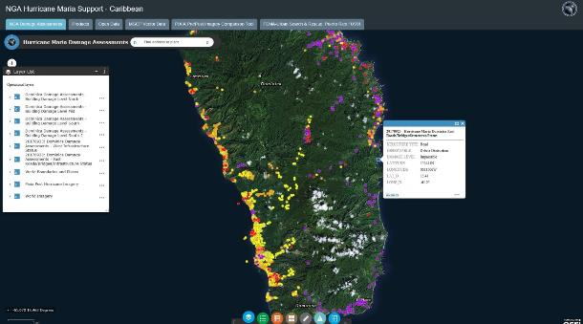
Products
UNCLASSIFIED
Damage Assessment
UNCLASSIFIED
Notes:
The Damage Assessments can also be reached via the Map interface.
The user just has to click on that feature on the map and a text window will appear with information about the feature.

Slide 8
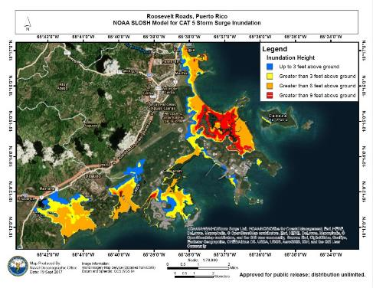
Products
UNCLASSIFIED
Storm Surge Inundation
UNCLASSIFIED
Notes:
Storm Surge Inundation products are also available from the Products tab on the Hurricane Support webpage.
This map gives expected Inundation Heights for this area of Roosevelt Roads, Puerto Rico.

Slide 9
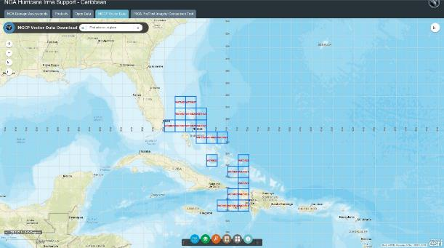
Data
UNCLASSIFIED
MGCP Vector Data
UNCLASSIFIED
Notes:
Some of the Multinational Geospatial Co-production Program (MGCP) data was made available to support the Hurricane Relief efforts.
For more information about MGCP: https://www.mgcp.ws/

Slide 10
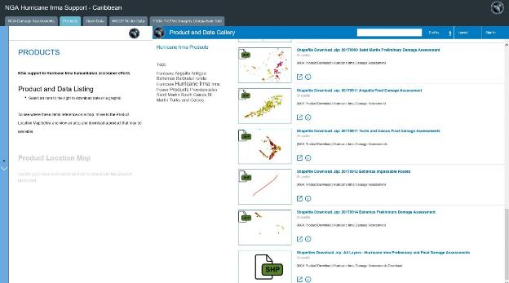
Data
UNCLASSIFIED
Shapefile Data
UNCLASSIFIED
Notes:
Some Data is also available on the Products tab.
In this case there Shapefiles of the Damage Assessments available for download and use in your GIS environment.

Slide 11
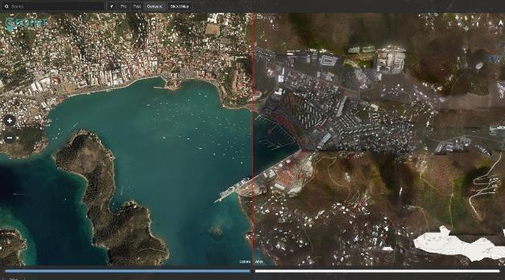
Imagery
UNCLASSIFIED
Imagery compare tool
UNCLASSIFIED
Notes:
For some areas there is a Imagery Compare tool available which shows before and after imagery of the area to help first responders plan their efforts.
There is a slider available that allows you to quickly compare the imagery by slide the bar back and forth.

Slide 12
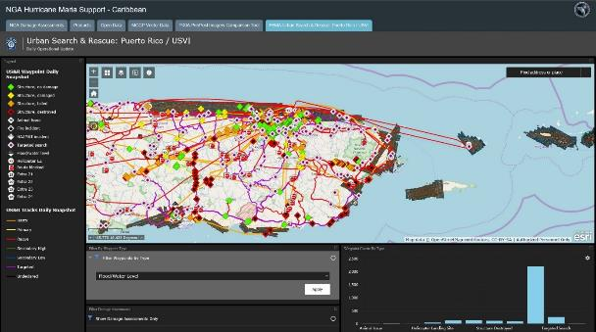
Search & Rescue
UNCLASSIFIED
Operational Update
UNCLASSIFIED
Notes:
The Search and Rescue tab provided a portal to show a Daily Operational Update of rescue efforts within the Hurricane zone.
The information was categorized and shown on the map with an appropriate symbol.

Slide 13
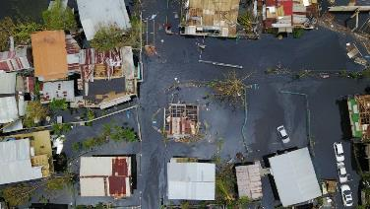
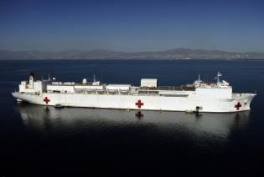
Humanitarian Aid
UNCLASSIFIED
The NGA Hurricane Irma and Hurricane Maria websites supported combined US efforts during the crisis.
The website also supported the efforts of the other international partners with their humanitarian aid as well.
The various products, maps, and data helped responders make more informed decisions.
UNCLASSIFIED
Notes:
The NGA Hurricane Irma and Hurricane Maria webpages provided support to both US and International efforts during the crisis.
The information made available for first responders and relief workers helped them make more informed decisions during the aftermath of the Hurricanes.

Slide 14
UNCLASSIFIED
UNCLASSIFIED

