Slide 1
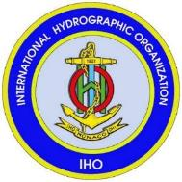
International Hydrographic Organization (IHO)
Mustafa Iptes,
Director, IHO

Slide 2
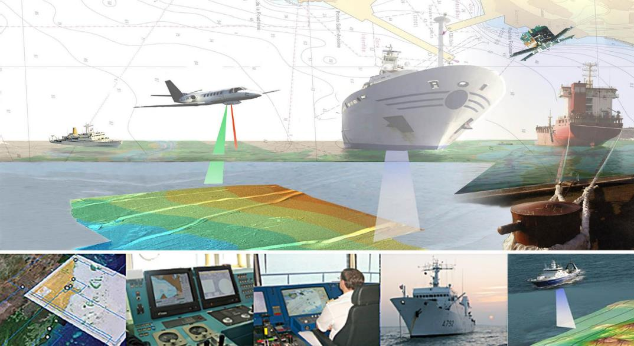

Slide 3
OUTLINE
Introduction
Hydrography – What is it?; Uses & Benefits; Who is responsible for it?
The IHO and Current Activities
Conclusion

Slide 4
Hydrography - (Definition)
Hydrography is the branch of applied sciences which deals with the measurement and description of the physical features of oceans, seas, coastal areas, lakes and rivers, as well as with the prediction of their change over time, for the primary purpose of safety of navigation and in support of all other marine activities including economic development, security and defence, scientific research, and environmental protection.

Slide 5
The International Hydrographic Organization
The Need for Hydrography

Slide 6
what is hydrography ?
how is it done ?
what do we do in Monaco ?

Slide 7
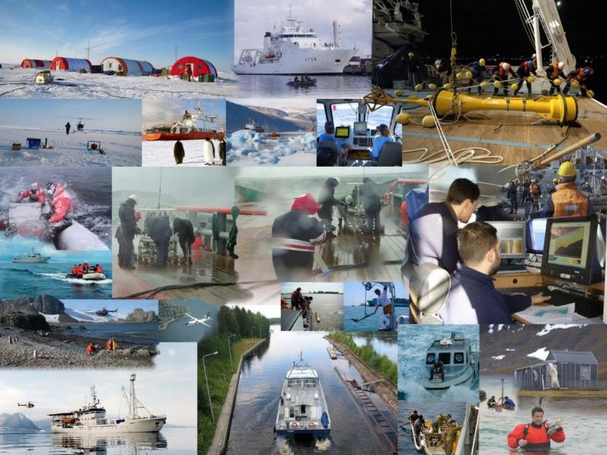

Slide 8
Hydrography is ….
- measuring and describing the physical features of oceans, seas, coastal areas, lakes and rivers
for :
- safety of navigation
- protecting the marine environment
- other marine activities including
- economic development
- security and defence
- scientific research

Slide 9
Hydrography Involves
The collection of hydrographic data
The production of nautical charts and publications
The dissemination of Maritime Safety Information (MSI)

Slide 10
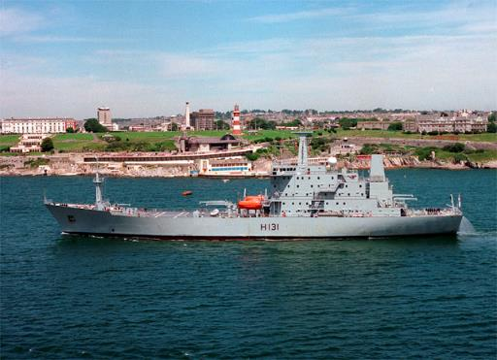
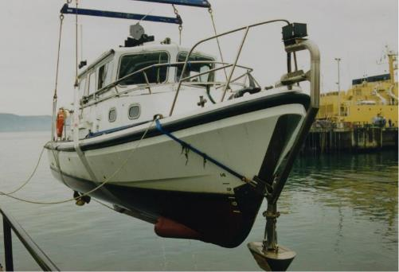
survey ships
survey boats

Slide 11
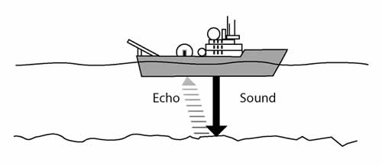
Hydrographic surveying ….
echo sounder

Slide 12
multi-beam echo sounder

Slide 13
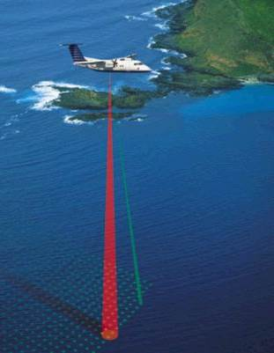
LiDAR – Light Detection And Ranging

Slide 14
Seafloor searching ….

Slide 15
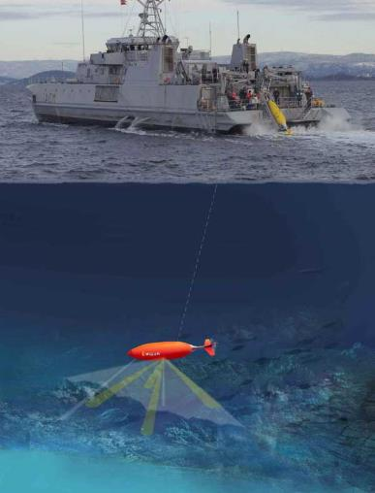
sonar - SOund Navigation And Ranging

Slide 16
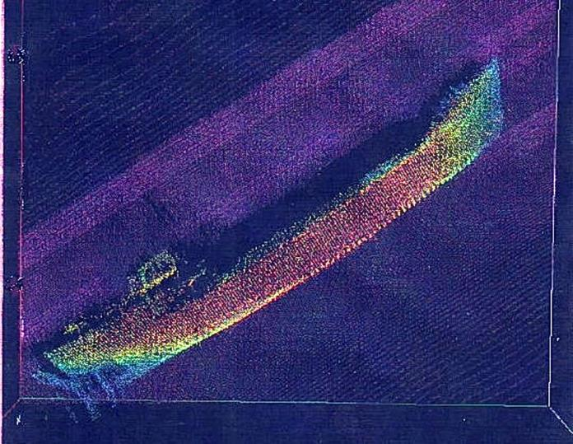

Slide 17
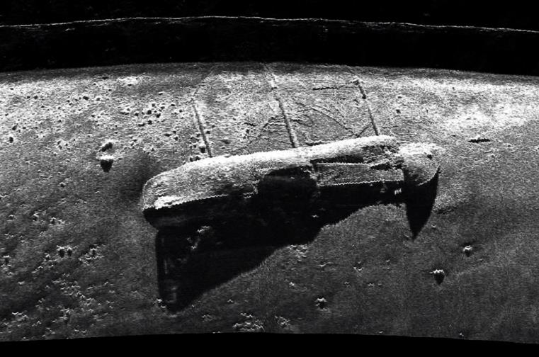

Slide 18
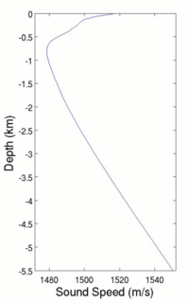
Calibration ….
sound velocity
temperature
salinity
depth

Slide 19
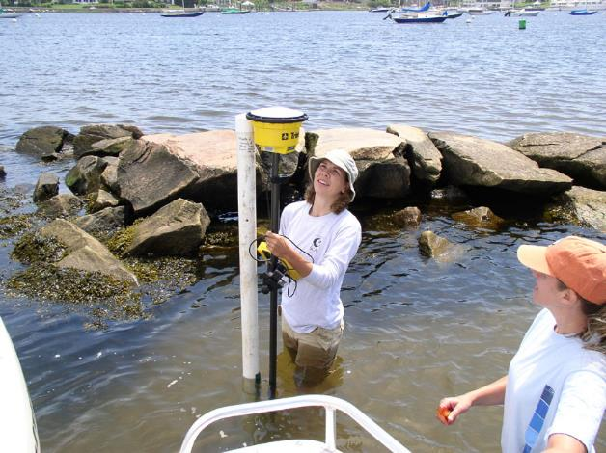
Tides ….

Slide 20
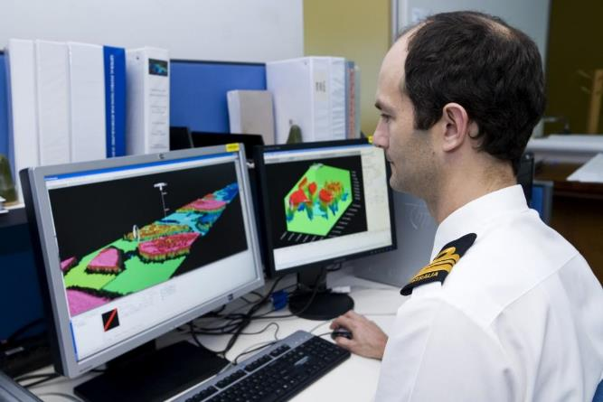
Processing the data ….

Slide 21
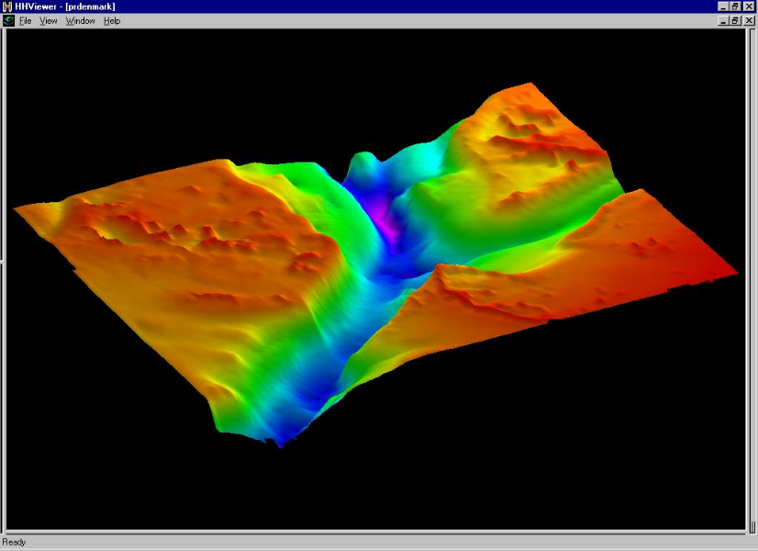

Slide 22
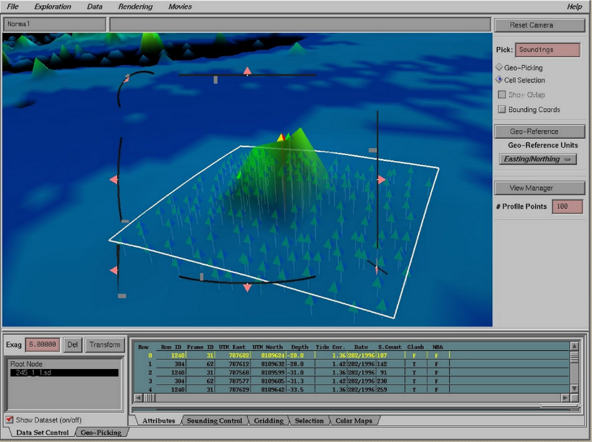

Slide 23
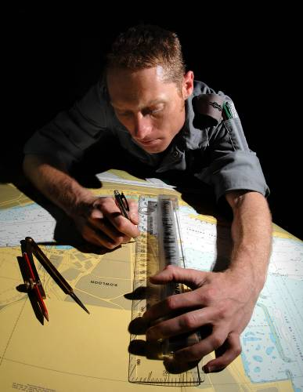
Making a chart ….

Slide 24
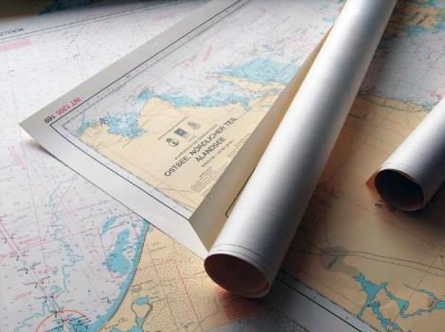
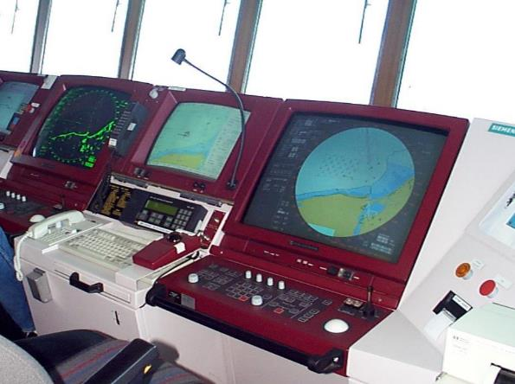
paper charts
electronic charts

Slide 25
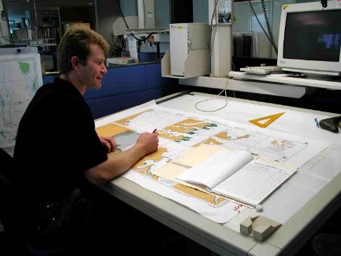
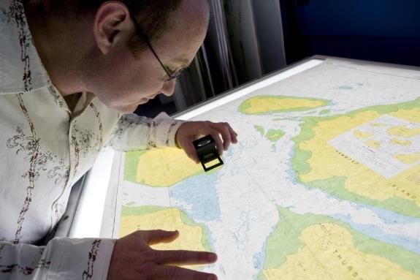

Slide 26
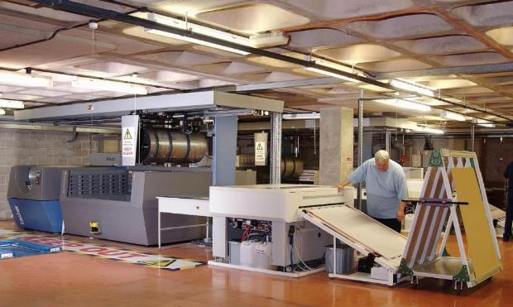

Slide 27
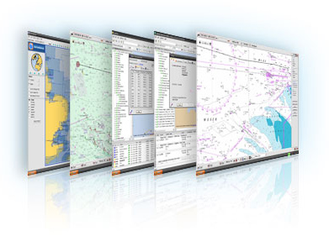

Slide 28
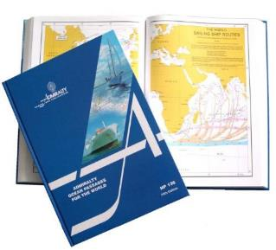
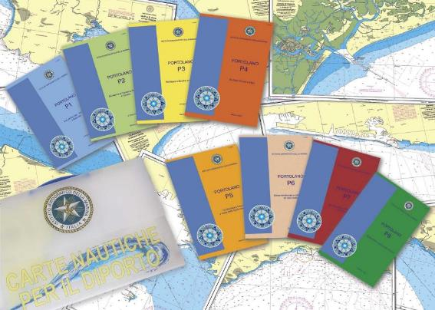
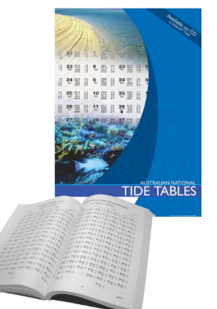
tide tables
sailing directions
lists of lights and radio signals

Slide 29
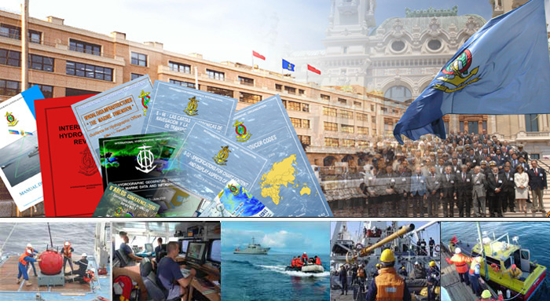
Role of the IHO

Slide 30
INTERNATIONAL HYDROGRAPHIC ORGANIZATION (IHO)
intergovernmental consultative and technical organization
established in 1921
to support safety of navigation and the protection of the marine environment

Slide 31
History of the IHO
1908 International Congress of Navigation, St Petersburg
1912 International Maritime Conference, St Petersburg
1919 International Hydrographic Conference, London
1921 IHB established by 24 nations in Monaco
1970 International Convention: established
2005 Protocol of Amendments to the IHO Convention
2016 Revised IHO Convention entered into force on 8 November

Slide 32
IHO Programmes
raising awareness on importance of hydrography
setting international standards and guidelines
coordination of regional and global nautical charting services
hydrographic capacity building

Slide 33
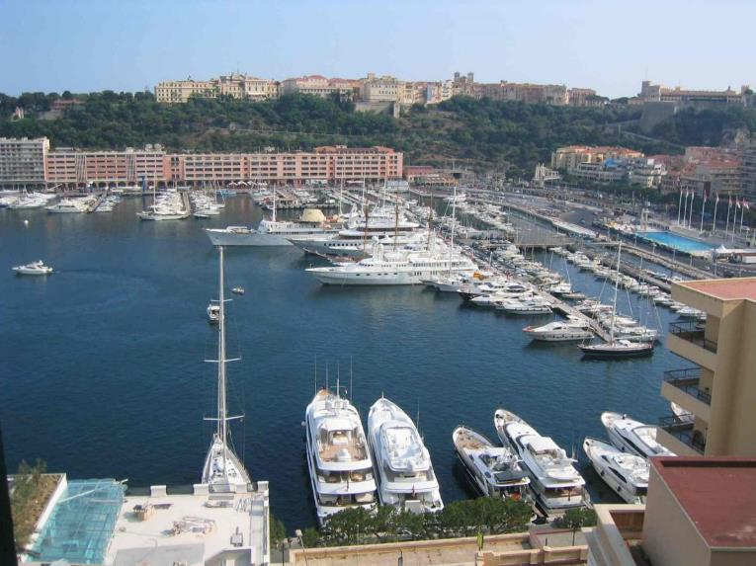
The IHO Secretariat in Monaco

Slide 34
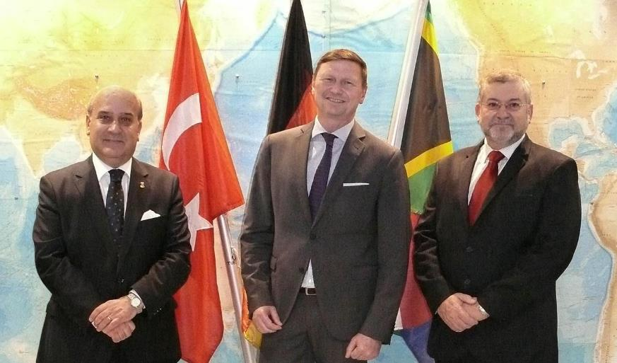
The IHO MANAGEMENT TEAM

Slide 35
The IHO Secretariat
19 Personnel
1 Secretary General and 2 Directors
5 Professional Assistants
2 + 1 Translators
8 Supporting Staff
+ 3 Seconded Staff (Japan, Peru, ROK)

Slide 36
Activities of the IHO Secretariat
Secretariat role
15 technical standards
10 associated guidelines
18 other publications
Direct support to 40 bodies (Committees, WGs and RHCs)
Conference organisation
External representation
bi-lingual website

Slide 37
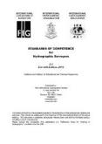
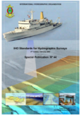
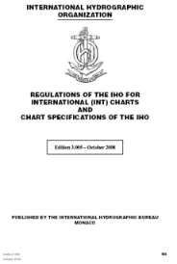
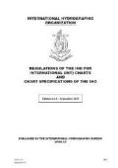
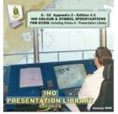
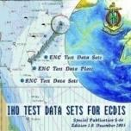
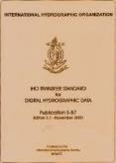
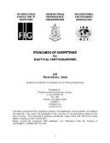
IHO
89 Member States
Recognized competent authority at UN General Assembly and IMO
Active liaison with: UN-IMO, UN-GGIM, UN-DOALOS, UNESCO-IOC, UN-WMO, EC, GEO, IALA, ISO, FIG, ICA, CIRM, ICS, …..

Slide 38
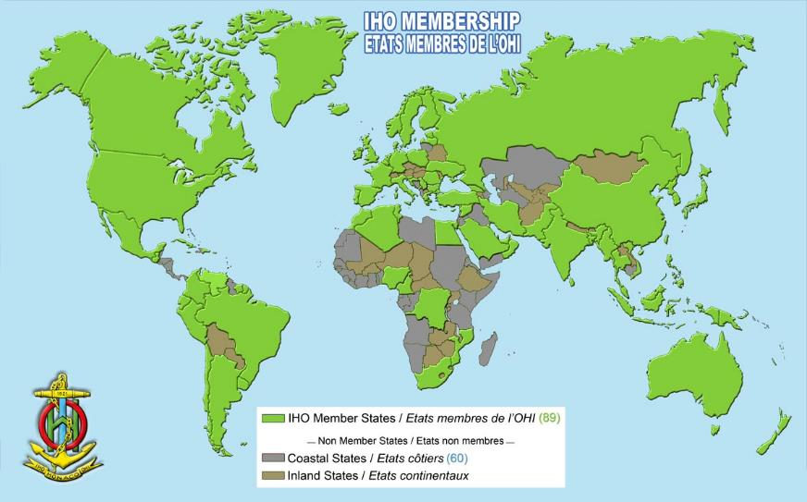
IHO Member States - 2018

Slide 39
The Structure of the IHO

Slide 40
IHO ASSEMBLY
Finance Committee (FC)
IHO COUNCIL
IHO SECRETARIAT
(SECRETARY-GENERAL)
Hydrographic Services and Standards Committee (HSSC)
Inter-Regional Coordination Committee (IRCC)
Capacity Building Sub-Committee (CBSC)
Nautical Cartography WG
(NCWG)
Regional Hydrographic
Commissions (RHCs)
ENC Standards Maintenance WG
(ENCWG)
Sub-Committee on the Worldwide Navigational Warning Service (WWNWS-SC)
Nautical Information Provision WG (NIPWG)
Hydrographic Commission on Antarctica (HCA)
S-100 WG
Worldwide ENC Database WG
(WENDWG)
Data Quality WG (DQWG)
IHO Data Centre for Digital Bathymetry (DCDB)
Marine Spatial Data Infrastructure WG (MSDIWG)
Data Protection Scheme WG (DPSWG)
IHO-IOC General Bathymetric Chart of the Oceans (GEBCO)
Guiding Committee (GEBCO GC)
Tides, Water level and Current WG (TWCWG)
IHO-EU Network WG
(IENWG)
Hydrographic Dictionary WG (HDWG)
Technical Sub-Committee on Ocean Mapping (TSCOM)
Crowd-Sourced Bathymetry WG (CSBWG)
IHO-IAG Advisory Board on the Law of the Sea (ABLOS)
Sub-Committee on Regional Undersea Mapping (SCRUM)
FIG-IHO-ICA International Board on Standards of Competence for Hydrographic Surveyors and Nautical Cartographers (IBSC)
Sub-Committee on Undersea Feature Names (SCUFN)

Slide 41
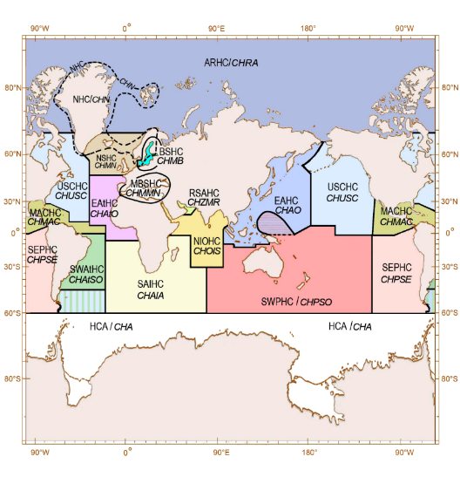
Regional Hydrographic Commission
15 RHCs + Hydrographic Commission on Antarctica
Regional coordination of
charting schemes
capacity building and assistance
bilateral cooperation
technical cooperation
training

Slide 42
3-yearly IHO Assembly
Annual Council meetings
Annual Committee meetings
Annual or bi-annual WG meetings + work by correspondence
Voting at Assembly and by correspondence

Slide 43
Participation in IHO Activities
Permanent Secretariat (20 full-time) + 3 seconded officers from MS
IHO Member States (via national Hydrographer)
Sister IGO’s
Accredited Non-Governmental Organizations (recognised international observer organizations)
Expert Contributors (industry and academia) - by invitation (to WGs only)

Slide 44
… some current IHO priorities
Outreach and raising awareness
Increasing IHO membership
MSDI and provision of geo-data
S-100 implementation and development
Supporting implementation of e-Navigation
Crowd-Sourced Bathymetry, Seabed2030 Project
Satellite Derived Bathymetry
Capacity Building

Slide 45
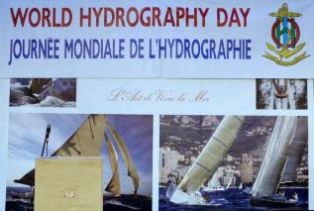
World Hydrography Day (21 June)
Hydrography-underpinning Blue Economy – 2013
Hydrography- Much More Than Just Nautical Charts - 2014
Our seas and waterways – yet to be fully charted and explored - 2015
Hydrography – the key to well-managed seas and waterways - 2016
Mapping our seas and oceans - more important than ever – 2017
Bathymetry-The Foundation for Sustainable Seas, Oceans
and Waterways (2018)

Slide 46
World Hydrography Day (2019)
Hydrographic information to drive Marine knowledge

Slide 47
The IHO Website
www.iho.int
An increasingly important means of facilitating communication between Member States, Committees, Working Groups and the IHO Secretariat

Slide 48
International Hydrographic Organization
IHO Secretariat
4b, Quai Antoine 1er
B.P. 445
MC 98011 MONACO CEDEX
Principauté de Monaco
Telephone: +377 93 10 81 00
Fax: +377 93 10 81 40
e-mail: info@iho.int
WEB Site: http://www.iho.int

Slide 49
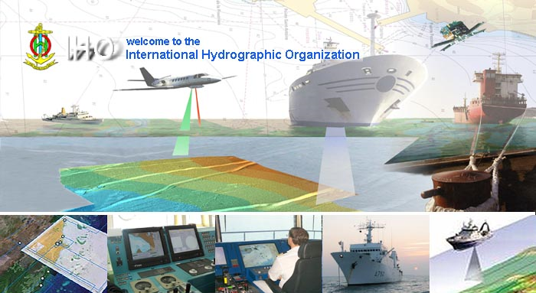
Questions?
www.iho.int

