Slide 1
Governance of the delivery of Aton and international compliance
Gerardine DELANOYE
Programme Manager; IALA World-Wide Academy

Slide 2
About IALA
International Association of Marine Aids to Navigation and Lighthouse Authorities

Slide 3
IALA Strategic 2014-2026 Goals for “Successful voyages, sustainable planet.”
G1 – Marine Aids to Navigation are developed and harmonised through international cooperation and the provision of standards.
G2 ‐ All coastal states have contributed to a sustainable and efficient global network of Marine Aids to Navigation through capacity building and the sharing of expertise.

Slide 4
IALA Document Structure
Standards; Recommendations; Guidelines; Manuals; Model Courses

Slide 5
Standard …
Standard 1050
Normative Recommendations
Informative Recommendations
Not all Standards may apply to your country, for example S1020 Vessel Traffic Services

Slide 6
Standards
IALA Standards may contain normative and informative provisions.
Normative provisions are those with which it is necessary to conform in order to claim compliance to the Standard.
Informative provisions are those which specify additional desirable practices but with which it is not necessary to conform in order to claim compliance to the Standard.

Slide 7
Standards

Slide 8
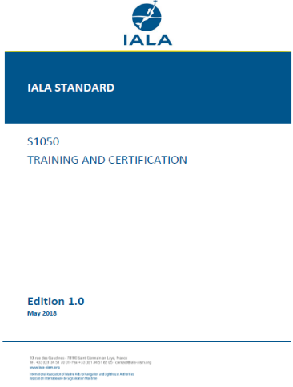
IALA Standard S1050 – Training and Certification
The Standard references normative provisions, detailed in the listed IALA Recommendations, covering:
Training and Assessment,
Accreditation, competency, certification and revalidation.
The following Recommendations are normative and shall be observed if compliance with this Standard is claimed:
R0141 – Training and Certification of AtoN Personnel,
R0103 – Training and Certification of VTS Personnel,
O-149 – Accreditation of Training Organisations.

Slide 9
The World-Wide Academy
Training and capacity building

Slide 10
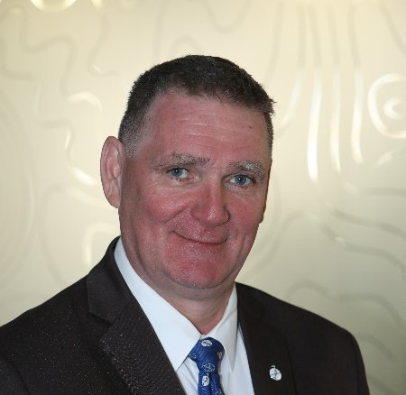
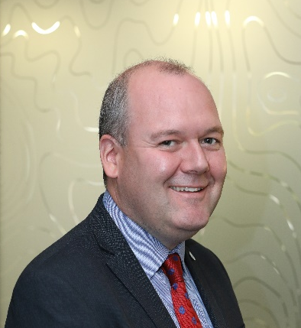
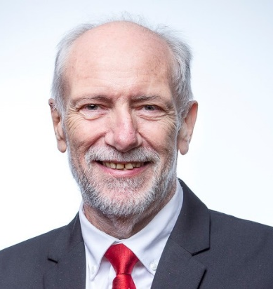
The World- Wide Academy Team
Omar Frits Eriksson:
Dep Sec-Gen IALA, Dean WWA, Strategy
High Level Meetings
Gerardine Delanoye:
Capacity Building & Resource Management
Focus on America’s
Kevin Gregory:
Education and Development Management,
Focus on Asia
Jacques Manchard:
Senior Advisor, Capacity Building,
Focus on Africa

Slide 11
What do we do?
Education and Training
Oversee IALA Training Accreditation scheme
Support Accredited Training Organisations
Deliver training on AtoN and Risk Management
Capacity Building
High Level Missions, raising awareness
Technical Assessment Missions to Coastal States in need
Long-term partnership and follow up activities with Coastal States
Research & Development
Determine knowledge gaps and need for R&D
Promote R&D
Harvest R&D results and feed this into IALA Committees

Slide 12
Developments
AtoN Accreditation & Training
VTS Accreditation & Training
Master in Aids to Navigation
Train the Trainer courses
Examination principles
Distance Learning ( e-Learning platform )
Missions and Reviews
Focus on Africa

Slide 13
Training 2019
Risk Management Training Seminar
In English at IALA HQ:
20-24 May 2019
IWRAP Mk2
PAWSA
SIRA
Simulation
In Spanish Meso-America
and Caribbean

Slide 14
Joint CB Coordination Meeting, IMPA HQ

Slide 15
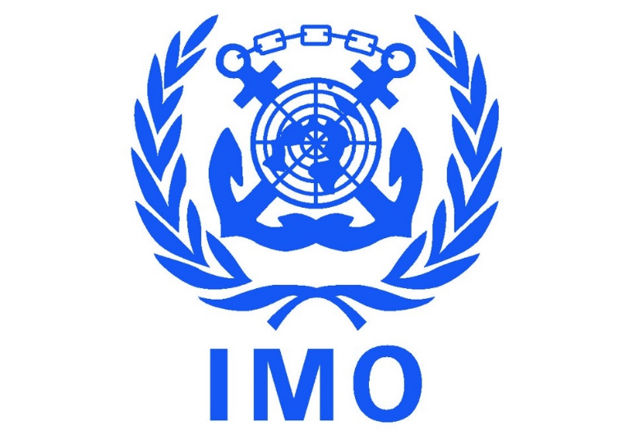
Delivering as one

Slide 16
IALA WWA Coastal States in need
The analyses of all coastal states
MATAIN Accreditation Project

Slide 17
There are some challenges out there…
Source: MarineTraffic.com

Slide 18
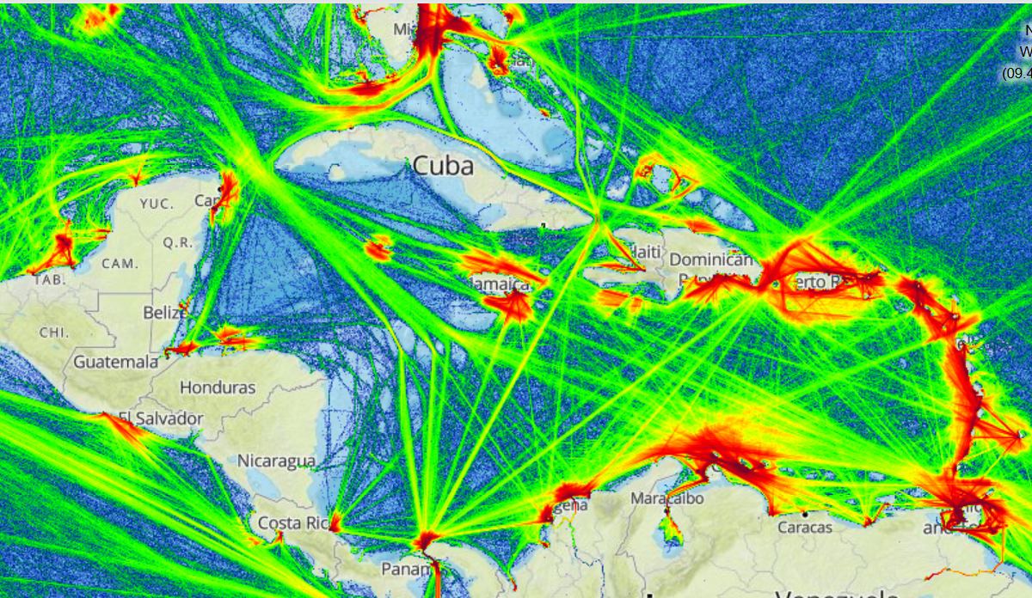
THE TRAFFIC IN YOUR REGION

Slide 19
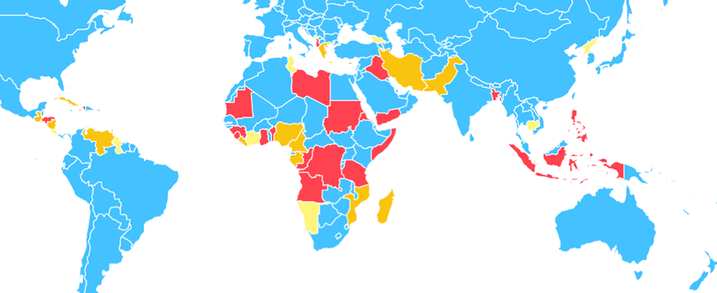
Those in need (still)
Priority
1
2
3

Slide 20
Assessment of Need of all 155 Coastal States
Quality of Maritime Management | high | States with the smallest need | States with smaller need
 | low | States with greater need | States with the greatest need TARGET STATES
 |  | low | high
 |  | Volume of Traffic and Degree of Risk
States with some need

Slide 21
What has been achieved?

Slide 22
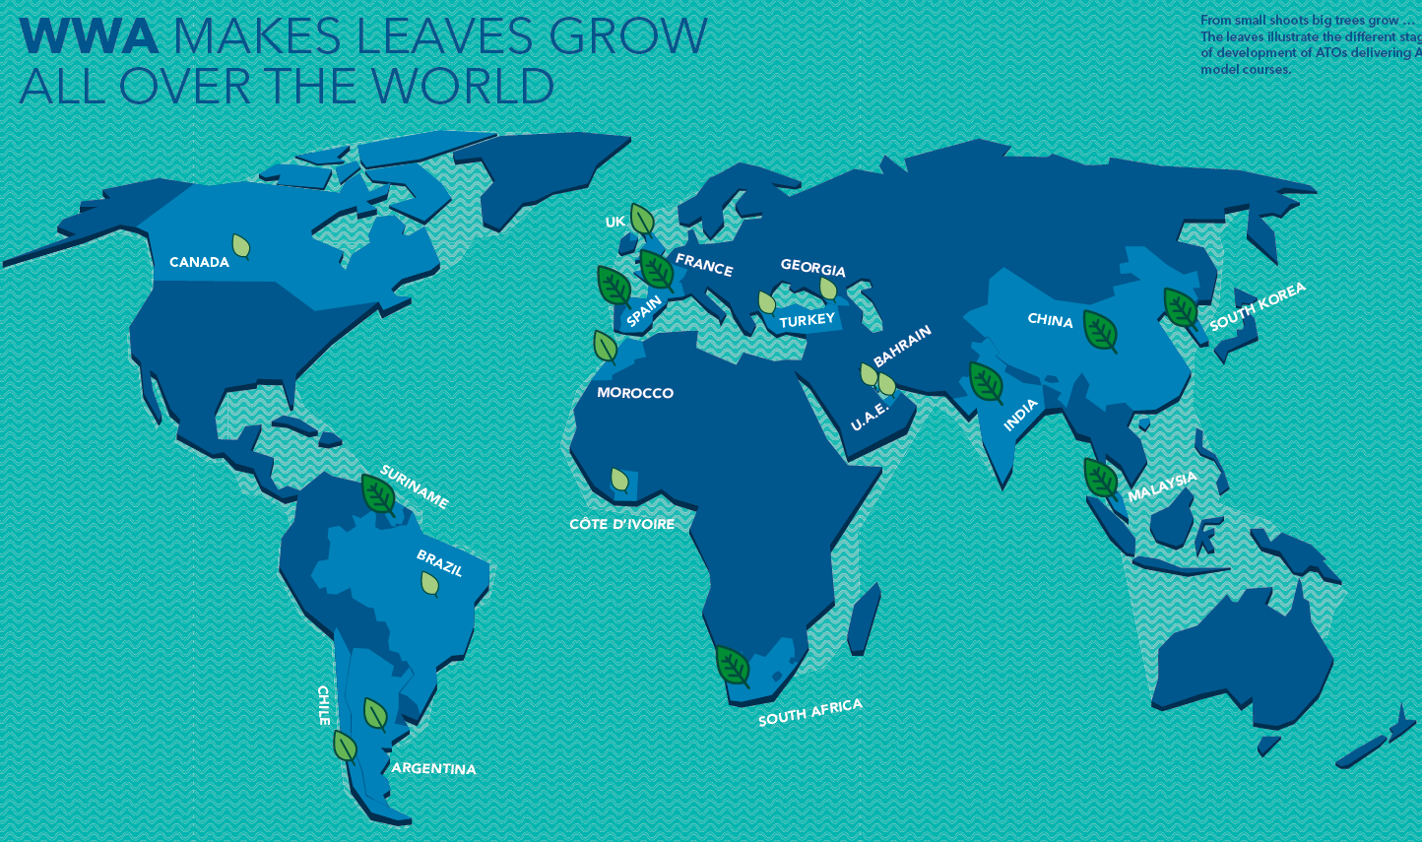

Slide 23
Increase in ATO´s and Level 1 AtoN Manager Courses

Slide 24
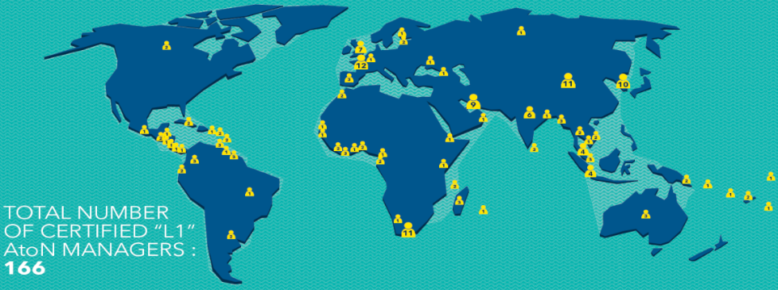
International Level 1 Aids to Navigation Managers
180

Slide 25
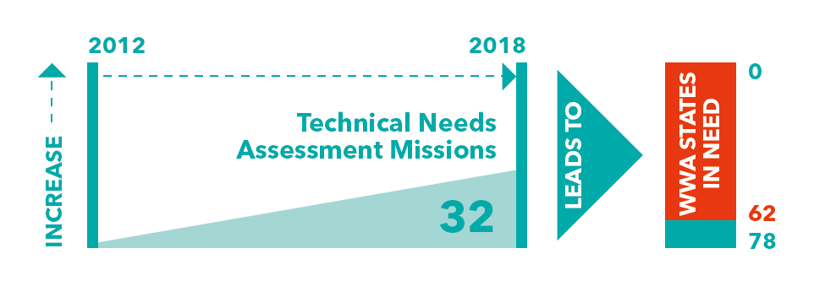
Technical Needs Assessment Missions & States in Need

Slide 26
SOLAS Chapter 5, Regulation 13
13 – Aids to Navigation Services
MATAIN Accreditation Project

Slide 27
SOLAS
International Convention for the Safety of Life at Sea - SOLAS
Established in 1914 after the Titanic disaster
Latest Convention 1974 came into force in 1980
12 SOLAS Chapters.
Chapter 5 (V) concerns Safety of Navigation including rules about providing AtoN
Chapter V was updated in 2000
From 1 July 2002 Contracting Governments are obliged to provide Hydrographic (Regulation 9); Vessel Traffic Services (VTS – Regulation 12) and AtoN services (Regulation 13)

Slide 28
Key SOLAS V Regulations
4 – Navigational Warnings: WWNWS
9 – Hydrographic Services
10 – Ships Routeing
11 – Ships Reporting Systems
12 – Vessel Traffic Services
13 – Aids to Navigation Services
19-2.4 – AIS

Slide 29
SOLAS V Regulation 13
Chapter V Regulation 13.1 requires a Contracting Government to provide “as it deems practical and necessary” by itself or with other Governments “such AtoN as the volume of traffic justifies and the degree of risk requires”
IALA Risk Management Toolbox endorsed by IMO in SN.1/Circ.296
Ch V Reg 13.2: AtoN should conform to international standards (IALA recommendations and guidelines)
Ch V Reg 13.3 information about AtoN must be given to all concerned (mariners; stakeholders etc.)

Slide 30
Responsibility for AtoN
The Competent Authority (CA) provides or formally delegates the provision of its AtoN service to States; Territories; local government; ports, harbours and waterways; military organisations or private groups
The geographical area of each must be defined
Responsibility for the AtoN service remains with the Government not with the service provider
Ensure that national maritime law specifies which Ministry is the CA and that the CA has the right to audit all AtoN service providers

Slide 31
Questions?
Contact: gerardine.delanoye@iala-aism.org

