Slide 1
IRCC 10 Outcomes
Complete IRCC report available on the IHO website
IHO.int
Member States note Annex F – List of Recommendations to RHCs

Slide 2
Agenda
General information and MACHC representation
Working Groups and Sub Committee highlights
IHO Resolution 2/1997 as Amended
IRCC Recommendations and requests to RHCs

Slide 3
MACHC Representation
IRCC 10 Held in Goa, India, June 4 to 6, 2018
IRCC 11 to be conducted in Genoa, Italy, June 3 to 5, 2019
MACHC region represented by the Vice Chair (USA) for the MACHC Chair (Mexico)
Noted MEIPWG and the SDI/MSDI research to assess regional portals
Highlighted cruise ship port analysis, identified 43 ports lacking large scale ENC coverage (14 have ENCs planned)
Noted some nations have funded projects to strengthen the hydrographic knowledge within the region
Noted the regional interest in MSDI, and the involvement of MACHC Members within the UN-GGIM Working Group on Marine Geospatial Information and the OGC Marine Domain Working Group
Noted the effort underway to better understand hydrographic risk within the region

Slide 4
IRCC WG items of note
WWNWS – Spain to investigate the possibility to translate MSI training material to Spanish – report due to IRCC 11
CBSC – established C-55RPT and use of CATZOC information as indicator of survey adequacy – MS encouraged to provide CATZOC information directly, or via RENC.
MSDI WG – Noted the need to establish National MSP Data Contact Points; Provide overview of regional MSP best practice
Coordination with OGC on the Concept Development Study on MSDI
CSBWG – CSB Guidance Document B-12 completed, endorsed by IRCC. Update to the ToR to continue work, focus on use of CSB

Slide 5
IRCC WG items of note
IBSC – Approved the clarifications and amendments to S-5A and S-8A
GEBCO GC – Noted the updated analysis of the state of our understanding of the sea floor – latest view is 6.2% is adequately mapped. Noted the establishment of the SeaBed 2030 Project and the building effort.

Slide 6
WEND WG
Noted concern caused by overlapping ENC; reported to IHO Council.
Noted the conviction that all ENC data be made available via the RENC system for QC and risk assessment of overlaps.
One year “clock” to resolve overlaps begins once identified and reported to ENC producers.
RHCs requested to make regional assessments of level of navigational risk caused by overlaps using RENC Policy on Risk Assessment
Updated the ToR to allow the WG to review options to expand the value of the WEND by use beyond ECDIS mandation purposes.
Noted the recommendation that RENCs consider S-57 license management services to support navigation for all classes of vessels

Slide 7
Revision of IHO Resolution 2/1997
Endorsed the draft IHO Resolution 2/1997 as amended, (small adjustments) for submission to the IHO Council (C-2)
Refer the draft IHO Resolution 2/1997 as amended, (substantive changes) to the RHCs for consideration and reporting back to IRCC (deadline October 2018) – note this has passed, but IRCC Chair willing to accept late submissions

Slide 8
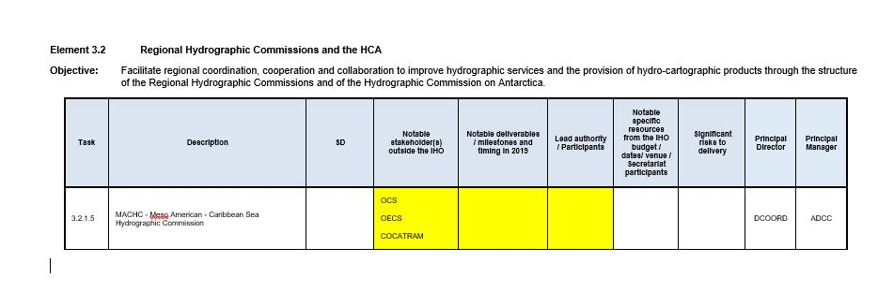
2020 Work Program input for IHO Work Program 3.2.15 MACHC

Slide 9
Recommendations to RHCs (IRCC10 Report Annex F)
MSs encouraged to provide material to the IHO Secretariat for the centenary of the IHO (deadline: IRCC 11)
Request National Coordinators to review the GMCSS Master Plan and IHO Publication C-55
Encourage use of the Joint Manual on MSI
Encourage closer engagement of the MS MSI Coordinators and NAVAREA Coordinator
Encourage liaison between regional CB Coordinator and Chair of WWNWS regarding programing and candidate selection for MSI
Encourage MS attendance at WWNWS meetings
Encourage MS to engage with their IMO delegations regarding support for IMO MS not MS of the IHO in order to comply with SOLAS Chapter V obligations

Slide 10
Recommendations to RHCs (IRCC10 Report Annex F)
Encourage MSs to provide CATZOC information to IHO Secretariat
Reinforce “one year clock” to resolve overlaps starts when Producer Nation notified of situation
Endorse management of overlaps be implemented by RHC
Note the RHCs should make own assessment of navigational risk for ENC overlaps using RENC’s Policy on Risk Assessment
Encourage RHCs to provide updated reports on the status of ENC schemes to the WEND in advance of the yearly meeting
Note the recommendation that RENC’s may consider S-57 license management service to support safety of navigation of all vessels

Slide 11
Recommendations to RHCs (IRCC10 Report Annex F)
Encourage MS’s to release datasets, or subsets, into the public domain via the IHO DCDB
Request MSs state their policy on data gathering restrictions within their maritime areas of jurisdiction to enable CSB activities
Request MSs support the CSB initiative with positive actions, such as requiring all research vessels collect bathymetry
Request MSs promote a scaled trial of CSB data collection as a follow on of earlier pilots
Continue to encourage RHCs to organize contribution of bathymetric data in shallow coastal areas to support the production of the GEBCO

Slide 12
Recommendations to RHCs (IRCC10 Report Annex F)
Encourage RHCs to invite and communicate with GEBCO members at their meetings
RHCs to share there internal guidelines and Best Practices regarding the population of CATZOC values through the DQWG
Consider how the IHO may be represented at events listed in Annex A of doc IRCC10-09B
Encourage RHCs to use the Tides, water level and currents training material resources offered by the TWCWG in their capacity building work program
Invite RHCs to encourage States in the region to contribute to the inventory of tide gauges and current meters

