Slide 1
Updates and Proposals from the HSSC
Kathryn Ries, John Nyberg and Neil Weston
Office of Coast Survey, NOS, NOAA
International Hydrographic Organization Organisation Hydrographique Internationale
Meso American - Caribbean Sea Hydrographic Commission (MACHC) - Cartagena de Indias, Colombia (26 November-1 December 2018)

Slide 2
HSSC Introduction
Chair: Rear Admiral Luigi Sinapi (Italy)
Vice-Chair: Mr. Mike Prince (Australia)
Secretary: Director Abri Kampfer (IHO Secretariat)
HSSC Work: Guided by IHO Work Programme 2 “Hydrographic Services and Standards” and by the Council key Priorities
To promote and coordinate the development of standards, specifications and guidelines for official products and services to meet the requirements of mariners and other users of hydrographic information
Next Meeting: HSSC 11 - Cape Town, South Africa (6-10 May 2019)
Meso American - Caribbean Sea Hydrographic Commission (MACHC) - Cartagena de Indias, Colombia (26 November-1 December 2018)

Slide 3
HSSC Main Items
Revision Process of IHO Resolution 2/2007
Amendments to the HSSC ToRs and RoPs
HSSC key priorities of the IHO Work Programme 2 for 2019 – 2020
Requesting use of the IHO Fund for Special Projects
Top 3 work items of the HSSC WGs
Meso American - Caribbean Sea Hydrographic Commission (MACHC) - Cartagena de Indias, Colombia (26 November-1 December 2018)

Slide 4
HSSC – Revision Process of IHO Resolution 2/2007
Revision process initiated in accordance with Decision A1/12 and Action C1/05
Revision process has two steps
Step 1 – Guidance on conduction of an impact study (Annex A2)
Step 2 – Proposal to divide the Appendix into two parts
Standards and Publications to follow the full process of IHO Resolution 2/2007
Standards and Publications to be developed and maintained w/o following the full process
Meso American - Caribbean Sea Hydrographic Commission (MACHC) - Cartagena de Indias, Colombia (26 November-1 December 2018)

Slide 5
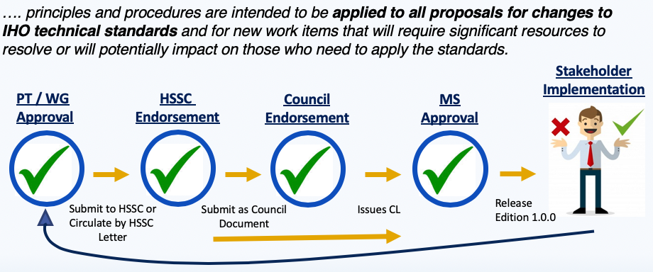
HSSC – Revision Process of IHO Resolution 2/2007
Current review cycle of S-100 base product specifications
Meso American - Caribbean Sea Hydrographic Commission (MACHC) - Cartagena de Indias, Colombia (26 November-1 December 2018)

Slide 6
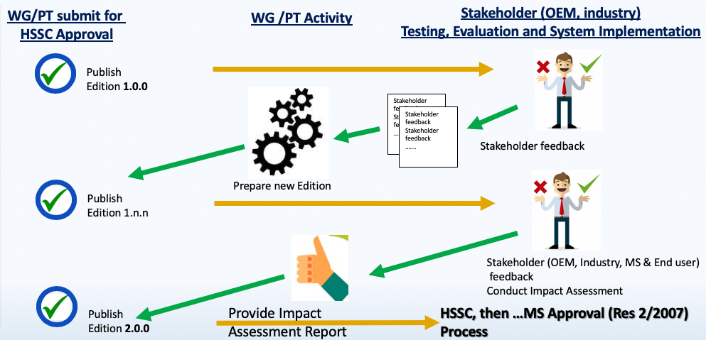
HSSC – Revision Process of IHO Resolution 2/2007
New Review Cycle for WG/PT Development Phase of Prod Specs (Annex A1)
Meso American - Caribbean Sea Hydrographic Commission (MACHC) - Cartagena de Indias, Colombia (26 November-1 December 2018)

Slide 7
Amendments to the HSSC ToRs and RoPs
Amendments
The presence and the role of the COUNCIL
The possibility for the HSSC to decide on the need to go through the Council for recommendations on standards and publications before submitting them to Member States for approval
Meso American - Caribbean Sea Hydrographic Commission (MACHC) - Cartagena de Indias, Colombia (26 November-1 December 2018)

Slide 8
Changes to the HSSC ToRs and RoPs
Changes
Consider and decide upon proposals for new work items under the Committee Work Programme, taking into account the financial, administrative and wider stakeholder consequences and the IHO Strategic Plan and Work Programme and report to each meeting of the Council.
Recommendations of possible strategic importance made by the Committee shall be submitted to IHO Member States for adoption through the Council to the Assembly. The Committee should appreciate and determine the need to go through the Council for recommendations. If prior endorsement of the Council is not deemed necessary by the Committee, the recommendations on standards and publications can be submitted directly to the IHO Member States for approval, once endorsed by the Committee.
Meso American - Caribbean Sea Hydrographic Commission (MACHC) - Cartagena de Indias, Colombia (26 November-1 December 2018)

Slide 9
HSSC key priorities of the IHO WP for 2019-2020
Current HSSC Key Priorities
Develop an S-100 Interoperability Specification
Targeted for HSSC11
Develop all the components needed to make S-101 a reality
Completed: Main document, feature catalogue, classification encoding & guide, encoding format. Validation partially completed
Develop S-121 Product Spec for Maritime Limits and Boundaries
Finalized draft S-121 spec, Edition 1.0.0 planned for March 2019
Meso American - Caribbean Sea Hydrographic Commission (MACHC) - Cartagena de Indias, Colombia (26 November-1 December 2018)

Slide 10
HSSC key priorities of the IHO WP for 2019-2020
Current HSSC Key Priorities
Consolidation and clarification of standards in relation to ECDIS/ENC
HSSC endorsed Ed 6.1.0 of S-58, Adoption of IHO CL 47 by September 2019
Consider data quality aspects in an appropriate and harmonized way for all S-100 based product spec
Data quality checklist for product specification developers has been developed
Prepare Ed. 6.0.0 of S-44
Draft edition 6 under review. HSPT3 to meet in March 2019
Meso American - Caribbean Sea Hydrographic Commission (MACHC) - Cartagena de Indias, Colombia (26 November-1 December 2018)

Slide 11
HSSC key priorities of the IHO WP for 2019-2020
Current HSSC Key Priorities
Develop initial guidance on definition and harmonization of Maritime Service Portfolios
Following Maritime Services have been identified as relevant for the IHO:
No. 5 - Maritime Safety Information Service (MSI)
No. 11 - Nautical Chart Service
No. 12 - Nautical Publications Service
No. 15 - Real-time hydrographic and environmental information Service
Meso American - Caribbean Sea Hydrographic Commission (MACHC) - Cartagena de Indias, Colombia (26 November-1 December 2018)

Slide 12
Request for IHO Fund for Special Projects
Priority | Work Item | Budget (in €) | Period (in months)
1 | Incremental updates of S-100 GML datasets | 20 K | 3-6
2 | Experimental production tool and viewer on the web | 40 K | 6-9
3 | Prototyping system for vector S-100-based data | 42 K | 6-9
Meso American - Caribbean Sea Hydrographic Commission (MACHC) - Cartagena de Indias, Colombia (26 November-1 December 2018)

Slide 13
Top 3 Items for Each WG
S-100
Publication of S-101 Edition 1.0.0 (end of 2018)
Investigate how to include S-100 into the IMO ECDIS Perf. Standards (2019)
Continued development of the S-98 Interoperability Specification (2019)
ENCWG
Maintain IHO Publications (S-52, S-57, S-58, S-63, S-64, S-65, S-66)
Consider the development of high density contour lines related to ENCs
Conduct a Cyber Security Risk on the new edition of the S-63
ABLOS
Maintain Publication C-51 “Technical Aspects of the Law of the Sea Manual”
Deliver a training program on maritime delimitation
Provide advice and guidance on the technical aspect of the Law of the Sea to relevant organizations, bodies and Member States
Meso American - Caribbean Sea Hydrographic Commission (MACHC) - Cartagena de Indias, Colombia (26 November-1 December 2018)

Slide 14
Top 3 Items for Each WG
NCWG
Maintain S-4 as the foundation document for all nautical charts
Develop discussion paper on the Future of the Paper Chart
NIPWG
Develop S-12n - Nautical Information Product Specifications
Coordinate the IHO contribution to the definition and harmonization of IMO Maritime Services within IHO’s remit
HDWG
Maintain and extend definitions in S-32 Hydrographic Dictionary Registry
Liaise with other IHO bodies and organizations preparing publications containing glossaries
Develop a digital database to support S-32 Hydrographic Dictionary Registry
Meso American - Caribbean Sea Hydrographic Commission (MACHC) - Cartagena de Indias, Colombia (26 November-1 December 2018)

Slide 15
Top 3 Items for Each WG
DQWG
Develop a data quality checklist for product specification developers
Provide guidance on data quality aspects to Hydrographic Offices, in particular to ensure harmonized implementation;
Periodically review S-100 based product specifications to ensure the data quality aspects have been taken into consideration
TWCWG
Develop, maintain and extend a Product Specification for digital tide and tidal current tables
Develop, maintain and extend a Product Specification for dynamic surface currents in ECDIS (S-111) and for dynamic tides water level in ECDIS (S-104)
Maintain and extend the relevant IHO standards, specifications and publications as required
Meso American - Caribbean Sea Hydrographic Commission (MACHC) - Cartagena de Indias, Colombia (26 November-1 December 2018)

Slide 16
Thank You Very Much

