Slide 1
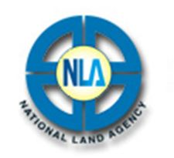
JAMAICA COUNTRY REPORT
National Land Agency
19th Meeting of the MACHC
Cartagena de Indias, Colombia
November 2018

Slide 2
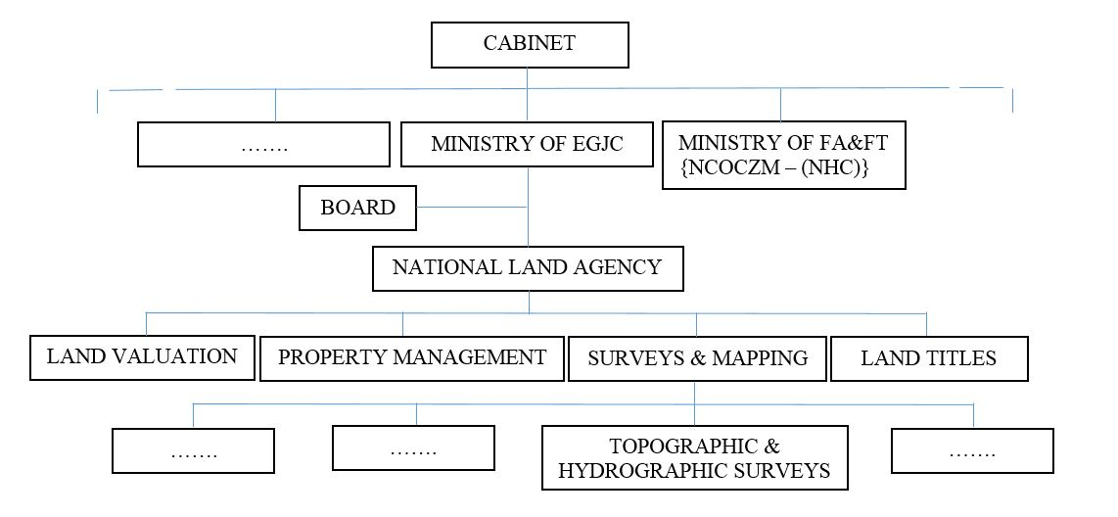
Organization
JAMAICA COUNTRY REPORT

Slide 3
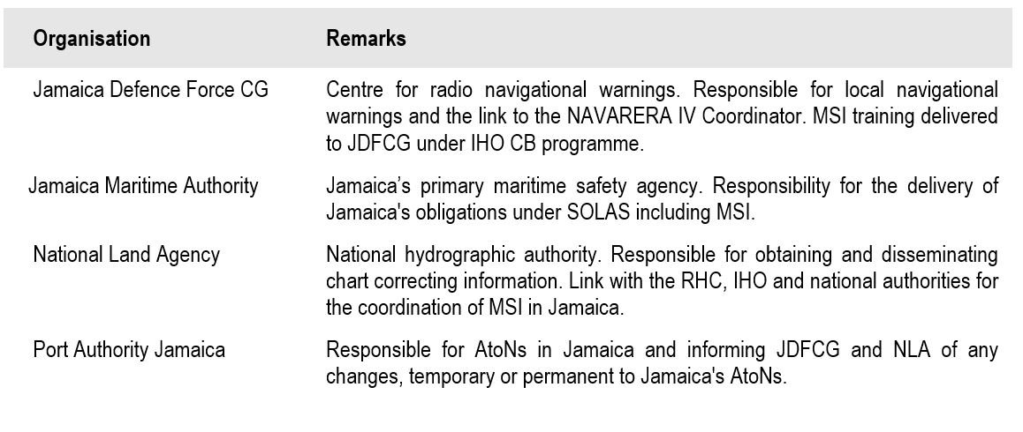
- Institutional Arrangement
JAMAICA COUNTRY REPORT

Slide 4
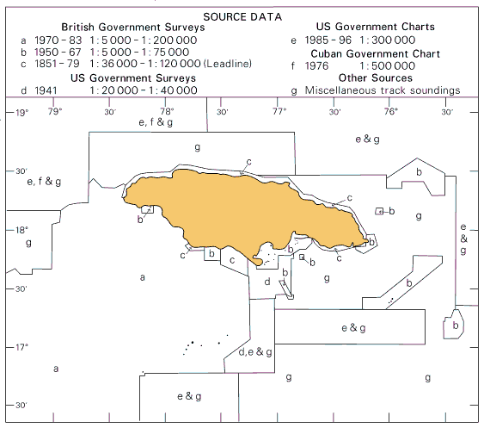
- Primary Charting Agency - Hydrographic Coverage Map
JAMAICA COUNTRY REPORT

Slide 5
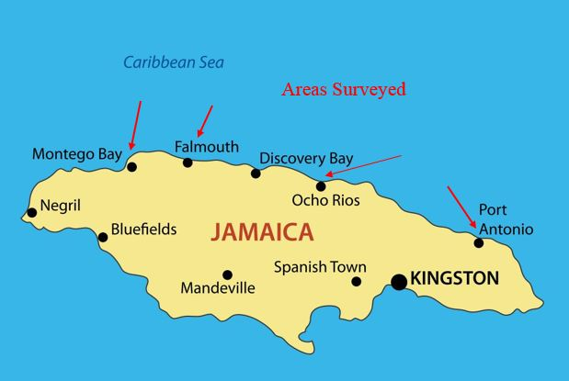
- New Surveys
JAMAICA COUNTRY REPORT

Slide 6
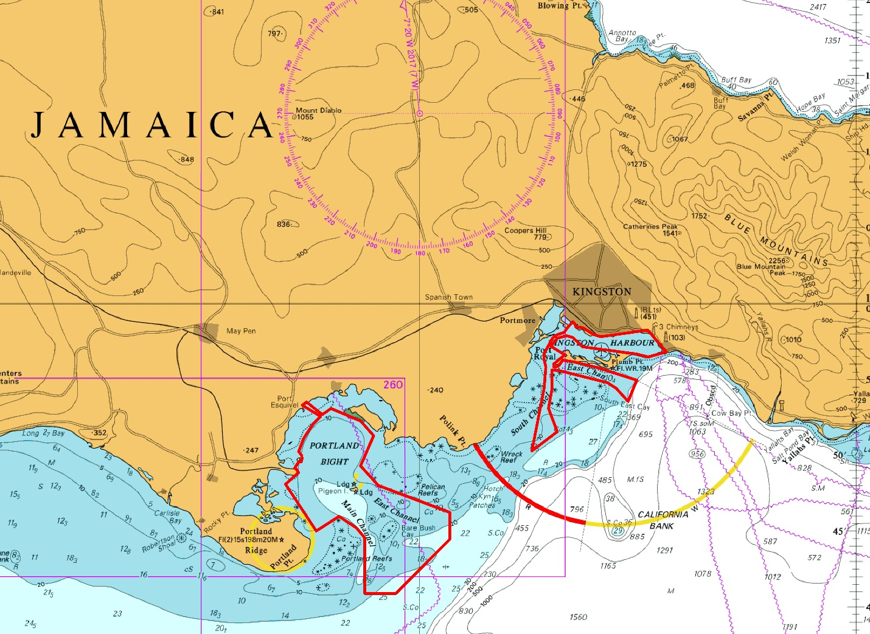
- UKHO – CME Hydrographic Survey Areas
JAMAICA COUNTRY REPORT

Slide 7
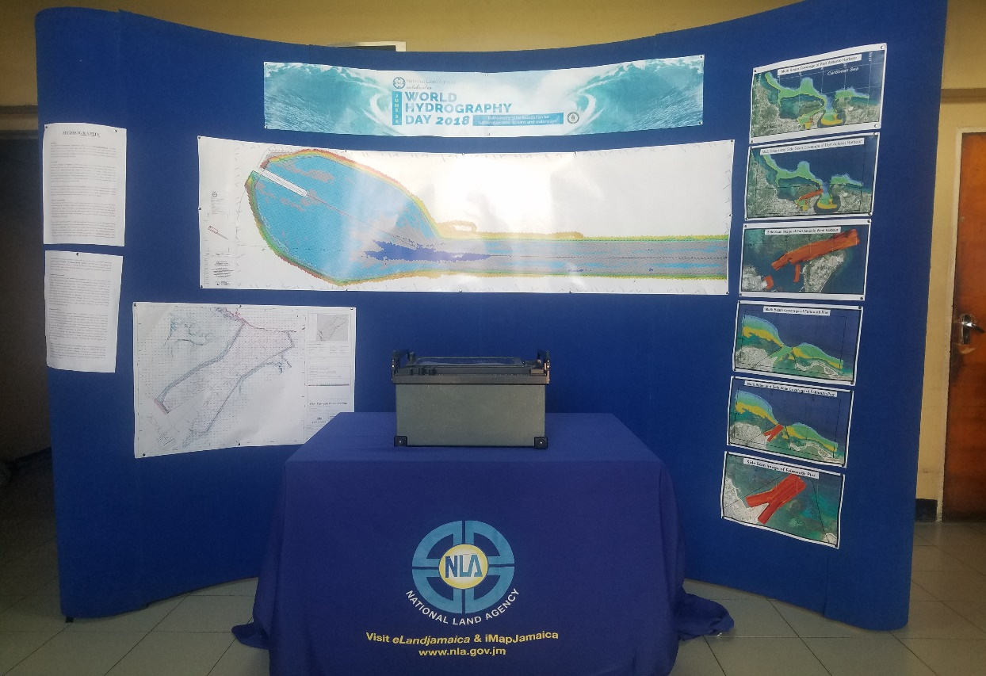
- Building Awareness
JAMAICA COUNTRY REPORT
NLA Celebrated World Hydrography Day on June 21, 2018

Slide 8
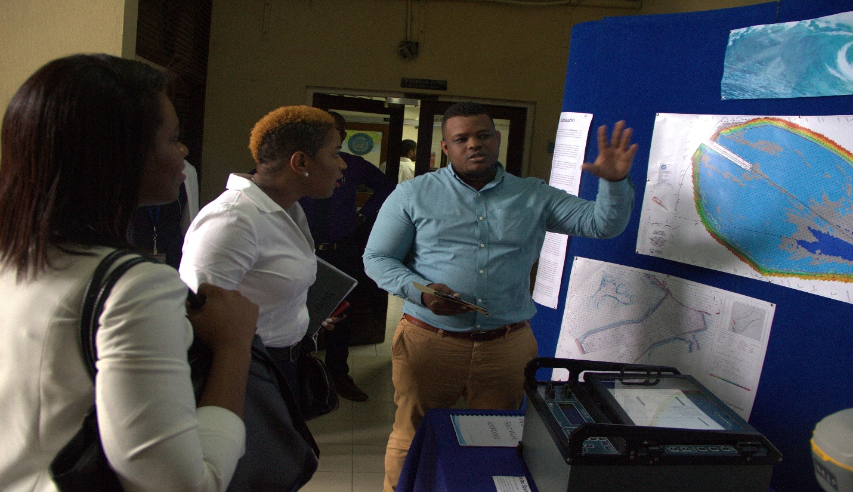
- Capacity Building
JAMAICA COUNTRY REPORT
ROK Category B course in Hydrography to be completed in December 2018.
ROK Category A Hydrographer course in 2019.
UKHO Category B Cartographer course in 2019.

Slide 9
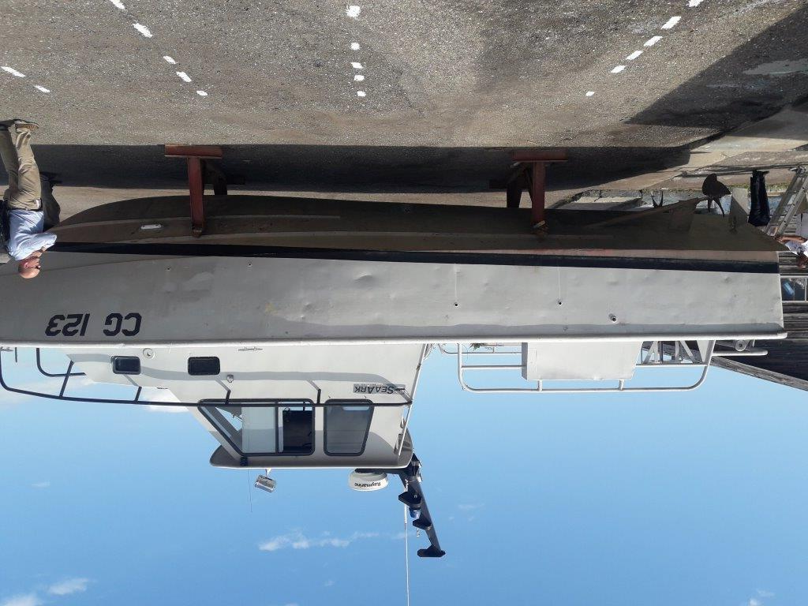
- Capacity Building
JAMAICA COUNTRY REPORT
UKHO CME- Multibeam Echosounder plus the related devices and software

Slide 10
THANK YOU

