Slide 1
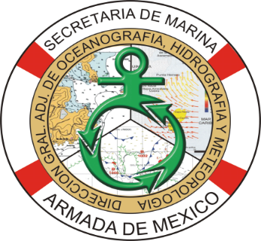
JOINT DIRECTORATE OF OCEANOGRAPHY, HYDROGRAPHY AND METEOROLOGY
NOVEMBER 2018

Slide 2
CONTENT
Organization of the Joint General Directorate of Oceanography, Hydrography and Meteorology (DIGAOHM).
Hydrographic Surveys.
New nautical charts and updates.
New Publications and Updates.
Maritime Safety Information(MSI).
Capacity Building.
Other activities.

Slide 3
I. Organization of the Joint General Directorate of Oceanography, Hydrography and Meteorology (DIGAOHM)

Slide 4
I. Organization of the Joint General Directorate of Oceanography, Hydrography and Meteorology (DIGAOHM)
DIRECCIÓN GENERAL ADJUNTA DE OCEANOGRAFÍA, HIDROGRAFÍA Y METEOROLOGÍA
DIRECCIÓN DE HIDROGRAFÍA
SUBDIRECCIÓN DE HIDROGRAFÍA Y CARTOGRAFÍA
SUBDIRECCIÓN DE LEVANTAMIENTOS HIDROGRÁFICOS
SUBDIRECCIÓN DE INFORMACIÓN PARA LA SEGURIDAD A LA NAVEGACIÓN
DEPARTAMENTO DE CARTOGRAFÍA
DEPARTAMENTO DE PLANEACIÓN Y PROCESAMIENTO HIDROGRÁFICO
DEPARTAMENTO DE ASUNTOS HIDROGRÁFICOS EXTERNOS
DEPARTAMENTO DE COORDINACIÓN LOGISTICA
DEPARTAMENTO DE CONTROL DE EQUIPO HIDROGRÁFICO
DEPARTAMENTO DE CONTROL DE EQUIPO INFORMÁTICO
DEPARTAMENTO DE AYUDAS A LA NAVEGACIÓN Y CONTROL DE PUBLICACIONES
DEPARTAMENTO DE DISEÑO E IMPRESIÓN
02 BRIGADAS DE LEVANTAMIENTO HIDROGRÁFICAS PACÍFICO
02 BRIGADAS DE LEVANTAMIENTO HIDROGRÁFICAS GOLFO DE MÉXICO
ARM RIO TUXPAN
(BI-07)
ARM TECOLUTLA
(BI-08)

Slide 5
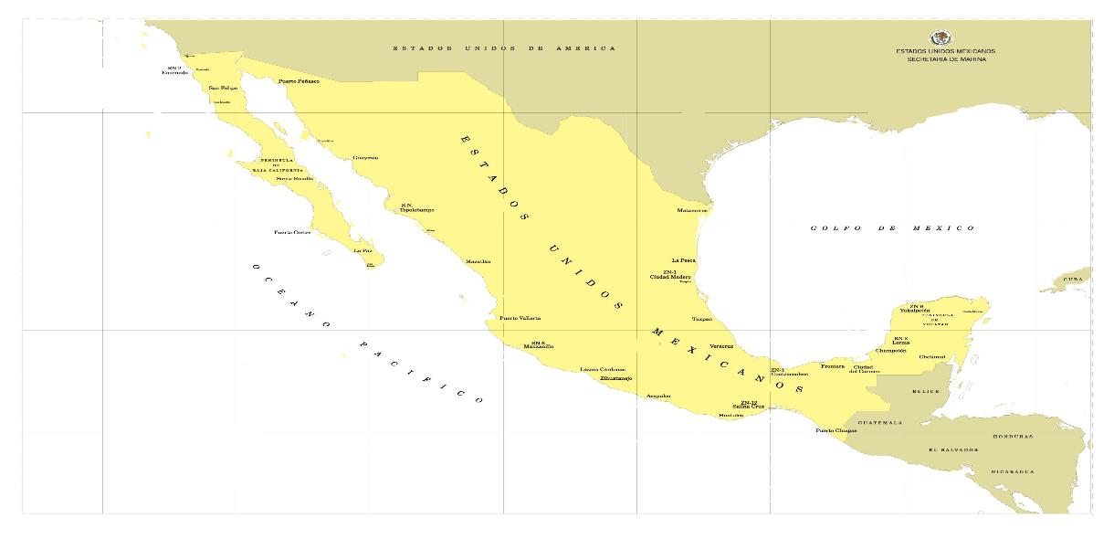
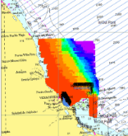
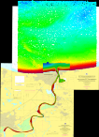
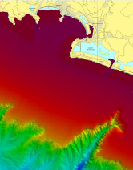
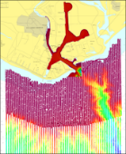
II. Hydrographic Surveys.
HYDROGRAPHIC CAMPAIGNS CARRIED OUT DURING 2018
“G-VER-2018-82000”
“G-VER-2018-83100”
“G-YUC-2017-9200”
“P-COL-2018-43100”
“P-MIC-2018-51110”
“P-OAX-2018-62210”

Slide 6
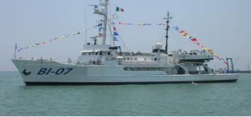
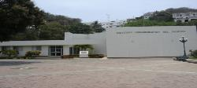
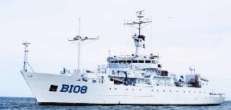
II. Hydrographic Surveys.
Platforms.
ARM. “ONJUKO” (BI-02)
ARM. “ANTARES” (BI-04)
I.O.G.M.C.
02 BRIGADAS HIDROGRÁFICAS
ARM. “TUXPAN” (BI-07)
ARM. “HONDO” (BI-06)
I.O.P.
02 BRIGADAS HIDROGRÁFICAS
ARM. “HUMBOLDT” (BI-01)
ARM. “ALTAIR” (BI-03)
ARM. “TECOLUTLA” (BI-08)

Slide 7
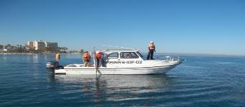
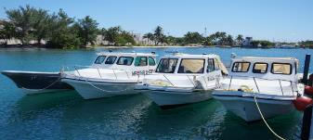
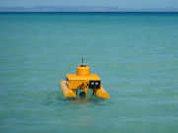
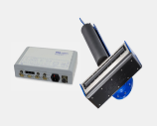
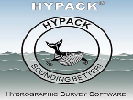
II. Hydrographic Surveys.
Hydrographic Launches
Equipment
Single beam echosounder (EA-400, ODOM hydrotrac, ceeducer pro)
Multibeam echosounder (Geoswath plus, R2 Sonic, ODOM ES3)
DGPS´s
Sound velocity profilers
Portable tide gauges
Acquisition and processing Software

Slide 8
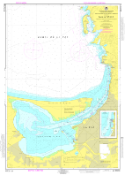
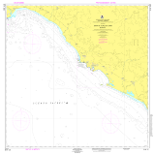
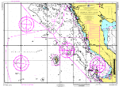
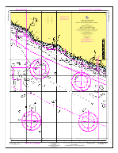
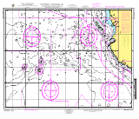
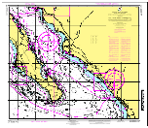
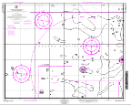
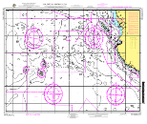
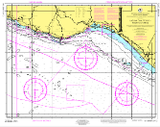
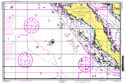
III. New nautical charts and updates.
14 new Electronic Nautical Charts (ENC).14 Cartas Náuticas Impresas nuevas.
27 Electronic Nautical Charts (ENC) updated.
12 Nautical Charts Printed updated.
SM 521 | MX25110 | MX25112 | MX51110 | MX51111 | MX51112 | MX8080
MX8081 | MX8082 | MX8083 | MX8084 | MX8085 | MX8086 | MX8087

Slide 9
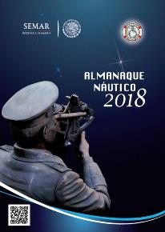
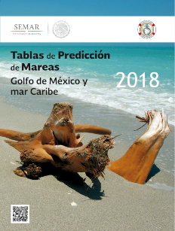
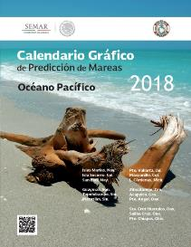
IV. New Publications and Updates.
Printed
Tide Prediction Tables
Tide prediction chart Calendar
Digital.
Catalog of Nautical Charts and Publications
Notice to Mariners
Coast Pilot of Mexican waters
Chart No. 1

Slide 10
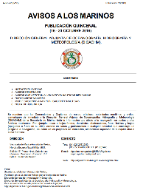
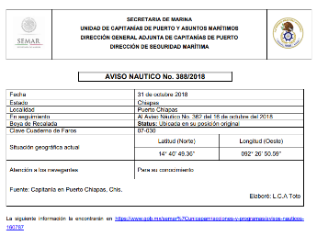
V. Maritime Safety Information (ISM).
Dissemination of maritime safety information that affects the Mexican Marine Zones through the fortnightly publication of Notice to Mariners and Nautical Warnings via NAVAREA coordinator zones IV and XII (NGA).
In 2018, 22 fortnightly Notice to Mariners publications were issued, and 104 nautical warnings from the Gulf of Mexico area and 105 from the Pacific sent to the NAVAREA regional coordinator..
As of January 1, 2018, the ISM is disseminated as follows:
Fortnightly publication of Notices to Mariners on the website: http://digaohm.semar.gob.mx/hidrografia/avisosalosmarinos.html
“Nautical Warnings available on the website: https://www.gob.mx/semar/unicapam/acciones-y-programas/avisos-nauticos-160787
Weather bulletins and forecasts available on the website: http://meteorologia.semar.gob.mx/

Slide 11
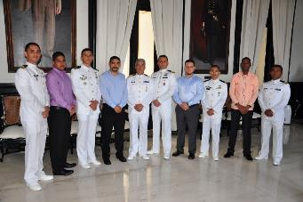
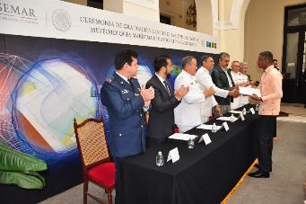
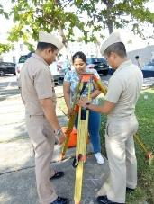
VII. Capacity Building.
The Secretariat of the Navy provides the Specialty of Hydrography and Cartography with a duration of one year at the Oceanographic Institute of the Gulf of México and the Caribbean Sea. Currently, there are 06 officers from the Ministry of the Navy, 02 national civilians and 02 foreign officers from the Project to Strengthen Hydrographic Capacities in Mesoamerica and the Caribbean Sea (FOCAHIMECA).
By 2019, the participation of 03 foreign delegates is expected.

Slide 12
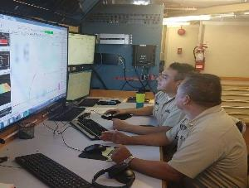
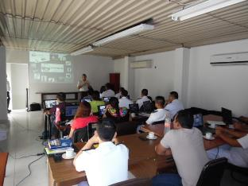
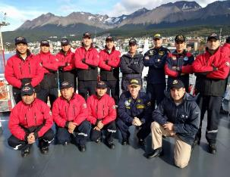
VII. Capacity building.
Name | Workshop | Place
Tte. Corb. SIA I. Top. Cecilia Cortina Guzmán | GEBCO Postgrado en Batimetría Oceánica (PBO) | New Hampshire, USA.
Tte. Frag. CG. EHC. Carlos David Loyo Illescas | Crucero de Investigación Antártica ANTAR XXV | Lima, Perú
Del 20 al 23 de marzo del 2018 (10 elementos) | Curso de entrenamiento de software hidrográfico Seafloor Information System | Manzanillo, México
Del 17 al 21 de Julio del 2018 (15 elementos) | Curso de entrenamiento multihaz Hypack 2018 | Veracruz, México

Slide 13
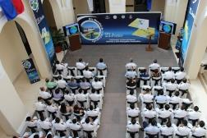
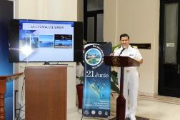
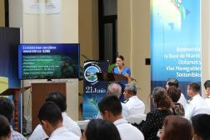
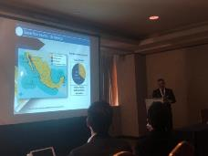
IX. Other activities.
On June 21 2018, the SEMAR carried out at the Oceanographic Institute of the Gulf and the Caribbean Sea, a cycle of conferences with the theme adopted in 2018 by the IHO "Bathymetry - the base of sustainable seas, oceans and waterways" In order to commemorate the "World Hydrographic Day. Participated in this cycle of conferences, authorities and representatives of scientific and marine research institutions, academic institutions and personnel belonging to the Directorate of Hydrography of Mexico.
On November 8, 2018, Admiral Enrique Flores Morado, Deputy Director General of Oceanography, Hydrography and Meteorology, participated as a speaker at the Latin American Geospatial Forum 2018, with the theme: The Importance of Nautical Cartography in National Maritime Development, this forum took place in Mexico City and more than 40 countries, 300 organizations, 1000 attendees and 160 speakers participated.
From September 12 to 17, 2018, the first hydrographic survey of the ship ARM Tecolutla BI-08 (ex-Knorr), transferred by the University of Woods Hole was carried out in mexican waters.

Slide 14
IX. Other activities.
Carga
Pasajeros
Pesca de altura
Pesca rivereña
Buques Mercantes
Cruceros
Buques pesqueros/logísticos
Edición de la carta
Fecha del levantamiento
Infraestructura
Señalamiento
Dragado
Cumple o no cumple normas
Port importance
Maritime traffic routes
Hydropraphic surveys for 2019
GUAYMAS
MAZATLAN
TUXPAN
DOS BOCAS
Age of the chart
Changes on the port infrastructure
Hydrographic coverage

Slide 15
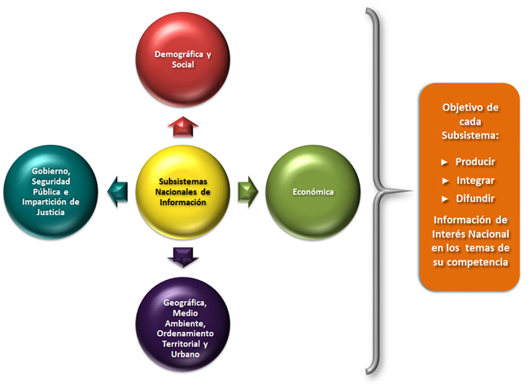
IX. Other activities.
Technical Committee Specialized in Marine Information
AION
CONACIO
CIMARES
CTEIM

Slide 16
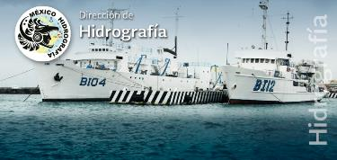
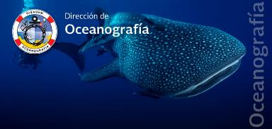
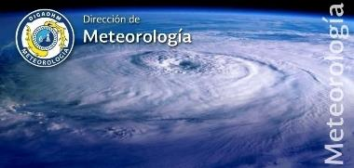
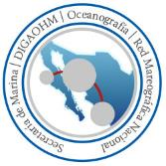
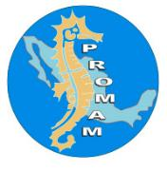
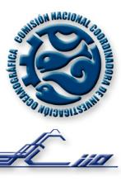
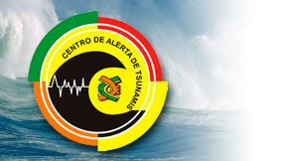
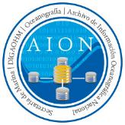
X. Conclusions.
The Mexican State through the Secretariat of the Navy carries out Oceanographic, Hydrographic and Meteorological research, in order to support Naval Operations; contributing to the National Maritime Development, the safeguarding of human life at sea, safety to navigation and the protection of the marine and coastal environment, as well as the integration of the National Oceanographic Information Archive.

