Slide 1
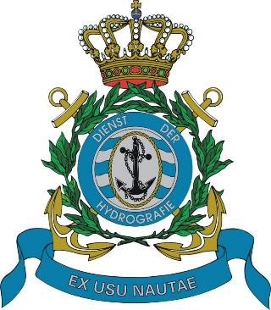
National report of the Kingdom of the Netherlands
MACHC 19
Captain (Navy) Marc van der Donck
November 2018

Slide 2

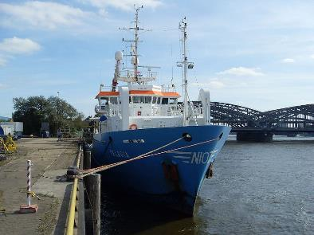
Main achievements 2018: survey (1)
Survey Windward/Leeward islands Cat.3:
Deep water MBES survey, no object detection,
no water level reduction, limited SV correction (S-44 order 2)
by Royal Netherlands Institute for Sea Research (NIOZ),
R/V Pelagia, 2018-Q1/2.

Slide 3
Main achievements 2018: survey (2)
Results R/V Pelagia, 2018-Q1/2
Prehistoric reef erosion
on Luymesbank
Sababank and Luymesbank

Slide 4
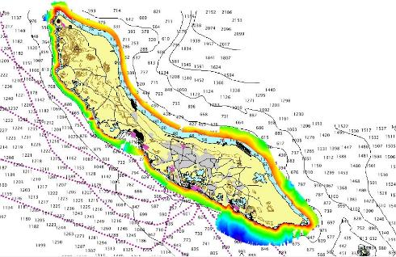
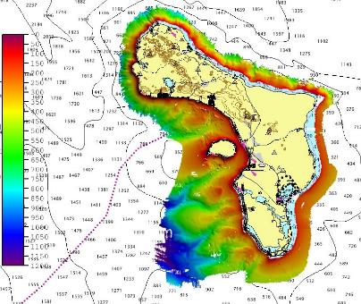
Main achievements 2018: survey (3)
Results R/V Pelagia, 2018-Q1/2
Curaçao
Bonaire

Slide 5
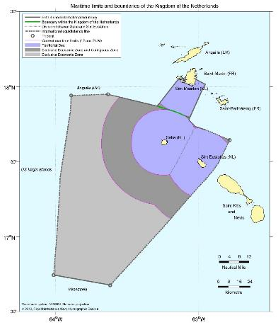
Main achievements 2018: Maritime boundaries
All-purpose maritime boundary
with the French Republic
has been ratified and effected.
Thank you Shom
for the excellent technical
cooperation 1998-2017!

Slide 6
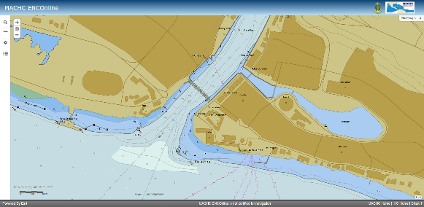
Main achievements 2018: local data providers
Visit to data providers on the Leeward Islands (2018)
Visit to data providers on the Windward Islands (2019)
MACHC ENC Online is very helpful in maintaining a two-way data flow.
Megapier Curaçao

Slide 7
Progress on MSDI
NL offers INSPIRE-compliant web services for:
gridded bathymetric data and,
geographic names,
of the Caribbean Sea, which will become available in the INSPIRE harmonized data format in 2019.
It is our intention to start up additional INSPIRE harmonized web services for the Caribbean Sea, for:
  administrative units (maritime zones) and
  area management (PSSA Sababank).
See the National Report for the URLs.

Slide 8
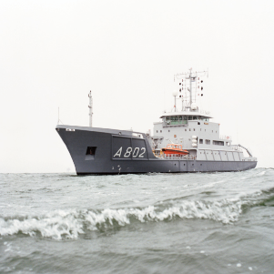
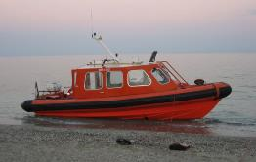
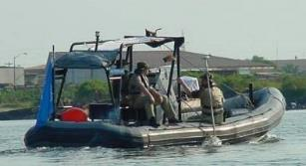
Plans 2019: survey (1)
Windward/Leeward islands Cat.1+2:
MBES/SSS survey,
Hydrographic Survey Vessel and smaller platforms,
2019-Q3/4.

Slide 9

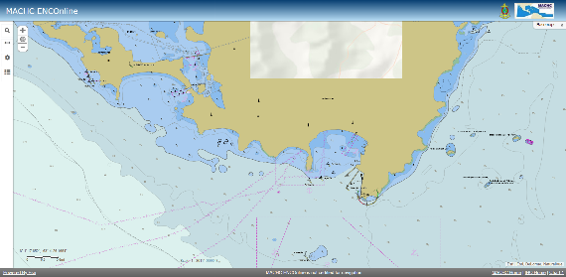
Plans 2019: surveys (2)
Sint Maarten Cat.1+2:
Land/sea LIDAR survey,
with local government/World Bank,
similar to French LIDAR survey Saint Martin/Saint Barthélémy,
2019-Q2.
Rocks and reefs
near Sint Maarten

Slide 10
Conclusion
Satisfactory status for surveying and nautical charting in the MACHC area.
Visits to local data providers improve the quality of data sets and nautical charting.
Hydrographic surveys were and will be done, often as a joint effort with partner organisations.
Efforts to establish maritime boundaries with our neighbouring countries are continuing.

