Slide 1
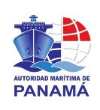
19th Meeting of the Meso America – Caribbean Sea Hydrographic Commission November/December 2018 National Report :
[PANAMA MARITIME AUTHORITY, PANAMA]

Slide 2
Main achievements during the year
Regular participation in different Hydrographycs Committees – MACHC18, IC-ENC (Validation Training Course and Steering Committee).
Bathymetric Survey by NAVOCEANO in January 2018 for actualization. Panama Canal Pacific entrance.
Actualization of National Bathymetric Plan – Thesis from FOCAHIMECA student for the certification.
Preparation of the Manual of good dredging practices, which included: use of dredged material for productive use. Characterization of the dredged material (first phase of future requirements for dredging requests).
Obtaining boat for bathymetric surveys and
Obtaining hydrographic equipment as part of agreements with UKHO.

Slide 3
Main challenges and/or obstructions
Approval by the (MEF) Ministry of Economy and Finance, for the creation of the Department of Hydrography of the Maritime Authority of Panama.
Installation of hydrographic equipment.
Training of technical personnel, for the use of (M3 Sonar PHS) Portable hydrographic system.
Execution of the National Bathymetric Plan starting with coastal surveys in 2019.

Slide 4
PANAMA HYDROGRAPHIC AND OCEANOGRAPHIC COMMISSION (CHOPAN)
Stablished in 2009 by 4 gubermental organization:
Panama Maritime Authority
Panama Canal Authority
National Service Aircraft
National Geographical Institute
MiAMBIENTE
National System of Civil Protection

Slide 5
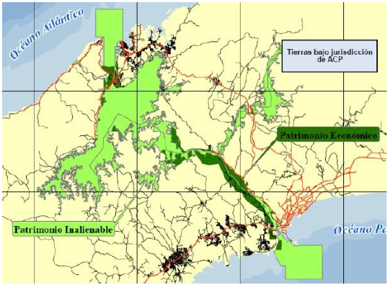
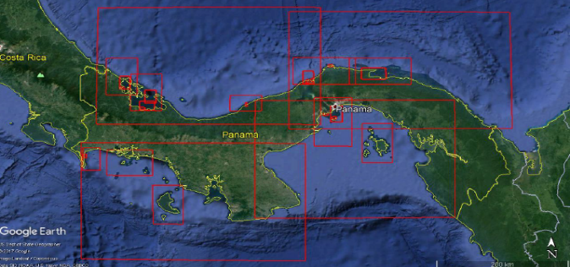
Panama Nautical Cartography Plan
Abstract
The Nautical Cartography Plan for the Republic of Panama represents a complete coverage of the jurisdictional waters, this will help safe navigation between ports at the national level for both national and international vessels.
Correspondence Waters of the Panama Canal Authority.
Source: Thesis by Eng. Juan Carlos Kelso - FOCAHIMECA

Slide 6
thanks you!

