Slide 1
19th Meeting of the Meso America – Caribbean Sea Hydrographic Commission National Report by
HYRONE JOHNSON
ST. VINCENT AND THE GRENADINES DEPARTMENT OF MARITIME ADMINISTRATION

Slide 2
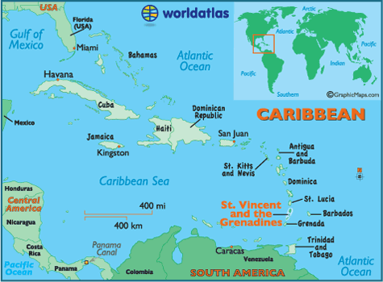
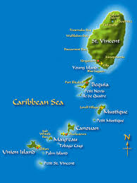
ST. VINCENT AND THE GRENADINES

Slide 3
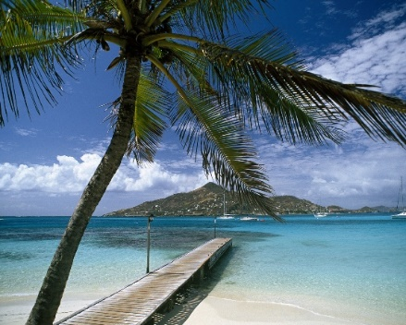
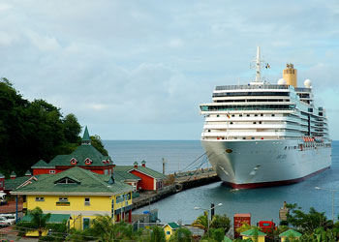
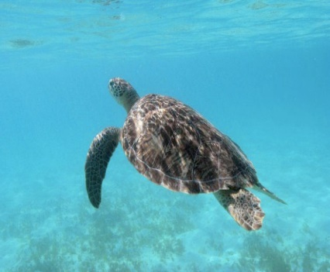
Main achievements during the year
Adoption of the NOPSAP by Cabinet on 18th June 2018.
Principle 5: Integrated Ocean Governance
Policy 5 – Apply integrated ocean governance arrangements
Goal 5.1 – “To establish and implement coordinated institutional arrangements for integrated marine management across relevant sectors through partnerships between government, the private sector and civil society”.
Establish a National Ocean Coordination Committee (NOCC) comprised of representatives from State agencies private sector, NGOs, and CSOs that have responsibility for maritime affairs and marine resource management.
- Sub-committee for hydrography and AtoN.
Saint Vincent and the Grenadines
National Ocean Policy and Strategic Action Plan

Slide 4
Main achievements during the year
To ensure Saint Vincent and the Grenadines (SVG) is compliant with the hydrographic elements of the SOLAS convention:
Commonwealth Marine Economies Program:
- Delivered bathymetric data and training to SVG.
- Delivery of other Maritime Spatial Data under the CME program regarding:
Satellite remote sensing – measurement of sea level, wind and waves
- Worked with the United Kingdom Hydrographic Office (UKHO) to identify gaps in SVG’s hydrographic governance.
- Amended the Job Description of the Senior Inspector of Ships and the MARAD Standard Operating Procedures,
- Created Terms of Reference for a proposed Hydrographic Sub-Committee of the National Oceans Governance
Coordination Committee,
- formalised the arrangement between SVG and UKHO:
- for the discharge of the national hydrographic charting responsibilities - producing navigational charts and
publications of SVG as the primary charting authority.

Slide 5
Main achievements during the year
Signed the MoU with the SVG Ports Authority for the issuance:
Local and coastal Maritime Safety Information
Installation and maintenance of AtoN
Conduction of hydrographic surveys in ports.
MARAD / Port Authority MOU Covering MSI
DATED March 2018
Saint Vincent and the Grenadines Maritime Administration
(“svgmarad”)
(2) Saint Vincent and the Grenadines Port Authority (“SVGPA”)
MEMORANDUM OF UNDERSTANDING GOVERNING AIDS TO NAVIGATION AND MARITIME SAFETY INFORMATION

Slide 6
Main achievements during the year
IALA technical needs assessment mission to St Vincent and the Grenadines (SVG) was conducted 2017.
Since then SVG:
Developed a prioritised list of actions with realistic target dates for completion of the recommendations.
Conducted a physical audit of all AtoN.
Developed a National AtoN register.
Prepared and published forms which will be used to report observed AtoN failures.
Post to include Safety Navigation Manager has been established.
- The Safety Navigation Manager should have complete training in
Suriname is 2018.

Slide 7
Main challenges and/or obstructions
Establish capability for collection of nautical information to
maintain existing charts and publications.
Establish capacity to conduct systematic hydrographic surveys,
collation and processing of data.
Lack of mechanism to manage data

