Slide 1
UK National Report
19th Meeting of the Meso American - Caribbean Sea Hydrographic Commission
(MACHC)
Cartagena de Indias, Colombia
28 November - 1 December 2018

Slide 2
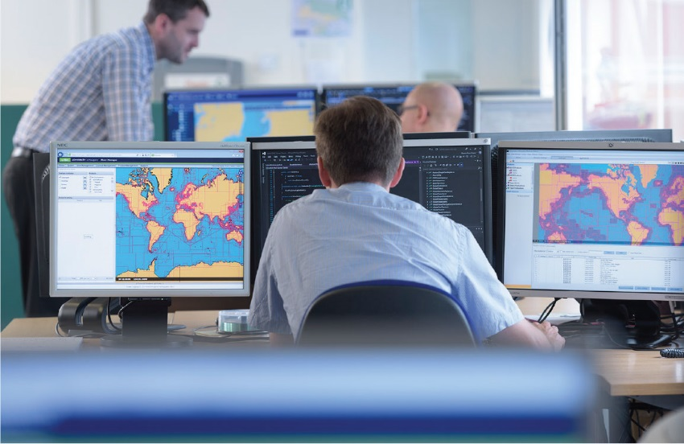
Building on Achievements UK activity since previous
MACHC
Chart Production
ENC Production
Publications
Capacity Building
Hydrographic Activity

Slide 3
Chart Production
Within the MACHC region, the UK has produced a total of 48 published charts since the last meeting in November 2017.
1 INT Chart
11 New Charts
36 New Editions

Slide 4
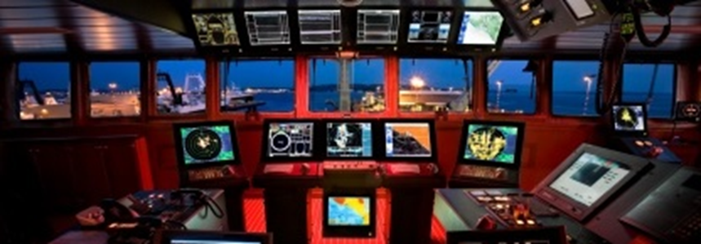
ENC Production
Within the MACHC region, the UKHO has released a total of 216 ENC cells.
Overview: 8 ENC
General: 14 ENC
Coastal: 34 ENC
Approach: 66 ENC
Harbour: 81 ENC
Berthing: 13 ENC

Slide 5
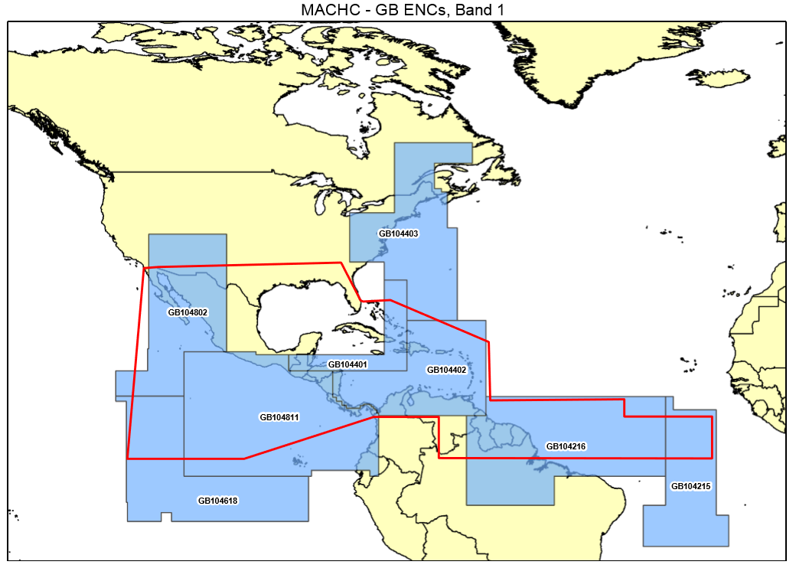
Coverage diagram of GB overview cells in region.
Coverage diagrams of all the 216 GB ENC cells which cover the MACHC region are included in the main report

Slide 6
Publications
Sailing Directions
The current status of Admiralty Sailing Directions in the MACHC region is as follows:
NP5 South America Pilot Vol 1
NP7 South America Pilot Vol 3
NP7A South America Pilot Vol 4
NP8 Pacific Coasts of Central America & United States Pilot
NP69A East Coasts of Central America & Gulf of Mexico Pilot
NP70 West Indies Pilot Vol 1
NP71 West Indies Pilot Vol 2

Slide 7
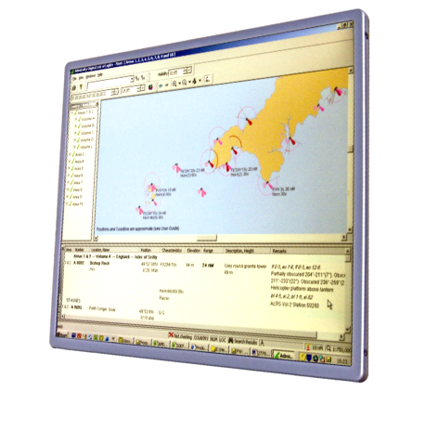
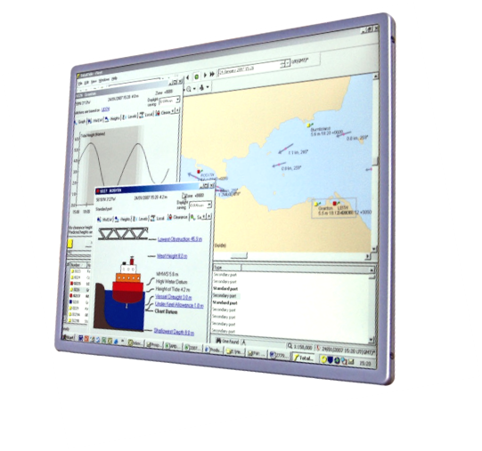
ADMIRALTY e-Nautical Publications (AENP): e-Book versions of ADMIRALTY Sailing Directions and reference publications.
ADMIRALTY Digital List of Lights (ADLL): Digital versions of ADMIRALTY lights publications.
ADMIRALTY TotalTide (ATT): Digital versions of ADMIRALTY tidal publications.
ADMIRALTY Digital Radio Signals (ADRS): Digital versions of ADMIRALTY radio signal publications.

Slide 8
Support to Capacity Building
UK fully supports the IHO Capacity Building Sub-Committee (CBSC) strategy and particularly its emphasis on getting Phase 1 and appropriate Phase 2 capacity in place
Provide trainers for IHO funded courses worldwide
Host the IHO/NIPPON CAT B accredited nautical cartography training

Slide 9
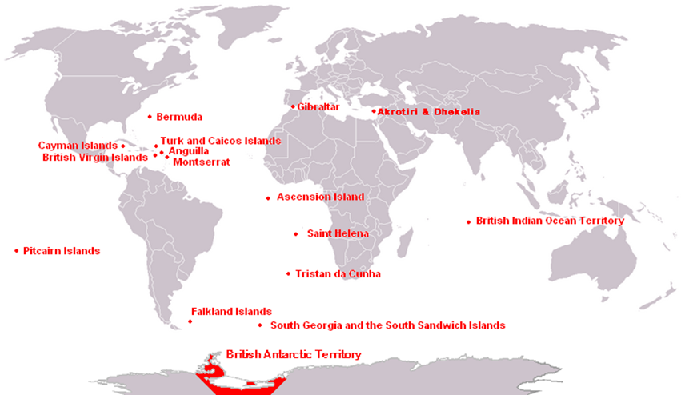
UK Overseas Territories
Overseas Territories Seabed Mapping Programme
Increased investment in the Overseas Territories – Anguilla, BVI, Cayman Islands, Monserrat, Turks and Caicos Islands
Enhance the quality of navigational products and services in the UK OT’s
Technical assessments, potential data gathering and capacity building

Slide 10
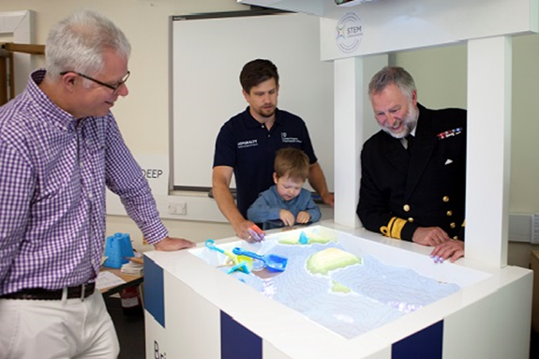
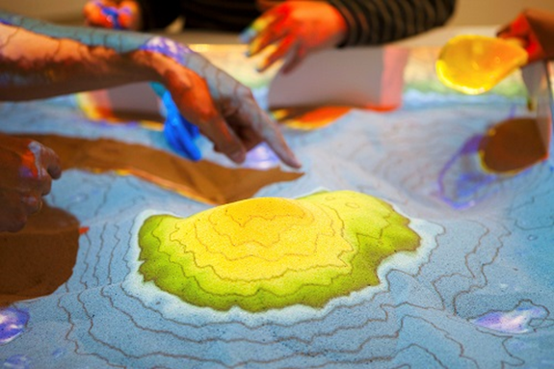
World Hydrography Day 2018
To promote World Hydrography Day 2018, the UKHO hosted an interactive family day at the Museum of Somerset.

Slide 11
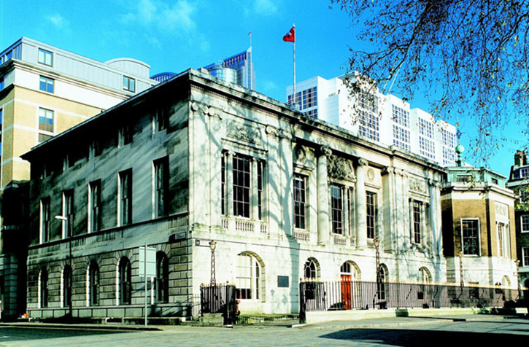
World Hydrography Day 2018
“Bathymetry – the foundation for sustainable seas, oceans and waterways”

Slide 12
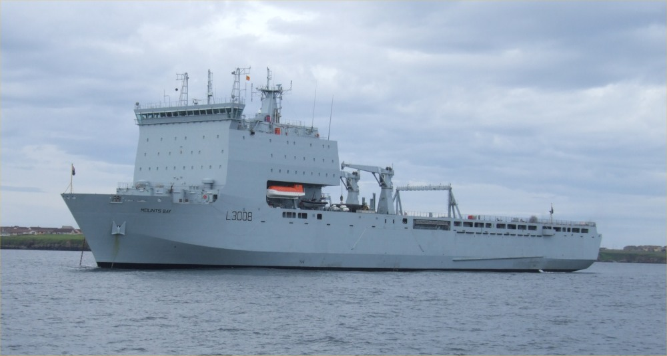
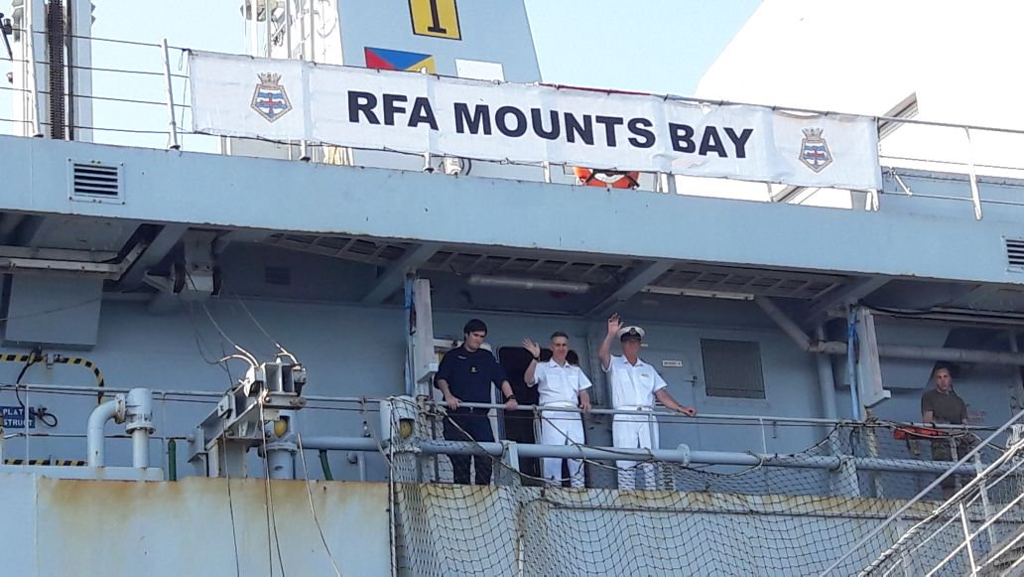
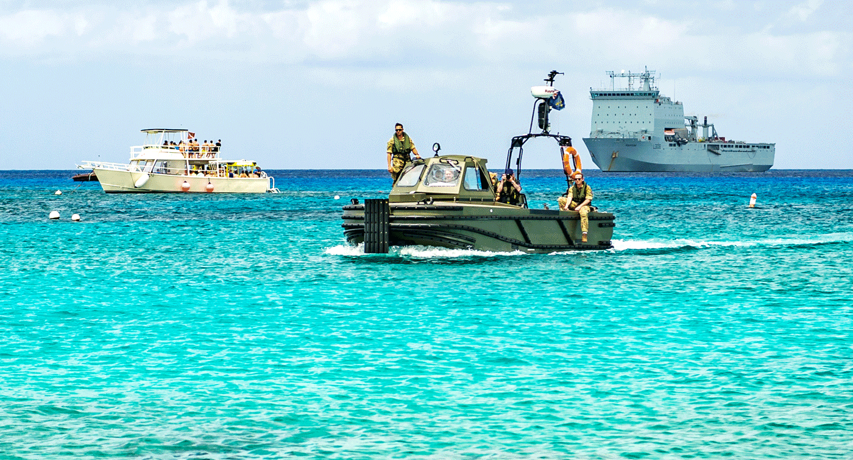
Broader UK Government Work
Blue Belt Programme

Slide 13
Looking Ahead Continuing UK activity 2018-19 and beyond
Product generation and renewal for charts and publications
Capacity Building – assessments, training, coordination, technical assistance
Hydrographic Activity

Slide 14
Thank you

