Slide 1
The Tsunami and Other Coastal Hazards Warning System for the Caribbean and Adjacent Regions (CARIBE/EWS)
Christa G. von Hillebrandt-Andrade
Past Chair CARIBE EWS
2012-2018 and
Manager of NOAA
NWS Caribbean Tsunami Warning Program
XIX MACHC Meeting
November 28, 2018
Cartagena,Colombia

Slide 2
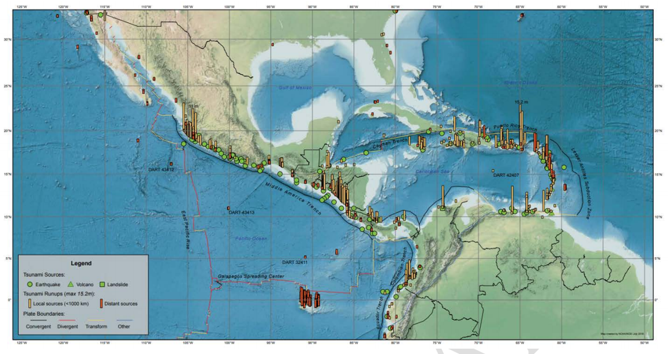
Tsunamis in the Caribbean and Adjacent Regions
Over the past 500 years more than 75 tsunamis have killed an estimated 4500 people in Caribbean

Slide 3
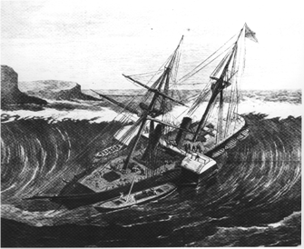
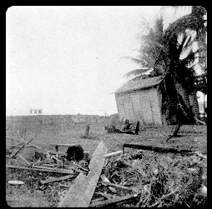
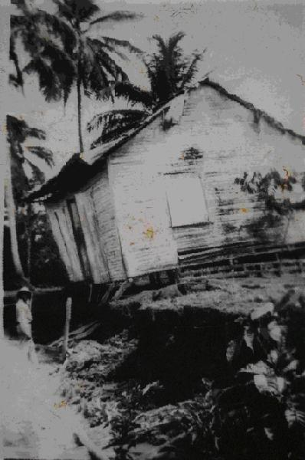
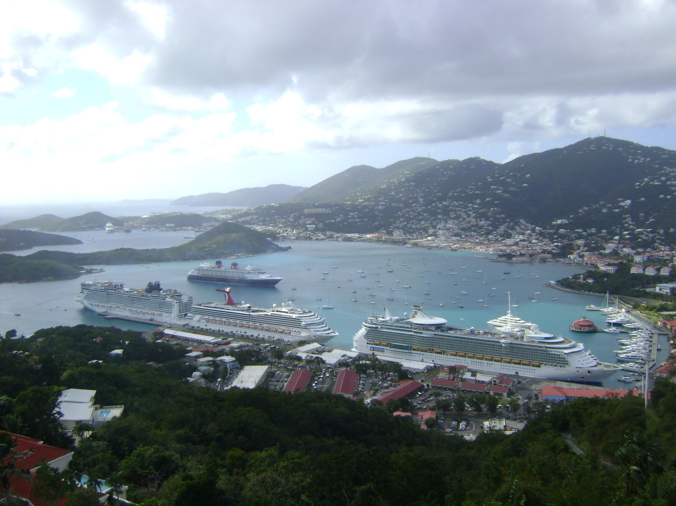
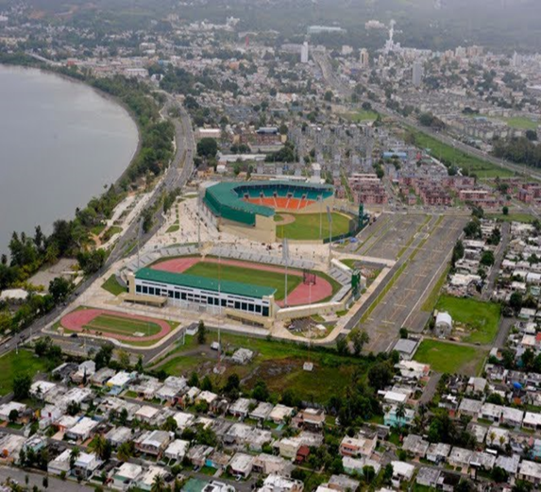
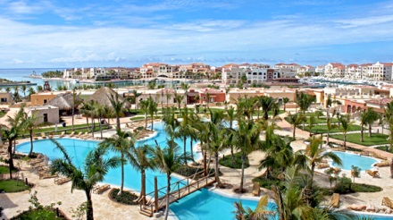
Then and Now
1867- US Virgin Islands
30 deaths
1918- Puerto Rico
140 deaths
1946- Dominican Republic
1790 deaths
Notes:
The most recent tsunami occurred as a consequence of the devastating Haiti earthquake in 2010 when tsunamis with waves up to 3 meters killed 7 people, but before that much bigger tsunamis occurred in the Virgin Islands, Puerto Rico and the Dominican Republic. In these three tsunamis alone over 2000 people lost their lives. But these tsunamis occurred decades ago, before cruise ships arrived, population increased, infrastructure, including hundreds of hotels were built along our beaches. Several hundred thousands of people would be at risk WHEN, not IF the next tsunami strikes.

Slide 4
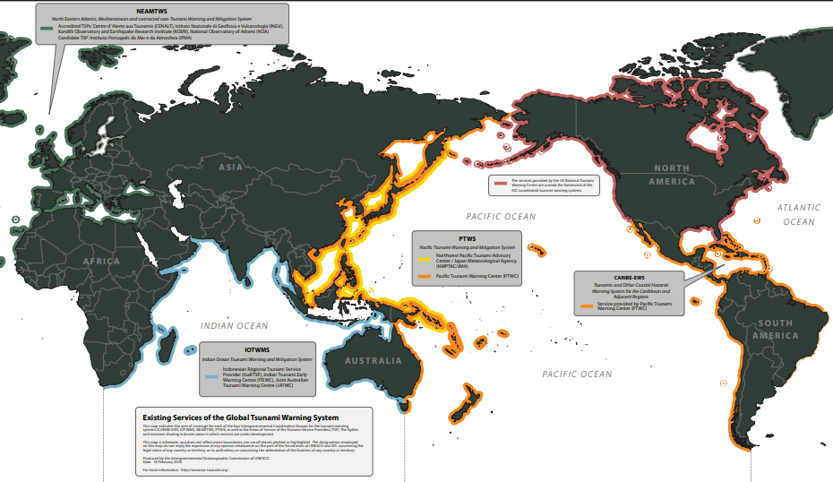
In 2005 the Intergovernmental Coordination Group for Tsunamis and Other Coastal Hazards Warning System for the Caribbean and Adjacent Regions (CARIBE/EWS) was established by UNESCO IOC. It serves 48 countries and territories from Bermuda thru Brazil.

Slide 5
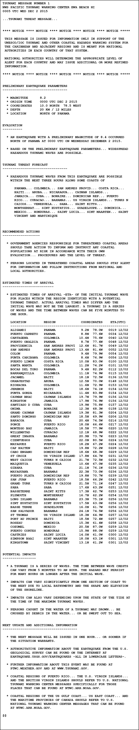
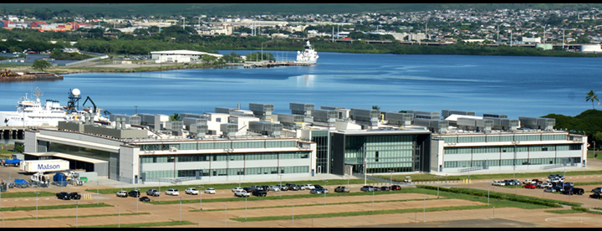
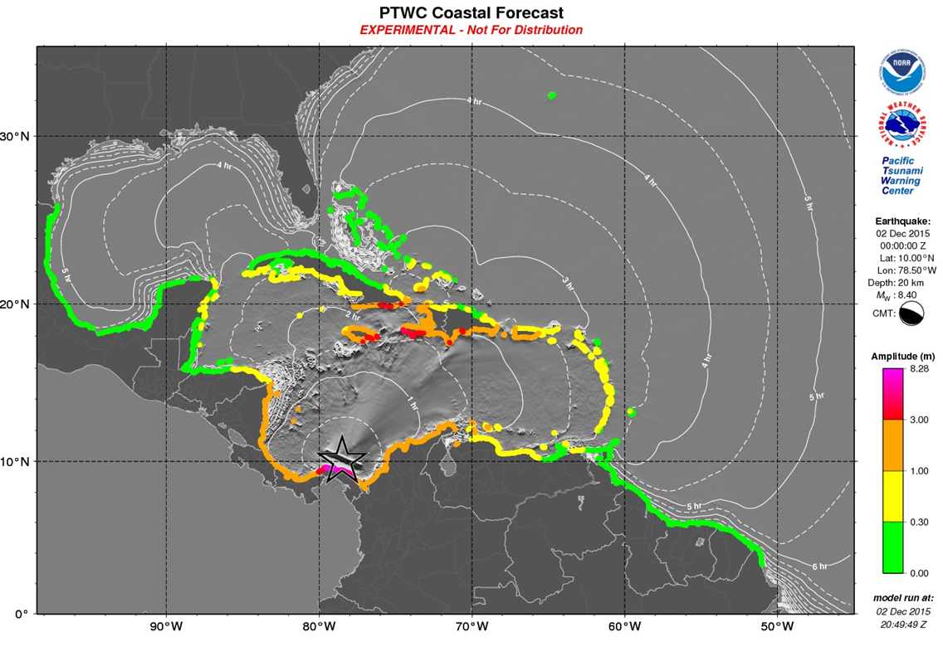
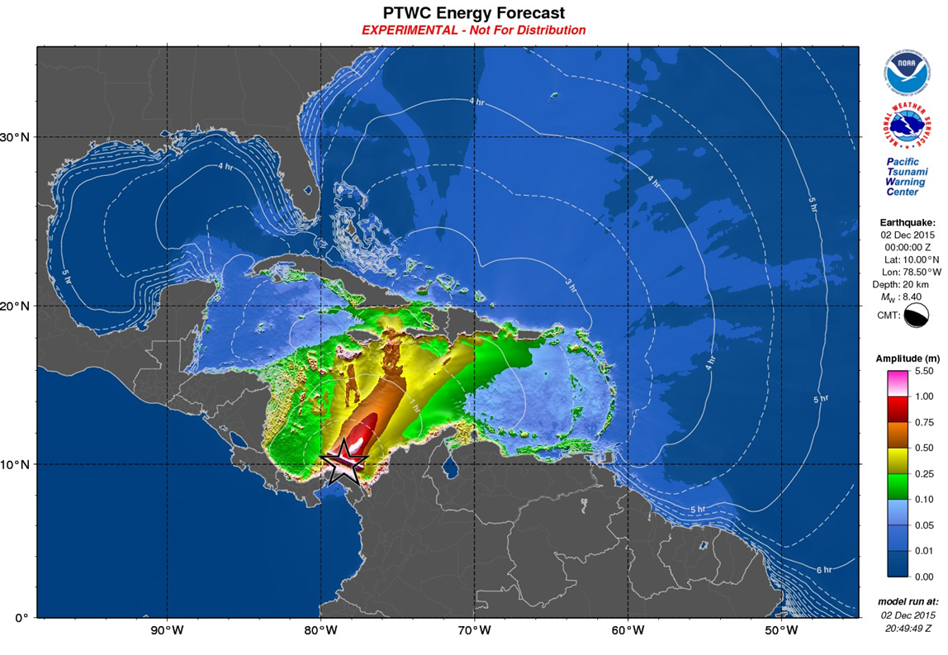
1. NOAA Pacific Tsunami Warning Center (Hawaii) is the CARIBE EWS (and PTWS) Tsunami Service Provider
Its products are offered as advice and its text products are available on tsunami.gov minutes after an Earthquake
Additional products are sent to officially designated National Tsunami Warning Focal Points/National Tsunami Warning Centers in support of national alerting – MACHC Stakeholders are encouraged to engage with national tsunami authorities.
UNESCO/IOC and IHO are working together to produce tsunami products for ships at sea – MACHC may note and support.
PTWC
Notes:
Tsunami Alerts which cover all countries and territories are provided by NOAA NWS PTWC (Hawaii). Per CARIBE EWS X recommendation PTWC transitioned fully to the enhanced products for the CARIBE EWS on March 1, 2016. Now products only contain threat information (NO MORE WATCHES), for this the countries need to have the SOP’s in place to issue their Alerts (Warning, Watch, Advisory, etc). These new products were exercised for several years before full implementation and additional web training and a workshop was held. Given the PTWC follows the service model and its proven track record as the interim service provider over the last 11 years, the CARIBE EWS XI recommended that they be referred to as a CARIBE EWS Tsunami Service Provider, dropping the word Interim. Also, the US continues with its plan for PTWC to also assume the issuance of domestic products for Puerto Rico and the Virgin Islands and therefore all the CARIBE EWS will be covered by the PTWC.

Slide 6
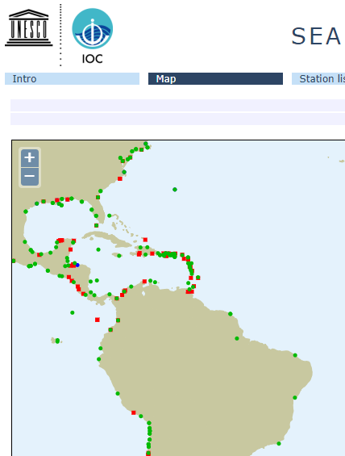

2. CARIBE EWS needs sea level data, just like MACHC
Sea level data is critical for detection & alerting of tsunamis
Almost 80 sea level stations have been installed in the Caribbean in the past decade for tsunami warning
These stations, if adequately operated can be used also for hydrographic purposes, more CB needed
CARIBE EWS fully supports the proposed MACHC Tides training proposal.
CARIBE EWS offers to work together with MACHC in the organization and conduct of the course and if additional funding is identified, to support costs.
Sea Level Monitoring Facility

Slide 7
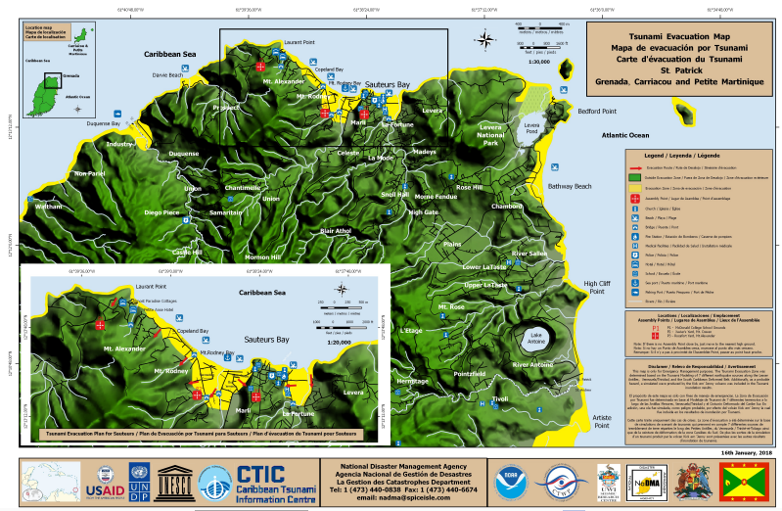
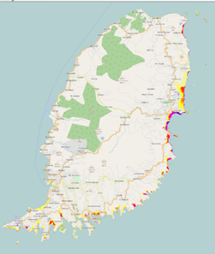
3. Tsunami Evacuation Maps
The main concern of coastal populations is to know where to go in case of a tsunami threat;
Tsunami evacuation mapping and planning requires tsunami modelling which in turn depends on high resolution coastal bathymetry (minimum 90 meters)
CARIBE EWS notes MACHC expertise and looks forward to engaging with MACHC stakeholders to develop better coastal digital elevation models and evacuation products.
Grenada Inundation and Evacuation Map (St. Patrick)

Slide 8
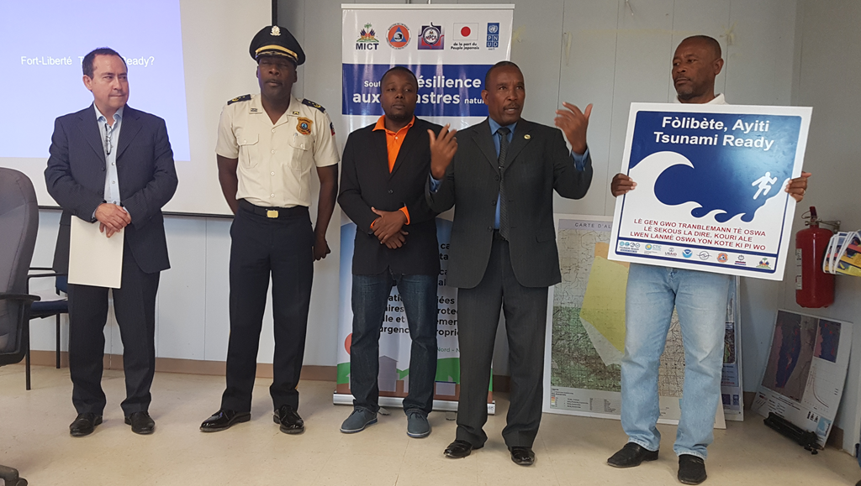
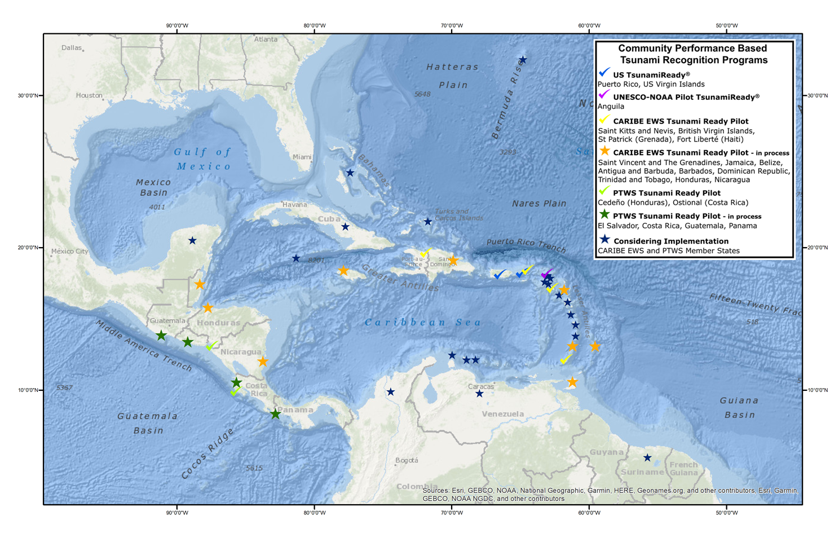
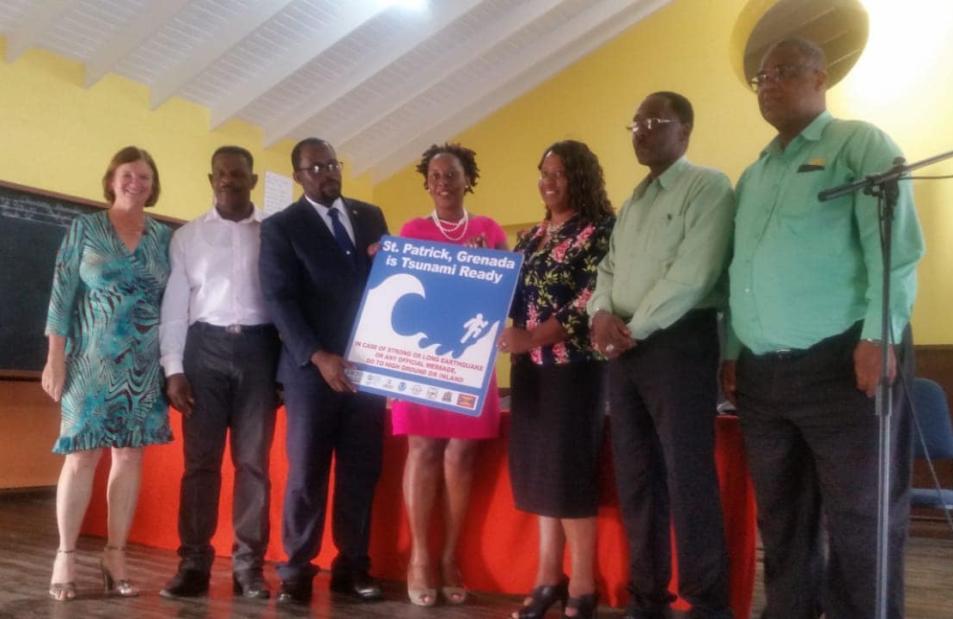
4. UNESCO IOC Tsunami Ready Recognition
52 communities in the Caribbean have implemented a community based performance recognition program
Anguilla, British Virgin Islands, St. Kitts and Nevis, St. Patrick (Grenada), Fort Liberte (Haiti), Cedeño (Honduras), Ostional (Costa Rica), USVI and Puerto Rico have been recognized as Tsunami Ready/TsunamiReady
TR Pilots/Renewals are underway in Anguilla, Antigua and Barbuda, Barbados, Belize, Costa Rica, Dominican Republic, El Salvador, Guatemala, Jamaica, Panama, Saint Vincent and the Grenadines.
MACHC Stakeholders are encouraged to make contact with corresponding implementation agencies (CTIC and CTWP) and national stakeholders to ensure all available bathymetry data is being used for preparation of maps.
Fort Liberte, Haiti
St. Patrick, Grenada

Slide 9
5. Are You Ready? MACHC Stakeholders, we invite you to test you readiness in CARIBE WAVE 19. Contact your Tsunami Authorities
Scenario | Origin Time | Mw | Epicenter
Panama | 14:00:00 UTC March 14, 2019 | 8.5 | 10.00⁰, -78.50⁰
Kick em’ Jenny |  | 6.0 | 12.34⁰, -61.65⁰
More information: http://caribewave.info

Slide 10
Closing Remarks
100’s of thousands of lives and billions of dollars at risk from Tsunamis
Fortunately, the Infrequency of the tsunamis has not disarmed the Caribbean
We are committed to continue developing the best tsunami warning system for the protection of the people and their livelihoods
Note 2021-2030 UN Decade for Ocean Sciences for Sustainable Development and opportunities for MACHC
MACHC Secretariat and Member States coordinate with the CARIBE EWS and other relevant international regional and national authorities for the advancement of tsunami readiness in coastal communities and at sea.
Thank You
Notes:
In closing I would like to reiterate that 100’s of thousands of lives and billions of dollars at risk in the Caribbean and Adjacent Regions from Tsunamis and as I hope you have been able to appreciate fortunately the Infrequency of the tsunamis has not disarmed us. The CARIBE EWS with its Member States has made very significant advances and are committed to continue developing the best tsunami warning system for the protection people’s lives and economies. We acknowledge and appreciate the engagement of the Member States and support of UNESCO/IOC and the consideration of the recommendations presented.

