Slide 1
IMarEST Support for Hydrography
Don Ventura, FIMarEST (Fellow of the IMarEST)

Slide 2
Quick intro to IMarEST
The Institute of Marine Engineering, Science & Technology
Non Governmental Organization
Promotes sustainability of the marine environment, industry and professions
Professional membership body for marine sector
22,000 members, 120 countries, 50 local branches, 3 regional offices
Provide lifelong learning, knowledge sharing and networking opportunities for members
Award professional qualifications / certifications for individuals
Global accreditation authority for marine courses and development programmes
Marine education and training provider “MLA College”
Deliver marine training courses and higher education programmes through specialist e-learning academy the “MLA College”
Programmes delivered through distance e-learning with supporting practical residential modules where appropriate
Courses cover: Hydrography, Oceanography, Meteorology, Sustainable Maritime Operations and Navigation

Slide 3
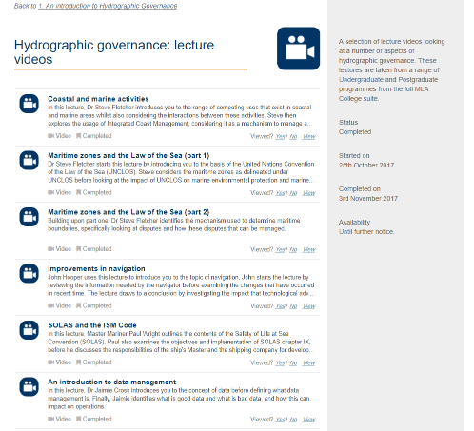
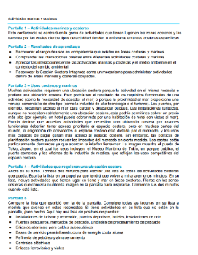
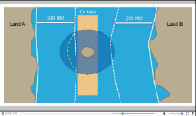
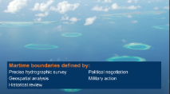
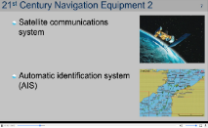
Supporting capacity building
FREE Hydrography e-learning to support MACHC and SAIHC
Notes:
Last year at the MACHC 18 in Cuba the IMarEST supported the capacity building seminar by giving a presentation on professional development for hydrographers. To accompany the seminar the IMarEST gave participants a FREE e-learning product to take away which covered introductory topics on aspects of hydrographic governance.
More recently the IMarEST has supported the capacity development workshop at the South Africa and Islands Hydrographic Commission in the Seychelles in August and also provided those participants with access to the free hydrographic governance e-training.
If you would like access to this e-learning resource to take back to offer your colleagues then give us your business card or email address and we’ll arrange access for you.
FYI -
The free e-learning materials provide a general overview of some key topics especially suited for staff working in a marine department or other organisation/department dealing with hydrography or maritime safety information.
The platform contains a welcome video and 2 ½ hours of video learning in English with written transcripts of the lectures available in Spanish.
You can download the lectures and transcripts to view without internet connection
You can test your knowledge with Quiz on Maritime Zones

Slide 4
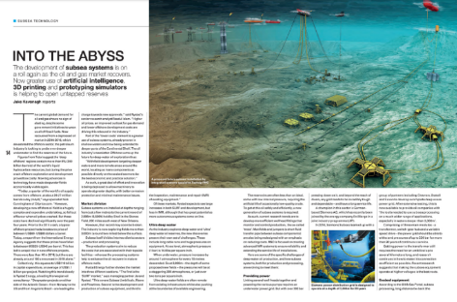
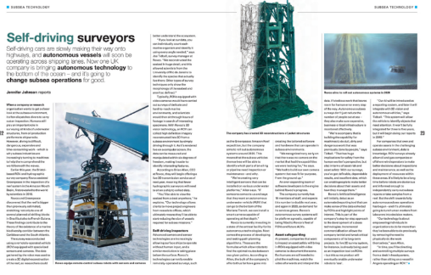
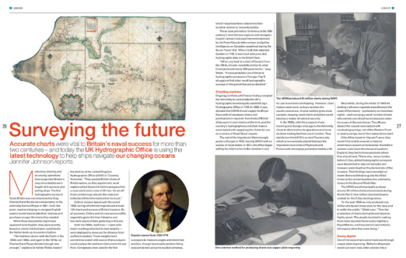
Raising Awareness of Hydrography
Notes:
IMarEST uses it’s voice and influence as an NGO working across all aspects of the marine sector and as a global publisher of industry marine technical publications and journals to raise awareness about Hydrography and the crucial role it plays in under pinning the blue economy.

Slide 5
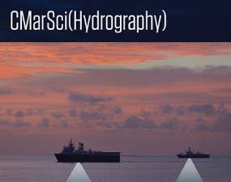
New certification launched
Chartered Marine Scientist (Hydrography)
Registration (e.g. Chartered status) is a globally recognised professional certification. It offers international recognition of a person’s skills, qualifications and experience by identifying that they possess key competencies and meet the core standards for marine professionals worldwide.
In October IMarEST launched a Hydrography specific
registration. CMarSci(Hydrography) recognises
that the individual is a Chartered Marine Scientist
with a specialism in Hydrography.
For more details go to
www.imarest.org/hydrography
Notes:
IMarEST offers a wide range of professional qualifications for marine engineers, technologists and scientists which are recognised globally but in October they introduced a new individual certification scheme designed specifically for the Hydrographers. The competencies for the new certification were developed following wide consultation with IMarEST members, hydrographic industry, academia as well as The Hydrographic Society UK. The certification takes into account an individual hydrographer’s education, qualifications, skills and experience to assess their competency. For more details and to apply go to www.imarest.org/hydrography

