Slide 1
MACHC19 Conference Cartagena de Indias, Colombia, 28-30 November 2018

Slide 2
Success Story
ROK Category B Survey Programme
IHO 2018 CBWP Activity P-02
Participants: Colombia, Cyprus, Georgia, Jamaica, Russia, Tunisia, Uruguay

Slide 3
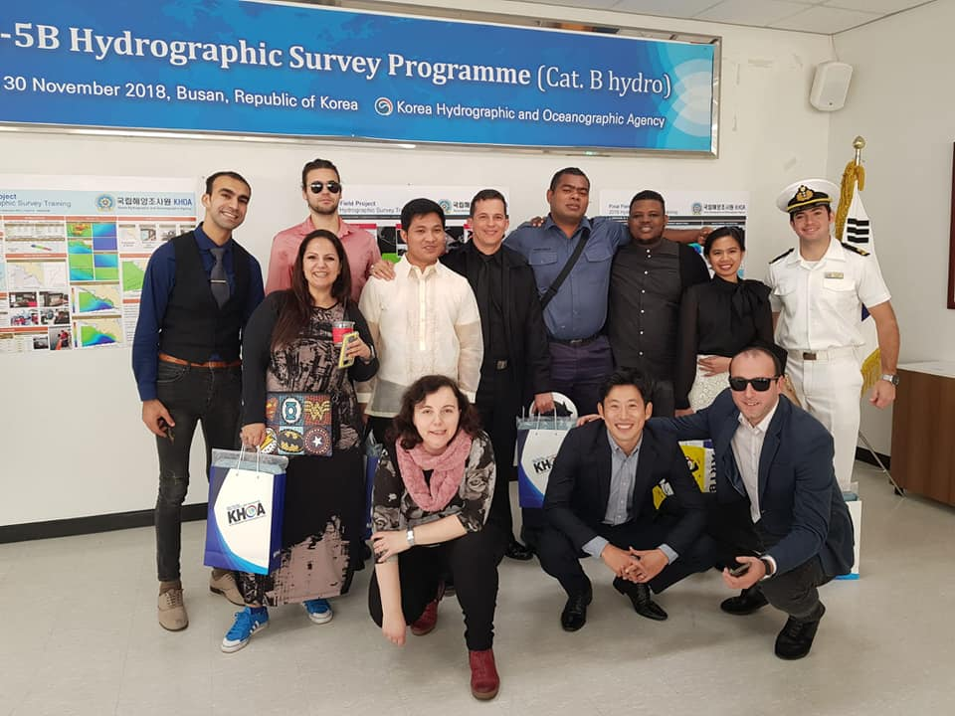
Group Photo

Slide 4
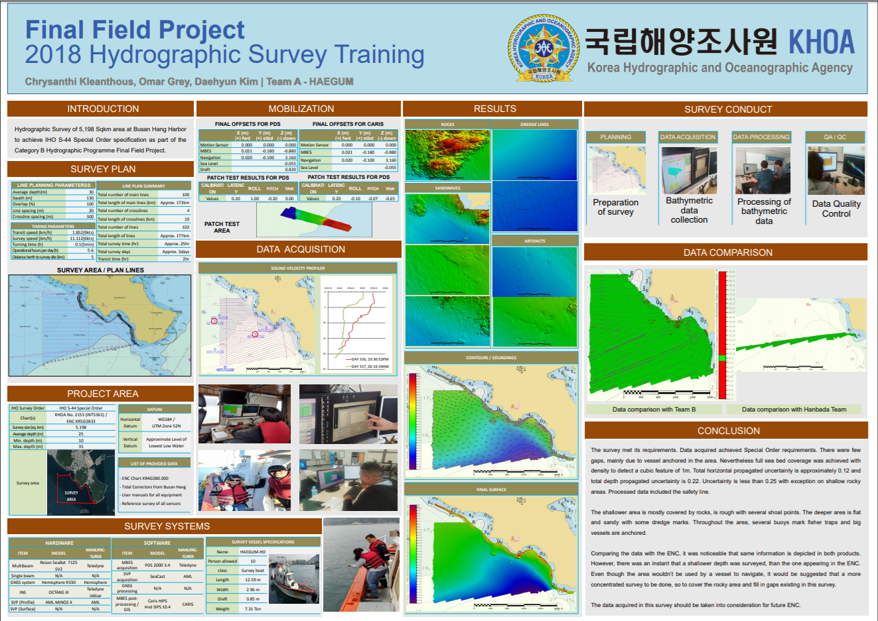
Group Photo

Slide 5
Group Photo

Slide 6
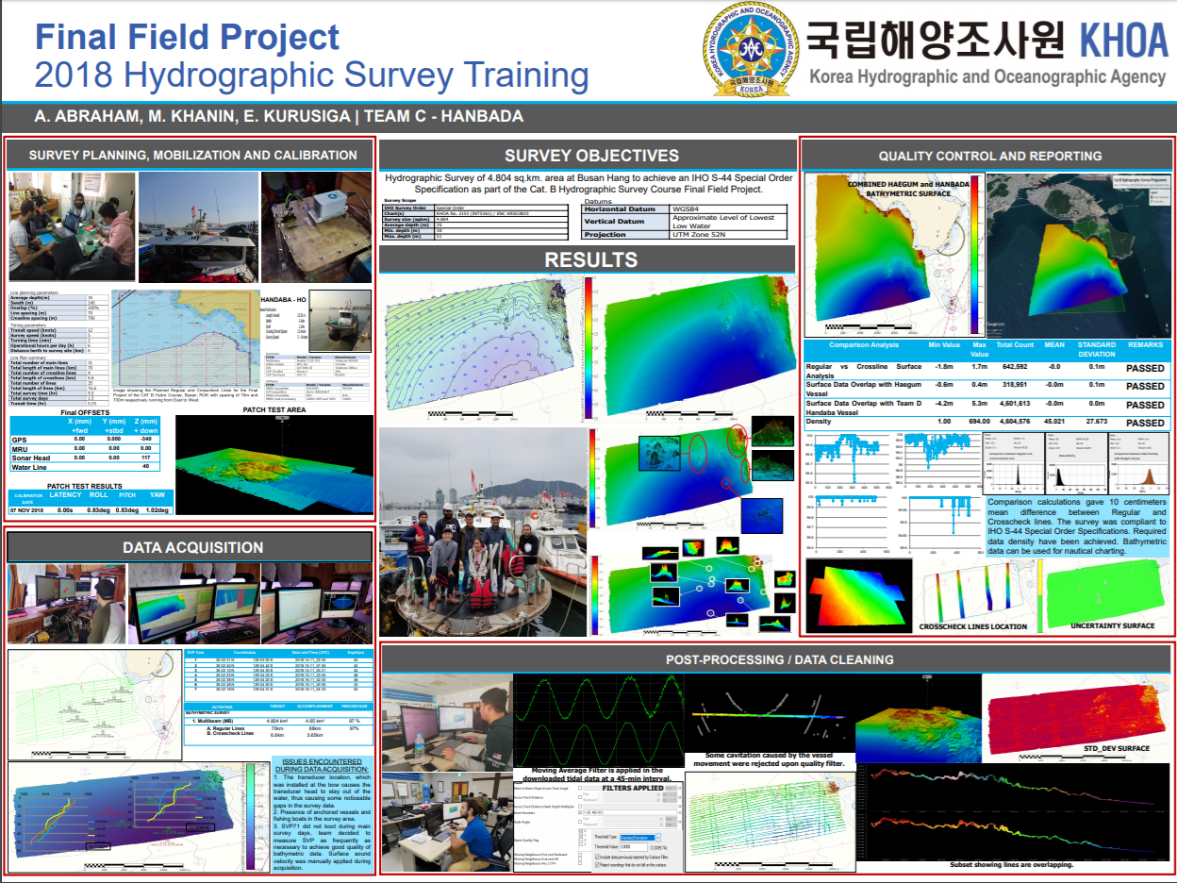
Group Photo

Slide 7
Group Photo

Slide 8
Thank you!

