Slide 1
“Strenghtening of Hydrographic Capacities in Mesoamerica and the Caribbean”
Short Sea Shipping (TMCD)
Mexican Agency of International Development Cooperation (AMEXCID)
Notes:
Oceanography, Hydrography and Meteorology
Mexican Secretariat of the Navy
ACS
Muy Buena colaboración que ha tenido AMEXCID con SEMAR: en diferentes temas como el de gestión del riesgo, ayuda humanitaria y en cooperación bilateral, por ejemplo con Belice.
C. CONTRALMIRANTE ENRIQUE FLORES MORADO
AGRADECIMIENTO A LA DGA DE OCEANOGRAFIA, HIDROGRAFIA Y METEOROLGIA. ESCUELA NAVAL MILITAR
AUTORIDADES DE COLOMBIA QUE NOS HAN DADO UN GRAN RECIBIMIENTO

Slide 2
Mexican Agency of International Development Cooperation
AMEXCID, with the support of the Mexican Embassies abroad and national institutions, offers and receives development cooperation.
1
Share successful experiences, strengthen capabilities, and exchange human, technical and financial resources with developing countries.
2
We work with keypartners to enhance our own capabilities and institutions to generate concrete results for Mexico´s development.

Slide 3
Short Sea Shipping (TMCD)
Background
-The cooperation agenda of AMEXCID with the Association of Caribbean States (ACS) originates from the agreements of the VI Summit of Heads of State of the Government of the ACS held in April 2014 in Merida, Yucatan where the Short Sea Shipping Project (SSS, TMCD in Spanish) was established.
Objective
-Strenghten competitiviness and promote regional trade through the establishment of short distance maritime routes through Workshops and Trainings.
Capacity-building in order to promote application of standards on digital mapping for maritime and economic development.
Meetings to improve trade facilitation, maritime traffic , sea traffic, unloading at ports (FAL Convention65).
Notes:
- Que se impulse el desarrollo y el comercio regional.

Slide 4
FOCAHIMECA (Strenghtening of Hydrographic Capacities in Mesoamerica and the Caribbean)
Strengthen hydrographic capacities
Contribute to maritime security
Databases including bathymetry
Efficient maritime routes
Promote economic and maritime development
Project promoted by the Secretariat of the Navy of Mexico (SEMAR), AMEXCID and ACS within the framework of cooperation of Mexico with the wider Caribbean region in order to strenghten maritime transport.
Notes:
Muy Buena colaboración que ha tenido AMEXCID con SEMAR: en diferentes temas como el de gestión del riesgo, ayuda humanitaria y en cooperación bilateral, por ejemplo con Belice.

Slide 5
FOCAHIMECA ACHIEVEMENTS
1
2
3
Workshops on bathymetry and mapping
Donation of Hydrographic Equipment
Specialization on Hidrography at the Naval School of the Mexican Navy

Slide 6
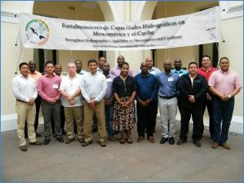
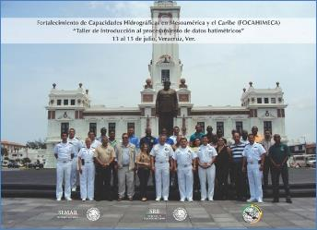
1
FOCAHIMECA
Achievements (2016)
2nd “Processing bathymetric data”
2016
1st “Bathymetry in shallow water”, during the third Summit of Hidrography.
2016
Learn about Bathymetry equipments used in Mexico
Implementation based on the information generated by the equipment.
Better relations among the hydrographic community.
Gaining knowledge, skills and abilities for handling and processing of geospatial data.
Use and application of digital mapping.
Notes:
To strengthen the hydrographic capacities of Member States, Mexico there were conducted workshops. Bathymetry (the measurement of depth of water in oceans, seas, or lakes). AMEXCID funds these activities.
Previo a los talleres de 2016, se llevó a cabo un Taller Técnico de Presentación del Proyecto para el Fortalecimiento de Capacidades Hidrográficas en Mesoamérica y Mar Caribe en Veracruz, Ver., México del 1 al 4 de diciembre de 2015.
Se presentaron los componentes y alcances del proyecto y se revisó y discutió la carta de Intención que sería firmada por los países interesados en participar.

Slide 7
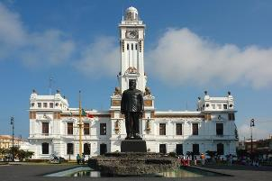
FOCAHIMECA
Achievements (2016)
3rd “Infrastructure of Maritime and space-based systems”
Veracruz, Ver., Mexico
2016
4rd “Maritime security
information (MSI)”
2016
Drafting guidelines for deep-sea shipping.
Standards for electronic navigation charts.
Processing and validation.
Knowledge about infrastructure of maritime and space-based systems.
Sources of hydrographic information.
Principles of Estandar S-100
Pictures and standards for the construction of navigation charts.

Slide 8
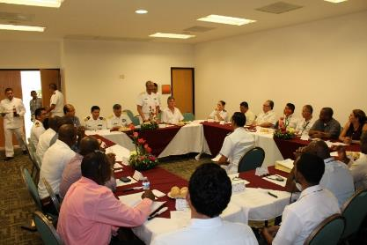
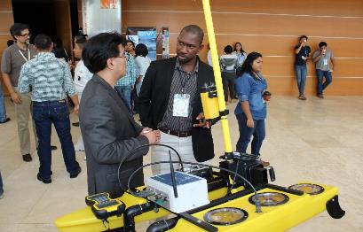
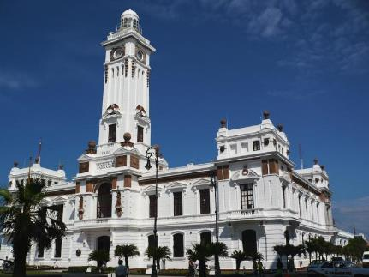
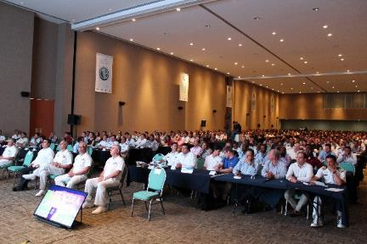
FOCAHIMECA

Slide 9
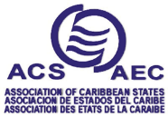
2
FOCAHIMECA – Achievements (2016)
Donation of Hydrographic Equipment
Triangular cooperation
Turkish Cooperation and Coordination Agency (TIKA) donated equipment to the Mexican Secretariat of the Navy (SEMAR), in order to use it for teaching and capacity building purposes during the training courses of FOCAHIMECA.
Notes:
Contribución al proyecto por parte de la Agencia de Cooperación de Turquía (TIKA).
Complemento a los esfuerzos de FOCAHIMECA.
Financiamiento de equipo hidrográfico para integrar un sistema de adquisición y procesamiento de Ecosonda.
Elaboración de cartografía para mejorar la eficiencia y la seguridad en navegación marítima y el comercio regional.
Uso del equipo como parte el proyecto FOCAHIMECA. (2 últimos talleres y los cursos de especialidad).

Slide 10
3
FOCAHIMECA
Specialization on Hidrography at the Naval School of the Mexican Navy.
Data processing
STARTS IN JANUARY
Creation and publication of Navigation charts
Design and perform hydrographic surveys according to international standards (International Hydrographic Organization-IHO)
43 WEEKS
International standards
Naval School of the Mexican Navy
Operation and maintenance
Hydrographic processing
# fellows (posts) per year
Call for applications opens each year in September
Notes:
In 2017, AMEXCID started providing scholarships for officials from member countries of the ACS to take a one year course of Specialization in Hydrography at the Naval School of the Mexican Navy. These studies complement and expand the lessons learned from previous workshops and training. The call for applications for such grants will open in late September October 2016.

Slide 11
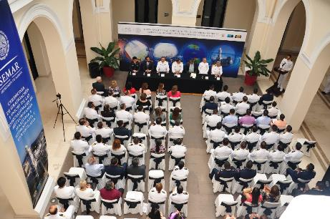
3
FOCAHIMECA
Specialization on Hidrography at the Naval School of the Mexican Navy.
2017-2018: Dominican Republic, Guatemala, El Salvador, Honduras, Nicaragua, Panama
2018-2019: Guatemala, Dominican Republic
2019-2020: candidates received (acceptation letters will be delivered through ACS)
Notes:
Enero 2017-enero 2018), contó con la participación de becarios de República Dominicana, Guatemala, El Salvador, Honduras, Nicaragua y Panamá, financiados en su totalidad por la AMEXCID.
Actualmente, se desarrolla el segundo curso (enero 2018-enero 2019) en el que participan dos expertos de Guatemala y República Dominicana.

Slide 12
3
FOCAHIMECA
Specialization on Hidrography at the Naval School of the Mexican Navy
País/country | Tesis
República Dominicana | Elaboración de cartas temáticas de Ecosistemas marinos protegidos
Panamá | Elaboración de plan de cartografía náutica.
Guatemala | Plan de Cartografía náutica.
Honduras | Creación del Departamento de Hidrografía en la fuerza naval conforme a normativas internacionales.
Nicaragua | Implementación de la cartografía náutica electrónica
El Salvador | Plan para actualización de la cartografía náutica.

Slide 13
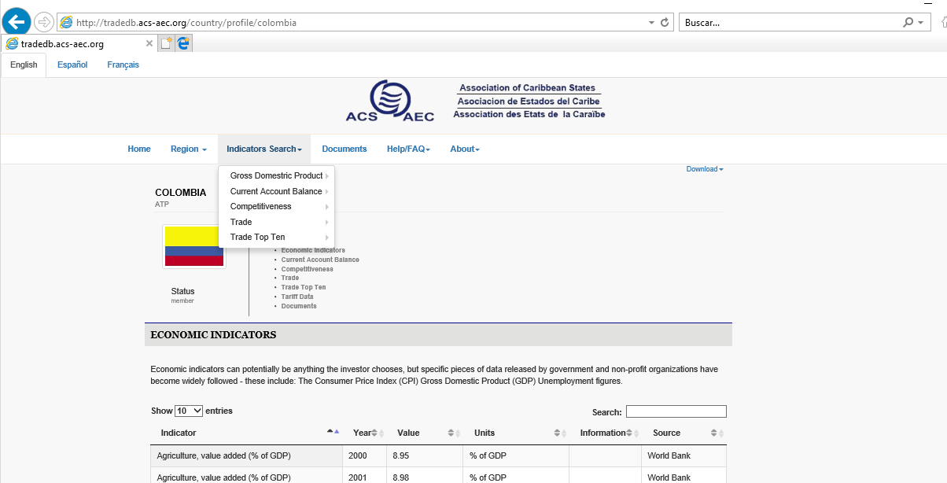
TMCD - Complementary activities in 2016
Another activity that is part of the Short Sea Shipping Project is the elaboration of a database about international trade in the wide Caribbean region (http://tradedb.acs-aec.org/country/profile/Colombia)
Notes:
It is important to disseminate information abut the database.

Slide 14
Short Sea Shipping (TMCD)
NEXT STEPS (2019)
Intensive Spanish courses (in order to promote the participation of English-speaking Caribbean countries).
Meeting between AMEXCID-SEMAR-ACS in order to encourage ACS Member State participation in FOCAHIMECA.
Translation from English to Spanish of the database of international trade. Joint work between ACS and AMEXCID
Notes:
Meeting, share the experience of participants of the Specialization of 2017-2018; 2018-2019.

