Slide 1
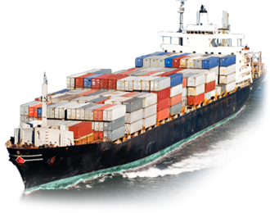
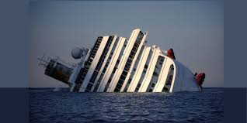
Global Statistical Analysis of Historical Marine Incidents
Amrika Maharaj PhD Candidate
The University of the West Indies
Notes:
My research is focused on solutions to reduce the risk of MN by developing a strategy that considers the likelihood of an incident in relation to vessel traffic flow and navigation information available to the mariner.
And this can be done by an examination and assessment of vessel accidents globally to identify the key contributing factors or the significant parameters that creates a MD. So today il be presenting on .

Slide 2
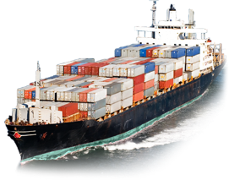
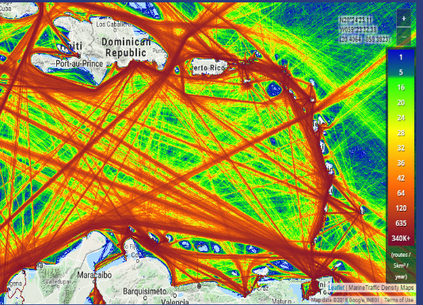
Introduction to the Study
MarineTraffic 2018
The Maritime environment represents a wide range of shipping activities.
The shipping activities become more complex as large-scale offshore operations and maritime activities continue to increase.
Figure 1 : Marine Traffic density across the Caribbean
Notes:
Covers a wide spectrum of shipping accidents of varying size of cargoes transiting in interoceanic routes
Therefore shipping is important..

Slide 3
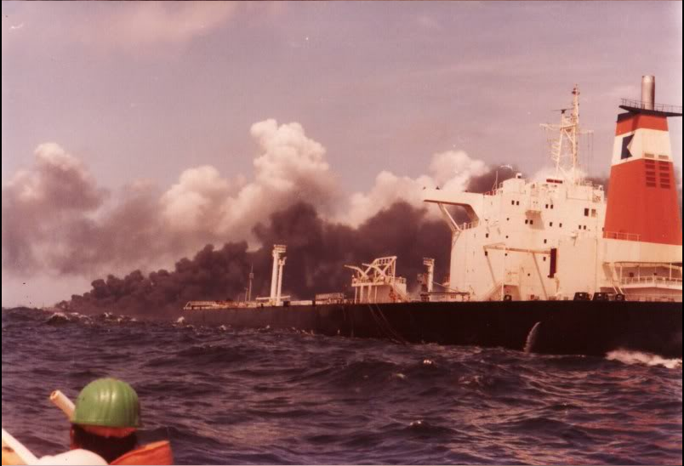
Shipping Incident
Marine traffic
Research into Risk Assessment of Maritime Navigation
Causation factors influencing vessel incidents
Visser n.d
Figure 2: Oil spill accident along the coast of Tobago, 1979.
Notes:
There have been many shippin ……
One of ….. An d resulted in the loss of life
So there is a risk in accidets and the shipping industry And to get a clear picture of what is happening in the marine environment, ive started lookini at
Research into…… an why these accidents happen

Slide 4
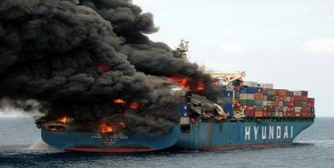
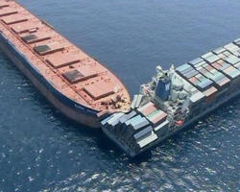
Causes of Maritime Accidents
Generic causes of Maritime Accidents:
Meteorological Conditions
Mechanical and Technical Issues
Human Errors
Malfunctioning aids to navigation
Inadequate charting (Bathymetry & Navigational Hazards)
Navigational Complexity
Visser n.d
Figure 3: Vessel Incident
Notes:
There are many parameters that influence the occurrence of maritime incidents in the maritime domain.
And lastly…

Slide 5
Quantitative Analysis of Maritime Causalities and Incidents
Notes:
In order to determine the causes of accidents, a global casuality and incident statistis over the last 16 years was obtained from IMO,
From jan 2002 – March 2018. and containd 6052 reported maritime accidents

Slide 6
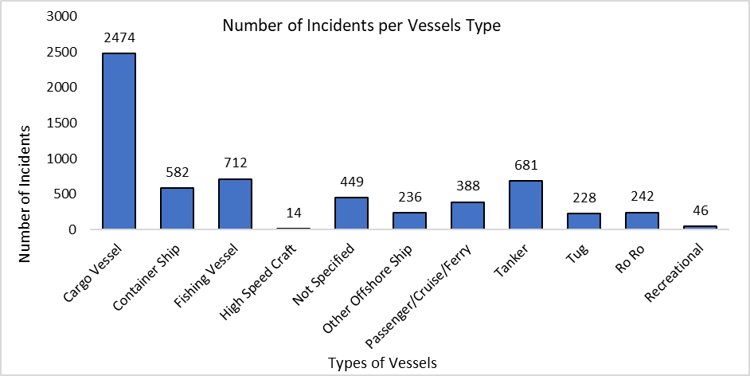
Quantitative Analysis of Maritime Causalities and Incidents
Figure 4 describes the vessel traffic worldwide from January 2002 – March 2018.
Figure 4
Notes:
From the database, the types of vessels….
It was clear that theVT resulting in most incidents are cargoes. By their design, these vessels carry a multiude of cargoes, goods and materials from 1 port to another. But infact there are more cargo vessels, so there a more likelihood of them being involved in an accident.
Fishing account for the second highest number of incidents followed by tankers

Slide 7
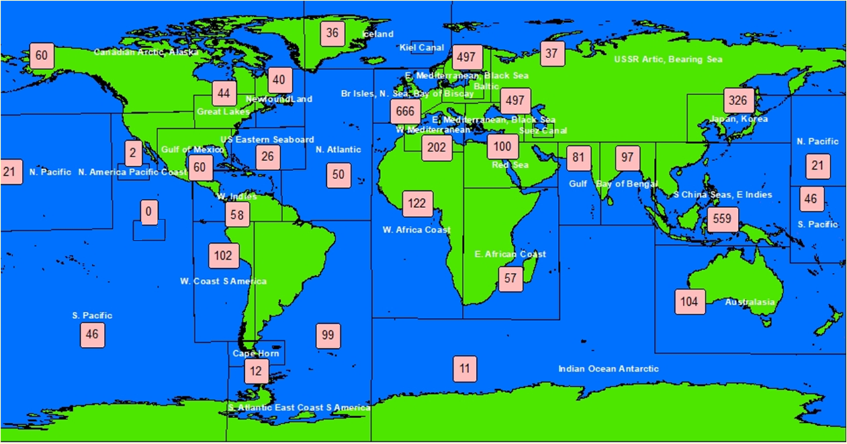
Number of Maritime Causalities and Incidents
5 Foundered
8 Collisions
10 Groundings
13 Mechanical and Technical Failure
Notes:
Putting the accidents into regions, 58 incidents occurred in the Caribbean region.. The geographical areas with the highest number of incidents are the Bay of Biscay, South China Sea (SCS), East Mediterranean, Black Sea and Japan and Korea, respectively. The map provides a clear indicator of potential problem areas in which there should be a focus of international attention for increased safety measures and enforcement of regulations and high standards.

Slide 8
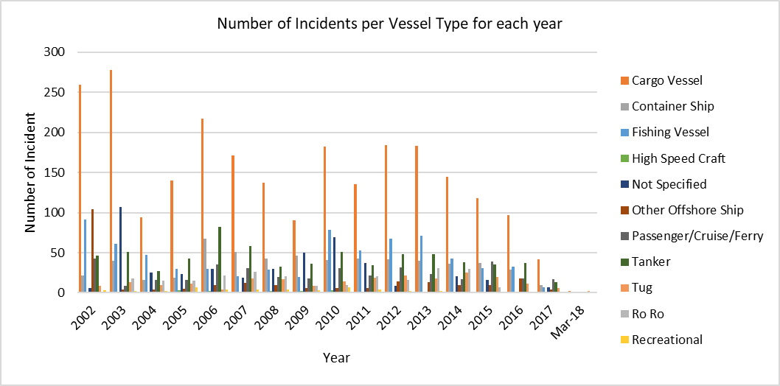
Quantitative Analysis of Maritime Causalities and Incidents
Figure 6
8
Notes:
Based on the analysis, I wanted to determine the no of incidents per vessel type per year. From this graph it shows that there are considerable temporal variation is shown by the different types of vessels.
Cargo vessesl are still the leadin vessel type, for each year throughtout the study period.
Container hghest in 2006
Fishin vessels 2002
Minimal incidents with HSC and recreational throught the study period
Passenger in 2002
RORO 2013
Tugs 2014

Slide 9
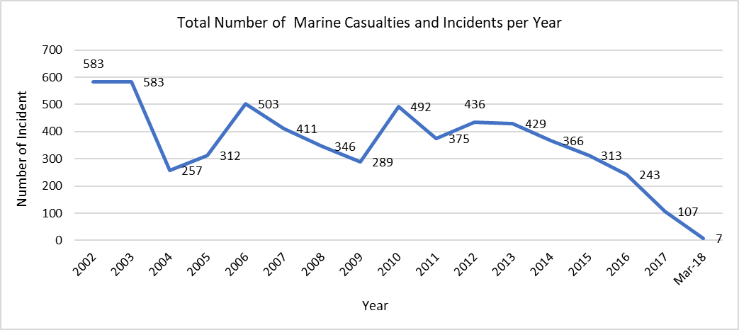
Quantitative Analysis of Maritime Causalities and Incidents
Figure 7
9
Notes:
Based on the analysis, it was important to determine whether these incidents are still increasing or dercesig
Despite this encouraging statistic it is clear that the number of global vessel incidents on an annual basis is still consistently far too high, indicating a requirement to understand and take action against the root causes of such accidents.

Slide 10
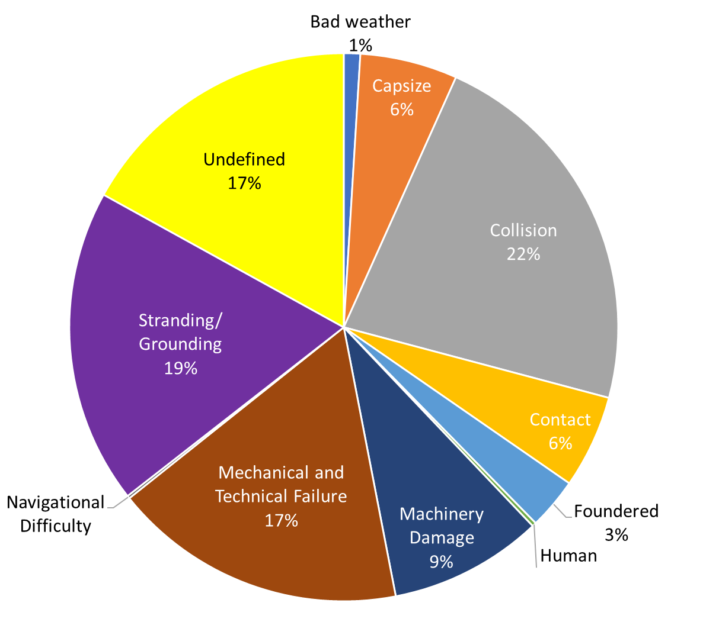
Quantitative Analysis of Maritime Causalities and Incidents
Figure 8
10
Notes:
The figure shows the distribution in percentage by accident types is shown in this figure. Based on the analysis, majority of the accidents are caused from collision with 1070 occ
This may be due to the difficulties realted to navigating n operation large vessels in narrow and busy ports or open waters.
Grounding the 2n highest because, depth of water varies from port to port. Not all ports allow ships of all sizes to enter, so the larger vessels run aground.

Slide 11
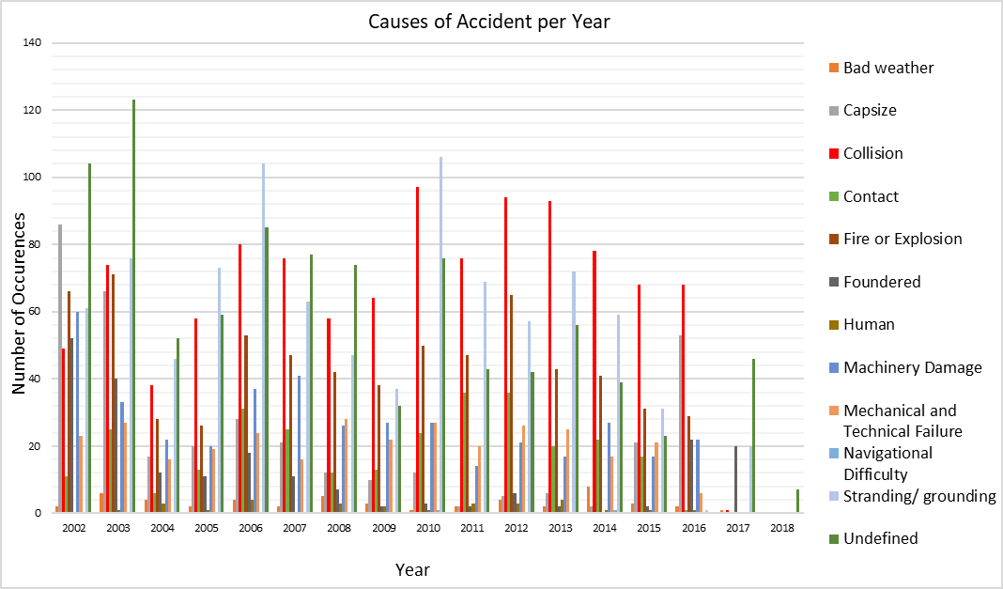
Quantitative Analysis of Maritime Causalities and Incidents
Figure 9
Number of Occurrence
11
Notes:
It was also important to investigate what were the causes of accidents per year.
As u can see from the figure theres a fluctuates between grounding as shown in grey and collisions in red, per year., but majority being collision throughout the study period.

Slide 12
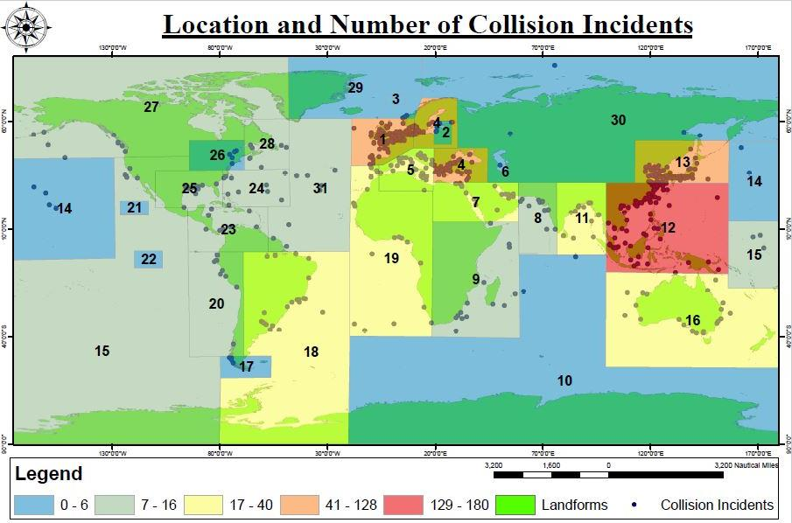
12
Location of Collision Incidents
ID Location
1 N. Sea, Bay of Biscay
2 Baltic
3 Kiel Canal
4 E. Mediterranean, Black Sea
5 W. Mediterranean
6 Suez Canal
7 Red Sea
8 Gulf
9 E. African Coast
10 Indian Ocean Antarctic
11 Bay of Bengal
12 S. China Seas, E Indies
13 Japan, Korea
14 N. Pacific
15 S. Pacific
16 Australasia
17 Cape Horn
18 S. Atlantic East Coast S America
19 W. Africa Coast
20 W. Coast S America
21 N. America Pacific Coast
22 Panama Canal
23 W. Indies
24 US Eastern Seaboard
25 Gulf of Mexico
26 Great Lakes
27 Canadian Arctic, Alaska
28 Newfoundland
29 Iceland
30 USSR Artic, Bearing Sea
31 N. Atlantic
Number of Collisions
Notes:
I also looked at the incidences by the geographical area.
Highest collision occur in the South China sea ……. The most dominat types of vessels trading here are cargoes, containers and tankers. It is because the SCS isa busy waterway providing the key maritime link between the Indian Ocean and East Asia.
Bay of Biscay yield the second highest….. Vessesl trading in these areas are cargoes, containers and fishing vessels. Some of the fiercest weather conditions is witness in this bay.

Slide 13
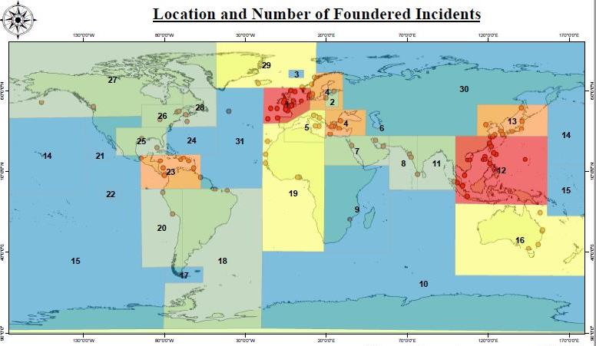
Location of Foundered Incidents
13
ID Location
1 N. Sea, Bay of Biscay
2 Baltic
3 Kiel Canal
4 E. Mediterranean, Black Sea
5 W. Mediterranean
6 Suez Canal
7 Red Sea
8 Gulf
9 E. African Coast
10 Indian Ocean Antarctic
11 Bay of Bengal
12 S. China Seas, E Indies
13 Japan, Korea
14 N. Pacific
15 S. Pacific
16 Australasia
17 Cape Horn
18 S. Atlantic East Coast S America
19 W. Africa Coast
20 W. Coast S America
21 N. America Pacific Coast
22 Panama Canal
23 W. Indies
24 US Eastern Seaboard
25 Gulf of Mexico
26 Great Lakes
27 Canadian Arctic, Alaska
28 Newfoundland
29 Iceland
30 USSR Artic, Bearing Sea
31 N. Atlantic
Number of Foundered Incidents
Notes:
The same applies to the foundered incidents. The third highest number of foundered incidents falls in the Caribbean and also covers the panama canal. These vessels that are involved are cargoes, fishing and tugs.
These incidences also occur in areas such as the North Sea, Black Sea, Japan and China Sea where there are high volumes of shipping.

Slide 14
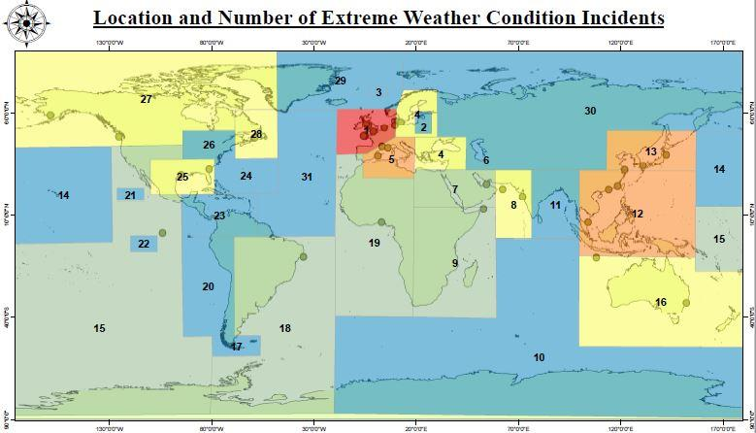
14
ID Location
1 N. Sea, Bay of Biscay
2 Baltic
3 Kiel Canal
4 E. Mediterranean, Black Sea
5 W. Mediterranean
6 Suez Canal
7 Red Sea
8 Gulf
9 E. African Coast
10 Indian Ocean Antarctic
11 Bay of Bengal
12 S. China Seas, E Indies
13 Japan, Korea
14 N. Pacific
15 S. Pacific
16 Australasia
17 Cape Horn
18 S. Atlantic East Coast S America
19 W. Africa Coast
20 W. Coast S America
21 N. America Pacific Coast
22 Panama Canal
23 W. Indies
24 US Eastern Seaboard
25 Gulf of Mexico
26 Great Lakes
27 Canadian Arctic, Alaska
28 Newfoundland
29 Iceland
30 USSR Artic, Bearing Sea
31 N. Atlantic
Location of Extreme Weather Condition Incidents
Number of Extreme Weather Condition Incidents
Notes:
As observed earlier, it is reflected that the bay of Biscay has the highest number of incidences due to bad weather, followed by the China Sea but this is not a problem in the Caribbean
However, this Is not a problem in the Caribbea

Slide 15
Location of Stranding/Grounding Incidents
15
ID Location
1 N. Sea, Bay of Biscay
2 Baltic
3 Kiel Canal
4 E. Mediterranean, Black Sea
5 W. Mediterranean
6 Suez Canal
7 Red Sea
8 Gulf
9 E. African Coast
10 Indian Ocean Antarctic
11 Bay of Bengal
12 S. China Seas, E Indies
13 Japan, Korea
14 N. Pacific
15 S. Pacific
16 Australasia
17 Cape Horn
18 S. Atlantic East Coast S America
19 W. Africa Coast
20 W. Coast S America
21 N. America Pacific Coast
22 Panama Canal
23 W. Indies
24 US Eastern Seaboard
25 Gulf of Mexico
26 Great Lakes
27 Canadian Arctic, Alaska
28 Newfoundland
29 Iceland
30 USSR Artic, Bearing Sea
31 N. Atlantic
Number of Groundings
Notes:
But there is infact many g incidents take plalce in the C R and yield the highest number of grounding incidents throughout the study period occur in the bay of Biscay and black sea

Slide 16
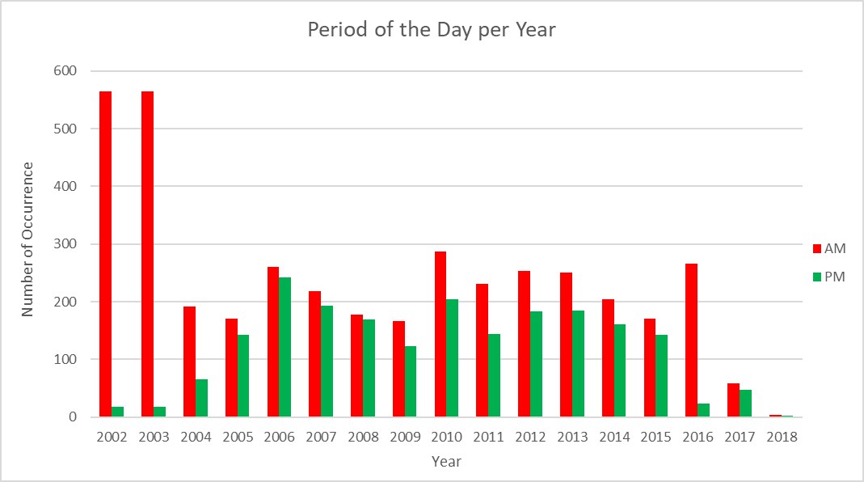
Quantitative Analysis of Maritime Causalities and Incidents
Figure 14
16
Notes:
It was also interested to investigate the period of the day in which these accidents occur,
It can be seen that 2002 and 2003 resulted in the most incidences for the AM time period, and most of the incidences throughout the study period occur in the AM period of the day.

Slide 17
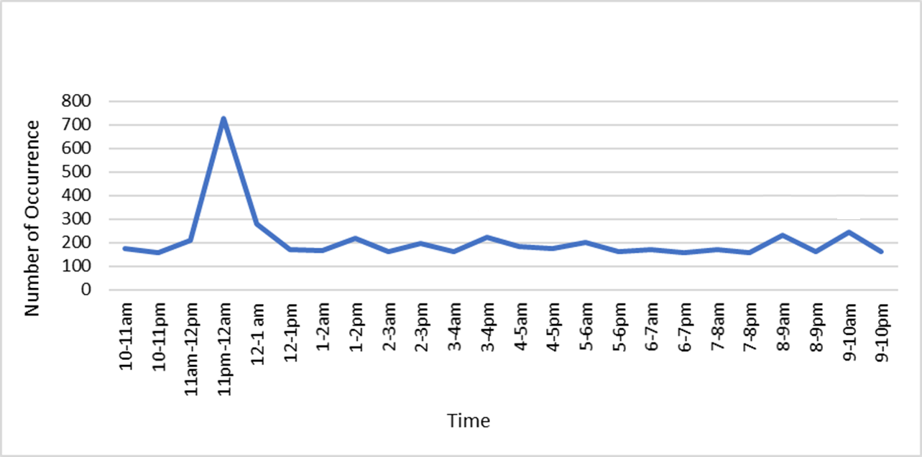
Quantitative Analysis of Maritime Causalities and Incidents
Figure 15
Marine Causality and Incident per Hour
Notes:
I then wanted to determine exactly the time of when these occur. So approx..’ly 700 incidences occurred between 11pm -12am. And other significant peaks has also been identified from 3-4pm and 8-9am

Slide 18
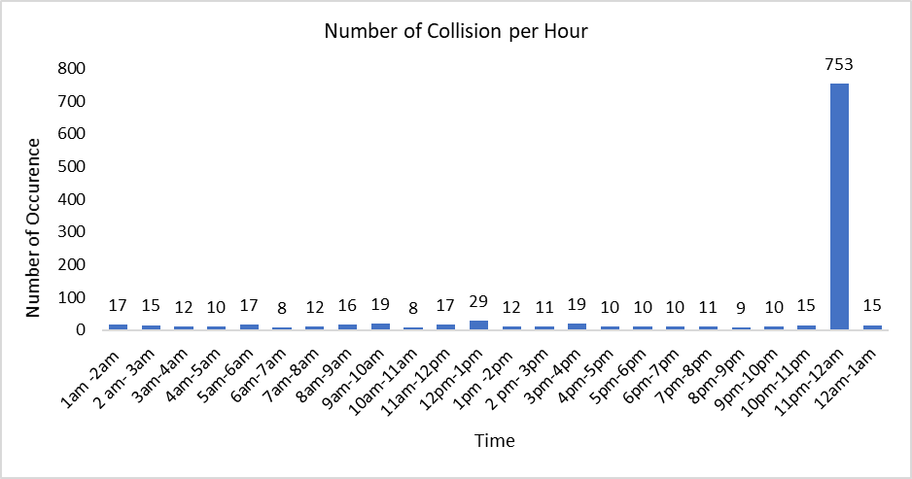
Quantitative Analysis of Maritime Causalities and Incidents
Figure 16
Notes:
An attempt was made to associate the time of these incidents with the causation factor. However, it was analysed that during 11pm – 12am, there were 753 collisions that occurred This however maybe explained by the poor visibility during the night time

Slide 19
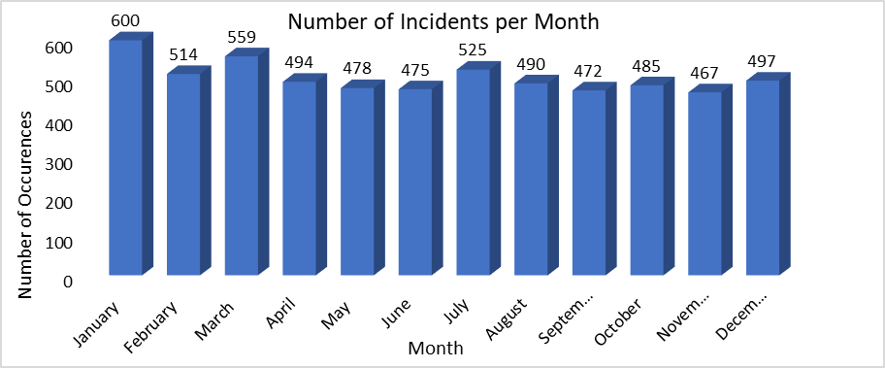
Quantitative Analysis of Maritime Causalities and Incidents
January has the highest number of events with 600 occurrences.
Figure 17
Number of Occurrence
Notes:
I also investigated whether there were seasonal variation for each year. January is th highest but its not that significant as compared to the other months, which is also relatively high.

Slide 20
Summary
From the analysis, it was determined that :
The cause of majority of these incidents resulted from Collision.
The major type of vessels that were involved in all accidents were cargo vessels, followed by fishing and tanker vessels.
The type of vessels that were involved in Collision were mostly cargo vessels.

Slide 21
Summary
The correlation between the causation factor and the location suggested that most incidents occur in the South China Sea, Bay of Biscay and the Black Sea.
It was observed that most accidents occurred during the early morning
time period rather than the PM time period.
The time of the incidents occurred mainly between 11pm– 12am.
Notes:
And these accidents are a result of collision and maye be due to lack of visibility due to the night time

Slide 22
Conclusion
It is important that proactive consideration of these potential high risk areas are taken to avert the risk of shipping accidents in the future in these highly sensitive and bio-diverse areas.
Notes:
Although the results shows a generally improving trend in shipping accidents, there is still in a significant number of incidents globally and particularly in the Caribbean region. Therefore there should be a focus on risk assessments and introduction of mitigation strategies.
for the safety of navigation, the maritime environment and human life.

Slide 23
Questions?

