Slide 1
UN-GGIM-WG on Marine Geospatial Information

Slide 2
Introduction
Established by the Committee of Experts through UN-GGIM decision 7/111, noting the need for technical expertise and broad representation
Provides a high level forum to encourage enhanced global cooperation to address issues related to the availability and application of marine geospatial information – including inland water bodies and waterways, coastal zones, seas and oceans

Slide 3
Work Plan Highlights
Recognize Capacity Development Initiatives which may Benefit from WG Activities
Liaise with Relevant Organizations including IHO and GGIM Regional Entities
Recognize and endorse established standards for geospatial information in marine and inland waters
Produce Communications Plan
Produce Use Case Report – due in 2020

Slide 4
Use Case Report
Report to show the benefits of open (readily available) marine geospatial information – examples…
Arctic Spatial Data Infrastructure
Data needed for determining where to best harvest wind energy and the associated economic impacts
Nautical charting data for use in mobile technology to assist small island reef fisherman

Slide 5
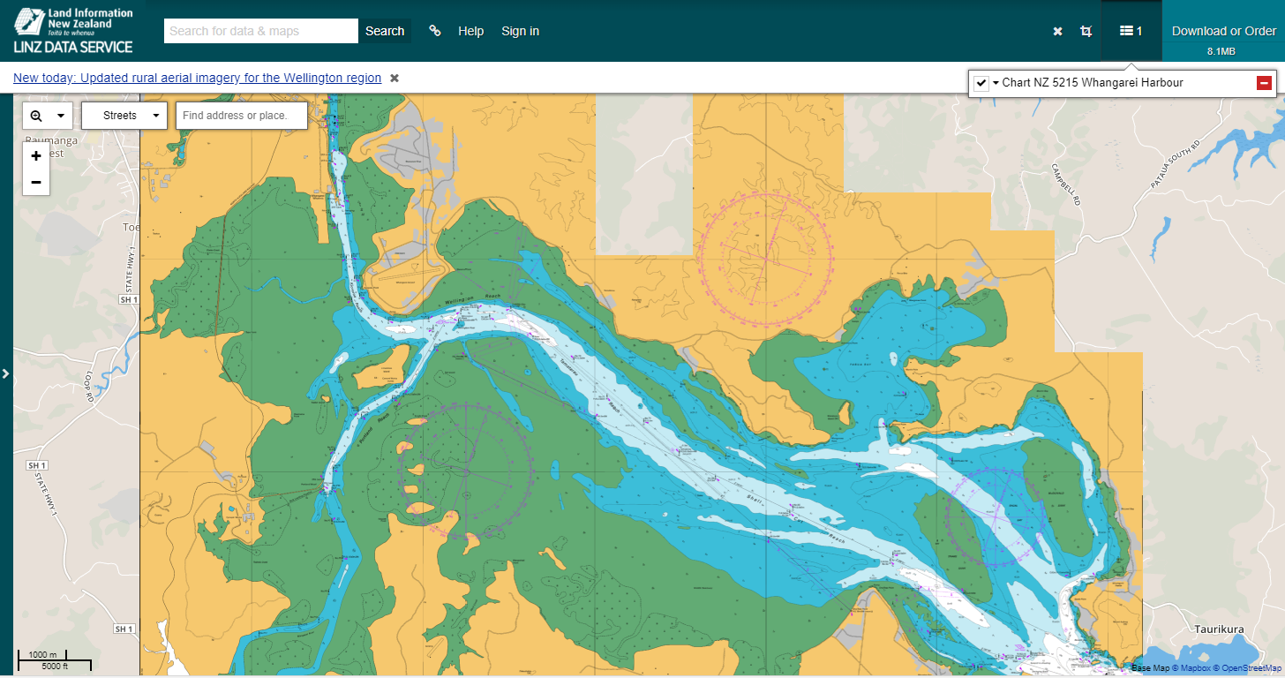

Slide 6
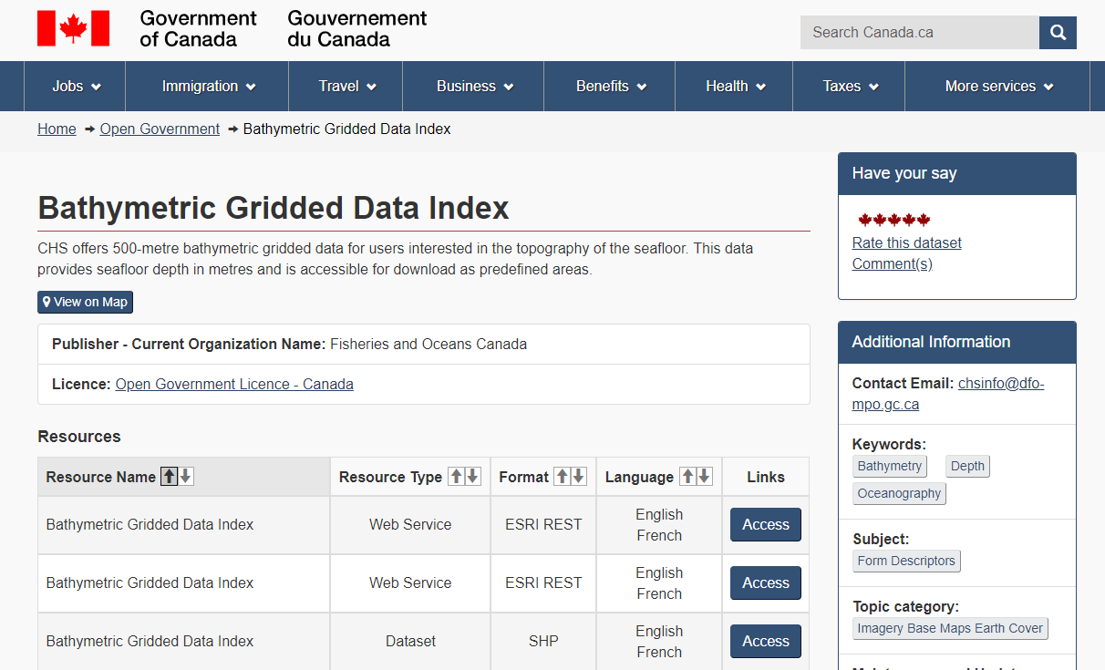

Slide 7
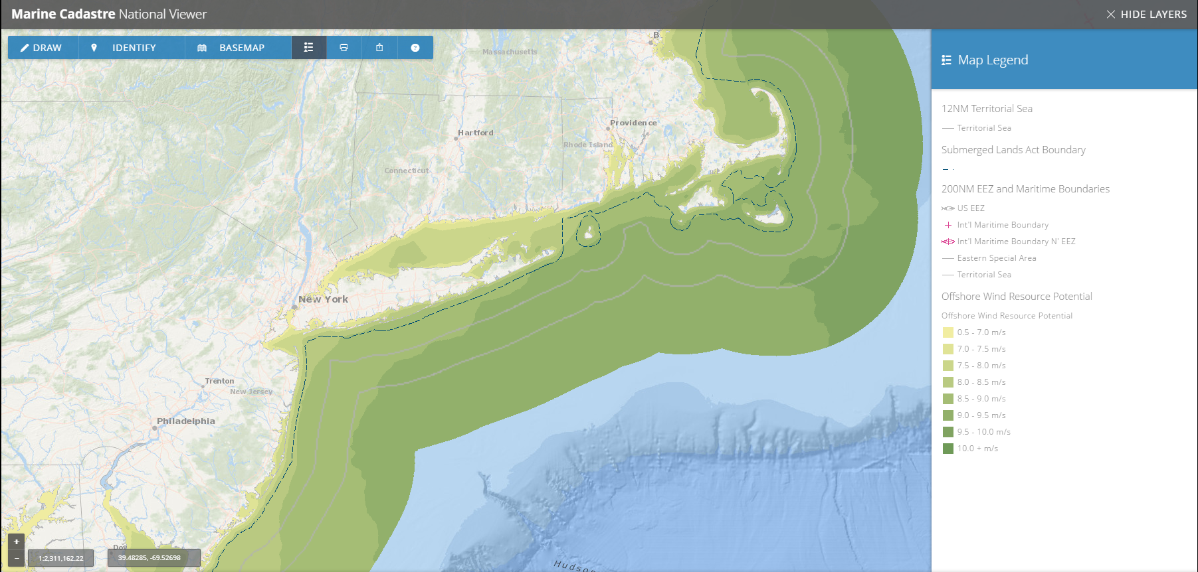

Slide 8
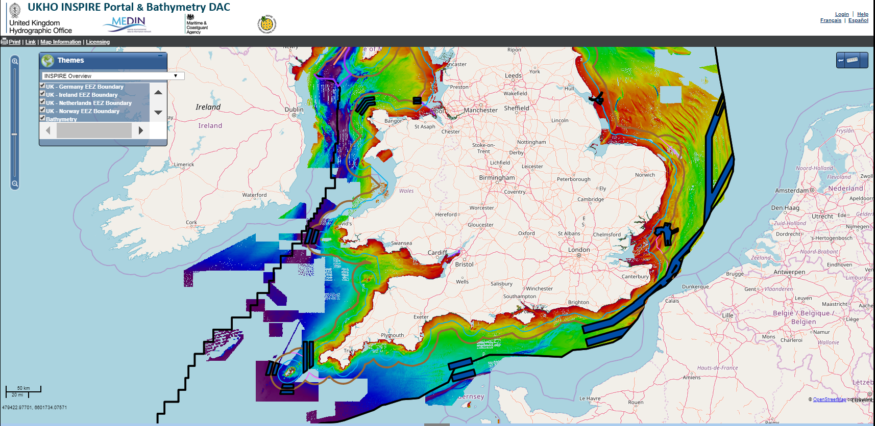

Slide 9
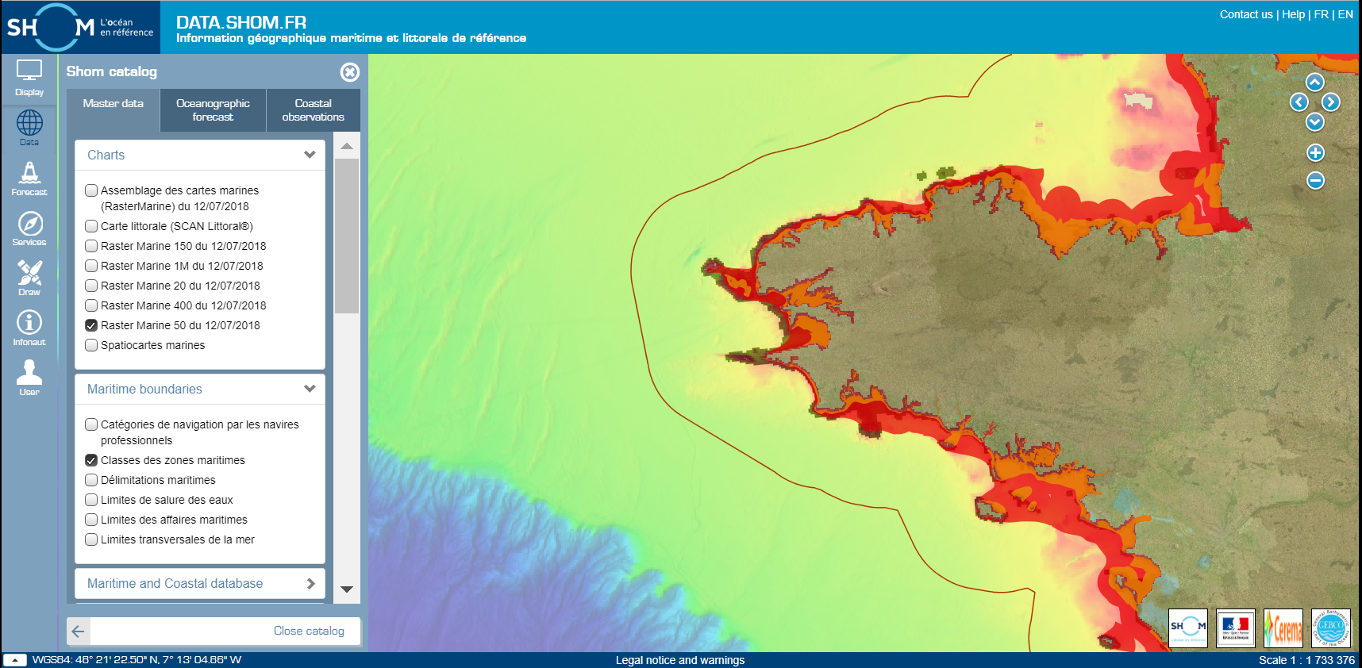

Slide 10
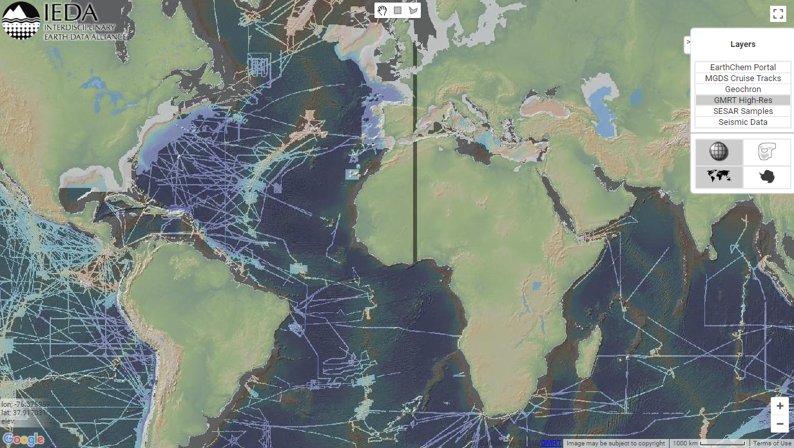
Notes:
The IEDA data facility’s mission is to support, sustain, and advance the geosciences by providing data services for observational geoscience data from the Ocean, Earth, and Polar Sciences.
IEDA systems serve as primary community data collections for global geochemistry and marine geoscience research and support the preservation, discovery, retrieval, and analysis of a wide range of observational field and analytical data types. Our tools and services are designed to facilitate data discovery and reuse for focused disciplinary research and to support interdisciplinary research and data integration.
​Our team of domain scientists, geoinformaticists and developers share a passion for the management and stewardship of earth science data. With decades of combined experience with data acquisition, management, system design, and scientific analysis our team aspires to bridge the gap between scientists and data that can support new and innovative discoveries. We work closely with our user communities to ensure that we continually optimize our tools and services to meet their needs. We also actively participate in the community of data stewards and cyberinfrastructure specialists to ensure that our systems meet evolving standards for interoperability and information sharing. We encourage an open and responsive dialog with our community of stakeholders and always welcome feedback.
​IEDA is funded by the US National Science Foundation through a Cooperative Agreement.

Slide 11
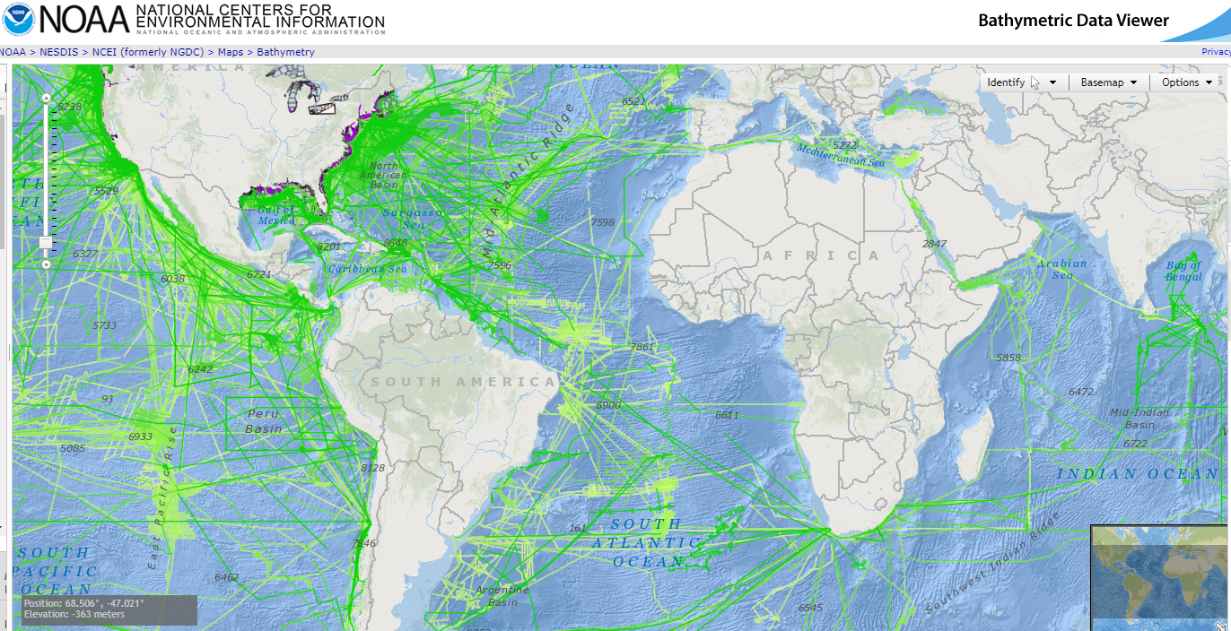

Slide 12
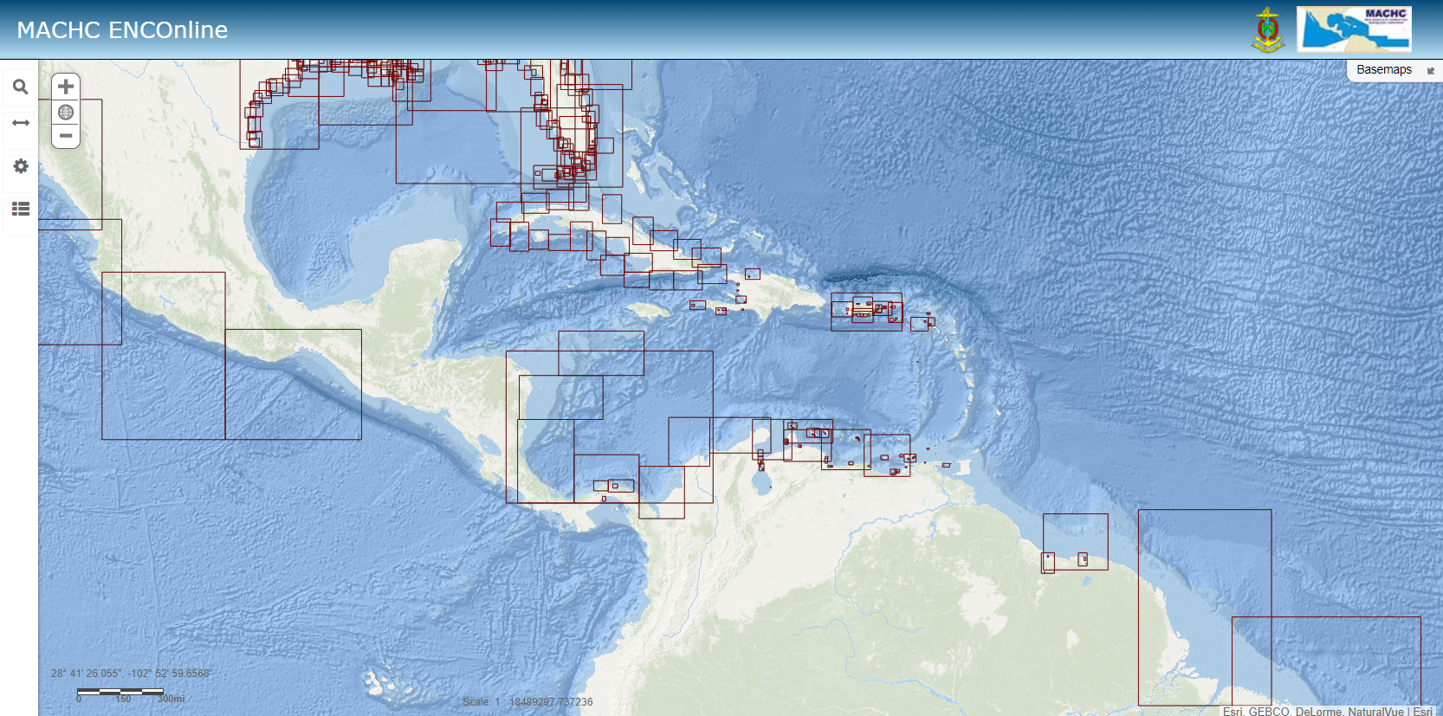

Slide 13
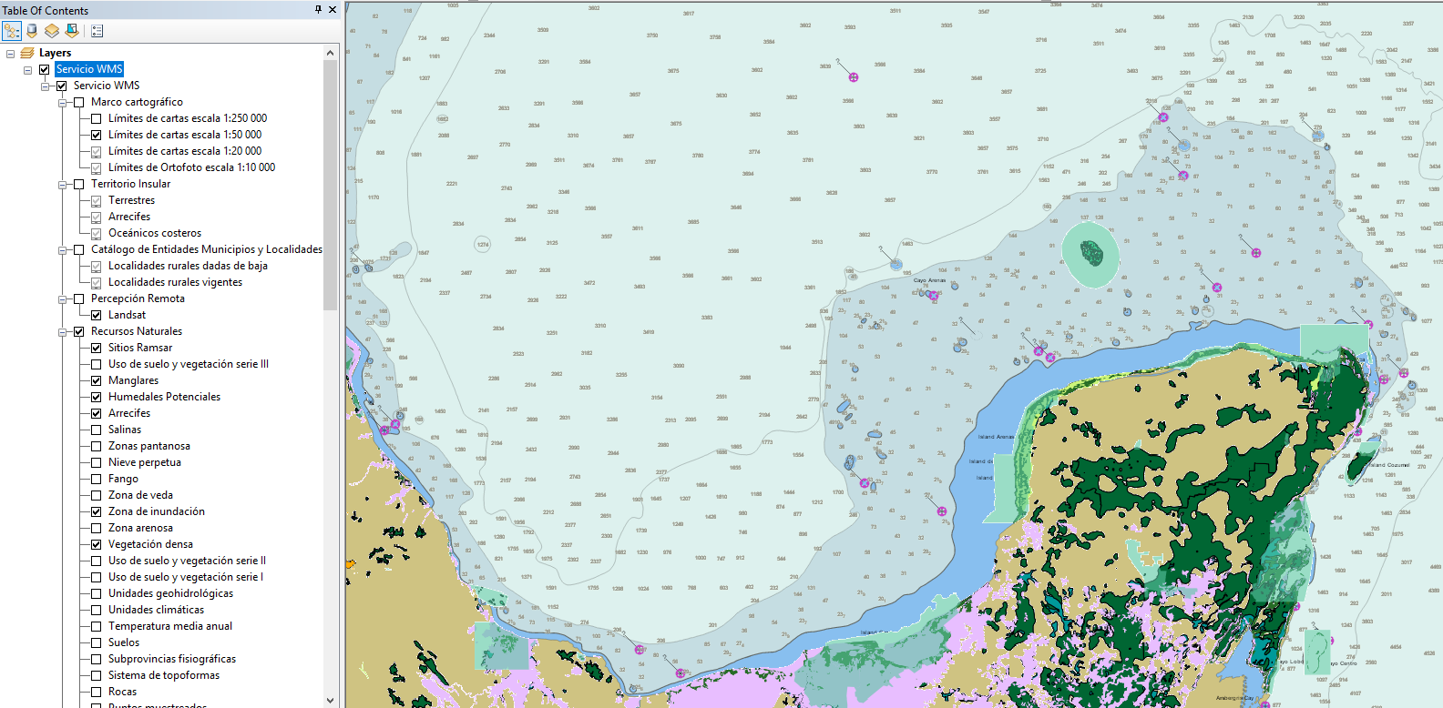
Notes:
MACHC ENC Online merged with Mexico’s INEGI dataset in ArcGIS. It would be great to have something like this – merging the land and sea together for the entire world, but ….

Slide 15
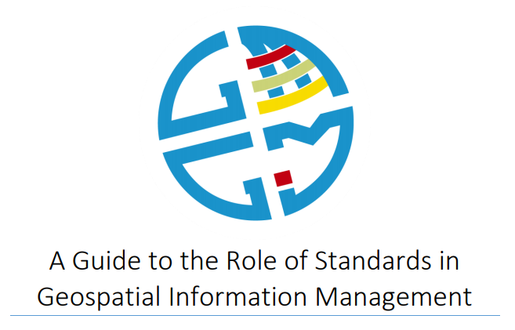
International Standards
S-101 ENC
S-102 Bathymetric Surface
S-103 Sub-surface Navigation
S-104 Water Level Information for Surface Navigation
S-111 Surface Currents
S-121 Maritime Limits and Boundaries
S-122 Marine Protected Areas
S-123 Radio
S-124 Navigational Warnings
S-125 Navigational Services
S-126 Physical Environment
S-127 Traffic Management
S-128 Catalogues of Nautical
S-129 Under Keel Clearance Management (UKCM)
S-201 Aids to Navigation Information
S-210 Inter-VTS Exchange
S-230 Application Specific Messages
S-240 DGNSS Station Almanac
S-245 eLoran ASF Data
S-246 eLoran Station Almanac
S-247 Differential eLoran Reference Station Almanac
S-401 Inland ENC
S-402 Bathymetric Inland ENC
S-411 Ice Information
S-412 Weather Overlay

Slide 16
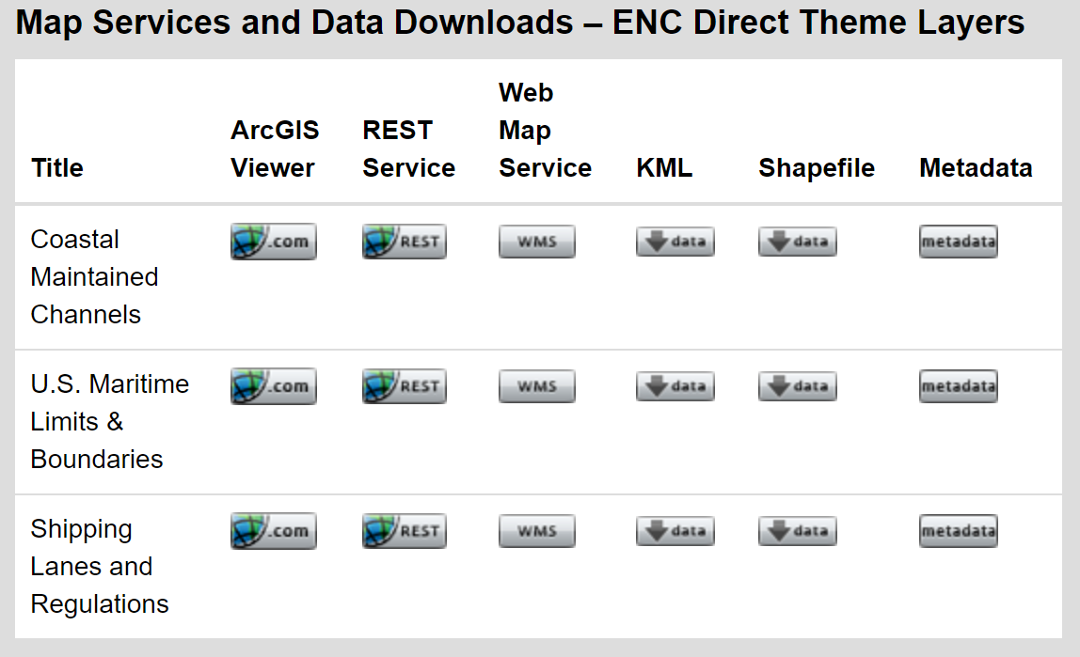
Data Layers – Export from S-57 Datasets

Slide 17
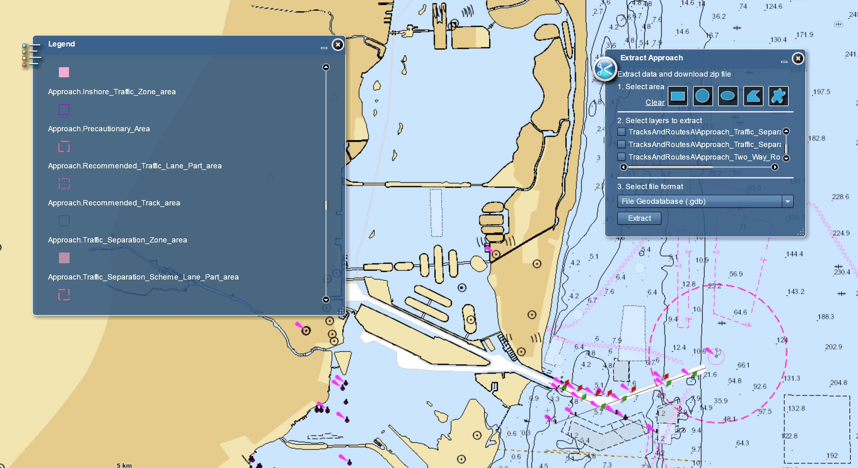

Slide 18
Strategic Development Goals
Notes:
The standards for geospatial information in our oceans, in support of marine transportation, are well managed by the International Hydrographic Organization. The UN-GGIM has endorsed IHO practices as part of the GGIM Guide to the Role of Standards in Geopsatial Information Management, and the United States has adopted IHO standards for nautical chart production.
The United States understands the importance of riverine geospatial information to inland communities and landlocked developing states, who spend twice as much on transport services and taxes as developing nations that have territorial access to seas and oceans.
Strategic Development Goal 6 seeks to ensure the availability and sustainable management of water and sanitation for all. More than 2 billion people are living in countries with excess water stress, and in 2012, only 65% of the 130 countries that responded to a survey on integrated water resources management reported that management plans were in place at the national level.
The United States recognizes the foundational nature of geospatial information in monitoring progress on many of the strategic development goals and applauds the work that the GGIM has done thus far. We consider the addition of a working group that focuses on the marine domain as strengthening the GGIM work plan and believe that it will help to expand coordination between land and sea data standards and policy.

Slide 19
Membership – Current Composition
17 Member States
2 UN-GGIM Private Sector Network Members (Esri and Ocean Wise)
The International Hydrographic Organization
Division for Ocean Affairs and the Law of the Sea, Office of Legal Affairs, United Nations
co-Chairs – Burkina Faso and United States of America

Slide 20
First Expert Meeting
Scheduled in conjunction with the International Hydrographic Organization’s Marine Spatial Data Infrastructure Working Group and OGC
March 7 – 9, 2019 Busan, Republic of Korea

Slide 21
Thank You
John.Nyberg@noaa.gov

