Slide 1
Hydrographic Data as a Service

Slide 2
INTRODUCTION
A project is underway with the CHS to implement an innovative bathymetry data service that will demonstrate the value of the evolving IHO S-100 data standards
The project team is made up of CHS (HO), Teledyne CARIS (hydro software) and PRIMAR (RENC)
It will focus on the latest technological approaches

Slide 3
KEY OBJECTIVES
What problems are we trying to solve?
The survey to bridge turn-around time
Efficiency and complexity of meeting the needs of multiple stakeholders
Operational preparedness for e-Navigation and autonomous shipping
Data integrity and security

Slide 4
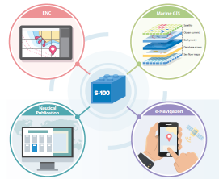
KEY OBJECTIVES
What approaches are required for success in the market place?
Service orientated
Cloud based
Bathymetry focused then charts
Latest open geospatial approaches
Latest computing techniques

Slide 5
KEY OBJECTIVES
What are the financial considerations and economic factors?
Learn from the ENC distribution market place
Understanding the bathymetry value chain
Provide innovative service based cost models
Base pricing on type of user and application

Slide 6
THE HIGH LEVEL CONCEPT
Subscribe to data
Data Request
Bathy DB
On Premise database
S-100 Data Services
cell based
GeoStore
Incoming Surveys and other Sources of Bathy Data
3rd party Access Point
Bathymetry Cloud Store
Bathy S-102
RESTful approach
Currents S-111
Tides S-104
Latest Data Updates
ENC S-101
S-100 Data Area
ECDIS
PPU / ECS
Marine SDI

Slide 7
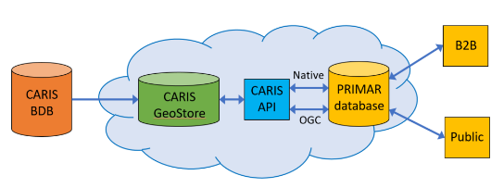
PILOT PROJECT OVERVIEW
This pilot will allow CHS, Teledyne CARIS and PRIMAR to demonstrate its ability to provide a service that consumers of bathymetry data can subscribe to
Data will be available in pre-determined geographic areas of interest
By bathymetry data we mean coverages, vector features and S-102 products
CARIS will develop a cloud hosted datastore located outside of the CHS infrastructure
CARIS will develop a rich API providing 3rd party access to the datastore
3rd party
PRIMAR will expand its existing applications to provide a store front to access S-102 bathymetry data
AWS

Slide 8
TECHNICAL APPROACH - CARIS
DATA INPUT
CHS Bathymetry residing in a on-premise Bathy DataBASE will be replicated to the Cloud datastore
A Cloud based BDB Server instance and BDB Admin tools will be used for the upload during the Pilot
New datasets will be published automatically to the cloud through scripts that run on schedule
DATA ACCESS - NATIVE
Data access will be via a documented REST API using JSON (some XML may be used in Pilot only)
The Native API will provide additional efficiency over the OGC API
This API will be used by partners like PRIMAR for the purpose of building B2B solutions
The following services will be supported
Coverage, Feature, Object, Catalogue, Authentication
DATA ACCESS - OGC
This API will provide access to the data for broader uses through open standards
The following services will be supported
WCS, WFS, CSW

Slide 9
TECHNICAL APPROACH - CARIS
CATALOGUE SERVICE
The catalogue service can be used to discover bathymetry data
Based on a geographic area of interest or data updated within a specific time period
Or a combination of both requests
client applications can then notify users what changed
CLOUD STORAGE
The data will be stored in a highly scalable “open” relational database
The schema will use the OGC simple features model

Slide 10
PROJECT DELIVERABLES
Three demo will act as project milestones
This will also enable all parties to discuss project progress with broader community
Demo 1 - Demonstration of CHS bathymetry via CARIS GeoStore in PRIMAR Web application
This will show how bathymetry in the datastore is available alongside ENC data for discovery
Demo 2 - Demonstration of CHS bathymetry via CARIS GeoStore in PRIMAR 3D viewer
This is a compelling use case of S-102 data showing the potential for e-Navigation
Demo 3 - Demonstration of full data flow from CHS database to client facing Web application
This will show how new bathymetry in the CHS database is automatically uploaded to the datastore and is available for users who have subscribed to that area

Slide 11
TIMELINE
Three milestones to demonstrate increasing capability of the bathymetry data service
Milestone 1
CHS bathymetry in CARIS GeoStore
and PRIMAR Web application
Milestone 3
Full data flow from CHS database
to end-users via Web application
Jun
Jul
Aug
Sep
Oct
Nov
Dec
Jan
Feb
Mar
Milestone 2
CHS bathymetry in CARIS GeoStore
and PRIMAR 3D viewer

Slide 12
S102 CREATION AND UPLOAD
Production BDB Server
Outdated Cells
CARIS Cloud
Historical DB
Combine & Export
BAG

Slide 13
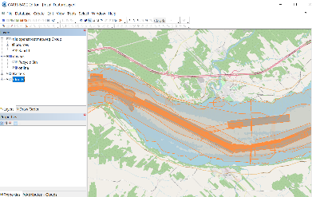
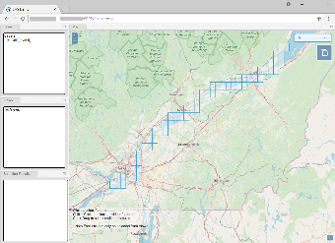
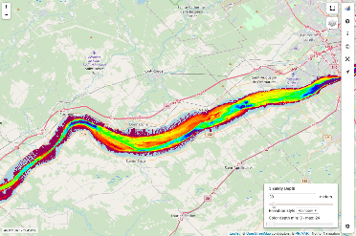
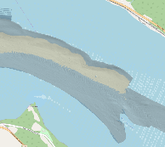
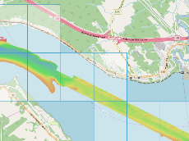
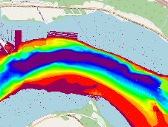
DEMO 1 – EXPLANATION
(1) CHS bathymetry in CARIS Bathy DataBASE as incoming surveys
(2) CHS bathymetry as S-102 cells in CARIS GeoStore on Amazon
(3) CHS bathymetry in PRIMAR Viewer

Slide 15
S-102 CREATION AND UPLOAD PROCESS
CHS Production database: Contains thousands of datasets, with hundreds overlapping
Outdated Cells repository: Contains the info about which tiles have been outdated
Creation and Upload process currently scheduled task, multiple processes run in parallel to increase performance
The outdated tiles are ordered by level and the date which they were outdated
Priority is given to the higher resolution tiles and those outdated the longest
For each outdated tile we create a new combined surface using the data from the Production database and CHS combine rules to create a BAG populated with metadata
The updated tile is then loaded onto CARIS Cloud
They are currently also loaded into an archive for history tracking

Slide 16
Thank You!

