Slide 1
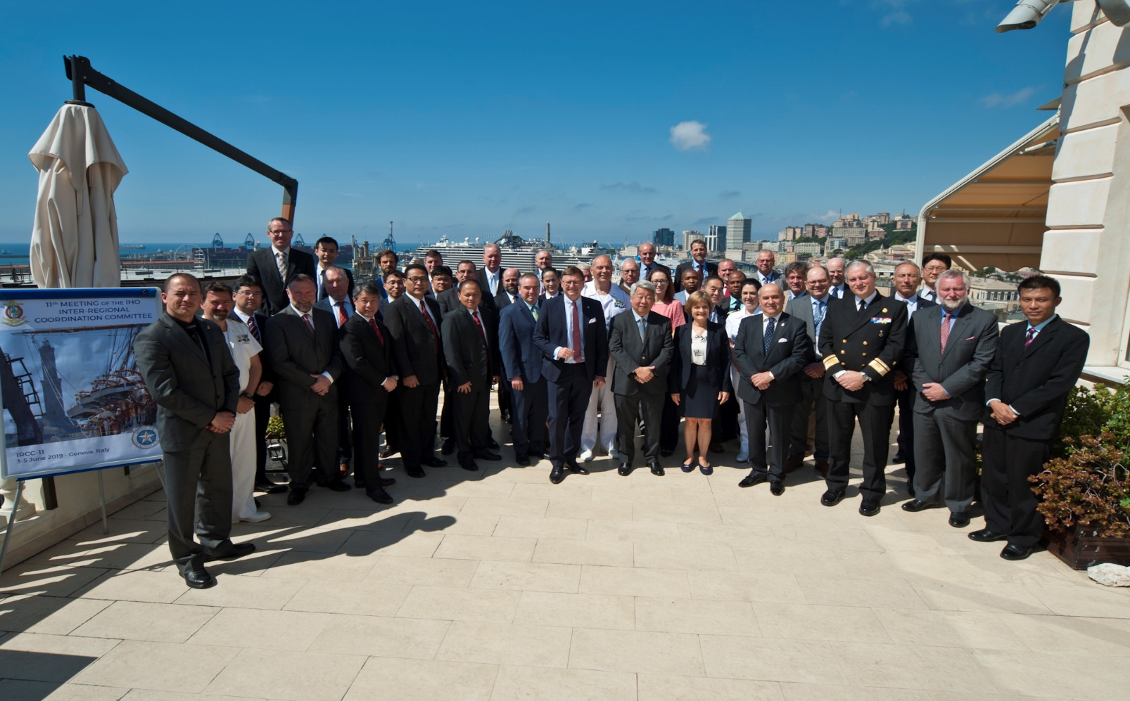
11TH MEETING OF THE IHO INTER-REGIONAL COORDINATION COMMITTEE IHO IRCC11 Outcomes
3 - 5 June 2019, Genoa, Italy

Slide 2
MACHC Representation
IRCC Meeting:
IRCC 11 was held in Genoa, Italy, June 3 to 5, 2019
IRCC 12 to be held in Gdansk, Poland, (8-10 June, 2020)
MACHC Representation: Chair (USA)
Other MACHC Member States attending included:
Colombia
France
Netherlands
United Kingdom
MACHC Report to IRCC11 distributed via MACHC CL 5

Slide 3
Status of IRCC10 Actions (relevant for MACHC) reported at IRCC11
3 | to submit draft IHO Resolution 2/1997 as amended (Annex C) to the RHC Members for comments and report back to IRCC (6.2) | RHC Chairs | MACHC submitted comments 12/20/18; accepted in final version approved by IRCC11 to go to C-3
8 | to report the status of MSI in coastal States to the next IRCC meeting (7b) | WWNWS-SC Chair | MACHC is assessing the status of MSI and will be posting it to its working website (under development) for tracking purposes- MACHC 20 Agenda Item 2.3
Notes:
The Committee approved the draft amended IHO Resolutions 2/1997 Establishment of Regional Hydrographic Commissions and 1/2005 IHO Response to Disasters.
All MACHC comments were accepted and integrated into the document, some of the significant changes include:
Resolution 2/1997 adjusted the National Reports as follows:
Encouraged on-line updates to the IHO Yearbook and C-55
Added a specific section for “MSDI”
Added a section for new “Innovations”
Added a section for “Conclusions”

Slide 4
Highlights of MACHC Report to IRCC11
Initiated collaboration with the Seabed 2030 Regional Data Center for the Atlantic to develop a regional “gap analysis”
Reinvigorated the International Bathymetric Chart of the Caribbean (IBCCA)
Created new Marine Spatial Data Infrastructure WG
Increased collaboration with regional partners for:
capacity building (4 MACHC CB training activities funded),
MSDI (RDC, DCDB, Caribbean Marine Atlas)
Increased ENC coverage (914 available; 12 large scale ENC coverage cruise ship ports)
Initiated Disaster Response Strategy for MACHC
Notes:
MACHC Report to IRCC11 distributed via MACHC CL 5—related challenges
For the newly established MACHC MSDIWG to determine how best to deliver regional MSDI data offerings. There is clearly a regional demand for data layers derived from ENCs for non-navigation purposes, to support activities such as the management of a regional marine protected area network, a regional risk assessment for maritime accidents and maritime disaster response.
While contact has been established with the Head of Seabed 2030 Atlantic/ Indian Oceans Regional Data Center, the International Bathymetric Chart for the Caribbean and the MACHC, a challenge is how to increase the regional contributions of existing data and to catalyze collaboration to fill gaps. A gap analysis is being developed for the MACHC as a tool to help generate that momentum.
To develop a Disaster Response Plan with the appropriate level of detail, including ideally a GIS-based layer that can most effectively support coordination and communication efforts before and after a maritime disaster event.
CARIBE/EWS, COCATRAM, SEPRHC, SWAtHC—co-sponsors of Tides and Water Levels training; leveraging resources for greater impact.

Slide 5
IRCC11 Actions assigned to RHCs
Reference | Action | Responsible party | Due date | Status
IRCC 11/1 | RHC Chairs to confirm/update the representatives to the IHR Editorial Board. (Chris Thorne UK is rep) | MACHC Chair | 30 Aug 2019 | Completed. Need content for articles/MACHC20
IRCC 11/8 | to request MSI National Coordinators to review the contents of the relevant Annexes of the GMDSS Master Plan and of section C (MSI) of IHO Publication C-55 – Status of Hydrographic Surveying and Nautical Charting Worldwide – to ensure consistency for their national entries (7b) | MACHC Chair, NavArea IV, MSI National Coordinators | 30 July 2019 | On MACHC20 Agenda 2.3 and is a continuous action
IRCC 11/12 (MACHC 17.6.5) | RHC Chairs to consider the tasks listed as duties for the Regional Seabed Coordinator/Mechanism (doc. IRCC11-07I3) and to include Seabed 2030 in RHC work plans and reports to IRCC. | MACHC Chair | IRCC 12 | Initiated via MACHC20 Agenda 6.4, need Coordinator designated
Notes:
Papers for consideration for publication in the IHR should be forwarded directly to the editor (ihreview@iho.int, copy to Brian.Connon@usm.edu).
The deadlines are:
end of January for the May Edition
end of July for the November Edition
Introduce live polling for this purpose
Complete IRCC report available on the IHO website IHO.int Member States note: Annex B – List of Decisions, and Annex C – List of Recommendations to RHCs

Slide 6
IRCC11 Actions assigned to RHCs
Reference | Action | Responsible party | Due date | Status
IRCC 11/13 | RHC Chairs to provide reports to A-2 to the IHO Secretariat in accordance with the Action C2/53. | MACHC Chair | 15 Nov now extended to Dec 2019 | Draft produced for MACHC20, to be finalized post meeting
IRCC 11/15 | IRCC Members to provide feedback on the draft Strategic Plan and on the implementation of the IRCC work programme to the SPRWG Chair. | MACHC Member States | 24 June 2019 | Completed. Via CL 7. Agenda 2.2
IRCC 11/16 | RHC Chairs to invite Members to make comments and suggestions to the secretary of the S-100 services roadmap drafting group (Council Chair, RDML Smith, shep.smith@noaa.gov). | MACHC Chair and Member States | 24 June 2019 | Completed. Via CL 7. Agenda 9.6

Slide 7
IRCC Recommendations for MACHC Member State Attention
Maritime Safety Information: 5 (Four already in MACHC Continuous Actions,
1 additional to be addressed in MACHC20 Agenda Item: 2.3)
Surveys: 7 of 10 are in the MACHC Continuous Action List; 3 on Crowd Sourced Bathymetry to be addressed under MACHC20 Agenda Item 6. Survey and Risk
Charting: 14 actions referred to the Chair, MACHC Integrated Charting Committee
to address as appropriate within their work plan
Others: IHR agenda item; IHO Hydrographic Dictionary support

Slide 8
Other Recommendations and Issues for MACHC attention
-Consider inviting MapAction to RHC meetings to look for opportunities for engagement—on MACHC20 agenda 8.4
-New training material for MSDI, funded by Denmark that was used as part of the Hydro Governance Seminar: Introduction to MSDI Training
-Capacity Building Resources are decreasing, emphasizing the need to engage with other identify national and regional projects and partners that may contribute to the CBWP and to coordinate the support for countries in need (Agenda Item 5).
Notes:
Mapaction, a humanitarian mapping charity, presented its work and the potential synergies in responding to disasters by working with the IHO and with RHCs.

