Slide 1
IMO/IHO World-Wide Navigational Warning Service NAVAREA IV / XII
United States

Slide 2
IMO/IHO World-Wide Navigational Warning Service (WWNWS)
International coordinated global service for promulgation of hazards to navigation by satellite affecting the safety of life at sea
Twenty One Navigation Areas (NAVAREAs), each with a Coordinator (Eighteen) responsible for the harmonization of navigational information in their area.
IMO Resolution A.706(17) MSC.1 Circ. 1288/Rev.1

Slide 3
WWNWS-SC
Established 1973
Monitors and guides the WWNWS
Provides guidance to IHO Member States to further evolution of WWNWS
International cooperation with IMO, WMO, IMSO, IALA
Chairman represents IHO for relevant IMO Committees.
Capacity Building Assistance
Rep Regional Hydrographic Commission Conferences
MSI Training
Chairman – Peter Doherty
Commission Membership – 40 plus IHO Member States plus IMO, WMO, IMSO and Inmarsat

Slide 4
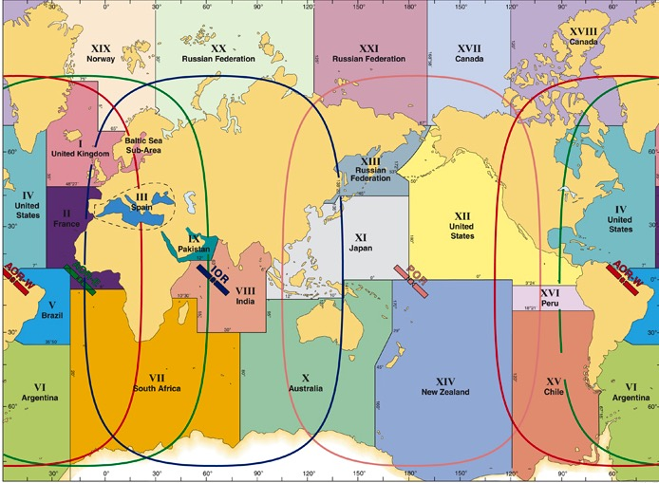
Navigation Areas (NAVAREA)

Slide 5
Definitions
NAVAREA: A geographical sea area established for the purpose of coordinating the broadcast of navigational warnings
NAVAREA COORDINATOR: The authority charged with coordinating, collating and issuing navigational warnings for a designated NAVAREA
NATIONAL COORDINATOR: The national authority charged with collating and issuing coastal warnings within a national area of responsibility.

Slide 6
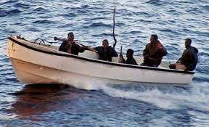
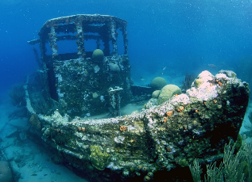
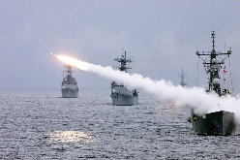
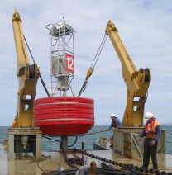
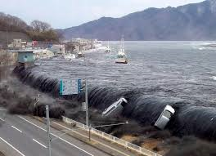
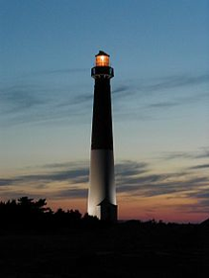
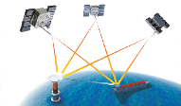
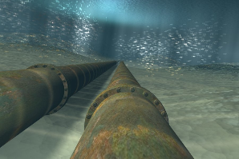
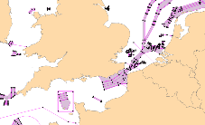
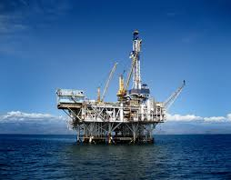
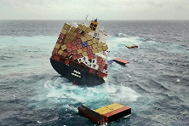
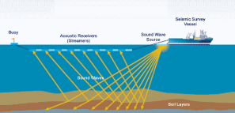
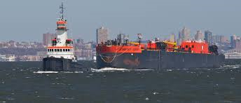
Navigational Warnings

Slide 7
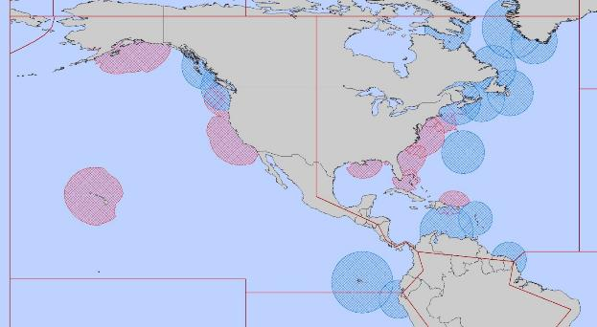
NAVAREA IV/XII Coordinator
Endeavour to be informed of all events that could significantly affect the safety of navigation within the NAVAREA
IV
XII
IMO Resolution A.706(17) MSC.1 Circ. 1288/Rev.1

Slide 8
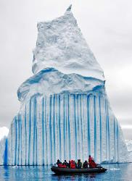
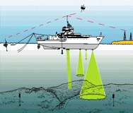
NAVAREA IV/XII Coordinator
Assess all information immediately upon receipt in the light of expert knowledge for
relevance to navigation in the NAVAREA;
Select information for broadcast

Slide 9
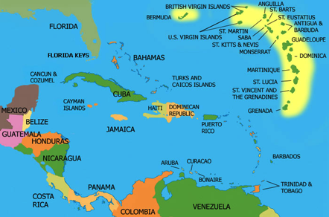
National Coordinator
Endeavour to be informed of all events that could significantly affect the safety of navigation within the NAVAREA
IMO Resolution A.706(17) MSC.1 Circ. 1288/Rev.1

Slide 10
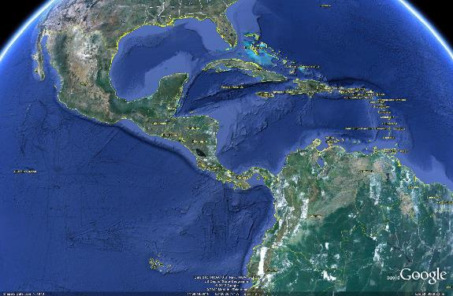
National Coordinator
Forward coastal warnings and relevant associated information for wider promulgation directly to NAVAREA Coordinator
navsafety@nga.mil

Slide 11
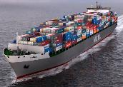
MSI Training Course – Santo Domingo 9-11 December 2019
3 day comprehensive training course held with region
Led by WWNWS-SC
Sponsored by IHO CBC
Endeavour to be informed of all events that could significantly affect the safety of life at sea
Notes:
National Activities
Phase 1
Form National Authority (NA) and/or National Hydrographic Coordinating Committee (NHCC).
Create/improve current infrastructure to collect and circulate information
Strengthen links with charting authority to enable updating of charts and publications
Minimal training needed
Strengthen links with NAVAREA Coordinator to enable the promulgation of safety information
Phase 2
Establish capacity to enable surveys of ports and their approaches
Maintain adequate aids to navigation
Build capacity to enable surveys in support of coastal and offshore areas
Build capacity to set up hydrographic databases to support the work of the NA/NHCC
Provide basic geospatial data via MSDI
Requires funding for training, advising & equipment or contract survey
Phase 3
The need shall be thoroughly assessed. Requires investment for production, distribution and updating
Alternatively, bi-lateral agreements for charting can provide easier solutions in production and distribution (of ENC through RENCs) and rewards.
Further development of MSDI

Slide 12
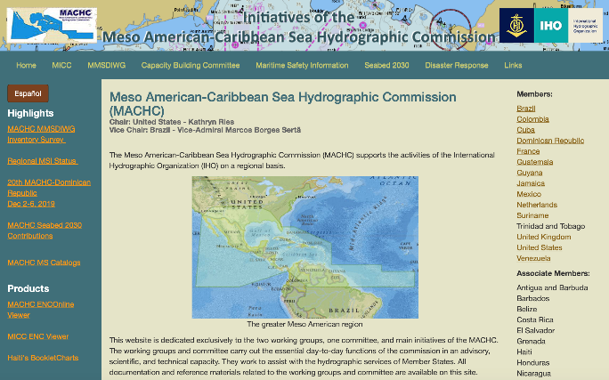
Regional MSI on MACHC Website
Notes:
National Activities
Phase 1
Form National Authority (NA) and/or National Hydrographic Coordinating Committee (NHCC).
Create/improve current infrastructure to collect and circulate information
Strengthen links with charting authority to enable updating of charts and publications
Minimal training needed
Strengthen links with NAVAREA Coordinator to enable the promulgation of safety information
Phase 2
Establish capacity to enable surveys of ports and their approaches
Maintain adequate aids to navigation
Build capacity to enable surveys in support of coastal and offshore areas
Build capacity to set up hydrographic databases to support the work of the NA/NHCC
Provide basic geospatial data via MSDI
Requires funding for training, advising & equipment or contract survey
Phase 3
The need shall be thoroughly assessed. Requires investment for production, distribution and updating
Alternatively, bi-lateral agreements for charting can provide easier solutions in production and distribution (of ENC through RENCs) and rewards.
Further development of MSDI

