Slide 1
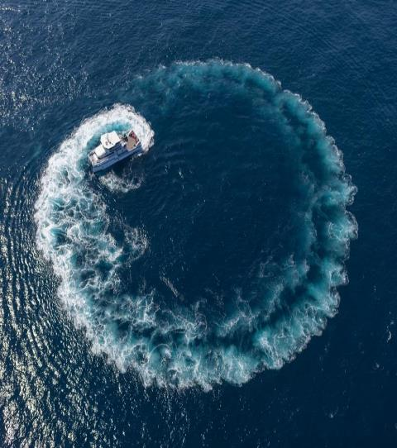

Slide 2
develops
advanced technologies to match Customers’ challenges in tough environments

Slide 3
PHOTONIC SOLUTIONS
NAVIGATION SYSTEMS
ACOUSTICS SYSTEMS
Specialty Fibers
& Photonic Components
Inertial Systems
& Navigation Solutions
Acoustic Positioning
& Sonar / Sounder solutions
MOTION SYSTEMS
SEA OPERATION
Multi-axis Tables, Simulators,
Pan & Tilt & Positioners
Composite
Specialized ships
A Survey
Company

Slide 4
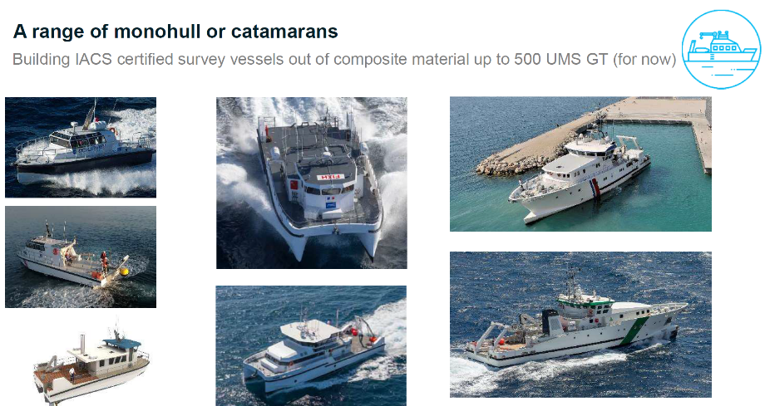

Slide 5
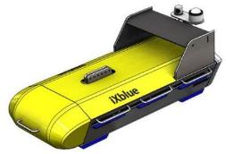
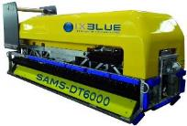
PROPERTY OF IXBLUE
SAMS – Mapping Sonar
The sonar merges the sonar data and the navigation and builds the in Real Time
Relative Positioning
A FOG Inertial Navigation System provides:
Accurate Attitude
Pitch ±.01deg
Roll ±.01deg
Heading ±.02deg
And Relative Positioning
Absolute Positioning
INS is aided by:
GPS for initialization
Depth Sensor, Sound Velocity
DVL: X, Y speed above ground
USBL providing Lat, Long and Z to the INS
Recent deliveries
China x 4
India x 2
Pakistan x 1

Slide 6
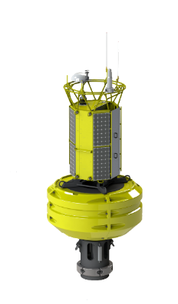
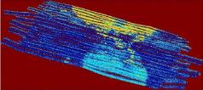
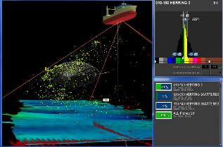
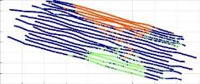
SEAPIX – Hydro grade environmental sonar
PROPERTY OF IXBLUE
An Environmental sonar
Fish discrimination
GBA – Global Biomass assessment
Seabed Classification
All data stored in built-in database
GIS
Recent successes
Feroe x 15
Turkey x 6
Japan x 4
Notes:
Sa

Slide 7
Improving Hydrographic awareness using USV MACHC 2019 – Regional IHO commission Contact: David Vincentelli david.vincentelli@ixblue.com +33 647 330 120
PROPERTY OF IXBLUE

Slide 8
1. USV DriX 2. 2019 achievements
PROPERTY OF IXBLUE

Slide 9
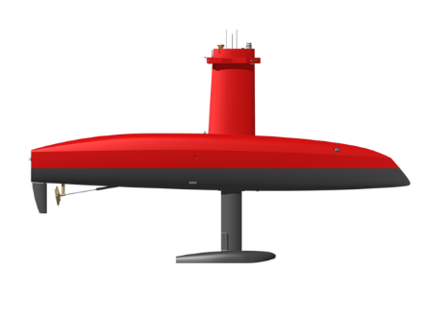
WHAT IS THE USV DriX ?
PROPERTY OF IXBLUE
What do hydrographers expect from unmanned Surface Vessel

Slide 10
PROPERTY OF IXBLUE
An hydrodynamic serving data gathering and endurance
Video removed by the IHO due to space

Slide 11
DriX in a nutshell
PROPERTY OF IXBLUE
Weight : 1.5T - DriX + LARS : 3T
Length : 8m
Low fuel consumption : 2.5L/h at 10kts speed
Autonomy 10 days @ 4kts / 5 days @ 8kts
Purpose made Autopilot: outstanding line keeping even in marginal weather - Colreg
Optimized vessel shape and Gondola
To reduce surrounding noise, to enhance data quality, and equipment capability
To maintain a higher average survey speed
To operate in marginal weather : seastate 3 up to 4 in data acquisition
Shorter line change
Unique “on the way” Launch and Recovery System

Slide 12
2019 Achievements
2

Slide 13
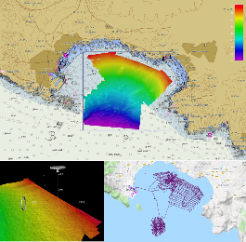
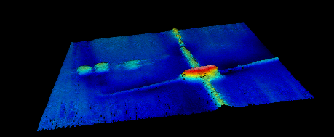
2019 Achievements
PROPERTY OF IXBLUE
MACHC region and its members at the vanguard of innovation
6 months autonomous survey operation in Mexico
2 + 2 weeks of USV operation assessment in cooperation with NOAA
At the present time 2 DriX are located in the region
Also an international trend
MCA, UK assessing and including autonomous survey in their annual scheme
Linz, iXblue operated DriX on a MBES/LIDAR survey operation in Tonga
SHOM investigating the introduction of USV for their future investments
First DriX sold in Korea - early 2019.

